Slide 1
Notes to Instructor
Training is approximately 45 Minutes total –
40 minutes of instruction and a 5 minute quiz
This training was created for general airport staff, tenants,
and construction contractors.
There are Optional slides to “localize” for your airport.
Use this slide deck as is, or add more to fit your needs.
There are no bullet point transitions, click once and see entire screen
Print a Notes Version for your Instructor Guide
Note: The final quiz can be offered as a printed quiz or class discussion.
Course handout (PDF) and certificate (last slide) are optional
Notes:
Notes to Instructor 45 Minutes total - 40 minutes of instruction and a 5 minute quiz)
This training course was created for general airport staff, tenants, and construction contractors.
There are Optional slides to “localize” for your airport situation. Use this slide deck as is, or add more to fit your needs.
There are no bullet point transitions, click once and see entire screen
Print a Notes Version for your Instructor Guide
Note: The final quiz can be a printed quiz or class discussion.
Course handout (PDF) and certificate (last slide) are optional

Slide 2
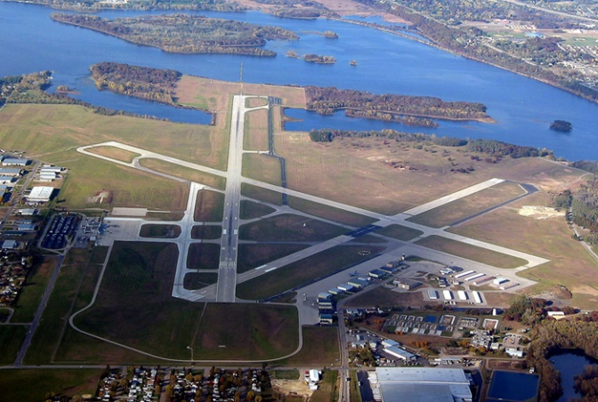
Course 1: Airport Stormwater & You
Notes:
Say: Welcome to Introduction to Airport Stormwater & You
This overview course was prepared for airport staff, tenants and construction contractors.
Even if your job is not directly involved with stormwater planning or water sampling, your knowledge, attitude and awareness are critical to keeping the airport safe, in compliance with the law, and a better environmental neighbor in the community.

Slide 3
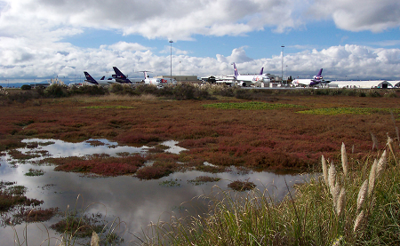
Course Objectives
In this course you will learn to identify:
Federal, State, and Local airport stormwater
runoff regulations
Sources of pollution in stormwater runoff
Good housekeeping practices
Spill prevention and cleanup
Construction site BMPs
Notes:
In this course you will learn to identify:
Federal, State, and Local airport stormwater runoff regulations
Sources of pollution in stormwater runoff
Good housekeeping practices
Spill prevention and cleanup AND FINALLY
Construction site Best Management Practices, or BMPs

Slide 4
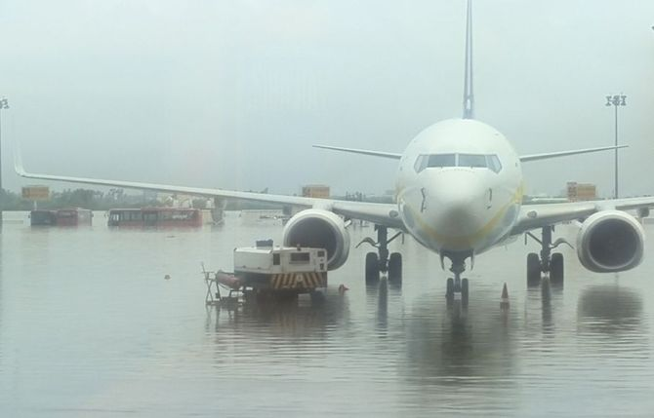
What is Airport Stormwater Runoff?
Rain or snow melt flows across the landscape and does not soak into the ground.
Pollutants:
Spilled oil
Fuels
Solvents
Sediment and nutrients
Deicing fluids
Pesticides, herbicides and trash
Notes:
What is Airport Stormwater Runoff?
Airport stormwater runoff is created when water from rain,
or snow melt flows across the landscape and does not soak into the ground. More runoff is generated from paved surfaces and rooftops than grass areas and undeveloped areas.
As stormwater moves it can pick up pollutants including: spilled oil, fuels, solvents, sediment and nutrients, deicing fluids, pesticides, herbicides, and trash.

Slide 5

Lesson 1: Stormwater Regulation
Why Do We Manage Stormwater Runoff?
Environmental Protection Agency Clean Water Act (CWA) 1972
CWA established basic structure for regulating pollutant discharges into water of U.S.
Gave EPA authority to implement
pollution control programs, such as the National Pollutant Discharge Elimination System or NPDES program
Notes:
Why do we manage stormwater runoff? The number one reason is: because it is required by law.
The Federal Water Pollution Control Act of 1948 was the first major U.S. law to address water pollution.
Growing public awareness for controlling water pollution led the Environmental Protection Agency or EPA to introduce new regulations with the Clean Water Act (CWA) of 1972.
The Clean Water Act:
Established the basic structure for regulating pollutant discharges into the waters of the United States.
The Clean Water Act
Gave EPA the authority to implement pollution control programs such as the National Pollutant Discharge Elimination System or NPDES program.

Slide 6
Water Quality Standards
CWA set water quality standards for all
contaminants in surface waters
Unlawful for any person to discharge any pollutant
into navigable waters, unless a permit was obtained
Your job at the airport has a direct impact on
our ability to meet water quality regulations
Notes:
The CWA set water quality standards for all contaminants in surface waters.
And made it unlawful for any person to discharge any pollutant from a point source into navigable waters, unless a permit was obtained under its provisions.
Your job at the airport has a direct impact our ability to meet these water quality regulations.

Slide 7
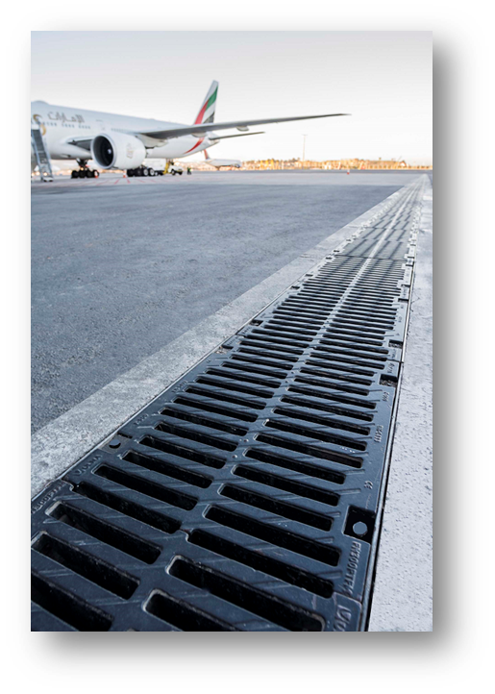
National Pollutant Discharge Elimination System (NPDES)
CWA established NPDES
Goal: Keep pollutants out of nation’s waterbodies!
NPDES permits regulate stormwater discharges
including: industrial activities, construction
activities and municipal
Non-stormwater permits: wastewater, pesticide
application and vessel discharges
Notes:
The Clean Water Act established the NPDES, or National Pollutant Discharge Elimination System program.
The goal of the NPDES program is to keep pollutants out of our nation’s waterbodies.
The primary way of accomplishing this goal is through NPDES permits that regulate stormwater discharges.
There are 3 types of NPDES permits issued that are most applicable to airports: industrial, construction and municipal.
There are other types of NPDES permits that regulate non-stormwater discharges, including wastewater, pesticide application and vessel discharges.
The EPA has delegated the authority to issue NPDES permits to most states.

Slide 8
National Pollutant Discharge Elimination System (NPDES)
Industrial NPDES Permit:
Multi-Sector General Permit (MSGP)
Individual Permit
Municipal NPDES Permit
Municipal Separate Storm Sewer System (MS4) Permit
Construction General NPDES Permit
> 1 acre project site requires a separate permit
Notes:
Most airports have an industrial permit to cover stormwater discharges from their facility. There are two types of Airport industrial stormwater permits, the Multi-Sector General Permit (MSGP) and an Individual Permit.
Airports that are located within a municipality that has a municipal separate storm sewer system, or MS4, or have themselves been designated as an MS4, may be subject to additional requirements under an MS4 NPDES permit. Coordination with the state agency and local MS4 may be necessary to coordinate efforts and avoid duplication.
Construction projects greater than 1 acre typically require a construction NPDES permit. Some state or local codes may require a construction permit for projects less than one acre.
NOTES
Ask: : Do you know which NPDES permit your work falls under? Do you know which NPDES permits apply to your airport?

Slide 9
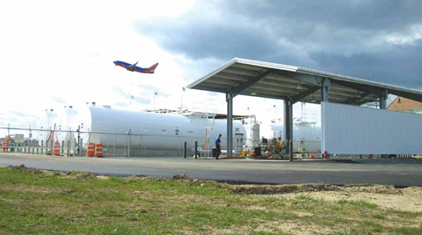
Spill Prevention Control and Countermeasures (SPCC)
SPCC Program (Spill Plan) Regulation to prevent and control oil and fuel spills is separate from NPDES
SPCC regulations apply when quantities of oil
and/or fuel stored onsite reach:
1,320+ gallons of Above Ground Storage
42,000+ gallons of Under Ground Storage
Notes:
Another federal regulation that is related to stormwater is the Spill Prevention Control and Countermeasures, or SPCC program (you might hear it referred to as the Spill Plan). This regulation to prevent and control oil and fuel spills is separate from the NPDES requirements.
The SPCC regulations apply when quantities of oil and/or fuel stored onsite reach certain thresholds:
1,320 gallons or more in Above Ground Storage containers
Or 42,000 gallons or more in Under Ground Storage Containers
Keep in mind that containers that are 55 gallons or greater are counted towards the total onsite storage.
NOTES
Ask: : Are you familiar with where fuel and oil storage tanks are located at the airport?
If you know the statistics, share with the class the totals of above and or under ground storage capacities and potential concerns with stormwater runoff.

Slide 10
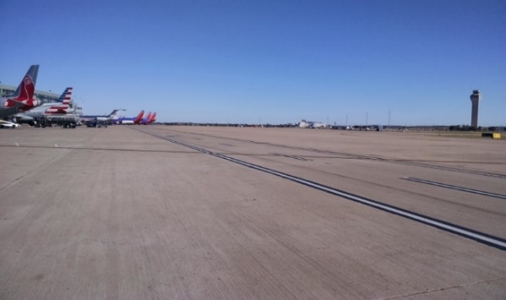
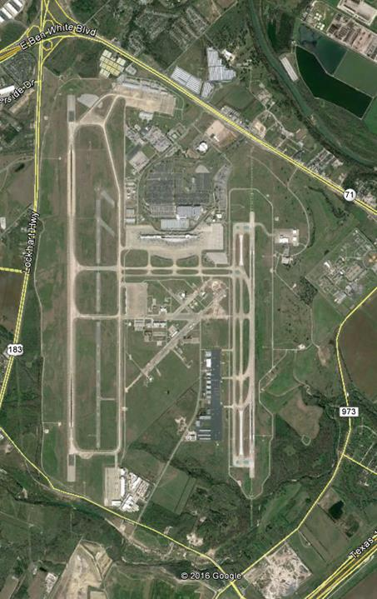
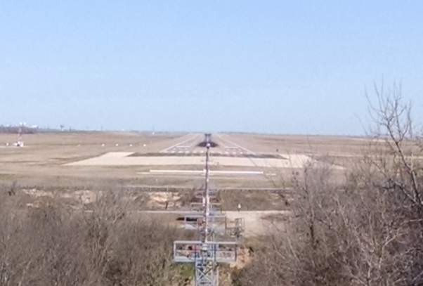
Localize for Your Airport
xxxx acres total
xx% impervious cover
Airside Picture
Stormwater System
{Brief summary of system.
Examples: drainage basins, stormwater ponds, etc.
Airfield Aerial
Outfalls xx outfalls or discharge locations
{Receiving water(s)}
Landside Picture
Stormwater Permit
Issued by xxxxxx
{other details}
Notes:
NOTE:
Replace this slide with pictures and facts from your airport. Here are suggested types of information to include on this slide.

Slide 11
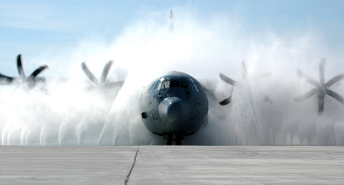
Sources of Pollution in Airport Stormwater
Deicing of aircraft and runways
Fueling operations
Aircraft landing and braking
Service and maintenance activities
Lavatory waste
Fire fighting training activities
Notes:
Sources of pollution in airport stormwater include activities that are unique to airports, such as:
Deicing of aircraft and runways
Fueling operations
Aircraft landing and braking
Service and maintenance activities, including washing of vehicles and aircraft
Lavatory waste, and
Fire fighting training activities
NOTES
Ask: Which of these activities do you think impacts airport stormwater runoff the most? (deicing in northern climates and vehicle maintenance in southern climates)

Slide 12
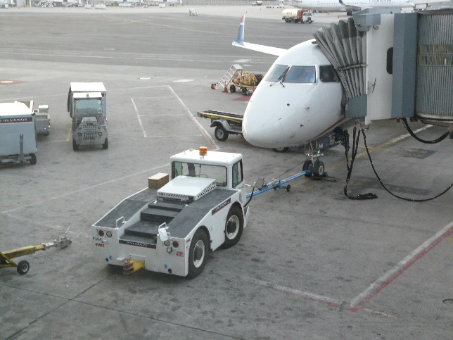
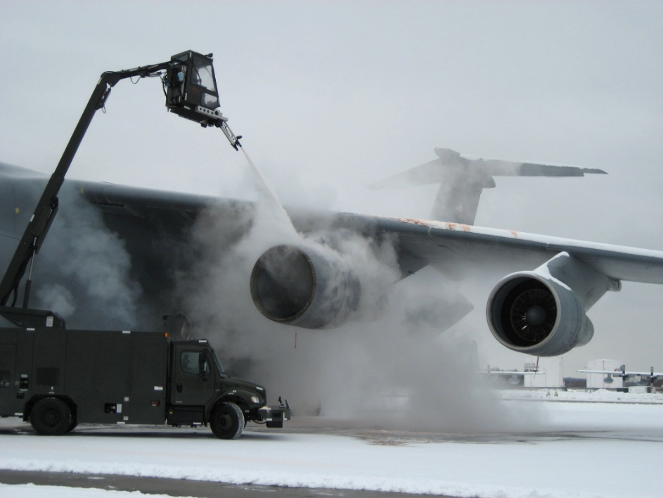
Pollution Sources of Greatest Concern
Northern airports = deicers
Southern airports = aircraft and vehicle fluids, pollutants include: oil, fuel, hydraulic fluid, wash water
All of these sources have implications for environmental impact
Notes:
At northern airports, the potential source of pollutants in airport stormwater of greatest concern is the use of aircraft and runway deicers required for safe winter operations.
If you are an airport located in warmer climates, the potential source of pollutants in airport stormwater of greatest concern is fluids from aircraft and vehicle operation and maintenance. These pollutants include: oil, fuel, and wash water.
All of these sources have implications for impact to the environment.

Slide 13
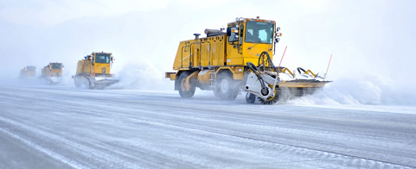
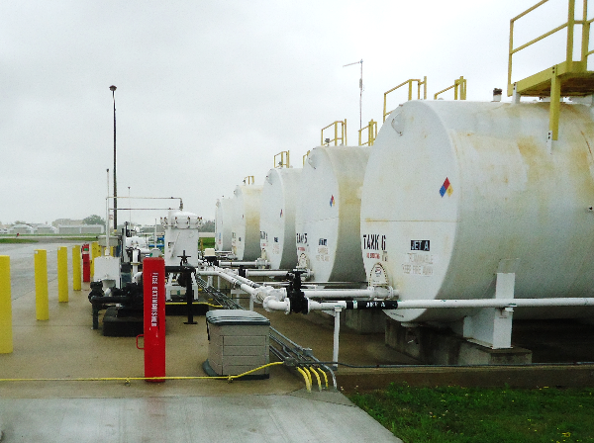
Implications for Environmental Impacts
Deicer fluids
Reduced dissolved oxygen in nearby streams
and waterbodies
Vehicle fluids
Toxicity to aquatic organisms
Notes:
All of the certified aircraft and airfield deicing products have potential for environmental impact. The primary concern is the risk of reduced dissolved oxygen in streams receiving stormwater containing deicers. Reduced dissolved oxygen has a negative impact on fish and other aquatic organisms.
Oil, fuel and other fluids from aircraft and other vehicles that leaks onto pavement surfaces and runoffs into storm drains can be toxic to fish and aquatic organisms.

Slide 14

Knowledge Check 1
True / False
The federal Clean Water Act is governed by the EPA.
Notes:
It’s time for a Knowledge Check. Recall the information you have just covered in this lesson. These questions similar to ones found on the final quiz (HINT).
Ask:
True / False
The federal Clean Water Act is governed by the EPA.
Correct Answer:
True

Slide 15
Knowledge Check 2
Which Clean Water Act program states as its goal
“to keep pollutants out of our nation’s waterbodies”?
EPA
DWA
NPDES
SPCC
None of the above
Notes:
Ask:
Which Clean Water Act program states as its goal “to keep pollutants out of our nation’s waterbodies”?
EPA
DWA
NPDES
SPCC
None of the above
Correct Answer:
C. NPDES (correct)

Slide 16
Knowledge Check 3
Which of the following activities has the greatest potential as a source of stormwater pollution at a northern airport?
Lavatory waste
Aircraft fueling
Aircraft and airfield deicing
Illicit discharges
None of the above
Notes:
Ask: Multiple choice
Which of the following activities has the greatest potential as a source of stormwater pollution at a northern airport?
Lavatory waste
Aircraft fueling
Aircraft and airfield deicing
Illicit discharges
None of the above
Correct Answer:
C. Aircraft and airfield deicing (correct)

Slide 17
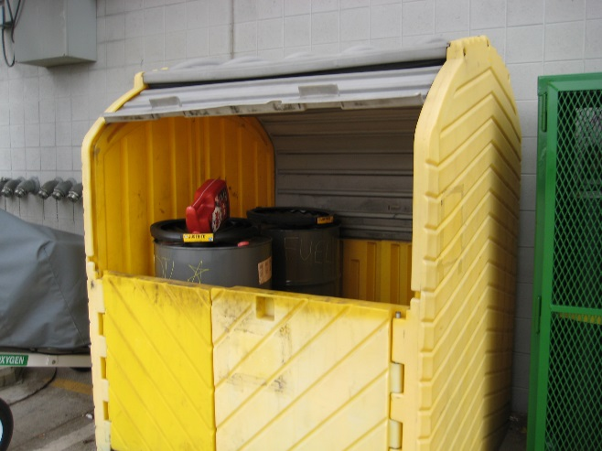
Lesson 2: Good Housekeeping Practices
Good housekeeping practices help keep pollutants
out of stormwater and include:
Proper management of waste materials and trash
Storage and washing of vehicles in designated areas
Proper storage and use of all materials
Keeping pollutants out of storm drains
You Have a Role in Stormwater Success
Notes:
Airport management depends on everyone to practice Good Housekeeping skills as they carry out their job responsibilities.
Good housekeeping practices are a type of best management practice or BMP in managing runoff and are the first line of defense. Good Housekeeping BMPs set procedures and protocols aimed at keeping potential pollutants out of stormwater and ultimately out of our rivers and lakes. Some examples of good housekeeping practices include:
Proper management of waste materials and trash.
Storage and washing of vehicles in designated areas.
Proper storage and use of all materials.
Keeping pollutants out of storm drains.
No matter what your role is at the airport, remember, you Have a Role in Stormwater Success
NOTES
Ask: What else can you add to this list? Some possible additional good housekeeping practices include training and preventive maintenance.

Slide 18
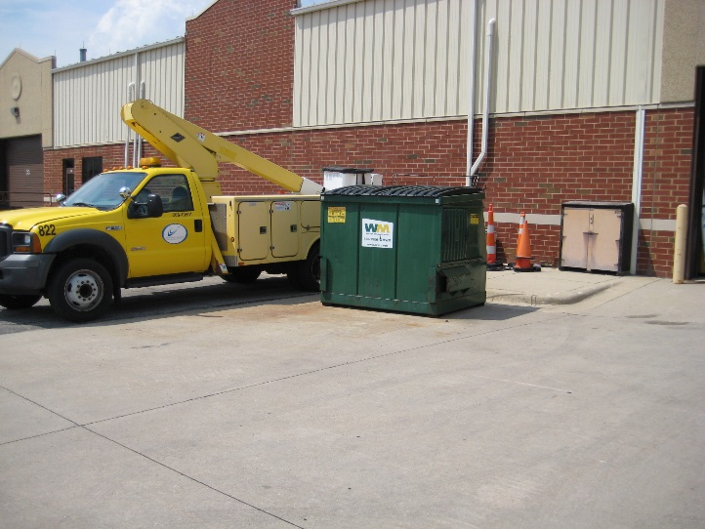
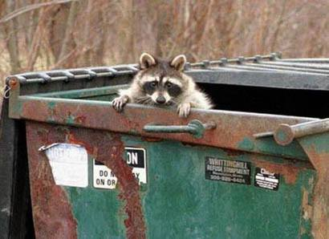
Manage Waste Materials and Trash
Bad Example
Good Example
Notes:
Dumpsters or waste containers should not be overfilled or left uncovered.
Overfilled or uncovered dumpsters can fill with rain water or snow and leak pollutants into nearby storm drains. Uncovered dumpsters can also lead to foreign object debris or FOD on airfield surfaces.
Another reason to properly manage trash is to avoid attracting wildlife which can present serious safety hazards to aircraft.
NOTES
Ask: Have you observed any dumpsters that need attention at the airport?

Slide 19
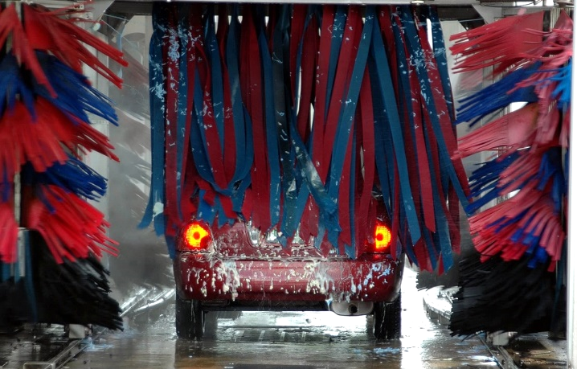
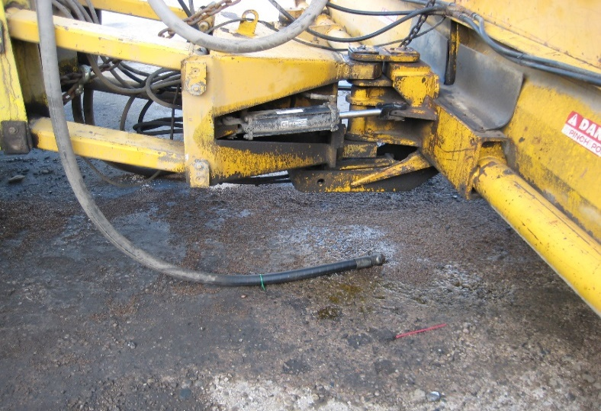
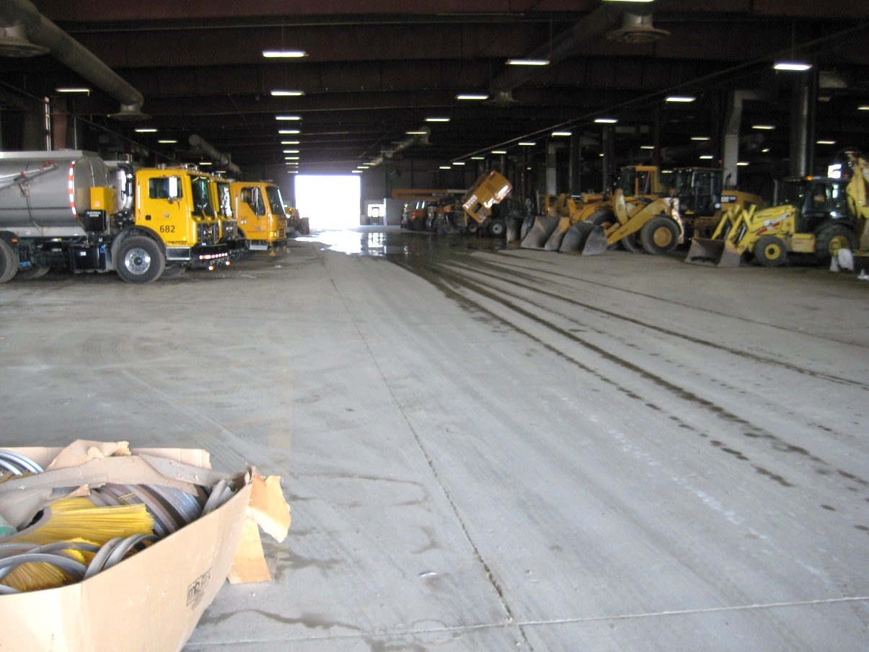
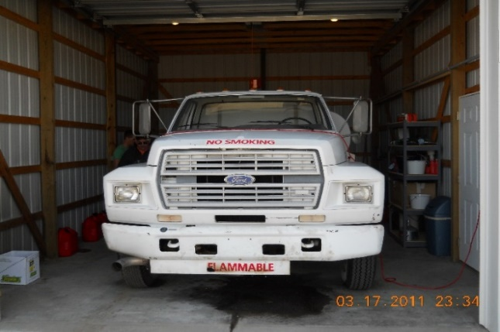
Proper Vehicle Storage and Washing
Car Wash
Repair Leaking Fluid
Indoor Storage
Indoor Storage
Notes:
Another important good housekeeping practice is proper storage and washing of vehicles to prevent contact with stormwater.
Always store vehicles in designated areas inside and outside.
Vehicles or equipment leaking fluids should be parked indoors with a drip-pan and scheduled for repair to fix the leaks.
Vehicles and equipment should always be washed indoors or in designed wash racks where wash water is captured and treated.
NOTES
Ask: Have you seen storage of a leaking vehicle on airport pavements?

Slide 20
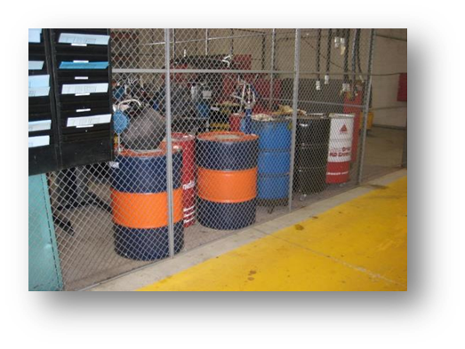
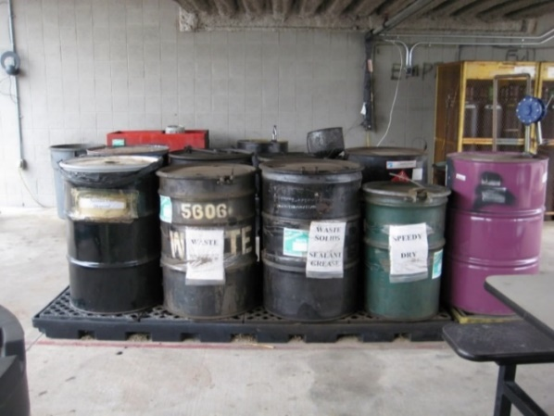
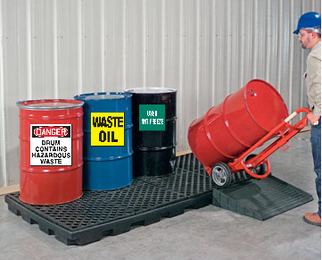
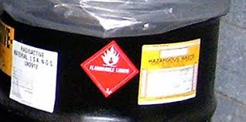
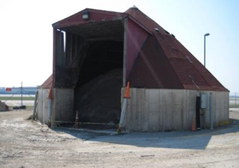
Proper Materials Storage
Store in Secured Area
Pallet Storage
Pallet Storage
Label Hazardous Materials
Covered Storage
Notes:
Another source of stormwater pollution is poor material handling and storage. This is especially important when dealing with hazardous materials and waste materials.
You can be a stormwater hero using these tips.
Remember to store materials indoors, if possible, or outdoors under a canopy to prevent pollutants from washing off and contaminating stormwater.
Remember to store Hazardous materials indoors where there are NO floor drains, and in bermed or curbed areas if possible to contain any spills.
Store used hazardous and non-hazardous waste materials in properly labelled containers prior to disposal.
Spills should be contained immediately to prevent tracking of materials into areas exposed to stormwater runoff.
NOTES
Ask: Are any hazardous materials stored in your work area? How are they stored?

Slide 21
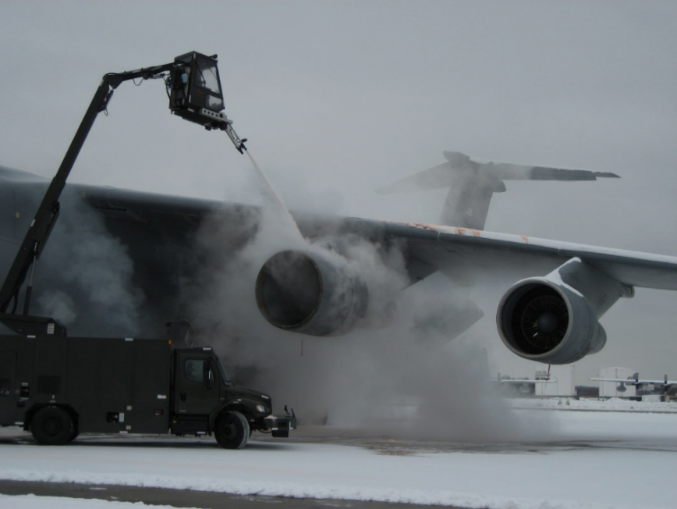
Deicing: Good Housekeeping
Proper storage of deicers
Promote use of approved deicers
Efficient application of deicers
Deice aircraft in designated areas where runoff can be properly managed
Notes:
Deicing fluids are of particular concern because of the impact to the environment and frequent use in winter months.
Good housekeeping practices for deicers include proper storage, use of approved deicers with the least environmental implications, and efficient application practices by aircraft operators and airfield maintenance.
Aircraft deicing should be conducted in designated areas where the runoff can be properly managed, which may include treatment or recycling.
Because this is an overview course, we will not be talking about deicing BMPs in depth. However, if you are interested in or are required to deal with deicing we recommend you view the Managing Deicing Runoff course.

Slide 22
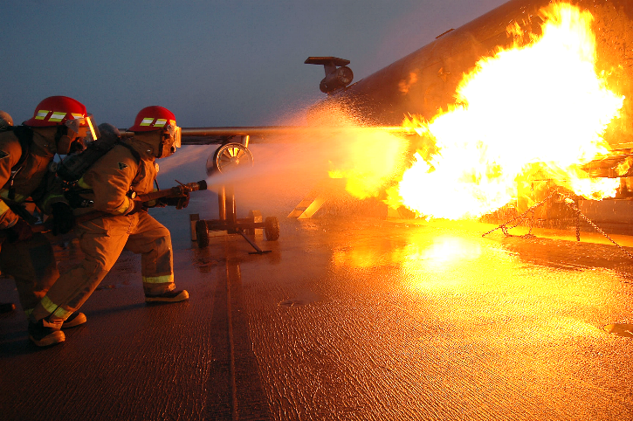
Good Housekeeping: Fire Fighting Foam
Implement policies on handling and use
Use approved AFFF that doesn’t contain PFAS
Store and handle to avoid contact with stormwater
Properly dispose of expired product
Contain and properly dispose of AFFF
dispensed during testing and training exercises
If possible, collect and properly dispose of
AFFF dispensed during incidents
Notes:
Aqueous film forming foam, or AFFF (“A-triple-F”) is used by airport fire departments during training exercises and response to fire emergencies. AFFF contains chemicals, called “PFAS” which do not readily breakdown in the environment and have negative human and ecological health impacts.
Good housekeeping strategies to reduce the impact of AFFF use, include:
Implementing policies on handling and use of AFFF
Use of approved AFFF that doesn’t contain PFAS
Storage and handling to avoid contact with stormwater
Properly disposing of expired AFFF product
Containing and properly disposing of AFFF dispensed during testing and training exercises
If possible, collecting and properly disposing of AFFF dispensed during emergency incidents

Slide 23
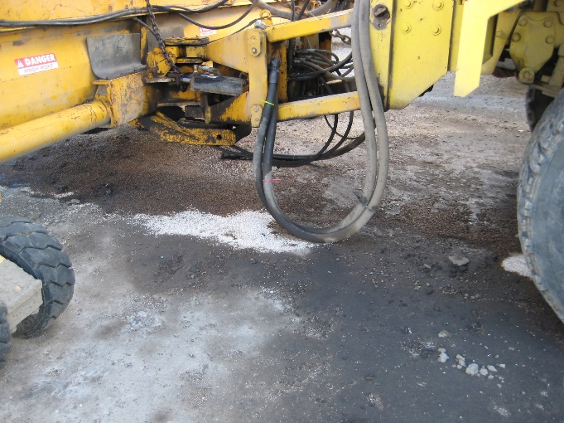
Good Housekeeping: Preventive Maintenance
Preventive maintenance is the best way to prevent spills and illicit discharges.
Training of staff and tenants is the first step in preventive maintenance.
Routine maintenance and regular inspections
of equipment and facilities are key to reducing
risks of a problem.
Notes:
Preventive maintenance is the best way to prevent spills and illicit discharges.
Training of staff and tenants is the first step in preventive maintenance.
Routine maintenance and regular inspections of equipment and facilities are key to reducing the risks of a problem occurring.

Slide 24
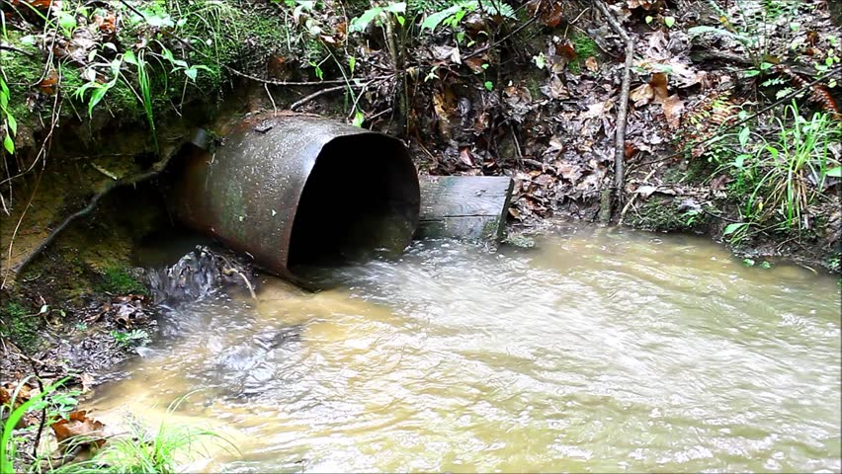
Keeping Pollutants Out of Storm Drains
Never put anything except stormwater into storm drains.
Never dump:
Paint or water with paint in it
Rinse water from herbicide or fertilizer tanks
Washwater of any type
Leaves or grass clippings
Remember, only rain goes down the drain!
Notes:
A final good housekeeping practice is to never put anything except stormwater into storm drains:
Never dump:
Paint or any water with paint in it
Rinse water from pesticide or fertilizer tanks
Washwater of any type
Leaves or grass clippings
Remember, only rain goes down the drain!

Slide 25
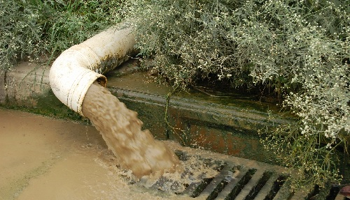
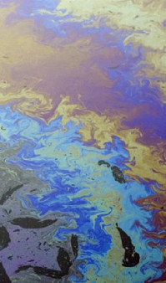
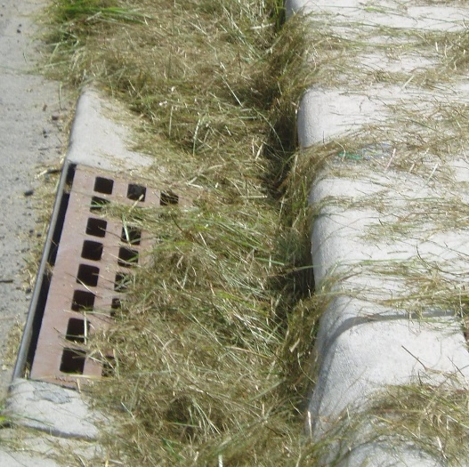
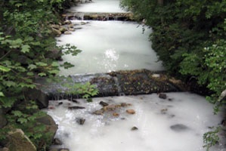
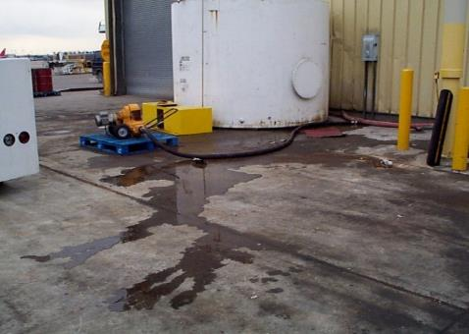
If You See Something, Say Something
Notes:
If you see something, say something.
Be aware of evidence of stormwater pollution, and report it to your supervisor or appropriate airport department.
Some typical examples include:
Dirty water in the street (e.g., sediment runoff from a construction site)
Washout of solids/liquids like concrete, oils, or paints.
Unusually colored discharges (e.g., milky white, red, purple, blue, black, green)
Improper disposal of solids/liquids (e.g., grass clippings blown down a storm drain or left in the street, oil dumped down a storm drain)
Leaks (e.g., around dumpsters, cars)

Slide 26
Localize for Your Airport
Replace this slide with
pictures of good housekeeping
at your airport
Notes:
NOTES
Use this slide to show good housekeeping, managing waste materials and trash, proper vehicle storage and washing areas, proper materials storage tips and techniques.

Slide 27
Knowledge Check 4
Which of the following good housekeeping practices help keep pollutants out of stormwater?
Proper management of waste materials and trash
Storage and washing of vehicles in designated areas
Proper storage and use of all materials
Notice and report evidence of
stormwater pollution
All of the above
Notes:
It’s time for a knowledge check
Ask:
Which of the following good housekeeping practices help keep pollutants out of stormwater?
Proper management of waste materials and trash
Storage and washing of vehicles in designated areas
Proper storage and use of all materials
Notice and report evidence of stormwater pollution
All of the above
Correct Answer:
E. All of the above

Slide 28
Knowledge Check 5
True / False
Materials that are potential pollutants can be stored
outdoors without a covering.
Notes:
It’s time for a knowledge check
Ask: True / False
Materials that are potential pollutants can be stored outdoors without a covering
Correct Answer:
False

Slide 29
Knowledge Check 6
True / False
Overfilled or uncovered dumpsters can fill with rain water or snow and leak pollutants into nearby storm drains.
Notes:
Ask: True / False
Overfilled or uncovered dumpsters can fill with rain water or snow and leak pollutants into nearby storm drains.
Correct Answer:
True

Slide 30
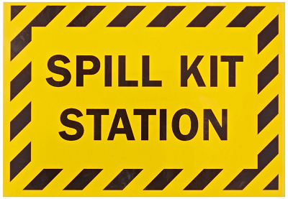
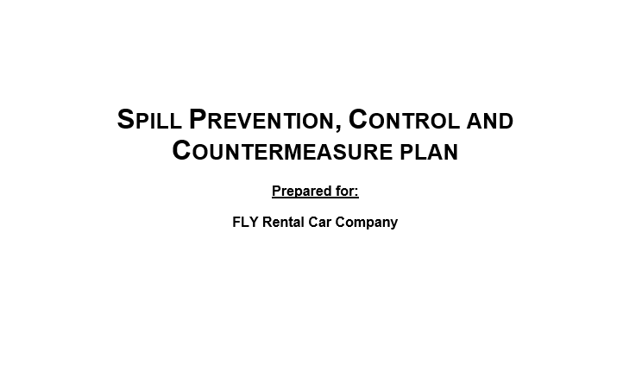
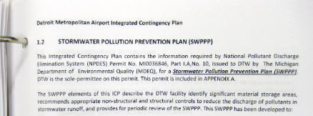
Lesson 3: Spill Prevention & Cleanup
See a spill? Immediately contact a responsible person
to get the spill contained and cleaned up
Spill cleanup should only be handled
by trained personnel
Don’t try to clean up a spill unless you’ve been
properly trained or have the right equipment
Does your job area have a spill plan?
Where is your spill kit located?
Notes:
Next we are going to talk about good spill prevention and clean-up tips
If you see a spill or leak, whether inside or outside, immediately contact your supervisor or a responsible person to get the spill contained and cleaned up.
Spill cleanup should only be handled by trained personnel or the Fire Department.
Don’t try to clean up a spill unless you’ve been properly trained or have the right equipment.
Does your job area have a spill plan?
Where is your spill kit located?
Ask: Are you familiar with your area’s Spill Management Plan.

Slide 31
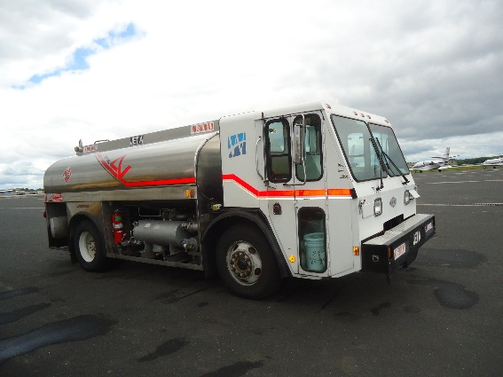
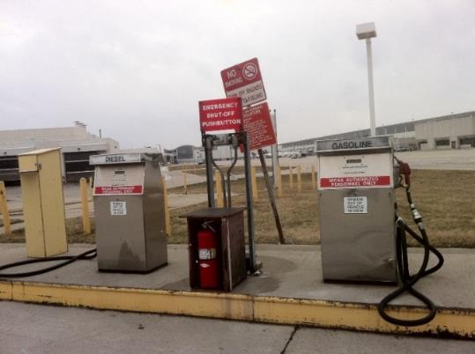
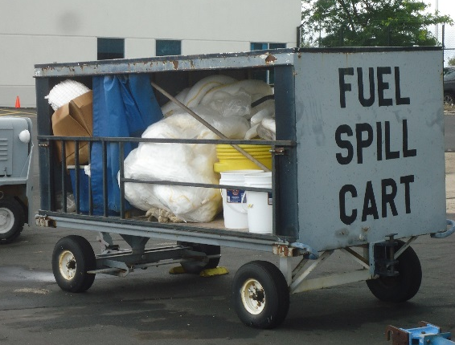
Fuel Spills & Cleanup
Fueling can occur at multiple locations
Fuel spills are potentially dangerous
Safe fueling practices help avoid spills
Only properly trained personnel should fuel vehicles, Class C training
Construction equipment fueling should only occur
away from inlets and drains
Notes:
Let’s talk about fuel spills and cleanup.
Fueling operations can occur at multiple locations at an airport
And fuel spills are potentially dangerous, so its important that everyone be aware of spill prevention and response.
Safe fueling practices help avoid spills and prevent fuel from entering the storm sewer system.
Only properly trained personnel should be allowed to fuel vehicles, and some fueling may require Class C training
Construction equipment fueling should only occur away from inlets and drains
Ask: Is there a fueling station near your work station?
If there is a fueling station near your work area, do you know where a fuel spill kit is accessible?
Do you know who to contact if you witness a potential fuel spill?
Take initiative and after this training ask your supervisor about the fuel spill kit location and who to contact for hazardous or non-hazardous spills.

Slide 32
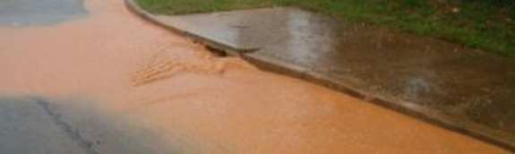
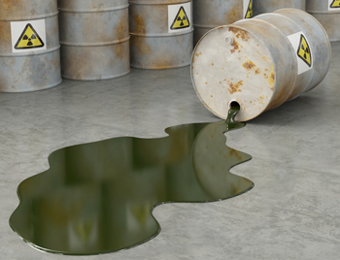
Be On The Lookout
Lookout for spilled or dumped items
If you see a spill, contact your supervisor or personnel responsible to get the spill contained and cleaned up
Aware of your area spill management plan?
Notes:
Be on the lookout for spilled, or dumped materials outside of fueling areas also.
If you see a spill, whether inside or outside, immediately contact your supervisor or personnel responsible for that area or to get the spill contained and cleaned up.
NOTES
Ask: Do you know where spill kits used in your area are stored?
Do you know who to contact if you witness a hazardous or non-hazardous spill?
Take initiative and after this training ask your supervisor about spill kit location and who to contact for hazardous or non-hazardous spills.

Slide 33
Optional: Localize for Your Airport SPCC
Localize or modify this slide to outline the details of your Spill Prevention, Control, and Countermeasure (SPCC) Plan
Notes:
NOTES Localize or modify this slide to outline the details of your Spill Prevention, Control, and Countermeasure (SPCC) Plan

Slide 34
Knowledge Check 7
True / False
Spills should only be cleaned up by trained personnel.
Notes:
It’s time for a knowledge check
Ask:
True / False
Spills should only be handled by trained personnel
Correct Answer:
True

Slide 35
Knowledge Check 8
Construction equipment fueling should occur _____ inlets and drains
Away from
Beside
Within 6 feet
All of these above
Notes:
Ask:
Construction equipment fueling should occur ______from inlets and drains
Away from
Beside
Within 6 feet
All of these above
Correct Answer:
A. Away from

Slide 36
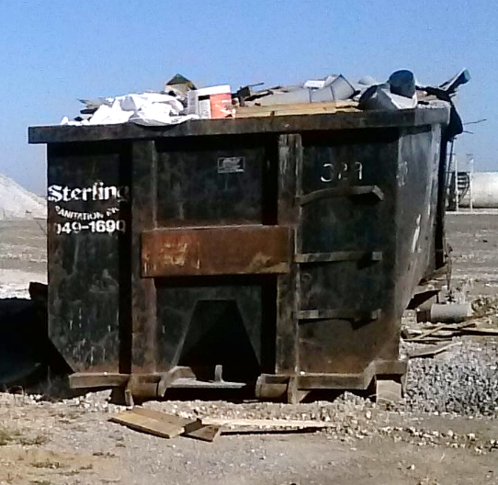
Lesson 4: Construction Stormwater
Sediment = main pollutant of concern
Other sources:
  Dewatering water
  Equipment and vehicle maintenance
  Concrete wash water
  Material storage
  Trash and other waste materials
Notes:
Let’s talk about Construction site stormwater runoff and the best management practices or BMPs that are associated with construction. What pollutants are associated with construction site runoff?
The main pollutant of concern is sediment. When vegetation and pavements are removed and it rains, soil can be displaced at a high rate. Practices need to be in place to prevent sediment transport.
Sediment in runoff is not the only stormwater pollutant of concern at construction sites. Others include:
Dewatering discharges, which can contain suspended sediments and other contaminants
Equipment maintenance activities generate various waste materials that must be disposed of properly to avoid contaminating stormwater
Concrete wash water is acidic and can be harmful to aquatic orgainsims if discharged into waterways
Trash and other debris generated at construction sites must be contained and managed to keep it out of stormwater
NOTES
Ask: Which of these activities do you think impacts airport stormwater runoff the most? (deicing in northern climates and vehicle maintenance in southern climates)

Slide 37
Construction Stormwater BMPs
Construction BMPs
Good Housekeeping
Sediment Control
Notes:
Even though you may not be responsible for working on a construction site, you are responsible for reporting any potential activities that you see that could negatively impact airport stormwater runoff.
Construction Stormwater Best Management Practices minimize sediment and other pollutant transport from construction sites.
Construction BMPs can be grouped into two main categories: good housekeeping practices and sediment control.
Activities that can be practiced to help reduce or eliminate impact to stormwater runoff within these two categories will be discussed next, starting with sediment control BMPs.

Slide 38
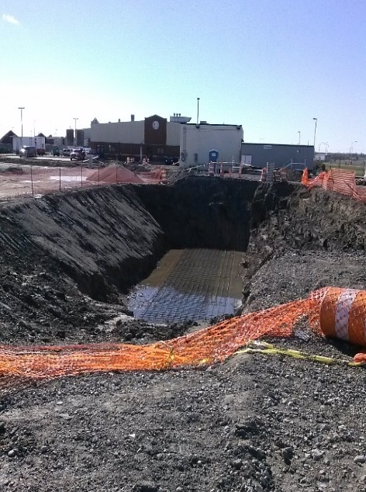
Construction Stormwater BMPs
Construction BMPs
Good Housekeeping
Sediment Control
Runoff controls
Stabilization measures
Perimeter control
Tracking control
Notes:
Sediment control BMPs include:
Runoff controls that divert off-site flow around construction site
Stabilization measures to minimize bare soil
Perimeter control practices to prevent sediment from leaving the construction site
Tracking controls at the entrance and exit of site to prevent sediment from leaving the construction site
What do these controls look like?

Slide 39
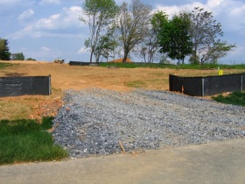
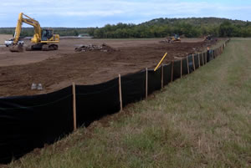
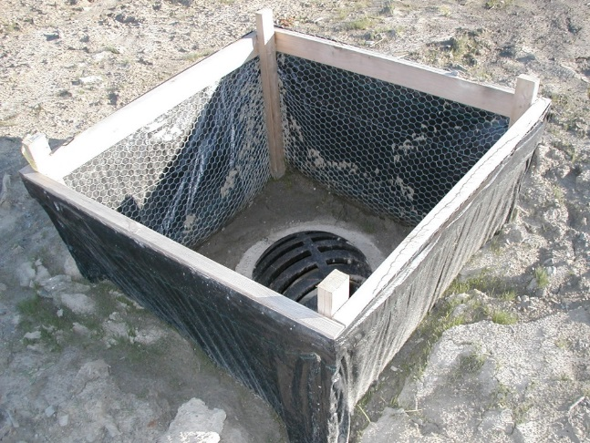
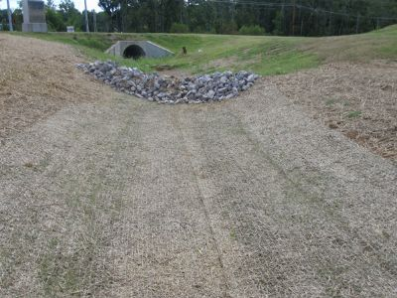
Sediment Control Practices
Notes:
Sediment control practices minimize sediment transport from construction sites.
Construction site exits should be protected with a construction gravel pad that is sized to prevent exiting vehicles from transporting or tracking sediment out of the area.
Stormwater inlets downstream of disturbed areas should have inlet protection, like the inlet shown in the lower left.
Exposed soil and stockpiles should be protected with silt fencing or other perimeter controls, as shown in the upper right.
Ditches or swales should be protected with check dams, as shown in the lower right to help keep construction site sediment contained.
Other examples of sediment control practices include a temporary sediment pond and careful staging of a project to avoid large areas of open excavations.
NOTES
Ask: What types of sediment controls have you observed in use at our airport?
Next we will discuss the Good housekeeping practices.

Slide 40
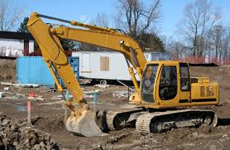
Construction Stormwater BMPs
Construction BMPs
Good Housekeeping
Sediment Control
Proper waste management
Concrete washout containment
Dewatering water management
Vehicle maintenance away from drainage inlets & drainage-ways
Proper project planning
Runoff controls
Stabilization measures
Perimeter control
Tracking control
Notes:
The main categories of Good Housekeeping Construction BMPs include:
Proper waste management
Concrete washout containment
Dewatering water management
Vehicle maintenance conducted away from drainage inlets and drainage-ways and
Proper project planning
What do these controls look like?

Slide 41
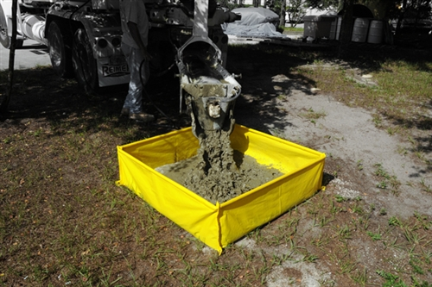



Construction Good Housekeeping Practices
Notes:
These examples of good housekeeping practices on construction sites provide best practices and methods to help keep pollutants out of stormwater. The top two pictures show two examples of concrete wash water containment, designed to hold the concrete wash water until is has dried and can be removed from the site or crushed up and re-used for general fill.
The bottom left photo is a good example of proper waste management. This dumpster is not overflowing and is closed. The final photo on the bottom right is an example of dewatering water treatment. Pumping of water into a settling area allows for sediment to settle before release into the drainage system. Other examples of dewatering water management include sediment bags and sediment basins.

Slide 42
Localize for Your Airport
Use this slide show how local construction activities address the impact of stormwater runoff.
Notes:
NOTES
Is there construction at your airport? Use this slide show how local construction activities address the impact of stormwater runoff.

Slide 43
Knowledge Check 9
True / False
Construction BMPs minimize sediment transport
from construction sites.
Notes:
It’s time for a knowledge check
Ask:
True / False
Construction BMPs minimize sediment transport from construction sites.
Correct Answer:
True

Slide 44
Knowledge Check 10
Multiple Choice
Which ways can you help the airport do a better job of preventing stormwater pollution?
Be aware of potential stormwater pollutants
in your work activities
Report spills, leaks and
illegal dumping immediately
Be observant of construction runoff
All of the above
Notes:
Multiple Choice
Which ways can you help the airport do a better job of preventing stormwater pollution?
A. Be aware of potential stormwater pollutants in your work activities
B. Report spills, leaks and illegal dumping immediately
C. Be observant of construction runoff
D. All of the above
Correct Answer:
D. All of the above (correct)

Slide 45
Course Summary
In this course you learned to identify:
Federal, State, and Local airport
stormwater runoff regulations
Good housekeeping practices
Spill prevention and cleanup
Construction site BMPs
Notes:
In this course you learned to identify:
Federal, State, and Local airport stormwater runoff regulations
Good housekeeping practices
Spill prevention and cleanup
Construction site BMPs

Slide 46
Class Wrap-up
Notes:
Note: The Final Quiz can be given a handout quiz or as a class discussion.
True/False Airport stormwater runoff is created when water from rain, or snow melt flows across rooftops or paved areas and does not soak into the ground
2. What is potentially the greatest concern in airport stormwater pollution?
A. Aircraft and airfield deicing at airports in northern climates
B. Algae in all climates
C. Vehicle fluids in southern climates
D. All of the above
E. A and C only (correct)
3. Which federal regulation has the goal to keep pollutants out of the nation’s waterbodies?
A. The global warming council or GWC
B. Municipal Separate StormSewer System or MS4
C. National Pollutant Discharge Elimination System or NPDES (correct)
D. None of the above
4. Proper materials handling / storage, Reporting leaking equipment, Cleaning up or reporting spills, Not dumping paint in
drains are all examples of what?
A. Best Management Practices or BMPs
B. Good Housekeeping
C. Being a good environmental neighbor
D. The right thing to do
E. All of the above (correct)
True/False. You should clean up every spill you see.
Correct Answer: Only clean up spills you are trained to and if you have the right equipment.
You should always notify the right authorities about a spill
What is the primary concern regarding stormwater pollution at airport construction sites?
A. Oil
B. Frogs
C. Sediments
D. Trash around construction trailers
Correct Answer: Sediments that are disturbed by the construction activity and can be transported off-site by stormwater flows to pollute surrounding waters.

Slide 47
Note:
This certificate is designed to be printed. You should test print on regular paper to ensure proper positioning before printing on card stock.
You may need to uncheck Scale to Fit Paper in the Print dialog (in the Full Page Slides dropdown).
Certificate
Your logo here
This Acknowledges That
___________
Has completed
Introduction to Airport Stormwater
1 Hour ACRP Training
facilitator
Date

