Slide 1
Notes to Instructor
Training consists of two lessons and is approximately 55 minutes total - 45 minutes of instruction plus 10 minutes for the quiz if class discussion is chosen
This training course was created for airport staff and tenants who are responsible for deicing related operations.
There are two Optional slides to “localize” for your airport situation. Use this slide deck as is, or modify to fit your needs.
There are no bullet point transitions, click and see entire screen
Print a Notes Version for your Instructor Guide
Note: The final quiz can be delivered as a printed quiz
or class discussion.
Course handout (PDF) and certificate (last slide) are optional
Notes:
Notes to Instructor
Training is approximately 55 Minutes total - 45 minutes of instruction plus 10 minutes for the quiz if class discussion is chosen.
This training course was created for airport staff and tenants who are responsible for deicing related operations.
There are two Optional slides to “localize” for your airport situation. Use this slide deck as is, or modify as required to fit your needs.
There are no bullet point transitions, click once and see entire screen
Print a Notes Version for your Instructor Guide
Note: The final quiz can be a printed quiz or class discussion.
Course handout (PDF) and certificate (last slide) are optional

Slide 2
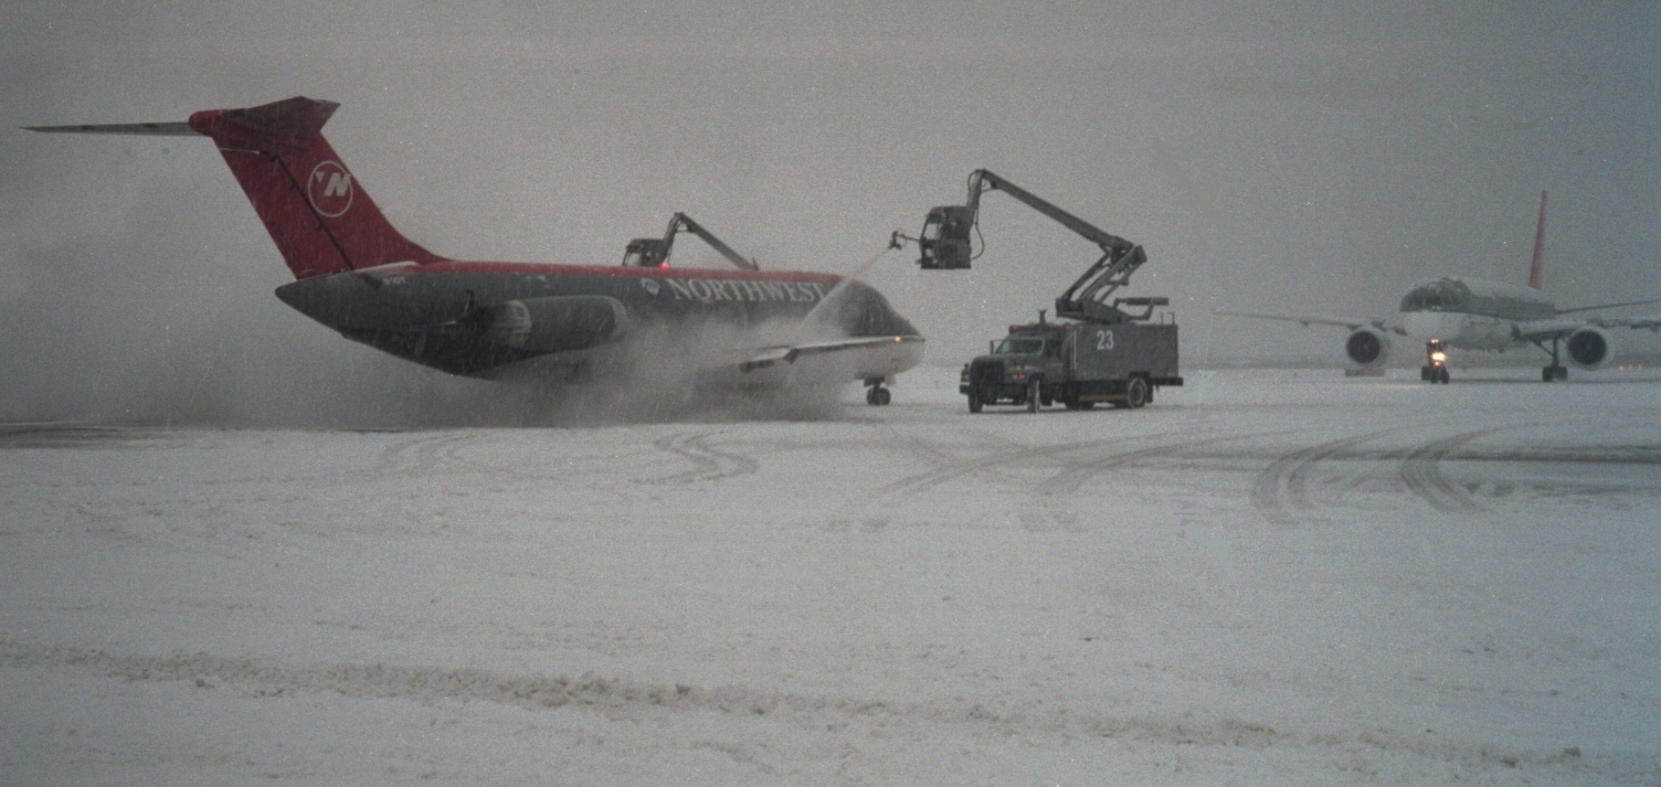
Course 4 Managing Deicing Runoff
L1: Introduction to Deicing
Notes:
Welcome to Course 4 Managing Deicing Runoff,
There are two lessons in this course. Let’s start with Lesson 1: Introduction to Deicing.

Slide 3
Lesson Objectives
In this lesson you will learn to identify:
Differences between aircraft and
airfield pavement deicers
Key ingredients in approved aircraft and
airfield pavement deicers
Regulatory requirements
Challenges in complying with
regulatory requirements
Notes:
In this lesson you will learn to identify:
Differences between aircraft and airfield pavement deicers
Key ingredients in approved aircraft and airfield pavement deicers
Regulatory requirements that apply to deicing
Challenges in complying with the regulatory requirements

Slide 4
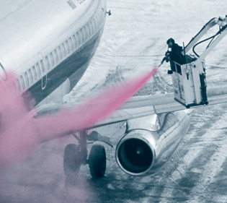
What is Deicing and Anti-Icing?
Required to maintain safe operations during winter weather conditions.
“Deicing” involves two separate steps:
Deicing: To remove accumulations
of frost, ice and snow
Anti-Icing: To prevent frost, ice
or snow from accumulating on
a clean surface for some period
of time
Notes:
Deicing of aircraft and airfield pavement is required to maintain safe operations during winter weather conditions.
The term “Deicing” involves two separate steps:
Deicing to remove accumulations of frost, ice, and snow, and
Anti-icing to prevent frost, ice, and snow from accumulating on a clean surface for some period of time. For aircraft, this period is called “hold-over time.”

Slide 5
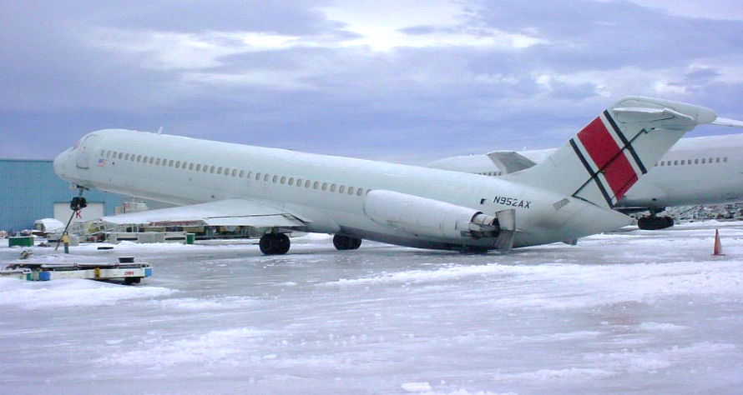
Frozen Precipitation is a Serious Threat
Frost, sleet, ice, and snow on aircraft
= serious threat to safe operation
1/8th inch of ice will significantly reduce
a wing’s aerodynamic lift
Extra weight can affect aircraft balance
or damage its structure
Richard Vincent
Notes:
Frost, sleet, ice, and snow on aircraft surfaces are a serious threat to safe operation.
As little as 1/8 of an inch of ice will significantly reduce a wing’s aerodynamic lift.
Extra weight from accumulated snow and ice can affect the balance of an aircraft, or even damage its structure.

Slide 6
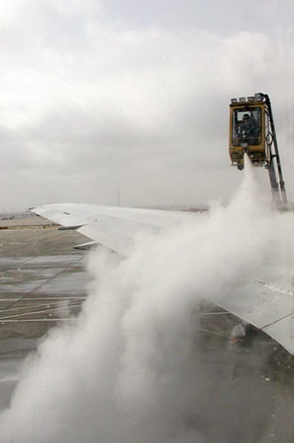
Aircraft Deicing Products
Two kinds aircraft deicing products (ADF)
Aircraft Deicing Fluids remove frost, snow, and ice, provide only short term protection against accumulation
Aircraft Anti-icing Fluids protect
clean aircraft surfaces from
accumulation of frozen
precipitation for extended periods
Notes:
There are two different types aircraft deicing products, collectively referred to as ADF
Aircraft deicing fluids are used to remove frost, snow, and ice but only provide short term protection against further accumulation..
Aircraft anti-icing fluids are thicker formulations that protect clean aircraft surfaces from accumulation of frozen precipitation for extended periods of time.

Slide 7
Type I Fluids
Produced as concentrate, diluted with water based on outside air temperature
50:50 concentrate: water is typical,
lower ratios under warmer temps
Provide some anti-icing protection,
short hold over time
Specifications published by
SAE International in AMS 1424
Notes:
Type I fluids are produced as a concentrate and are diluted with water prior to application based on outside air temperature.
A 50:50 ratio of concentrate to water dilution is typical, but lower ratios can be used under warmer temperatures.
These fluids provide some anti-icing protection, but have a relatively short holdover time.
Specifications for Type I fluids are published by SAE International in Aerospace Material Specification (AMS) 1424.

Slide 8
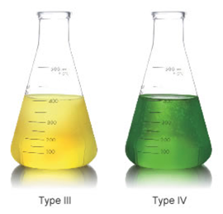
Type II, III and IV Anti-icing Fluids
Ready to use without dilution, contain at least 50% glycol + thickening agents
Longer hold over times than Type I fluids
Type IV = longer hold over time than Type II and most widely used
Type III rarely used
Specs in SAE International
AMS 1428
Type II
Type IV
Notes:
Type II, III and IV anti-icing fluids are delivered ready to use without dilution and typically contain at least 50 percent glycol in addition to thickening agents that keep the fluid on the aircraft surfaces until take-off.
As a result, these fluids provide longer hold-over times than Type I fluids.
Type IV fluids provide longer holdover time than Type II fluids, and are the most widely used anti-icing fluids.
Type III anti-icing fluid can be thought of as a compromise between type I and type II fluids, but it is rarely used at commercial airports in North America.
Specifications for Type II, III and IV fluids are published by SAE International in AMS 1428.

Slide 9
(Optional) Localize for Your Airport
Replace this slide with local information
Notes:
NOTES
Replace this slide to introduce the types of aircraft and pavement deicing and anti-icing products used at your airport.

Slide 10
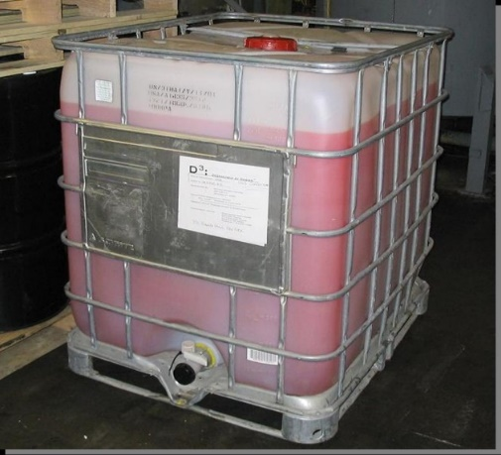
Freezing Point Depressant (FPD)
Primary ingredient in Aircraft Deicing
and Anti-icing Fluids
Melts frost, ice, snow by lowering temperature at which it freezes
Notes:
All types of Aircraft Deicing and Anti-icing Fluids (ADF) contain ingredients that are required to meet certification standards.
The primary ingredient in ADF is a freezing point depressant, or FPD, that melts frost, ice, and snow by lowering the temperature at which it freezes.

Slide 11
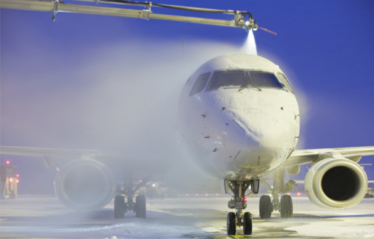
Common FPDs Used In ADF
Most common FPD in ADF in U.S.
is Propylene Glycol, found in foods, beverages, and pharmaceutical products
Ethylene Glycol used by some U.S. carriers, most common in Canada
Other FPDs in ADF:
Glycerol and
1,3 Propanediol
Notes:
Currently, only a few chemicals meet all of the performance, compatibility, and environmental requirements for the FPD.
The most common FPD in ADF used in the United States is propylene glycol. This chemical is also found in a wide variety of foods, beverages, and pharmaceutical products.
Ethylene glycol is used by some carriers in the United States, and is the most common FPD in ADF products used in Canada.
Other FPDs, such as glycerol and 1,3 Propanediol are also used in some ADF products.

Slide 12

Other Ingredients in ADF
Up to 80% of ADF sprayed on aircraft
is water
1-2% ADF consists of additives required to meet performance certification:
  Surfactants
  Corrosion inhibitors
  Thickeners
  Dyes
Notes:
The second ingredient in ADF is water.
Depending on the conditions, as much as 80 percent of the ADF solution sprayed on aircraft can be water.
Approximately 1 to 2 percent of ADF consists of additives required to meet performance certification. These include surfactants, corrosion inhibitors, thickeners, and dyes.

Slide 13
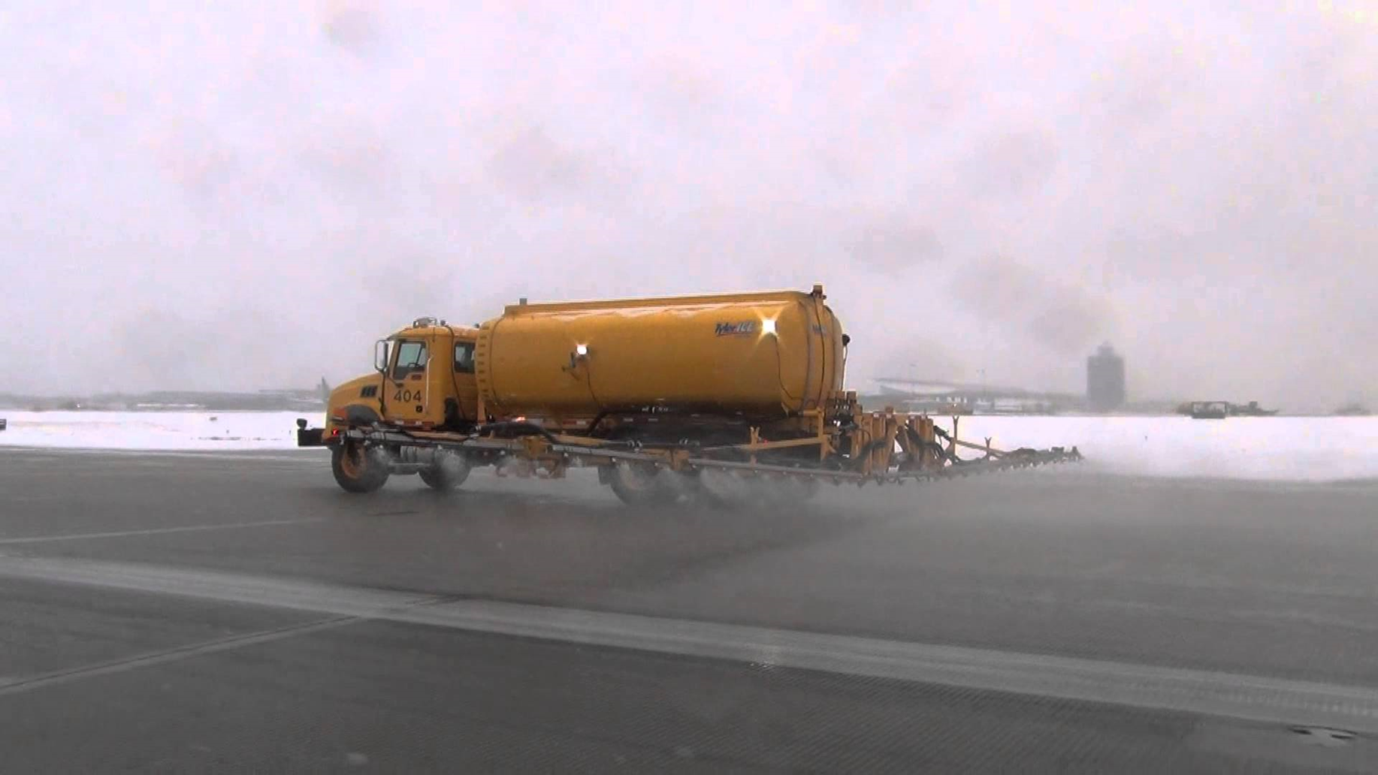
Airfield Pavement Deicers
Different from ADF
Available as fluids or solid products
Notes:
The deicers are used on airfield pavements are very different from ADF.
Airfield pavement deicers are available as either fluids or solid products.
Let’s take a closer look at these deicing products.

Slide 14
Airfield Pavement Deicers
Heated sand provides friction,
no deicing or anti-icing
In addition to glycols, FPDs in airfield pavement deicers include: potassium acetate, potassium formate in liquid form and sodium acetate, sodium formate in solid form
Contain small
amounts of additives
Notes:
A wide variety of products are approved for use in deicing airfield pavement.
Heated sand provides added friction on airfield pavement, although it doesn’t provide significant deicing or anti-icing properties .
In addition to the glycols, freezing point depressants in airfield pavement deicers include potassium acetate and potassium formate in liquid deicers,
and sodium acetate and sodium formate in solid form deicers.
Pavement deicers also contain small amounts of additives needed to meet performance specifications

Slide 15
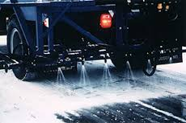
Airfield Pavement Deicers: Urea
FPD allowed in pavement deicers
Readily breaks down into ammonia,
can be toxic to environment
USEPA has stringent runoff control requirements on airports using urea,
rarely used today
Notes:
Urea is a freezing point depressant that’s also allowed in pavement deicers,
But it readily breaks down into ammonia, which can be toxic to the environment.
For that reason, the USEPA has placed stringent runoff control requirements on airports that use urea-based deicers, and they are rarely used today.

Slide 16
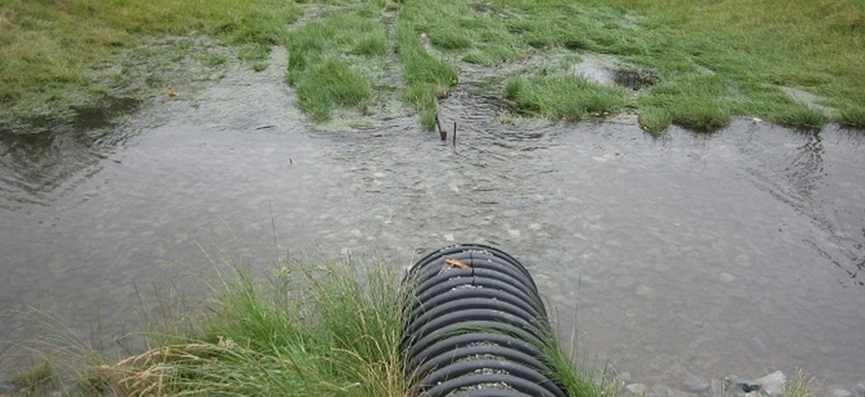
Environmental Implications of Deicing
All certified aircraft and airfield deicing products have implications for environmental impact
Primary concern is risk of reduced dissolved oxygen in streams stormwater containing deicers
Notes:
Airport deicing runoff is an environmental concern because all of the certified aircraft and airfield deicing products have some implications for environmental impact.
The primary concern is the risk of reduced dissolved oxygen in streams receiving stormwater that contains deicers.

Slide 17
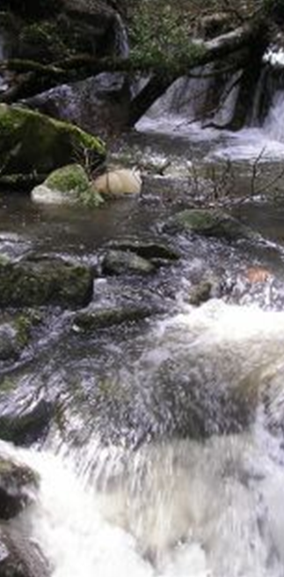
FPDs and Dissolved Oxygen
FPDs = food source for microorganisms that consume oxygen (O₂)
Oxygen consumed too fast
= low O₂ concentrations, unhealthy
for aquatic life
Maintain O₂ by managing balance between deicers in discharges
and receiving water’s capacity
to assimilate them
Notes:
Dissolved oxygen can be impacted because the freezing point depressants in these products are readily biodegradable, and can be a rich food source for microorganisms in the environment. These microorganisms consume oxygen as they break down the FPDs.
If oxygen is consumed faster than it can be replenished by natural processes, oxygen concentrations in the stream may go down to levels that are unhealthy for aquatic life.
Maintaining necessary dissolved oxygen concentrations requires understanding and managing the balance between the deicers in discharges and the receiving water’s capacity to assimilate them.

Slide 18
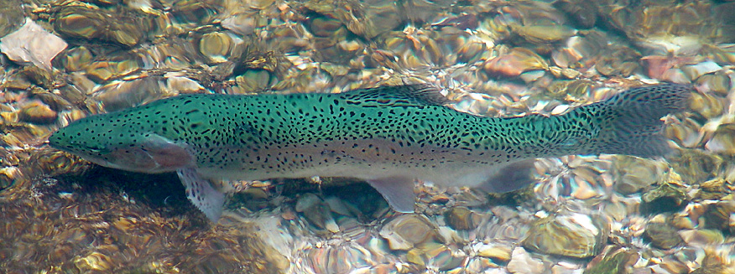
Other Environmental Concerns
Deicers may be toxic to fish and other aquatic organisms in high concentrations
Foul odors produced when glycols break down = a problem in areas where workers or public exposed to them
Deicers can promote growth of naturally-occurring biofilms
Notes:
Deicers can also present other environmental concerns
Deicers can be toxic to fish and other aquatic organisms when concentrations are very high. Fortunately, this is rarely the case.
Foul odors can be produced when glycols break down in airport storm sewers. These odors are often described as being similar to onions or garlic, and can be a problem if they occur in areas where airport workers or the public are exposed to them.
Under certain conditions, deicers in stormwater can promote the growth of naturally-occurring attached microbial communities, called “biofilms.”
Aesthetic quality, as well as aquatic habitat can be degraded if this growth is too abundant.

Slide 19
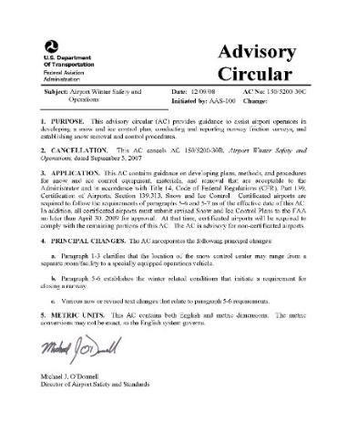
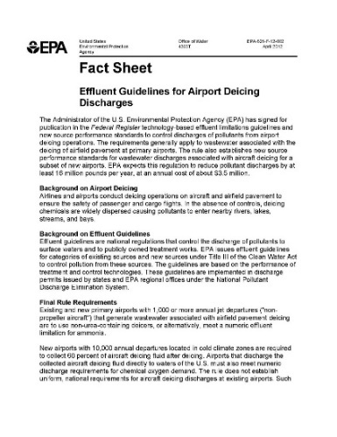
Regulatory Requirements
Requirements for managing stormwater containing deicers defined by safety and environmental protection regulations
FAA Advisory Circulars & Orders
EPA regulates airport deicing as
an industrial activity
Authorization through National
Pollutant Discharge Elimination
System (NPDES) permit
Notes:
The requirements for managing stormwater containing deicers are defined by safety and environmental protection regulations.
The FAA provides specific guidance and requirements for virtually every aspect of aircraft and airfield pavement deicing to ensure the safety of wintertime operations. These are contained in various FAA Advisory Circulars and Orders. See the Course Guide for a list of the AC’s.
The US EPA regulates airport deicing as an industrial activity, and
authorization for discharging stormwater associated with deicing operations is granted through either a general or individual National Pollutant Discharge Elimination System, or NPDES, permit.

Slide 20
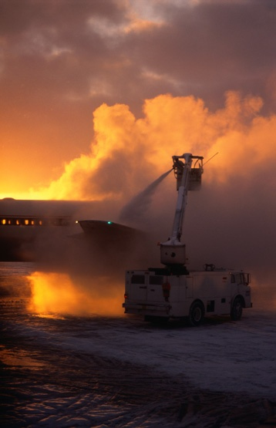
Challenges in Managing Deicing Runoff
Materials and practices are regulated
Only certified deicers may be used
FAA requires approved practices in handling and applying deicers
Deicers dispersed over airfield
Containment and collection of stormwater impacted by deicing
requires specialized techniques
Notes:
There are significant challenges in managing deicing runoff to comply with regulatory requirements.
The materials and practices are regulated:
Only certified deicers may be used on aircraft and airfield pavement.
In addition, the FAA requires that specific and approved practices be used in handling and applying deicers.
Deicing is conducted outside, across large areas, and often under stormy conditions with wind and freezing precipitation.
As a result, deicers are widely dispersed over the airfield. Containment and collection of stormwater impacted by deicing requires specialized techniques.

Slide 21
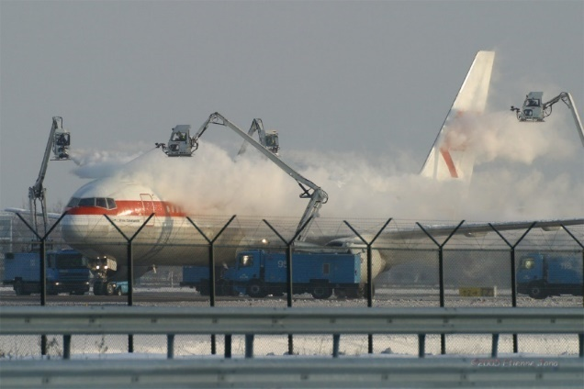
Challenges in Managing Deicing Runoff
Flows and pollutant concentrations vary
between storm events
Large volumes of water to manage,
which requires complex infrastructure
Difficult to understand level of
control required to avoid
environmental impacts
Notes:
A fundamental challenge in managing deicing runoff is that it presents the same difficulties faced in managing other types of stormwater:
flows and pollutant concentrations vary within and between storm events,
there are large volumes of water to manage, which requires complex infrastructure,
and its often difficult to clearly understand what levels of control are required to avoid environmental impacts.

Slide 22
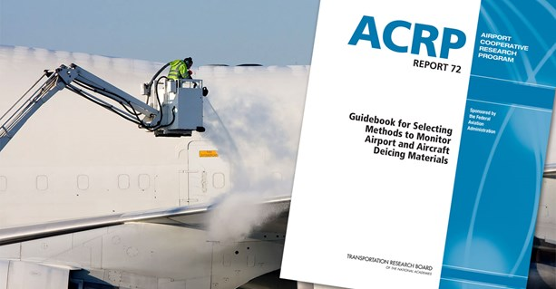
Challenges in Managing Deicing Runoff
Deicing runoff controls = < 100% effective < 80% of applied ADF is collectible,
even with aggressive efforts
Numerous organizations involved:
airport departments
aircraft operators and
service providers
regulatory agencies
Notes:
Just like other stormwater controls, but unlike other industrial pollution controls, deicing runoff controls are significantly less than 100% effective.
USEPA estimates that less than 80 percent of applied ADF is potentially collectible, even with the most aggressive efforts.
There are numerous organizations involved in deicing that have to be coordinated in managing the runoff.
These include airport departments, aircraft operators and their service providers, and regulatory agencies.

Slide 23
Lesson Summary
In this lesson you learned to identify:
Differences between aircraft and airfield
pavement deicers
Key ingredients in approved aircraft
and airfield pavement deicers
Federal regulatory requirements
Challenges in complying with
regulatory requirements
Notes:
In summary, in Lesson 1 you learned to identify:
Differences between aircraft and airfield pavement deicers
Key ingredients in approved aircraft and airfield pavement deicers
Federal regulatory requirements
Challenges in complying with regulatory requirements

Slide 24

Knowledge Check 1
True / False
The primary ingredient in ADF is a freezing point depressant, or FPD, that melts frost, ice, and snow by lowering the temperature at which it freezes.
Notes:
It’s time for some Knowledge Checks over the information just covered.
True or False
The primary ingredient in ADF is a freezing point depressant, or FPD, that melts frost, ice, and snow by lowering the temperature at which it freezes.
Correct Answer : True

Slide 25
Knowledge Check 2
True / False
Some certified aircraft and airfield deicing products have no implications at all for environmental impact.
Notes:
True or False
Some certified aircraft and airfield deicing products have no implications at all for environmental impact.
Correct Answer: False

Slide 26
Knowledge Check 3
Multiple Choice
The primary environmental concern with deicers is the risk of _____ in streams that receive stormwater containing deicers.
  low dissolved oxygen
  aquatic toxicity
  increased salinity
  reduced ice cover
Notes:
Multiple Choice
The primary environmental concern with deicers is the risk of _____ in streams that receive stormwater containing deicers.
Low dissolved oxygen
Aquatic toxicity
Increased salinity
Reduced ice cover
Correct answer: A. Low dissolved oxygen
You have now completed lesson 1, let’s continue to lesson 2.

Slide 27
Course 4 Managing Deicing Runoff
L2: Deicing Runoff Management Toolbox
Notes:
Welcome to Lesson 2: The Deicing Runoff Management Toolbox. In Lesson 2, you’ll learn about the four categories of deicer Best Management Practices (BMPs).

Slide 28
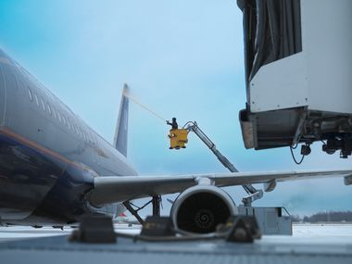
Lesson Objectives
In Lesson 2 you will learn to:
Define four categories of deicing runoff
Best Management Practices (BMPs)
Identify key BMPs in each category
Describe how BMPs from
each category are combined
to create deicing runoff
management systems
Notes:
In Lesson 2 you will learn to:
Define the four categories of deicing runoff Best Management Practices, or BMPs
Identify key BMPs in each of the four categories
Describe how BMPs from each of the categories are combined to create deicing runoff management systems
For detailed information on these topics, refer to ACRP Report 14 Deicing Planning Guidelines and Practices for Stormwater Management Systems

Slide 29
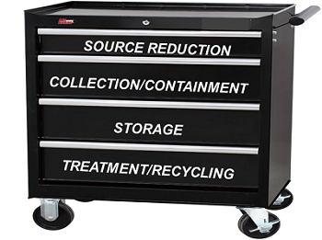
Deicing Runoff Management Toolbox
Notes:
The deicing runoff management toolbox has four categories of Best Management Practices (BMPs):
Source reduction BMPs that reduce the amount of deicers needed to maintain safe operations during winter conditions
Collection and containment BMPs that isolate and collect runoff from deicing operations
Storage BMPs that hold collected deicing runoff prior to transfer to treatment or recycling
Treatment and recycling BMPs used to dispose of the collected runoff
Now let’s look into each drawer of the toolbox to understand the tools that are available to us.

Slide 30
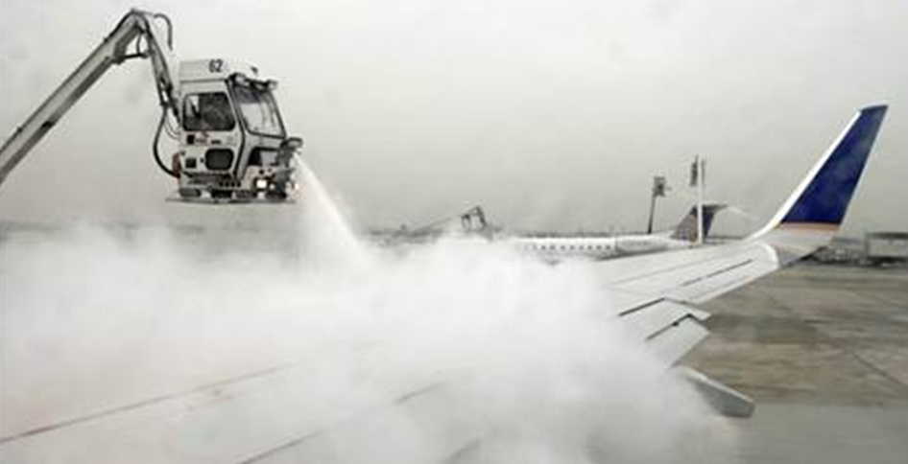
Source Reduction Tools: Aircraft Deicing
Tools to reducing ADF in stormwater
Selecting products with best environmental profile
Storage / handling of ADF to avoid exposure to stormwater
Technologies / practices
optimize use
of ADF in aircraft deicing
Notes:
A basic principle of pollution control is to first consider opportunities to reduce the generation of pollutants. Reductions here will make other control efforts easier.
Available tools for reducing ADF in stormwater range from selecting products with the best environmental profile,
to storage and handling of ADF to avoid exposure to stormwater,
to technologies and practices that optimize the use of ADF in aircraft deicing.
We’ll take a closer look at few of the tools that are most widely used and have the greatest potential impact on source reduction.

Slide 31
Source Reduction: Blending to Temperature
FPD concentration determines minimum temperature at which ADF can be used
Lower concentrations can be used at higher temperatures
Blending to temperature
matches ADF concentration to
outside temperature
May reduce ADF usage by 30%+
over a winter season
Notes:
The concentration of the freezing point depressant in ADF determines the minimum temperature at which it can be used. As shown in this example chart, lower concentrations of ADF can be used at higher temperatures.
Blending to temperature takes advantage of this by applying ADF concentrations that are matched to the outside temperature.
Depending on the location and climate, blending to temperature has been found to reduce ADF usage by 30% or more over the course of a winter season.

Slide 32
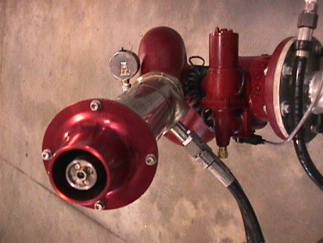
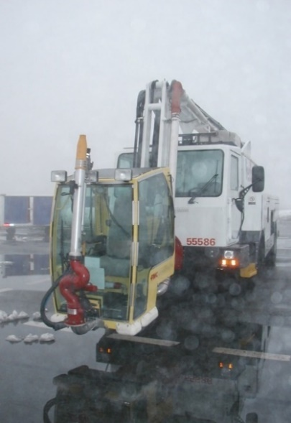
Source Reduction: Forced Air/Fluid Deicing
Hybrid deicing trucks use this technology
Combines hot air jet with
reduced flow ADF spray head
Controlled amounts of ADF
assist in ice removal and provide
anti-icing protection
Upwards of 70% reductions in ADF
usage reported using
forced air/fluid technology
Notes:
“Hybrid” deicing trucks use forced air/fluid deicing technology that combines a hot air jet with a reduced flow ADF spray head.
The blast of air physically removes much of the snow and ice from the aircraft surface.
Controlled amounts of ADF are used as needed to assist in dislodging material that’s tightly bonded to the aircraft,
and then to provide anti-icing protection after the surface has been cleared.
Upwards of 70% reductions in ADF usage have been reported with the use of forced air/fluid technology, depending on weather conditions.

Slide 33
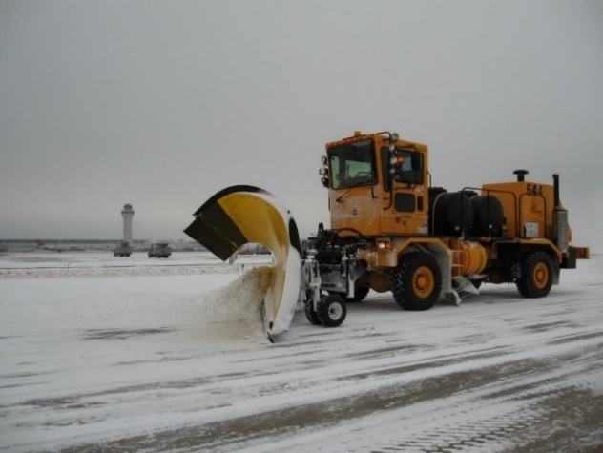
Source Reduction: Pavement Deicing
Airport pavement deicing source
reduction BMPs are more limited
than aircraft deicing options
Physically remove snow and ice
from runways and taxiways
prior to applying deicers
Use pavement deicers with
best environmental profile,
not urea
Notes:
Airfield pavement deicing source reduction BMPs are much more limited than aircraft deicing options.
Where conditions allow, using plows and brooms to physically remove snow and ice from runways and taxiways prior to applying deicers reduces the use of deicers.
The use of pavement deicers with the best environmental profile is a fundamental BMP in this category. In particular this means not using pavement deicers that contain urea.

Slide 34
Source Reduction: Pavement Deicing
Technology is available to adjust deicer application rates as a function of
location / pavement friction condition,
which optimizes application under a wide range of conditions
Pre-treating pavement with liquid deicers prior to storm events provides anti-icing protection and makes removal easier
Notes:
Technology is available to adjust pavement deicer application rates as a function of location and pavement friction condition, which optimizes application under a wide range of conditions.
Finally, pre-treating pavement with liquid deicers prior to storm events provides some anti-icing protection and makes physical removal easier.

Slide 35
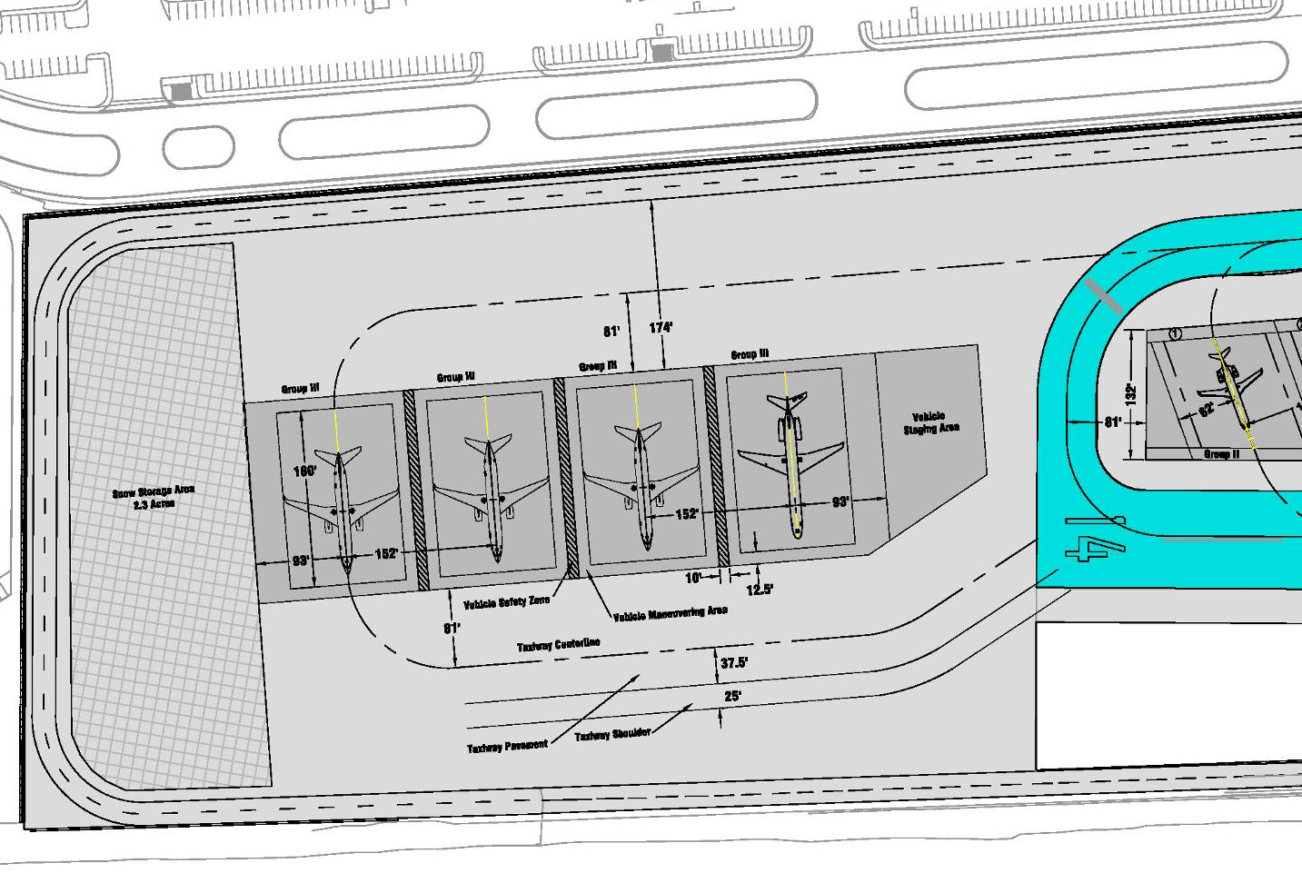
Collection / Containment: Deicing Pads
Note to Instructor
Replace this graphic with
a picture of your airport deicing pads
or use this one.
Notes:
Note to Instructor: Replace this graphic with a picture of your airport deicing pads or use this one.
The next tool category is Collection and Containment.
There are different methods for isolating, collecting, and containing stormwater runoff from deicing activities.
The first collection/containment tool we’ll look at our local central deicing pads, which provide an area specifically designed for efficient deicing and effective capture of deicing runoff.
Critical considerations in locating and sizing pads include:
proximity to departure runways,
size and orientation of deicing slots needed to serve the target fleet,
The space required for deicing trucks and other support equipment,
the pattern of traffic in and out of the pad.

Slide 36
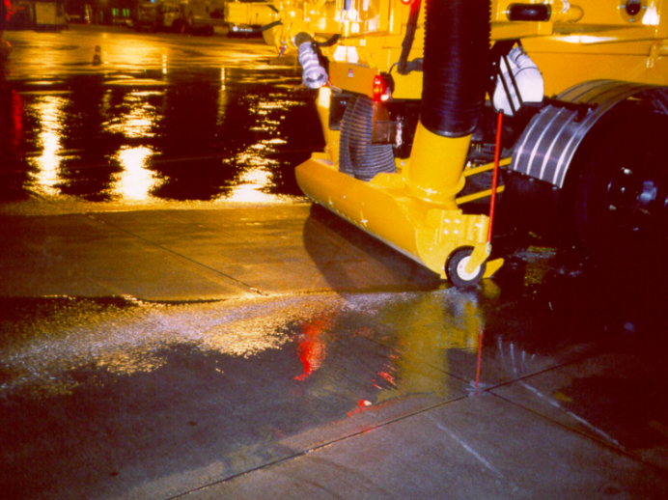
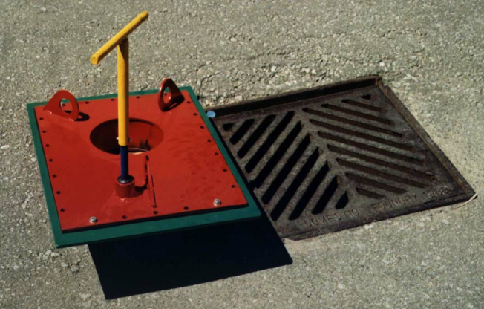
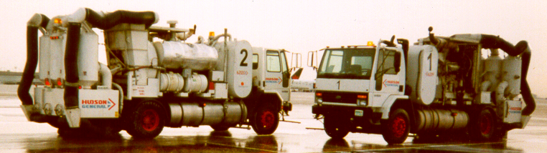
Glycol Collection Vehicles
Notes:
The second collection / containment method is glycol collection vehicles.
Glycol collection vehicles are specially designed to vacuum up deicing runoff from the pavement surface and store it in an onboard tank for subsequent off loading and disposal. They can be truck mounted, as shown here, or on a trailer towed behind a tractor.
Collection effectiveness is greatly enhanced by keeping deicing runoff from entering the storm sewer system until it can be picked up. This is accomplished using various types of drain blockers.
A catch basin insert is shown in the upper right hand picture prior to installation under the grate of a stormwater catch basin. This metal plate has a hole and valve in the center that can be opened or closed from the surface using the removable yellow “T” handle seen in the picture. The valve is closed prior to beginning deicing operations, and opened after the deicing runoff has been collected.

Slide 37
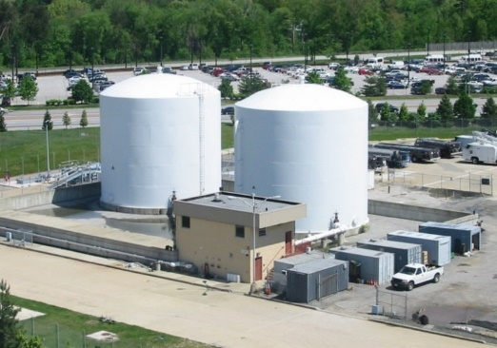
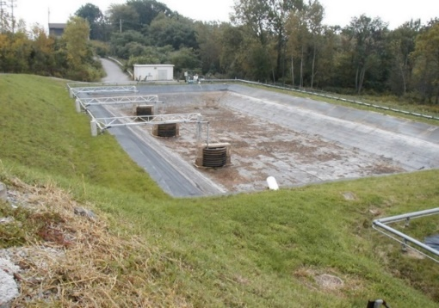
Storage Tools
Collected deicing runoff is stored
before transfer to disposal or recycling
Options: portable / modular tanks,
permanent above and
underground tanks, and ponds
Amount of storage needed is
determined by how fast runoff is
collected and how fast it can be
sent to disposal or recycling
Notes:
The next tool category is Storage.
Collected deicing runoff usually needs to be stored before it can be transferred to disposal or recycling. This is accomplished using portable and modular tanks, permanent above ground and underground tanks, and ponds
The amount of storage needed is determined by how fast runoff is collected, and how fast it can be sent to disposal or recycling.

Slide 38
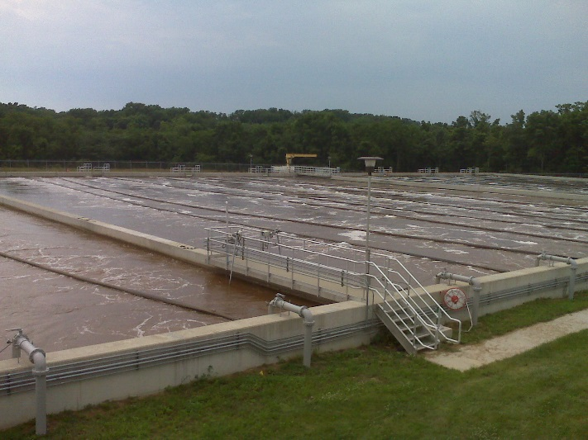
Options for Disposing of Collected Runoff
POTW discharge
Anaerobic fluidized bed reactor
Reciprocating subsurface treatment
Moving bed bioreactor
Sequencing batch reactor
Natural treatment systems
Membrane filtration
Glycol recovery/recycling
Notes:
The final tool category, Treatment and Recycling, provides different options for disposing of collected deicing runoff.
The treatment and recycling processes generally involve destruction through some kind of biological treatment process, or recovery of the glycol in aircraft deicing runoff for reuse.
Let’s take a closer look at a couple of the more common treatment/recycling options.

Slide 39
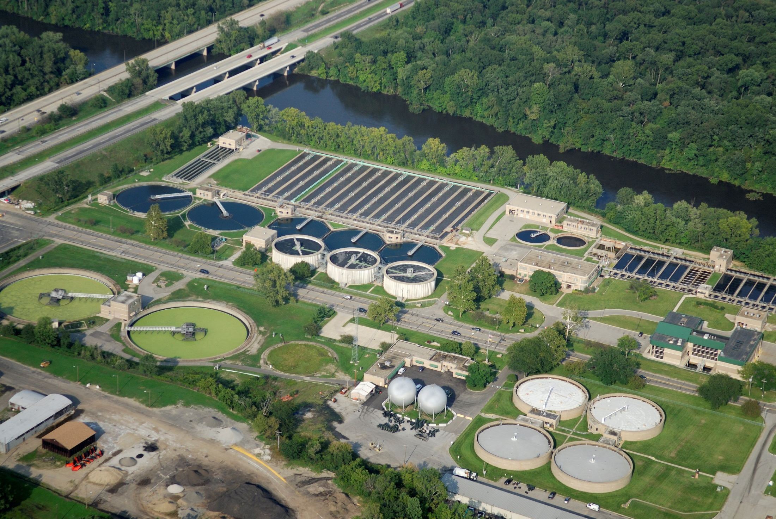
Publicly-Owned Treatment Works (POTW)
Notes:
The most common option is sending collected deicing runoff to a Publicly-Owned Treatment Works, or POTW, for treatment.
There are a distinct advantages to using the POTW option:
Most airports are already connected to a POTW for treatment of sanitary wastewater and deicing runoff can sometimes be discharged into the existing sanitary sewers.
Treatment charges are typically less expensive than other options
Operational requirements are typically limited to managing the flow and loading to the sanitary sewer
However, there are also constraints.
To be feasible, there has to be available treatment capacity at the POTW.
Treatment plant operators are cautious about accepting waste streams that they are unfamiliar with, and must be educated regarding the characteristics of the runoff to be treated.
Some POTWs have strict policies against accepting stormwater, and may refuse to accept deicing runoff for that reason.
Discharges to the sanitary sewer will require coordinated management of flows and loads to avoid negatively impacting POTW operations.

Slide 40
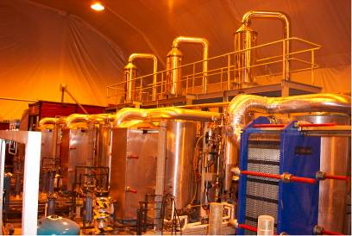
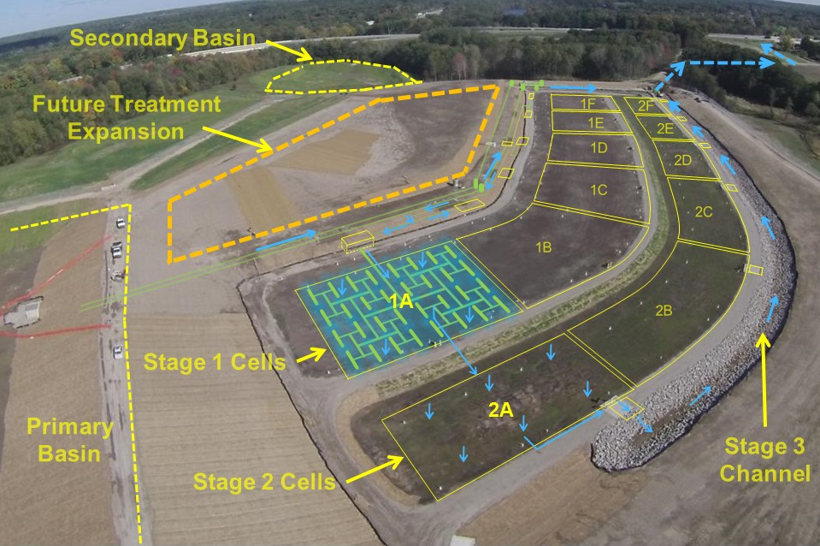
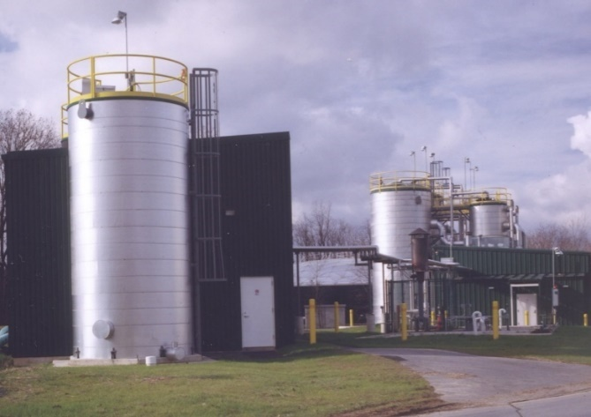
Treatment / Recycling: On-Site Facilities
Notes:
Onsite treatment may be the only option if POTW treatment is not available, or if pre-treatment is required prior to discharge to a POTW.
There are a variety of processes that can be installed and implemented on site for disposing of deicing runoff. These include aerobic and anaerobic biological treatment and glycol recovery.
The lower picture is an anaerobic treatment plant located on the perimeter of an airport.
Where space is available, onsite Natural Treatment Systems, shown in the upper right can provide treatment with lower cost than traditional treatment approaches.
On the upper left is an interior picture of an on-site glycol recovery and recycling plant. Onsite glycol recovery often, but not always involves concentrating the glycol to the point where it can be economically transported to an offsite facility for final processing into pure glycol.

Slide 41

Deicing Runoff Management Systems
Source
Reduction
Collection/
Containment
Storage
Treatment/
Recycling
Notes:
Every airport deicing runoff management system is a combination of BMPs from each of the four categories we’ve learned about.
Just as in a jigsaw puzzle, the each of the categories must be fit with the others for the system to work as a whole.

Slide 42

One Size Does Not Fit All
Notes:
It is important to keep in mind that there is no single “best” approach to managing deicing runoff at all airports. The combination of source controls, collection/containment, and treatment/recycling that works well at one facility may not work at another.
Just as you wouldn’t grab a crowbar from your toolbox to work on your computer, you need to match the right deicing runoff management tools to the specifics at your airport.

Slide 43
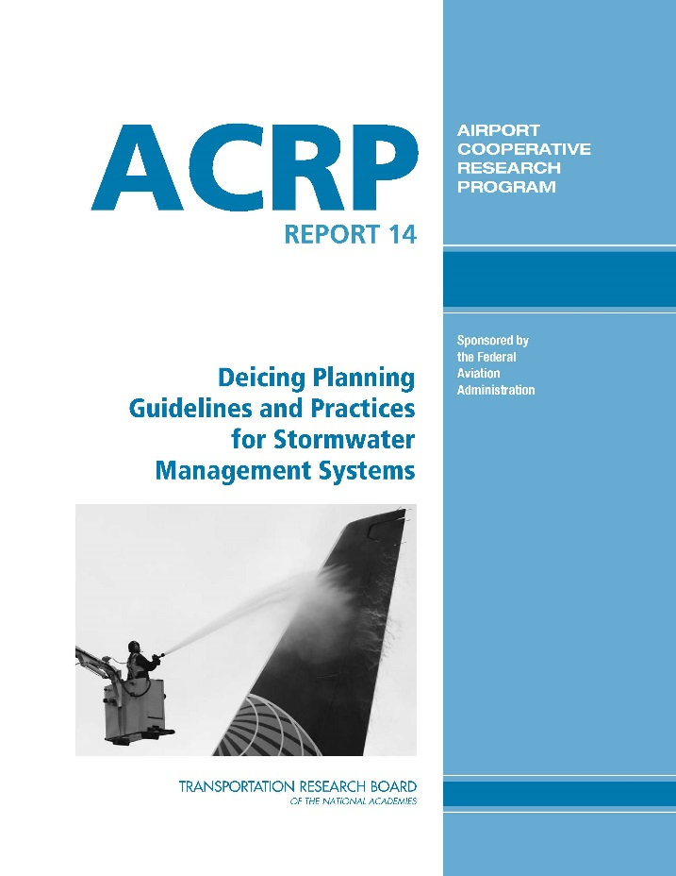
To learn more on this topic
Notes:
To learn more on the topic of planning deicing runoff management programs, refer to the latest edition of ACRP’s “Deicing Planning
Guidelines and Practices for Stormwater Management Systems”

Slide 44
Lesson Summary
In Lesson 2 you learned to:
Define four categories of deicing runoff
Best Management Practices (BMPs)
Identify key BMPs in four categories
Describe how BMPs from each category are combined to create deicing
runoff management systems
Notes:
In Lesson 2 you learned to:
Define the four categories of deicing runoff Best Management Practices, or BMPs
Identify key BMPs in each of the four categories
Describe how BMPs from each of the categories are combined to create deicing runoff management systems
For detailed information on these topics, refer to ACRP Report 14 Deicing Planning Guidelines and Practices for Stormwater Management Systems

Slide 45
Knowledge Check 4
True / False
A basic principle of pollution control is
to first consider opportunities to reduce
the amount of pollutants generated.
Notes:
It’s time for a Knowledge Check. Recall the information you have just covered in the lesson. Let’s begin
True or False
A basic principle of pollution control is to first consider opportunities to reduce the amount of pollutants generated.
Correct Answer: True

Slide 46
Knowledge Check 5
Multiple Choice
Which of the following categories are BMPs in the deicing runoff management toolbox?
Source reduction
Collection/containment
Alternative energy
Treatment/recycling
A, B and D
Notes:
Multiple Choice
Which of the following are categories are BMPs in the deicing runoff management toolbox?
Source reduction
Collection/containment
Alternative energy
Treatment/recycling
A, B and D
Correct Answer: E. A, B and D

Slide 47
Knowledge Check 6
True / False
A well-designed deicing runoff collection system will capture 100% of
the deicers used at an airport.
Notes:
True or False
A well-designed deicing runoff collection system will capture 100% of the deicers used at an airport.
Correct Answer: False

Slide 48
Class Wrap-Up
Notes:
Note to instructor: Correct answers are in bold. (options) You may want to have students fill out a workshop survey and provide a workshop certificate to everyone. The last slide is a certificate if you need one.
Instead of a taking final quiz, let’s wrap-up with a quick discussion of today’s training topics.
1. Multiple Choice: _____ is the primary environmental concern in waters that receive stormwater containing deicers.
___ A. Low dissolved oxygen
___ B. Aquatic toxicity
___ C. Increased salinity
___ D. Reduced ice cover
2. Multiple Choice: The categories of BMPs available in the deicing runoff
management toolbox include:
___A. Treatment/Recycling
___B. Source Reduction
___C. Collection/Containment
___D. all of the above
3. True / False: Urea is the most environmentally friendly airfield pavement deicing product available.
Answer: Urea has the greatest potential for environmental problems among the approved airfield pavement deicers.
4. True / False: Foul odors can be produced when glycols break down in conditions
of low oxygen, such as in airport storm sewers.
5. True / False: Deicers are readily biodegradable and are a rich food source for
microorganisms in the environment.
6. True / False: Some certified aircraft and airfield deicing products have
no implications at all for environmental impact.
7. True / False: Blending to temperature has been found to reduce ADF usage by 30%
or more over the course of a winter season.
8. Multiple Choice: Less than approximately ___ of applied ADF is potentially collectible,
even with the most aggressive efforts.
___ A. 10%
___ B. 25%
___ C. 60%
___ D. 80%
9. True / False: Environmental regulatory compliance requirements related to deicing
are not contained in an airport’s NPDES stormwater discharge permit.
10. True / False: 100% of the deicers applied to aircraft and airfield pavement
make it to a stormwater outfall.

Slide 49
Note:
This certificate is designed to be printed. You should test print on regular paper to ensure proper positioning before printing on card stock.
You may need to uncheck Scale to Fit Paper in the Print dialog (in the Full Page Slides dropdown).
Certificate
This Acknowledges That
___________
Has completed
Managing Deicing Runoff
1.5 Hour ACRP Training
facilitator
Date

