Slide 1
Notes to Instructor
Training is approximately 90 Minutes total -
80 minutes of instruction plus 10 question final quiz as a class discussion
This overview training was created for airport staff who are responsible for stormwater management and regulatory compliance and reporting.
There are Optional slides to “localize” for your airport situation.
Use this slide deck as is, or add more to fit your need.
There are no bullet point transitions, click and see entire screen
Print a Notes Version for your Instructor Guide
Note: The final quiz can be a printed quiz or class discussion.
Course handout (PDF) and certificate (last slide) are optional
Notes:
Notes to Instructor
Training is approximately100 Minutes total –
90 minutes of instruction plus 10 question final quiz as a class discussion
This overview training was created for airport staff who are responsible for stormwater management and regulatory compliance and reporting.
There are three Optional slides to “localize” for your airport situation.
Use this slide deck as is, or add more to fit your need.
There are no bullet point transitions, click and see entire screen
Print a Notes Version for your Instructor Guide
Note: The final quiz can be a printed quiz or class discussion.
Course handout (PDF) and certificate (last slide) are optional

Slide 2
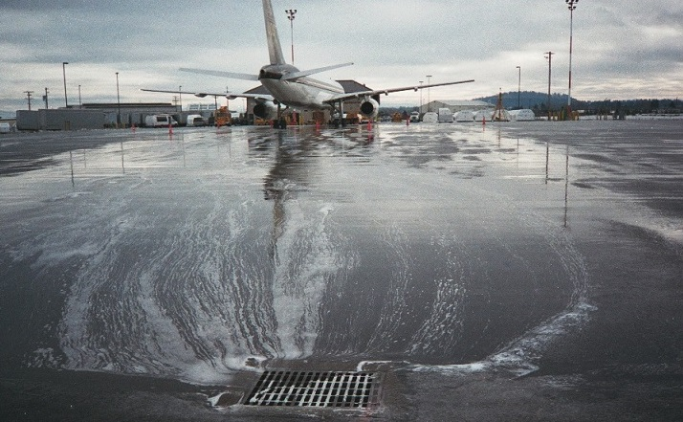
Course 3: Airport Stormwater Plans, Inspections & Reporting
Notes:
In this course there are four lessons in which you will learn about various types of stormwater plans airports may be required to implement and maintain, the interrelation between them and the reporting and inspections required with each plan.

Slide 3
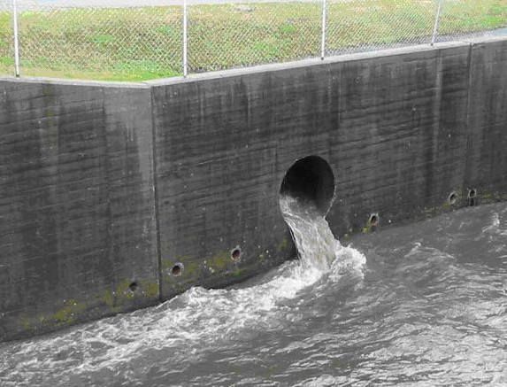
Lesson 1 Objectives
In this lesson you will learn to:
Identify three types of stormwater plans
Define stormwater plan terms:
SPCC, SWPPP, SWMP, NPDES,TMDL, MS4
Compare / contrast to determine instances
where each is required
Notes:
In this lesson you will learn to:
Identify three different types of stormwater plans
Define stormwater plan terms including: SPCC, SWiPPP, SWiMP, NPDES, TMDL, & MS4
Compare and contrast stormwater plan requirements to determine instances where each is required.

Slide 4
Stormwater Plans
Industrial Activities
Construction Activities
NPDES Permitting Program
State
or
EPA
EPA Clean Water Act
Spill Prevention Controls & Countermeasures (SPCC)
Municipal Separate Storm Sewer System (MS4)
Total Maximum Daily Load (TMDL)
Notes:
Stormwater plans are prepared to achieve specific stormwater pollution prevention goals of the airport and comply with various regulatory requirements at the federal, state and local levels. The three types of plans that we will discuss are a spill prevention controls and countermeasures plan or SPCC Plan, a Stormwater Pollution Prevention Plan or “swip” and a Stormwater Management Plan or “swimp”.
The EPA Clean Water Act is the overarching federal law for the SPCC, National Pollution Discharge Elimination System or NPDES, and Total Maximum Daily Load or TMDL programs. The NPDES and TMDL programs are most commonly regulated by state agencies, while EPA administers the SPCC program.
The NPDES program includes 3 permit types that airports are commonly faced with: permits for stormwater associated with industrial activities, permits for stormwater associated with construction activities, and Municipal Separate Storm Sewer System , or MS4, permits for stormwater associated with non-industrial activities.
Next we will describe the stormwater plans that are required under these regulations, starting with Swip.

Slide 5

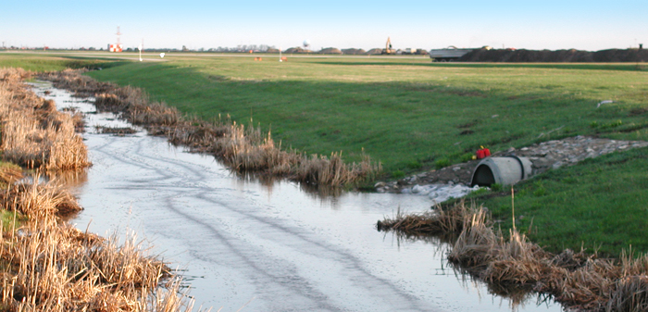
SWPPP: Stormwater Pollution Prevention Plan
Prepared as a regulatory requirement of
Airport’s Industrial Stormwater Permit or
Construction Stormwater Permit
Permits require control measures
SWPPP describes how control measures
are implemented to satisfy the requirements
Notes:
The Stormwater Pollution Prevention Plan, or SWPPP is prepared as a regulatory requirement of an Airport’s NPDES Industrial Stormwater Permit or Construction Stormwater Permit.
The permits contain requirements for measures to prevent pollution to stormwater runoff from industrial activities performed on airports or activities at construction sites.
A SWPPP describes how control measures are implemented to satisfy the permit requirements.

Slide 6

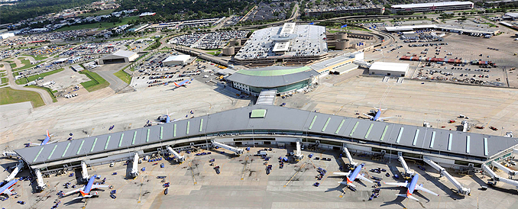
Stormwater Management Plan (SWMP)
SWMP is a regulatory requirement for urban or other areas regulated under Municipal Separate Storm Sewer System (MS4) program
Airports within or designated MS4 may be required to prepare a compliance plan with six minimum controls
Notes:
The second type of stormwater plan we’ll learn about is the Stormwater Management Plan, or SWMP.
A SWMP is prepared as a regulatory requirement for urban or other areas that are regulated under the Municipal Separate Storm Sewer System or MS4 permit program. Airports located within an MS4 permitted municipalities, or designated as an MS4, may be required to prepare a compliance plan with the 6 minimum controls. These will be discussed in more detail in Lesson 3.

Slide 7
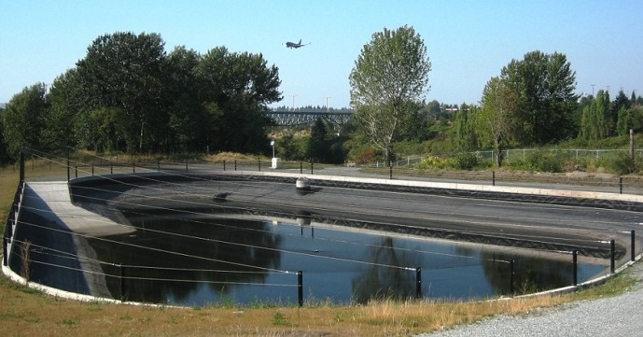
Airport SWPPP & SWMP
Airport SWPPPs and SWMPs can be combined
into one plan
Combining plans is coordinated with regulatory agency overseeing NPDES and municipality if they are
the MS4 permit holder
Notes:
Both SWPPPs and SWMPs address stormwater quality under different parts of the NPDES regulation.
SWPPPs and SWMPs may have overlapping requirements and are sometimes combined into one plan to ease the Airport’s burden of maintaining two separate but closely related documents.
Combining plans is coordinated with the regulatory agency that oversees NPDES permit compliance, as well as the municipality if they are the MS4 permit holder.

Slide 8
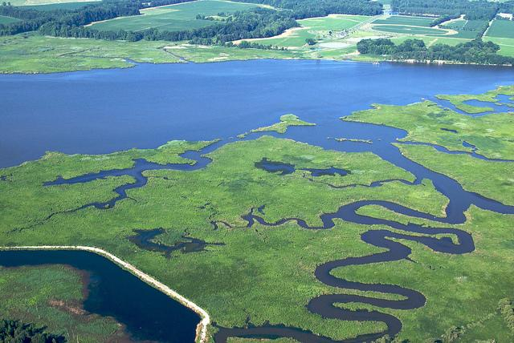
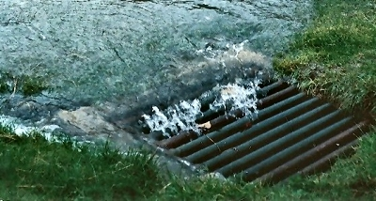
Total Maximum Daily Load (TMDL)
Required by EPA where receiving waters
are listed as impaired
TMDL = Amount of pollutant a
waterbody can receive and still meet
water quality standards
MS4 and NPDES permits tied to TMDL
developed for receiving waterbody
TMDL requirements incorporated as
part of a SWPPP or MS4 SWMP
Notes:
TMDL is the acronym for the Total Maximum Daily Load.
TMDLs are required by EPA where receiving waters are listed as impaired by a state or EPA because they do not meet minimum water quality standards.
A TMDL is the amount of a pollutant a waterbody can receive and still meet water quality standards.
An airport’s MS4 permit and NPDES permits may be tied to a TMDL that’s been developed for the receiving waterbody.
Where TMDL requirements apply, they are incorporated as part of a SWPPP and/or MS4 SWMP. More information on TMDLs can be found at your state agency or the EPA website.

Slide 9
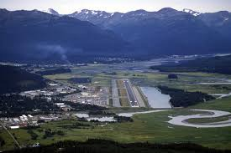
(Localize) SWPPP, SWMP, or Both?
Replace this slide with local information
and local picture
Notes:
NOTES
Replace this slide with information about your local airport stormwater
Is your airport required to have a SWPPP, SWMP or both?

Slide 10
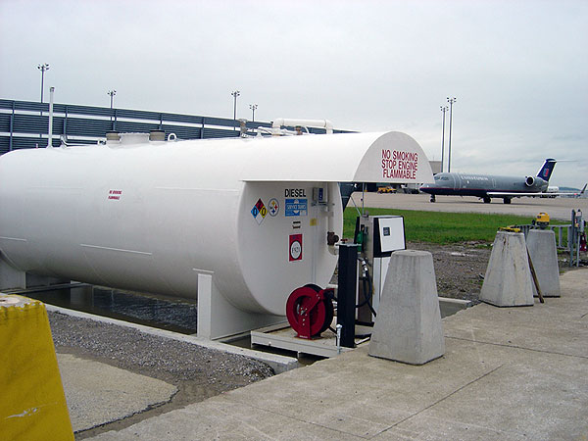
SPCC Plan
SPCC plan required by EPA when airport and/or tenants store oil and/or fuel on-site that exceed
  Above Ground 1,320 gal
  Below Ground 42,000 gal
SPCC establishes control /response
procedures to mitigate impact of a spill
Notes:
The last stormwater plan we will discuss in this lesson is an SPCC plan, which is required by the EPA when an airport and/or its tenants store volumes of oil and/or fuel on-site that exceed certain minimums.
For above ground facilities, the minimum is 1,320 gallons, while the minimum for below ground tanks is 42,000 gallons.
Exceeding either volume triggers the need for an SPCC plan.
The SPCC plan establishes control and response procedures to mitigate the impact of a spill if it occurs

Slide 11
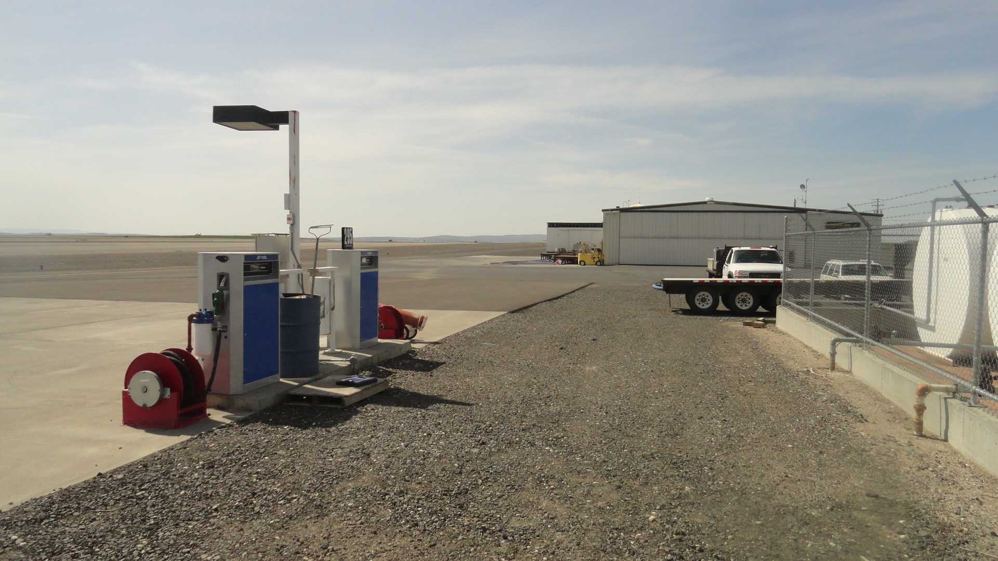
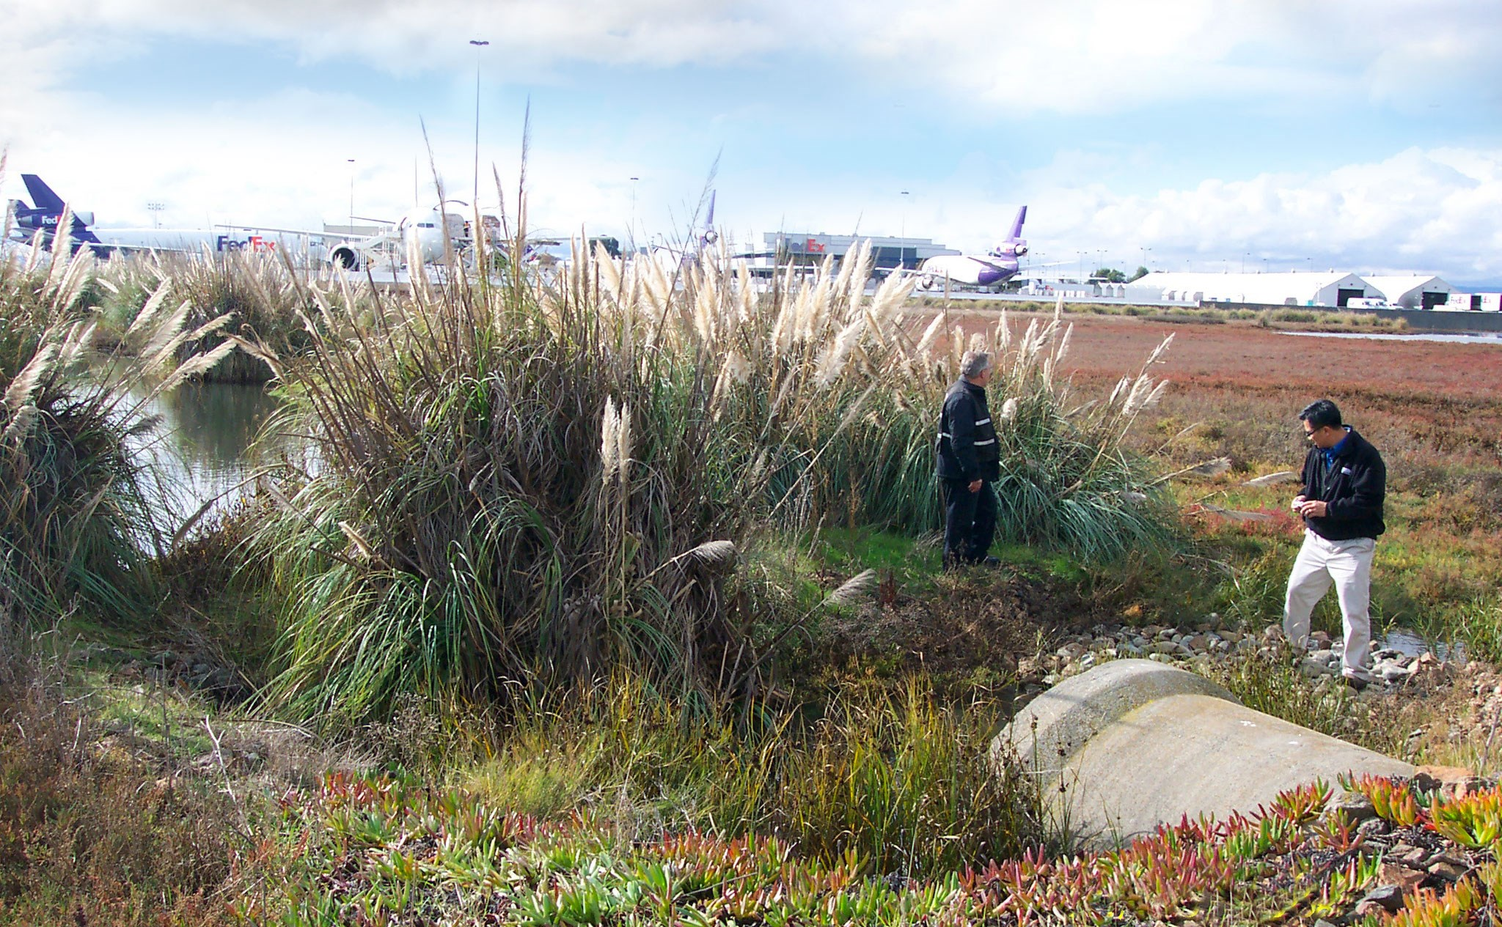
SPCC Plan Overlap with SWPPP, SWMP, NPDES
SPCC plans may overlap with SWPPP or SWMP plans
SPCC covered under Code of Federal Regulations, separate from NPDES
SPCC plans are usually not combined with
SWPPP or SWMP
Notes:
SPCC plans may have some overlap with SWPPP or SWMP plans.
However, because SPCC plans are covered under the Code of Federal Regulations, they are separate from NPDES program requirements.
For this reason, SPCC plans are usually not combined with either the SWPPP or SWMP.

Slide 12

Knowledge Check 1
Stormwater plans comply with which type of regulatory requirement?
Federal
State
Local
All of the above
Notes:
It’s time for a Knowledge Check. Recall the information you have just covered in the lesson
Multiple Choice
Stormwater plans comply with which type of regulatory requirement:
Federal
State
Local
All of the above (correct)

Slide 13
Knowledge Check 2
True / False
SWPPPs and SWMPs can often be combined into one stormwater plan with consent from the regulatory agency.
Notes:
True / False
SWPPPs and SWMPs can be combined into one stormwater plan with consent from the regulatory agency.
True (Correct answer)

Slide 14
Knowledge Check 3
SPCC stands for:
Spill Protection of Coal Carts
Stormwater Protection Control and Carts
Spill Prevention Controls and Countermeasures
SPills Can be Controlled
Notes:
Multiple Choice
SPCC stands for:
Spill Protection of Coal Carts
Stormwater Protection Control and Carts
Spill Prevention Controls and Countermeasures
Spills Can be Controlled

Slide 15
Lesson 2: Stormwater Pollution Prevention Plans
Notes:
In lesson 2 we will examine airport Stormwater Pollution Prevention Plans in depth.

Slide 16
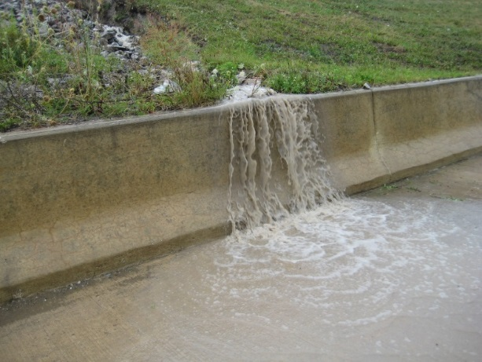
Lesson 2 Objectives
In this lesson you will learn to:
Identify five SWPPP components
Describe SWPPP Inspections & Reporting
Identify the six essential practices of SWPPP
Notes:
In lesson 2 you will learn to:
Identify five key SWPPP components
Describe SWPPP Inspections & Reporting
Identify six essential practices of SWPPP

Slide 17
Stormwater Pollution Prevention Plan (SWPPP)
Industrial Activities
Construction Activities
NPDES Permitting Program
SWPPP
Notes:
Recall that a SWPPP or Stormwater Pollution Prevention Plan is prepared as a regulatory requirement of the Airport Industrial Stormwater Permit or a Construction Stormwater Permit.

Slide 18

Industrial SWPPP Overview
Required when these activities occur:
Service, maintain, or repair aircraft or GSE
Equipment cleaning and maintenance
Deicing/anti-icing operations
Purpose: Identify potential sources of
stormwater pollution, describe measures
to minimize stormwater pollution
Notes:
Industrial NPDES permits and SWPPPs are required at airports that perform certain activities that could pollute stormwater such as:
Servicing, repairing, or maintaining aircraft and ground support equipment or GSE;
Equipment cleaning and maintenance, which includes vehicle and equipment repairs, painting, fueling, and lubrication; and
Deicing/anti-icing operations.
The purpose of an Industrial SWPPP is to identify potential sources of stormwater pollution from these specific industrial activities and describe the measures that are being taken to minimize associated stormwater pollution.

Slide 19
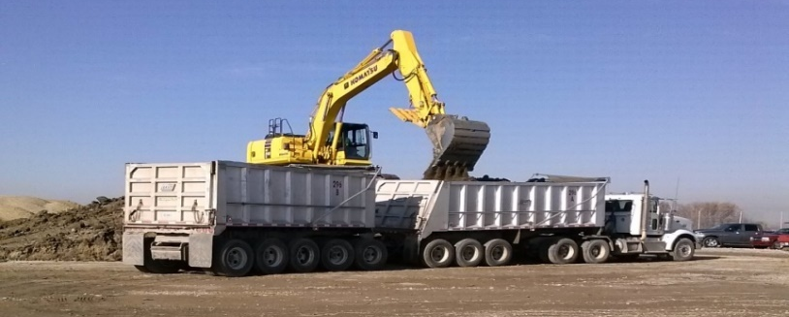
Construction SWPPP Overview
Required when: Project is greater than 1 acre
Purpose: identify potential sources of stormwater pollution associated with construction activities and describe the measures that are being taken to
Duration: length of the project
Notes:
A construction stormwater permit and SWPPP are required when the project disturbs an area greater than 1 acre. Some state and local jurisdictions may have smaller site size thresholds for when a permit and SWPPP is required.
The purpose of the construction SWPPP is to identify potential sources of stormwater pollution associated with construction activities and describe the measures that are being taken to minimize stormwater pollution.
Sediment from soil erosion is typically the main pollutant of concern, but the SWPPP must also address concrete washout, fuel and oil spill potential and other site specific requirements
A construction SWPPP is in effect only for the duration of the construction project.

Slide 20
Localize for Your Airport (Optional)
Replace this slide to give a facility desciption
Notes:
Your airport Industrial SWPPP may already be prepared. The Industrial SWPPP is a plan the Airport follows and is typically renewed every 5 years.

Slide 21
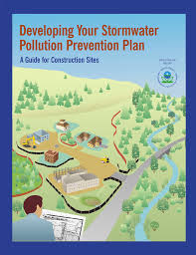
SWPPP: Five Major Elements
  Pollution Prevention Team Identification
  Facility Description
  Potential Pollutant Sources
  Control Measures Best Management Practices BMPs
  Schedules and Procedures
  In EPA regulated states, SWPPP must identify
  and document historical / endangered species
Notes:
There are five major elements common to both Industrial and Construction permit SWPPPs. These are:
Pollution Prevention Team Identification
Facility Description
Potential Pollutant Sources
Control Measures (BMPs)
Schedules and Procedures
In EPA regulated states and territories, the SWPPP must also identify and document historical and endangered species.
Now let’s look at each of the five SWPPP elements.

Slide 22
SWPPP: Five Major Elements
  Pollution Prevention Team Identification
Airport
Airport Staff
Airport Tenants
Contractor
Industrial Permit
Construction Permit
Notes:
The pollution prevention team consists of the individuals responsible for creating, implementing and updating the SWPPP. The roles and responsibilities of each team member must be outlined in the plan.
The pollution prevention team for an industrial SWPPP consists of the Airport itself; the Airport on behalf of its tenants; and tenants for themselves.
The pollution prevention team for construction SWPPPs is often one person in charge of overseeing implementation of BMPs, oversee operations and conduct routine inspections

Slide 23
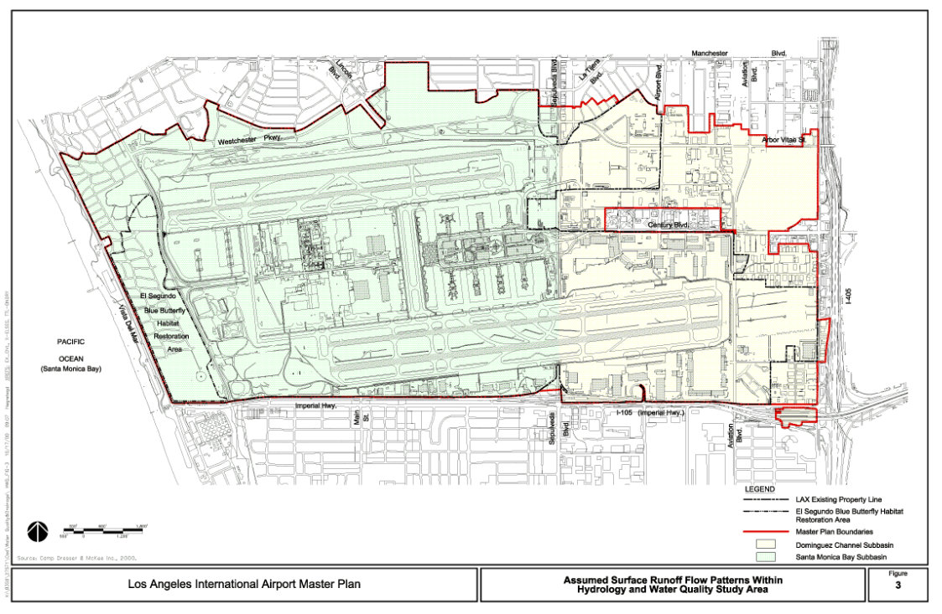
(Localize) SWPPP Site Map
Localize for your airport
Notes:
NOTE: Instructor may want to substitute local airport SWPPP site map on this and the next slide
A facility description section contains a description of the activities and locations of inspections and management practices. A site map is typically included as part of the facility description and includes locations for inspections, stormwater outfalls, drainage areas, places on the site where industrial activities occur and best management practices or BMPs to prevent stormwater pollution.

Slide 24
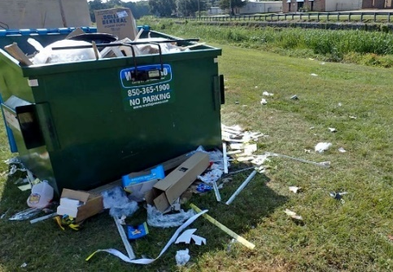
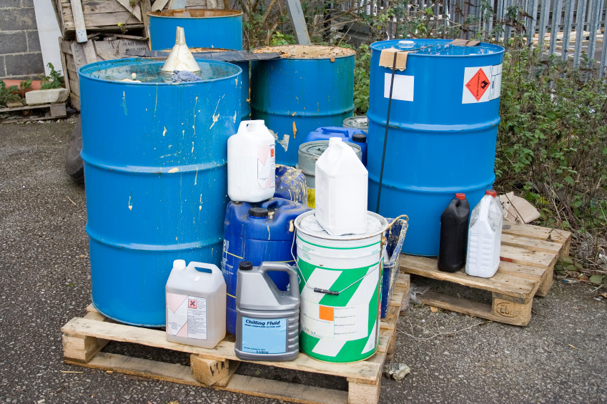
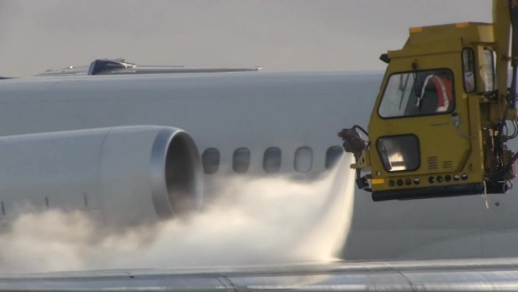

Potential Pollution Sources
Pollution Sources describes activities at airport that could contribute pollutants to stormwater, such as:
Oil or chemical storage
  Aircraft maintenance and fueling
  Waste management
  Aircraft deicing
  Lavatory waste transfer
  Vehicle wash racks
Notes:
The pollution sources section of the SWPPP describes the types of activities at the airport that could contribute pollution to stormwater runoff. Examples of industrial activities that could be pollutant sources include:
Oil or chemical storage
Aircraft maintenance and fueling
Waste management
Aircraft deicing
Lavatory waste transfer
Vehicle wash racks

Slide 25
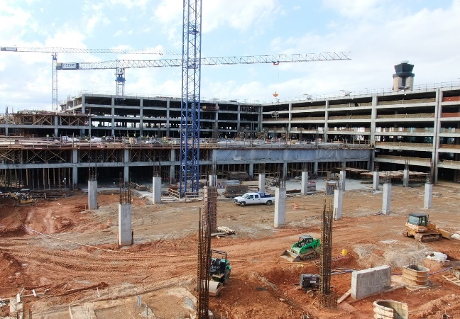
Construction SWPPP
Activities could contribute pollutants to stormwater:
  Land disturbance – sediment
  Concrete washout
  Paving operations
  Equipment maintenance and fueling
  Dewatering operations
  Material and vehicle storage
  Waste materials
Notes:
Potential Pollution Sources section of the Construction SWPPP describes the various types of activities at construction sites that could contribute pollution to stormwater, such as:
Land disturbance, with causes sediment from erosion. This is the main pollutant of concern from construction project sites.
Examples of other potential pollutant sources from construction sites include:
Concrete washout and paving operations
Equipment maintenance and fueling
Dewatering operations
Material and vehicle storage
Waste materials handling

Slide 26
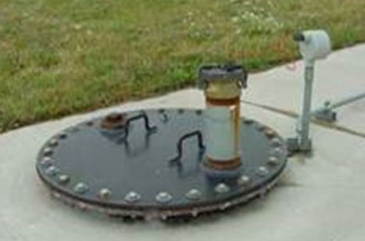
Control Measures or BMPs
Control Measures or BMPs are actions, practices, or structural controls that minimize pollutants from
airport stormwater
BMPs implemented to control pollutants include:
Structural controls: Oil/water separators
Non-structural controls: policies, SOPs,
and Good Housekeeping practices
Notes:
Control measures or Best Management Practices are actions, practices or structural controls designed to minimize pollutants from entering the airport stormwater system.
Once the pollutant sources are identified in the SWPPP, this section describes the BMPs implemented to control those pollutants.
BMPs may include
structural controls such as oil/water separators and other types of treatment devices, and
non-structural controls such as policies, standard operating procedures, and Good Housekeeping practices.

Slide 27
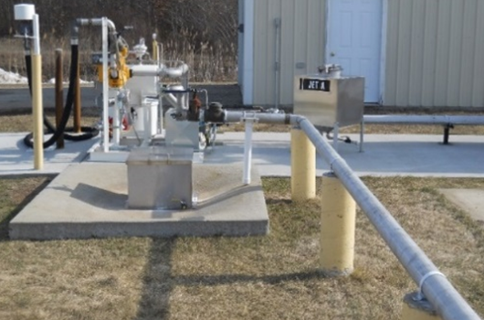
SWPPP Schedules and Procedures
  Inspections of BMPs and outfalls
  Monitoring of stormwater where permit requires operation and maintenance of BMPs
  Periodic SWPPP review for permit compliance
  SWPPP updates
Notes:
The Schedules and Procedures section identifies when and how the following activities will be conducted:
Inspections of BMPs and outfalls,
Monitoring of stormwater where the permit requires operation and maintenance of the BMPs
Periodic review of the SWPPP for compliance with the permit, and
SWPPP updates that may be required
Routine facility inspection intervals and quarterly visual assessment of stormwater outfalls are spelled out in this section and are key to making sure the requirements of the SWPPP are being carried out. Routine inspections and monitoring are critically important activities in permit and plan compliance.

Slide 28
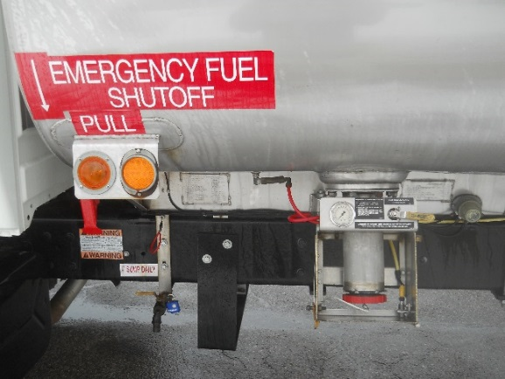
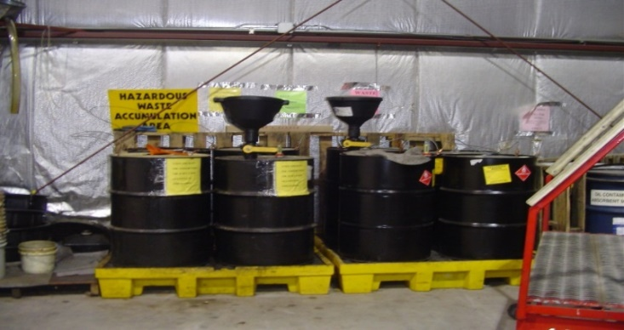
Schedules and Procedures: Industrial Permit
Operation and Maintenance plan for structural controls
Plan of inspections for non-structural controls
and good housekeeping practices
Spill prevention/Response procedures
Schedule for employee training,
monitoring and updating of report
Notes:
The main items to be covered under schedules and procedures specific to an industrial permit are:
Operation and Maintenance plan for structural controls
Plan of inspections for non-structural controls, and good housekeeping practices
Spill prevention and response procedures
A schedule for employee training, monitoring and updating of the report

Slide 29
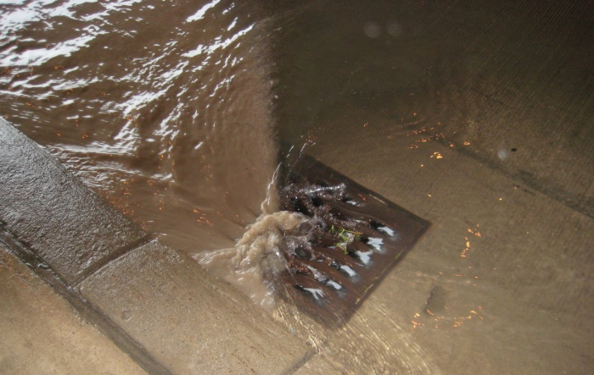
Schedules and Procedures: Construction
  Project schedule and phasing must be identified with timing of installation of each control measure
Inspection intervals are specified and assigned
to appropriate person
  Updates required if deficiencies observed
Notes:
In a construction SWPPP, the project schedule and phasing must be identified along with the timing of installation of each control measure.
Inspection intervals are specified and assigned to the appropriate person.
Updates to a construction SWPPP are required if deficiencies in pollution control are observed. For example, if the site has excessive erosion or has an unacceptably muddy discharge after rain events, additional erosion control practices may need to be installed and then documented in the SWPPP.

Slide 30
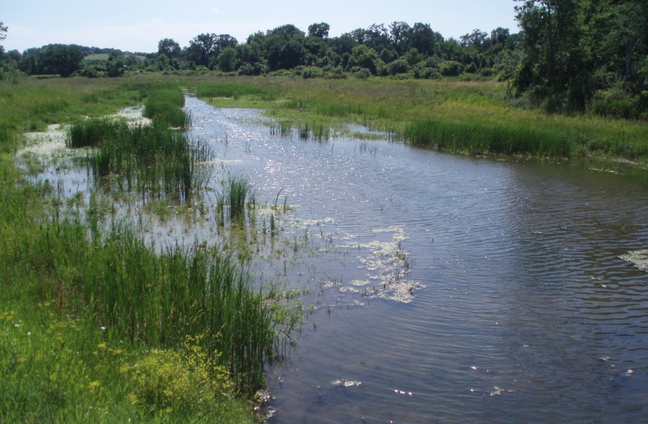
SWPPP: Inspections and Reporting
Inspections and reporting are set by the
Schedules and Procedures section of the SWPPP
Inspections carried out at regular intervals
by a qualified individual
Qualified stormwater inspector knows
what to look for and can help identify
potential issues with control practices
Notes:
Once the SWPPP is created, it should be implemented by the Airport or responsible tenant or construction contractor.
Inspections and reporting requirements are set by the Schedules and Procedures section of the report.
Inspections should be carried out at regular intervals by a qualified individual.
A qualified stormwater inspector knows what to look for and can help identify potential issues with control practices on the Airport.

Slide 31
Stormwater Inspections
General Inspections
Construction
SWPPP
Airport Industrial SWPPP
Illicit Discharge Inspections
Notes:
Stormwater inspections occur at various times through the year and are timed to coincide with the various regulated activities taking place at the airport.
The two types of stormwater inspections are:
General inspections, which are conducted for construction site and Industrial SWPPPs, and
Illicit discharge inspections, which are typically conducted only for the Industrial SWPPP.

Slide 32
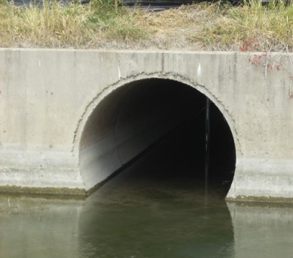
General Inspections
Outfall inspections conducted to visually
identify stormwater pollution
Inspections of Good housekeeping practices including proper material storage and
secondary containment
Observed evidence of pollutants in runoff is
investigated and addressed
Notes:
General inspections include:
Outfall inspections conducted to visually
identify evidence of stormwater pollution
Inspections of good housekeeping practices, including proper material storage and secondary containment
Observed evidence of pollutants in runoff should be investigated and addressed

Slide 33
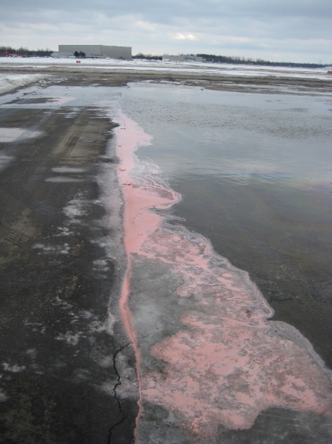
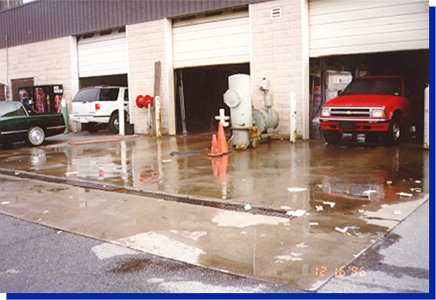
Illicit Discharge Inspections
Identify pollution from non-stormwater sources:
Visually identify evidence of stormwater pollution
Sampling may be required for further investigation
One inspection per reporting period
Notes:
Illicit Discharge inspections are conducted to identify pollution from non-stormwater sources.
Visual inspections identify evidence of pollution, such as unusual color or odor in the water.
Sampling may be required to further investigate visual evidence and track down the source of pollution.
At least one inspection per reporting period should take place during a period when there is no stormwater runoff. This timing is important because you are more likely to see contributions from illicit discharges under low flow conditions.
Any observed evidence of pollutants in runoff should be investigated and addressed.

Slide 34
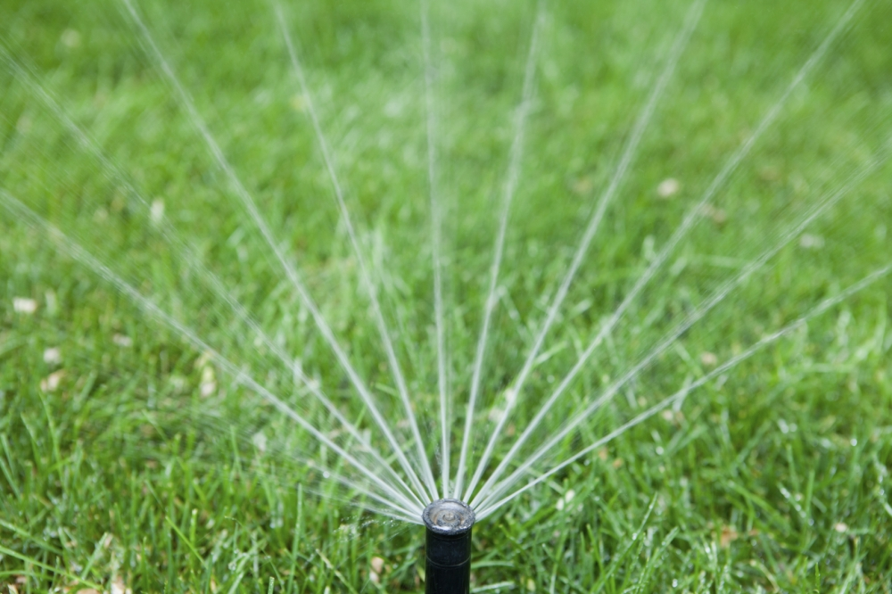
Illicit Discharge Inspections
Any discharges to stormwater conveyance system
not entirely composed of storm water,
except those allowed under NPDES permit:
Hydrant flushing water,
Landscaping watering
Building foundation drains
  Firefighting water
  Wash water with no detergents
  Landscaping watering
  Building foundation drains
Allowable discharge
Notes:
Illicit discharges are any discharges to the stormwater conveyance system that are not entirely composed of storm water, except for those that are allowed under the NPDES permit such as:
Hydrant flushing water,
landscaping watering and
building foundation drains.
Note that vehicle wash water is not an allowable discharge.

Slide 35
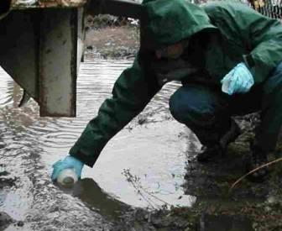
Monitoring Permitted Stormwater Outfalls
  Monitoring permitted stormwater outfalls is a requirement of most industrial stormwater permits
  Confirm Airport’s BMPs are operating correctly, determine if additional measures are needed
  Monitoring: visual observations, field
  measurements, lab samples for analysis
  Monitoring can be a requirement for
  construction stormwater permits depending
  on jurisdiction where airport is located
Notes:
Monitoring of permitted stormwater outfalls is a requirement of most Industrial stormwater permits. The purpose is to confirm that the airport’s BMPs are operating correctly, and help to determine if additional measures are needed to protect water quality.
Monitoring can include visual observations, field measurements, and collection of samples for laboratory analysis.
Monitoring can also be a requirement for construction stormwater permits, depending on the jurisdiction where the airport is located.

Slide 36
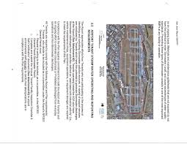
Annual Report to Permitting Agency
Annual industrial permit reporting consists of:
Inspection logs, Monitoring results, Deicer usage
Changes to Airport during reporting period
Updates to control practices, glycol management
or oil/water separators
Where permit discharge benchmarks or limits are exceeded, additional reporting may be required
Not common to have reporting for construction permits
Notes:
Reporting requirements for the Airport’s Industrial Permit commonly take the form of an annual report to the permitting agency.
Annual industrial permit reporting typically consists of:
Inspection logs and monitoring results
deicer usage,
changes to the airport during the reporting period and
updates to control practices such as the glycol management system or oil/water separators.
In instances where permit discharge benchmarks or limits are exceeded, additional reporting may be required to investigate the cause and confirm that its been addressed through corrective measures.
It is not common to have reporting for construction permits, unless requested by the permit agency.

Slide 37
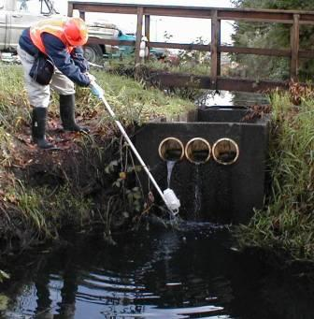
Six Essential Practices of Industrial SWPPP Management
Responsible staff aware of the SWPPP
Annual training for staff
Inspect facilities annually or more frequently if required
Modify plan as changes take place
Report to regulatory agency
Maintain records
Notes:
With the knowledge you have gained through learning the fundamentals of a SWPPP, you should now know the six essential practices of SWPPP management. They include:
Ensure that responsible staff are aware of the SWPPP
Hold annual training for staff
Inspect facilities annually or more frequently if your permit requires
Modify plan as changes take place at the Airport
Report to regulatory agency
And Maintain records

Slide 38
Lesson 2 Summary
In summary, in this lesson you learned to:
Identify five key SWPPP components
Describe SWPPP Inspections & Reporting
Identify six essential practices of SWPPP
Notes:
In summary, in lesson 2 you learned to:
Identify five key SWPPP components
Describe SWPPP Inspections & Reporting
Identify six essential practices of SWPPP

Slide 39
Knowledge Check 4
Multiple Choice:
Stormwater pollutants come from a variety of sources at an airport including:
Vehicle and aircraft maintenance
Spills or illegal dumping
Deicing
All of the above
Notes:
It’s time for a Knowledge Check. Recall the information you have just covered in the lesson
Multiple Choice
Stormwater pollutants come from a variety of sources at an airport including:
Vehicle and aircraft maintenance
Spills or illegal dumping
Deicing
All of the above (correct)

Slide 40
Knowledge Check 5
True / False
Sediment in runoff from construction projects is a main pollutant of concern in construction permits.
Notes:
True / False
Sediment in runoff from construction projects at airports is a main pollutant of concern in construction permits.
True

Slide 41
Knowledge Check 6
True / False
Vehicle wash water is considered an illicit discharge.
Notes:
True / False
Vehicle wash water, when detergents are used, is considered an illicit discharge.
True (Correct)

Slide 42
Lesson 3: Stormwater Management Plan (SWMP)
Notes:
Welcome to lesson 3, in this lesson we will discuss the need for a stormwater management plan or swimp and discuss the overlap with the industrial permit stormwater pollution prevention plans.

Slide 43
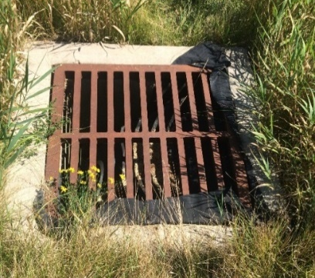
Lesson 3 Objectives
In this lesson you will learn to:
Define MS4 Stormwater Permitting Program
Identify six minimum control measures
Identify overlap between SWMP and SWPPP
Notes:
In this lesson you will learn to:
Define the MS4 Stormwater Permitting Program
Identify six minimum control measures and other considerations
And Identify the overlap between an MS4 stormwater management plan and an Industrial Permit stormwater pollution prevention plan

Slide 44
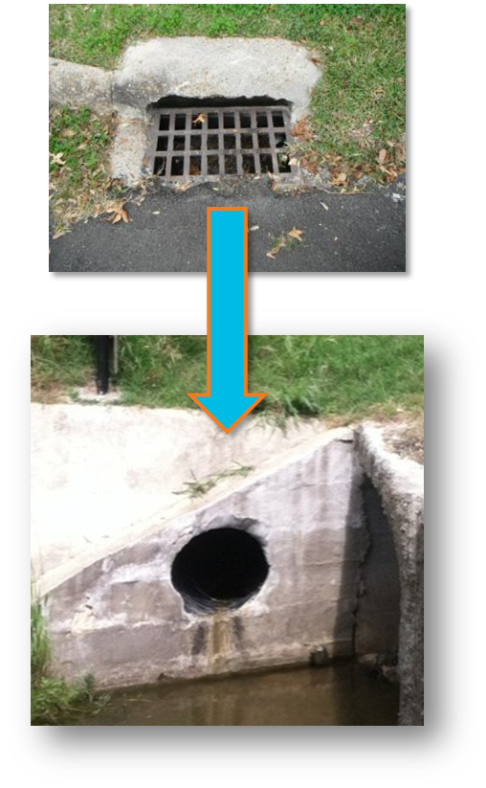
What is an MS4?
Municipal Separate Storm Sewer System (MS4) conveyance system operated by a local government or public entity and is:
Designed for collecting/conveying storm water
Not a combined sewer or public wastewater facility
Most designated MS4s serve urban areas or
urban clusters, but airport systems may
also be designated MS4s
Notes:
A Municipal Separate Storm Sewer System, or MS4 is defined as: A conveyance or system of conveyances that is owned or operated by a State or local government entity that discharges to the Waters of the U.S. and is:
Designed for collecting and conveying storm water
Not a combined sewer
Not part of a Publicly Owned Treatment Works or public wastewater facility
Most designated MS4s serve urban areas or urban clusters, but certain non-traditional systems, including airports, may also be designated as an MS4.

Slide 45
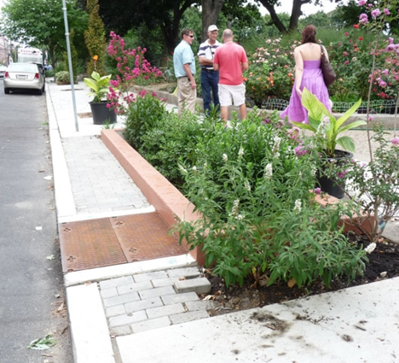
SWMP and MS4: Stormwater Management Plan
Airports may need to manage non-industrial stormwater
regulated under MS4
MS4s are required to develop / implement a
stormwater management program,
documented in a SWMP
Goal of SWMP:
Reduce contamination of stormwater runoff
Prohibit illicit discharges
Notes:
If an airport falls under the MS4 program, it may need to manage non-industrial stormwater in addition to stormwater associated with industrial activities, .
MS4s are required to develop and implement a stormwater management program, documented in a Stormwater Management Plan (SWMP)
The goal of the SWMP is to reduce the contamination of stormwater runoff and prohibit illicit discharges. This is also the main goal of the Airport’s Industrial SWPPP.
It should also be noted that the plan prepared for construction NPDES permits is sometimes also called a stormwater management plan instead of a SWPPP.

Slide 46
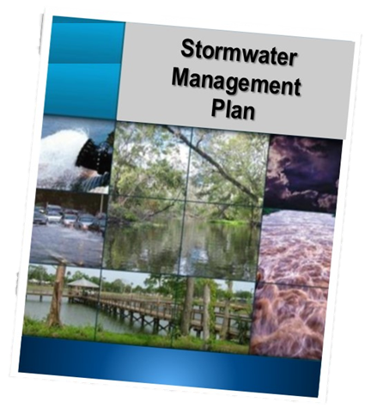
MS4 SWMP
MS4 permittee must develop and implement a SWMP
  Establish and implement best management practices (BMPs) that satisfy 6 min control measures (MCMs)
  Establish and implement a stormwater
  monitoring program
  Develop measurable goals for program
  Evaluate effectiveness of program
Notes:
Each MS4 permittee must develop and implement a SWMP.
The SWMP must accomplish the following:
Establish and implement best management practices, or BMPs, that satisfy 6 minimum control measures, or MCMs.
Establish and implement a stormwater monitoring program
Develop measurable goals for the program
Evaluate the effectiveness of the program
There may be a lot of overlap between the SWMP and SWPPP requirements.
Next we will look at the six minimum control measures that are required by MS4 permits.

Slide 47
Six Minimum Control Measures
Public Education and Outreach
Public Participation/Involvement
Illicit Discharge Detection and Elimination
Pollution Prevention/Good Housekeeping
Construction Site Runoff Control
Post Construction Runoff Control
Notes:
The SWMP must contain six minimum control measures for managing stormwater pollution.
The six controls are:
Public Education and Outreach
Public Participation/Involvement
Illicit Discharge Detection and Elimination
Pollution Prevention/Good Housekeeping
Construction Site Runoff Control
Post Construction Runoff Control
Additional control measures may be required by the permitting authority, such as other reporting, drainage basin mapping, or a schedule of compliance.
We’ll now take a closer look at these measures and discuss the overlap with the Airport’s Industrial SWPPP. Some airports that are required to prepare in Industrial SWPPP and an MS4 SWMP may choose to combine them into one plan because there is overlap with some of the requirements. Combining of plans is typically done with consent of the permitting authority.

Slide 48
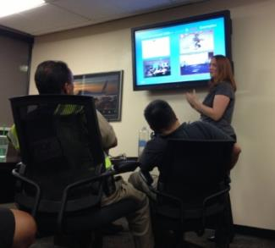
1. Public Education and Outreach
Informed and knowledgeable community is crucial to the success of a stormwater management program
Industrial
Permit
SWPPP
MS4
SWMP
Airport Staff and Tenant Training
Notes:
The first minimum control measure in the MS4 SWMP is public education and outreach.
An informed and knowledgeable community is crucial to the success of a stormwater management program since it helps to ensure greater support and compliance for the program.
The public’s role at an airport differs from the public’s role in a municipal setting. There are two distinctly different components to the “public” at an airport.
The most influential group in terms of impacts on stormwater is the people who work at the airport.
The other group is the traveling public that use the airport.
Airports must train staff and tenants so they are informed of the goals of the Industrial SWPPP and the MS4 SWMP. The training program outlined in the Schedules and Procedures section of the SWPPP typically covers this control measure.
For the traveling public, the focus is typically limited to building awareness of the airport’s stormwater management programs, and how the traveling public can support the program goals.
Details may be added to this section of the SWPPP to address any additional unique public education components related to the MS4 SWMP.
The remainder of the information on public outreach and education focuses on the community of people who work at the airport.

Slide 49
2. Public Involvement and Participation
Active community is crucial to success of a SWMP
Industrial
Permit
SWPPP
MS4
SWMP
Airport Staff and Tenant Training
Airport Staff and Tenant Staff
Notes:
An active and involved community is crucial to the success of a stormwater management program. The intent behind public participation is for all to take a stake in reducing pollution to stormwater runoff. At the airport, this is part of training and making airport and tenant staff aware that it is their responsibility and their job to help o prevent stormwater pollution.
The Schedules and Procedures section of the SWPPP typically covers this control measure.

Slide 50
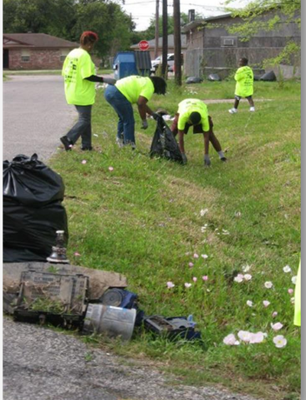
2. Public Involvement and Participation
  Beyond what’s covered in the SWPPP, the airport can take additional actions to involve the pubic by:
  Surveying tenants
  Checking in with municipal MS4 permit manager
  Participating in outreach events and
  community cleanups
Notes:
Beyond what’s covered in eth SWPPP, the airport can take additional actions to involve the public, such as:
Tenant surveys
Checking in with municipal MS4 permit manager to see if there is anything the Airport can do to participate in the public participation plan
Participating in outreach events and community cleanups

Slide 51
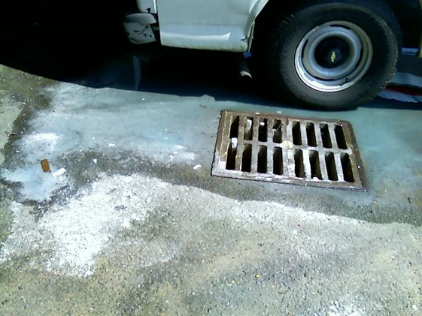
3. Illicit Discharge Detection and Elimination
“...any discharge …that is not composed
entirely of stormwater...”.
Industrial
Permit
SWPPP
MS4
SWMP
Illicit Discharge Program
Notes:
The third minimum control measure is Illicit Discharge Detection and Elimination
As a reminder, an illicit discharge is “...any discharge …that is not composed entirely of stormwater...” or a discharge from explicitly authorized activities. An example of an authorized non-stormwater discharge is condensate from air conditioning units.
The illicit discharge inspection schedule and procedures outlined in the Schedules and procedures section of the Industrial SWPPP can cover this MS4 control measure as long as it includes non-industrial areas of the airport.

Slide 52
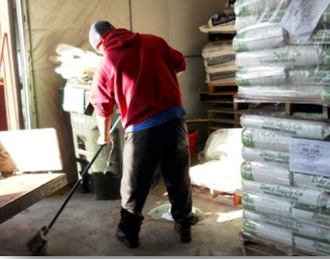
4. Pollution Prevention: Good Housekeeping
Implement pollution prevention / good housekeeping to minimize contamination of stormwater discharges
Inspection and maintenance of stormwater
system and controls
Industrial
Permit
SWPPP
MS4
SWMP
Control Measures/BMPs
Notes:
The fourth minimum control measure is Pollution Prevention through Good Housekeeping practices.
The key requirements here are:
Implement a program of pollution prevention/good housekeeping to ensure existing operations minimize contamination of stormwater discharges
Conduct inspection and maintenance of stormwater system and controls.
This minimum control measure is covered in the Management Practices section of the Industrial SWPPP. The inspection topic is typically covered in the Schedules and Procedures section of the Industrial SWPPP.

Slide 53

5. Construction Site Stormwater Runoff
Permits for discharge of pollutants from construction sites ≥ 1 acre in size typically by state or local agency
Airport can:
Address control of site waste (i.e. discarded building materials, concrete truck washout water, chemicals, litter, sanitary waste)
Educate contractor staff on the importance of sediment control from construction sites
Notes:
The fifth minimum control measure is Construction Site Stormwater and Runoff Controls.
Permits for construction site stormwater discharges are usually issued by state agencies or local municipalities. Airports do not typically create additional requirements in a SWMP, but can create policies that require the control of construction site waste such as building material disposal, concrete wash water and other debris.
The Airport can:
Address control of site waste (i.e. discarded building materials, concrete truck washout water, chemicals, litter, sanitary waste).
Educate construction contractor staff on the importance of sediment control from construction sites.
If the Industrial SWPPP and MS4 SWMP are combined, an additional section could be added to discuss policies the airport has for control or monitoring of potential pollutants to stormwater from construction projects.

Slide 54
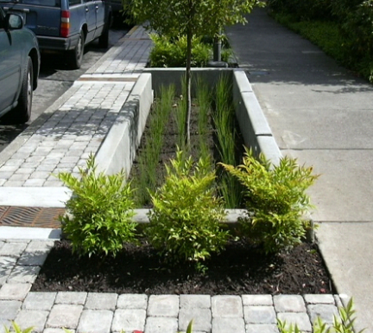
6. Post Construction Stormwater Management
Industrial
Permit
SWPPP
MS4
SWMP
Control Measures/BMPs
Notes:
The sixth minimum control measure is Post Construction Stormwater Management
This control measure is typically covered in the control practices section of the Industrial SWPPP.
Coordinate with your local regulators to confirm that the measures in place satisfy the post construction stormwater management goals of the MS4 Permit.

Slide 55
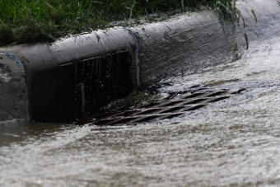
Other Considerations
TMDL requirements specific to receiving waterbodies
Local jurisdictional requirements
Discussions with local agencies is
highly recommended
Notes:
There are other factors that may impact SWMP requirements, for example:
TMDL requirements that are specific to receiving waterbodies. These would take the form Measures and controls.
Local jurisdictional requirements.
Discussions with local agencies responsible for these types of requirements is highly recommended.

Slide 56
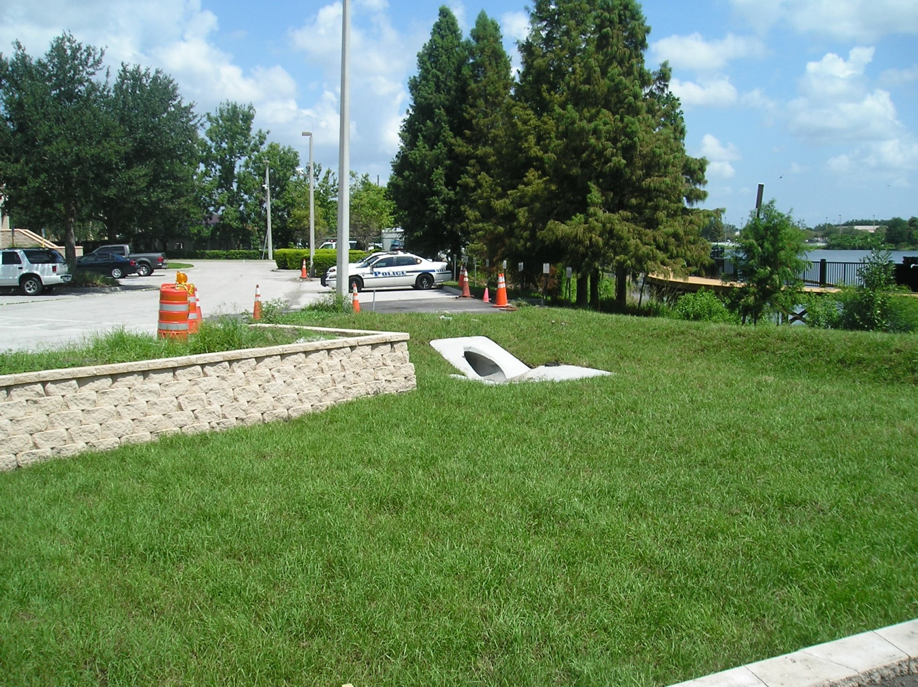
Lesson 3 Summary
Define MS4 Stormwater Permitting Program
Identify six minimum control measures
Identify overlap between
SWMP and SWPPP
Notes:
In summary in lesson 3 you learned to:
Define MS4 Stormwater Permitting Program
Examine the Components of a SWMP Plan
Identify six minimum control measures and other considerations
And Describe Essentials Practices of a SWMP

Slide 57
Knowledge Check 7
Under the ____ Program, MS4s are required to develop and implement a stormwater management program.
SPCC
TMDL
NPDES
All of the above
Notes:
It’s time for a Knowledge Check. Recall the information you have just covered in the lesson
Multiple Choice
Under the ____ Program, MS4s are required to develop and implement a stormwater management program.
SPCC
TMDL
NPDES (correct)
All of the above

Slide 58
Knowledge Check 8
True /False
Illicit discharge inspections are common to both the SWPPP and SWMP
Notes:
T/F
Illicit discharge inspections are common to both the SWPPP and SWMP
True

Slide 59
Lesson 4: Spill Prevention, Control and Countermeasures (SPCC)
Notes:
Welcome to Lesson 4 on Spill Prevention, Control and Countermeasures (SPCC) Plans

Slide 60
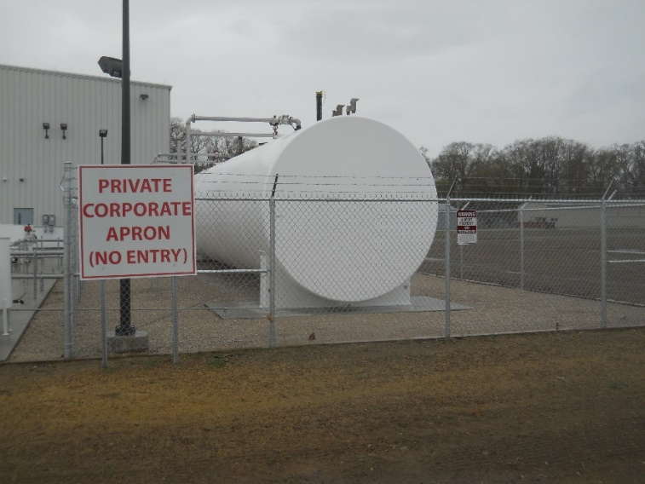
Lesson 4 Objectives
In this lesson you will learn to:
Describe SPCC regulations
Identify key components of
an SPCC plan
Notes:
In this lesson you will learn to:
Describe SPCC regulations
Identify the key components of an SPCC plan

Slide 61
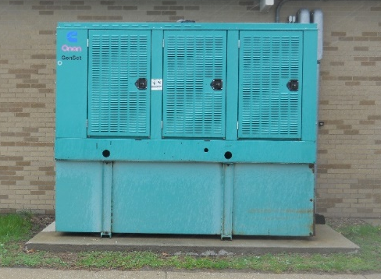
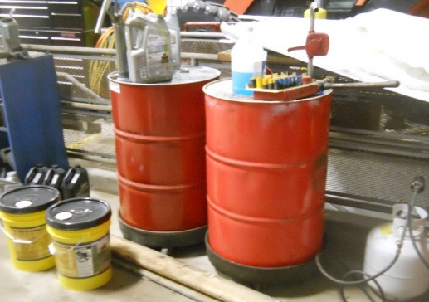
SPCC: Spill Prevention, Controls, & Countermeasures
SPCC Plan establishes: procedures,
methods, equipment and other criteria
to prevent discharge of oil products
and hazardous substances into
US waters or adjoining shorelines
Establishes control and response
procedures to mitigate impact
of a spill if it occurs
Notes:
Recall SPCC Plan stands for Spill Prevention, Control and Countermeasures Plan
The SPCC Plan establishes
procedures,
methods,
equipment, and
other criteria to prevent the discharge of oil products and hazardous substances into or upon waters of the United States or their adjoining shorelines
It also establishes control and response procedures to mitigate the impact of a spill if it occurs.

Slide 62
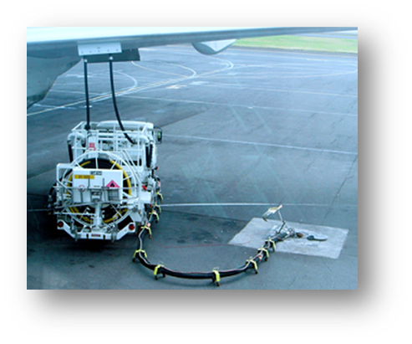
SPCC Plan
Required by EPA when airport and/or tenants
store oil and / or fuel on-site that exceed:
Above Ground 1,320 gal
Below Ground 42,000 gal
SPCC establishes control / response
procedures to mitigate impact of a spill
if it occurs
Notes:
An SPCC plan is required by the EPA when an airport and/or its tenants store volumes of oil and/or fuel on-site that exceed certain minimums.
For above ground facilities, the minimum is 1,320 gallons, while the minimum for below ground tanks is 42,000 gallons.
Exceeding either volume triggers the need for an SPCC plan.
The SPCC plan establishes control and response procedures to mitigate the impact of a spill if it occurs

Slide 63
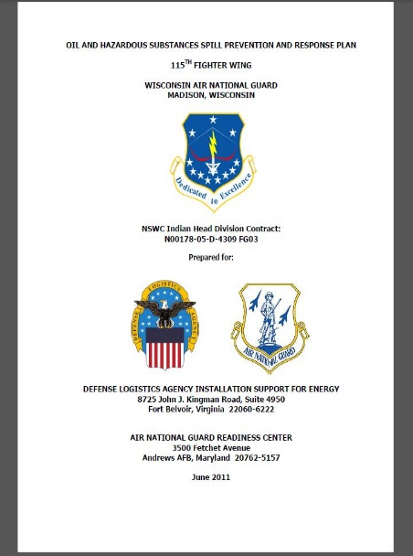
SPCC: Other Names
Spill Plan
Spill Response Plan
Spill Prevention and Response Plan
Notes:
Other common names for SPCC Plans are:
Spill Plan,
Spill Response Plan or
Spill Prevention and Response Plan.

Slide 64
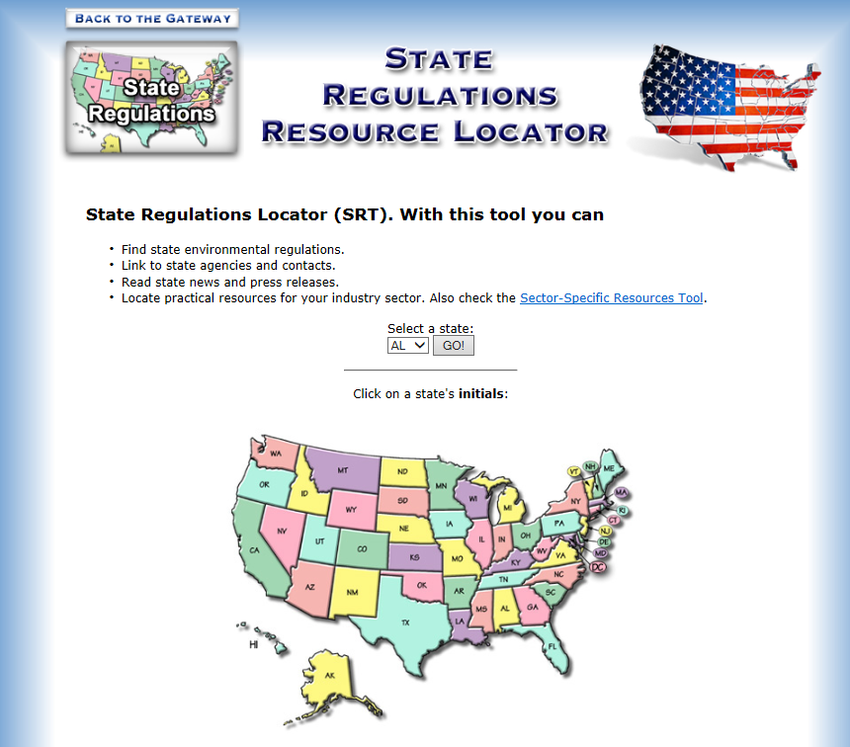

State SPCC Regulations
States have oil storage regulations or registries
that apply to oil stored
Check with your state
natural resources agency
Notes:
Many states have their own oil storage regulations or registries that may apply to the oil stored at the Airport.
Check with your state natural resources agency for this information.

Slide 65
SPCC: Spill Prevention, Controls, & Countermeasures
SPCC plans may overlap with SWPPP or SWMP
SPCC plans are covered under Federal Code of Regulations separately from NPDES programs
SPCC plans are usually not combined
with SWPPP or SWMP
Notes:
SPCC plans may also have some overlap with SWPPPs or SWMPs.
However, because SPCC plans are covered under the Federal Code of Regulations separately from NPDES programs
SPCC plans are usually not combined with either the SWPPP or SWMP.

Slide 66
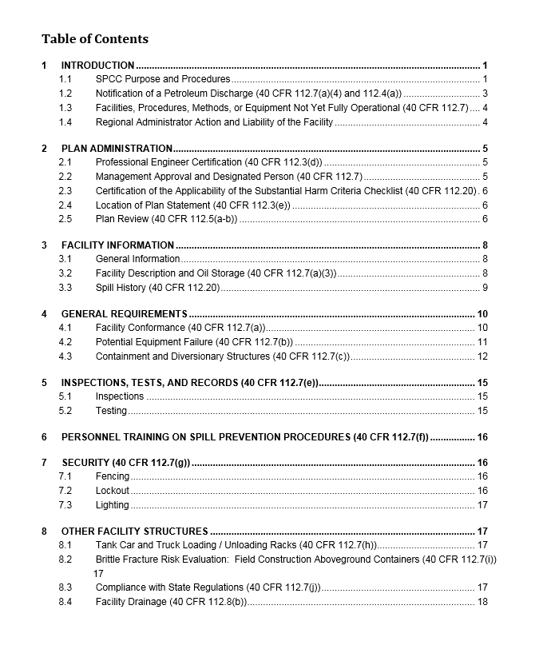

Six SPCC Plan Components
Basic components of a Spill Plan:
Facility description and oil quantities stored
Facility map
Controls for proper storage and use
Facility response or Emergency Action Plan
Inspections and Training
Recertification Schedule
Notes:
The basic components of a spill plan are:
Facility description and oil quantities stored
Facility map
Controls for proper storage and use
Facility response or Emergency Action Plan
Inspections and Training
Recertification Schedule
Let’s look at the details of each component.

Slide 67


SPCC Plan Component 1: Facility Description
Facility description section should be site specific:
  Description of facility and oil quantities stored
  List nearby water-bodies
Notes:
The facility description section should be site specific and include
a description of the facility and oil quantities stored and
a list of nearby water-bodies that could be affected.

Slide 68

SPCC Plan Component 2: Facility Map
Fuel and oil storage locations
Direction of flow from storage locations
Secondary containment locations
Site security fences
Nearby drainage features: wetlands,
creeks, streams, lakes, ponds
General locations of site activities
Notes:
The Facility map identifies:
Oil and fuel storage locations
Direction of flow from the storage locations
Secondary containment locations
Site security fences
Nearby drainage features such as wetlands, creeks, streams, lakes or ponds
General locations of site activities

Slide 69

SPCC Plan Component 3: SPCC Controls
Describes practices to meet regulations
  Proper storage of fuel and oil
  Secondary containment in place in case a spill occurs
  Testing schedule oil storage containers
  Fuel and oil transfer practices and
  procedures to prevent a spill
Notes:
The Controls section of the spill plan describes the practices in place to meet the regulations including:
The proper storage of fuel and oil
The Secondary containment measures that are in place in case a spill occurs
The testing schedule of fuel and oil storage containers and the
Fuel and oil transfer practices and procedures to prevent a spill

Slide 70




SPCC Plan Component 3. SPCC Controls (Continued)
  Spill kits
  Secondary containment
  Best practices for mobile refueling
  to prevent and contain a spill
Notes:
Examples of SPCC site controls include
Spill kits
Secondary containment and
Best practices for mobile refueling to prevent and contain a spill

Slide 71


SPCC Plan Component 3. SPCC Controls (Continued)
Proper oil transfer procedures are a control in SPCC
Mobile re-fueling operations are a form of oil transfer
“General secondary containment” required
for mobile refueling ops, consists of
response procedure in lieu of installed
physical containment
Other oil transfers: fuel islands,
loading/unloading oil drums, oil pipelines
Notes:
Proper oil transfer procedures are a type of control listed in an SPCC plan.
Mobile re-fueling operations are a form of oil TRANSFER on an airport.
Note that “general secondary containment” is allowable for mobile refueling operations. This consists of a response procedure in lieu of installed physical secondary containment.
Other transfers of oil could include fuel islands, loading and unloading oil filled drums and oil pipelines.

Slide 72


SPCC Plan Component 3. SPCC Controls (Continued)
Testing is a good practice to prevent a tank failure, can take place of secondary containment,
if conducted at regular intervals
Types of testing to consider are:
  Integrity
  Brittle facture
  Tank controls
Notes:
Testing is a good practice to prevent a tank failure and can take the place of secondary containment if conducted at regular intervals.
Types of testing to consider are:
Integrity testing
Brittle facture evaluation of above ground containers
Tank controls testing

Slide 73


SPCC Plan Component 4: Response Plan
When spills happen, recognition of problem and rapid response are key to a timely and appropriate cleanup
1 gal of oil can contaminate 1,000,000 gals of water
Key to timely response = a site specific response plan
Notes:
When spills happen, recognition of the problem and rapid response is key to a timely and appropriate cleanup.
The importance of spill response is demonstrated by the fact that a spill of 1 gallon of oil can contaminate 1,000,000 gallons of water
The key to timely response is to have a site specific response plan

Slide 74

SPCC Plan Component 4: Response Plan (Continued)
Types of Spill Response Action Plans:
General Discharge Response 112.7 (a)(5) in SPCC
Facility Response Plan (FRP) 112.20
Notes:
There are two types of spill response action plans.
The first is a general discharge response 112.7(a)(5) that is included in the SPCC document text.
The second is called a Facility Response Plan or FRP 112.20.
Only one of these plans is required at a facility.

Slide 75
SPCC Plan Component 4: Response Plan (Continued)
FRP is less common, only required when
> 1Million gallons of oil stored OR
facility transfers oil over water to / from vessels and has storage capacity over 42,000 gallons
FRP is separate document, attached to SPCC plan
as an appendix
Notes:
An FRP is less common and is only required when more than 1 million gallons of oil are stored at the facility OR
the facility transfers oil over water to and from vessels and has a storage capacity over 42,000 gallons.
An FRP Plan is a separate stand-along document, that is most commonly attached to the SPCC plan as an appendix.

Slide 76


SPCC Plan Component 4: Response Plan
Locate/Stop Source: Emergency shut-off switches
Warn Key Personnel: Notify the right people
Contain Spill: Using secondary containment or spill kit
Clean Up and Dispose of Properly:
Use right kit and appropriate disposal
Notify Proper Authorities: If spill is large
Document /Report Spills: Keep records,
report ifover regulatory threshold
Notes:
These six steps are common to either type of spill response action plan:
Locate and Stop the Source: Know where emergency shut off switches are located so spills can be minimized.
Warn Key Personnel: Notifying the right people is important to containing the spill and preventing unsafe conditions.
Contain the spill: Spills can be contained by secondary containment or with spill kit materials.
Clean up and Dispose of Properly: Use the right kit and dispose of the used materials properly.
Notify the proper authorities: If a spill is large enough, it should be reported to the authorities.
Document and Report Spills: It is important to keep a record of all spills for program evaluation and to help guide corrective actions that may be necessary. Report all spills over the applicable regulatory threshold.

Slide 77


SPCC Plan Component 4: Emergency Action Plan
Emergency Action Plan (EAP) Steps:
Evaluate if SPCC plan and SWPPP were effective
If spill occurs in area with no secondary containment,
consider adding containment if
potential for a spill remains
Final Follow-up Step
Notes:
A final follow-up step is required to evaluate if the SPCC Plan and SWPPP are effective. For example, if a spill occurs in an area where no secondary containment is in place, you may want to consider adding it if there is a reasonable potential for a spill to occur again at that location.

Slide 78

SPCC Plan Component 4: Emergency Response
Spill may handled by Fire Department
EPA National Response Center 1-800-424-8802
if oil discharge to waters of US or adjoining shorelines
Notify EPA in writing if oil spilled to water is
>42 gals on 2 occasions within a 12 month period
or >1,000 gals in a single spill
Gallon amount specified = oil that reaches
navigable waters, not total amount of oil spilled
All numbers included in Plan are posted for staff
Notes:
Spills may need to be handled by a Local Fire Department, so their emergency response number should be determined.
Notify the EPA National Response Center (NRC) at 1-800-424-8802 if you have an oil discharge to waters of the U.S. or adjoining shorelines
Notify your EPA Regional office in writing if the amount of oil spilled to water is more than 42 gallons on two different occasions within a 12-month period or more than 1,000 gallons to water in a single spill event.
The gallon amount(s) refers to the amount of oil that actually reaches navigable waters of the United States or adjoining shorelines, not the total amount of oil spilled.
All of these numbers should be included in the Plan and posted where staff that handle fuel and oil can readily find them.
Check the Course Guide for a link to State Agency Response Center hotline numbers.

Slide 79

SPCC Plan Component 5: Inspections Plan
Have an inspection plan in place with an identified responsible person
Inspections can help prevent spills
Know which tanks need
secondary containment
Identify deficiencies
  Tanks appear new, double walled
  New tanks do not need secondary containment if they meet criteria
  Have inventory of tanks and which ones are in need of secondary containment, identify deficiencies
Notes:
It is important to have an inspection plan in place with an identified person responsible for carrying out this important step of SPCC Plan regulation.
Inspections can help prevent spills.
Have an inventory of your tanks and which ones are in need of secondary containment will help to quickly identify deficiencies.
In the photos, at first glance it appears the secondary containment is inadequate. The gravel area does not appear to be sized to handle a spill.
However the tanks appear new, which means they may be double walled and not require secondary containment.

Slide 80



SPCC Plan Component 5: Spill Response Equipment
During inspections, response equipment
should be examined
Replaced if missing or expired
Keep a checklist of items contained in spill kits so missing items can be identified
Notes:
During inspections, spill response equipment should be examined and replaced if missing or expired.
Keep a checklist of items contained in spill kits so missing items can easily be identified.

Slide 81


SPCC Plan Component 5: Staff Training
Training for all staff handling oil or oil filled equipment
Train staff on a regular basis about spill risks,
be prepared if spill happens
Records of training and inspections kept a minimum
of three years
Notes:
It is important to implement training for all staff who may be handling oil or oil filled equipment.
Train staff on a regular basis about spill risks and so they are prepared if and when a spill happens.
Records of training and inspections should be kept for a minimum of three years

Slide 82


SPCC Plan Component 6: Recertification
Recertification of a spill plan required every five years by a professional engineer who is:
  Knowledgeable of regulations
  Made a site visit
  Certifies plan prepared with
  good engineering practices
Notes:
Recertification of a spill plan is required every five years by a professional engineer who
is knowledgeable of the regulations,
has made a site visit, and
certifies the plan has been prepared with good engineering practices.

Slide 83

SPCC Plan Component 6: Self-Certification
Self-Certification = option for Tier 1 and Tier 2 sites:
Total above ground oil storage capacity is
10,000 gallons or less AND
In prior 3 years, facility had no single discharge of oil exceeding 1,000 US gallons or two discharges of oil each > 42 US gallons within 12-month period
Does not require a professional engineer
Notes:
Self-certification is an option for Tier 1 and Tier 2 sites where
Total above ground oil storage capacity is 10,000 U.S. gallons or less, AND
In the prior 3 years, the facility has had no single discharge of oil exceeding 1,000 U.S. gallons,
or two discharges of oil each exceeding 42 U.S. gallons within any 12-month period.
Self-certification does not require a professional engineer.

Slide 84

Lesson 4 Summary
In this lesson you learned to:
Describe SPCC regulations
Identify key components of an SPCC plan
Notes:
In lesson 4 you learned to:
Describe SPCC regulations
Identify the key components of an SPCC plan

Slide 85
Knowledge Check 10
Other common names for SPCC are:
Spill Plan
Spill Response Plan
Spill Response and Prevention Plan
All of the above
Notes:
It’s time for a Knowledge Check. Recall the information you have just covered in the lesson
Multiple Choice
Other common names for SPCC are:
Spill Plan
Spill Response Plan
Spill Prevention Controls and Countermeasures Plan
All of the above (correct)

Slide 86
Knowledge Check 11
True / False
The purpose of a spill plan is to establish procedures, methods, equipment, and other criteria to prevent
the discharge of oil products and
hazardous substances into or upon waters
of the United States or their adjoining shorelines.
Notes:
True / False
The purpose of a spill plan is to establish procedures, methods, equipment, and other criteria to prevent the discharge of oil products and hazardous substances into or upon waters of the United States or their adjoining shorelines.
True (Correct)

Slide 87
Knowledge Check 12
The purpose of a discharge plan is to _____.
Report spill incidents
Prepare for spill response
Map a location
All of the above
Notes:
Multiple Choice
The purpose of a discharge plan is to _____.
Report spill incidents
Prepare for spill response (correct)
Map a location
All of the above

Slide 88
Class Wrap-up
Notes:
Note to instructor: The correct answer is given in bold.
Instead of a taking final quiz, let’s wrap-up with a quick discussion of today’s topics.
1. A ____ is a conveyance or system of conveyances owned and operated by a State or local government entity that discharges to US waters.
EPA
MS4 (correct)
SWPPP
SWMP
2. An oil/water separator is an example of a ____ BMP.
Structural (correct)
Non-structural
Non compliant
None of the above
3. True / False
Secondary containment barriers around fuel tanks are an example of a non-structural BMP.
False (Correct) - an example of a non-structural BMP
4.) Training is an important component of what type of plan:
SWPPP
SWMP
SPCC
All of the above
5. Which two stormwater quality documents are often combined into one plan to ease the Airport's burden in maintaining two separate documents?
SWPPP and SWMP (correct)
SWPPP and MS4
NPDES and SWPPP
All of the above
6. A TMDL is the amount of a ___ a waterbody can receive and still meet water quality standards.
MS4
sodium
Pollutant (correct)
EPA
7. Which type of stormwater plan describes procedures, methods, equipment and other criteria to prevent the discharge of oil products and hazardous substances into or upon US water or adjoining shorelines?
SWMP
SWPPP
MS4
SPCC (correct)
8. True / False
The SPCC stormwater plan focuses on oil and fuel amounts at airports and establishes control and response procedures to mitigate a spill. True (correct)
9. ________ is one of the main pollutants in construction stormwater runoff.
Fertilizers
Trash
Sediment (correct)
None of the above
10. A SWPPP site map contains:
Stormwater flow direction and receiving waters
Property boundaries
Locations of previous spills and locations of regulated activities exposed to the elements
All of the above (correct)

Slide 89
Note:
This certificate is designed to be printed. You should test print on regular paper to ensure proper positioning before printing on card stock.
You may need to uncheck Scale to Fit Paper in the Print dialog (in the Full Page Slides dropdown).
Certificate
This Acknowledges That
___________
Has completed
Airport Stormwater Plans, Inspections, reporting
1.5 Hour ACRP Training
facilitator
Date

