Slide 1
Notes to Instructor
Training is approximately 60 Minutes total 50 minutes of instruction plus 10 question class discussion quiz
This training course was created for airport staff and tenants who are responsible for management of stormwater operations.
There are two Optional slides to “localize” for your airport situation. Use this slide deck as is, or add more to fit your need.
There are no bullet point transitions, click and see entire screen
Print a Notes Version for your Instructor Guide
Note: The final quiz can be a printed quiz or class discussion.
Optional: Course handout (PDF) and certificate (last slide)
Notes:
Notes to Instructor
Training is approximately 60 Minutes total 50 minutes of instruction plus 10 question class discussion quiz
This training course was created for airport staff and tenants who are responsible for management of stormwater operations.
There are two Optional slides to “localize” for your airport situation. Use this slide deck as is, or add more to fit your need.
There are no bullet point transitions, click and see entire screen
Print a Notes Version for your Instructor Guide
Note: The final quiz can be a printed quiz or class discussion.
Optional: Course handout (PDF) and certificate (last slide)

Slide 2
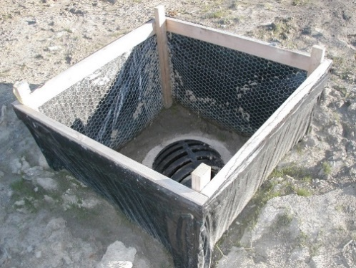
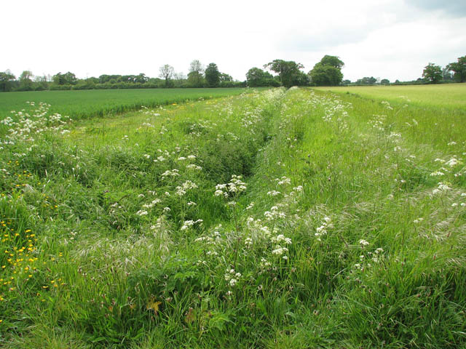
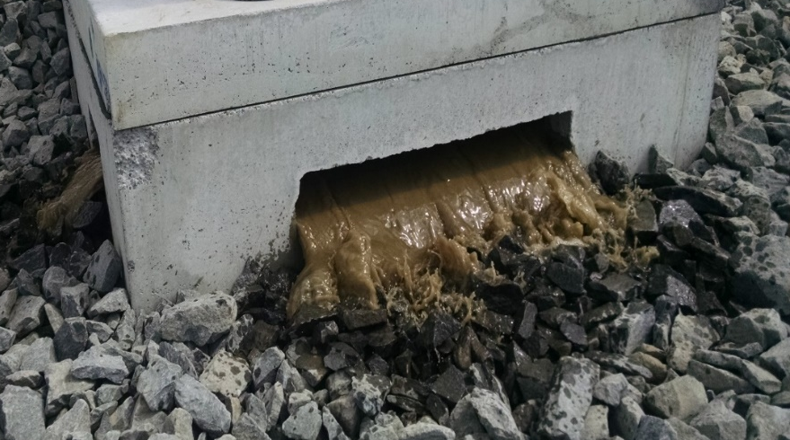
Course 2: Planning and Design of Stormwater BMPs
Notes:
Welcome to Planning and Design of Stormwater Best Management Practices, or BMPs

Slide 3
Course Objectives
In this course you will learn to:
Discuss how stormwater BMP selection is unique at airports
Describe three categories of stormwater BMPs and define where each is applicable
Review three design case study examples of BMPs that fit within the airport environment
Notes:
In this course you will learn to:
Discuss how stormwater BMP selection is unique at airports
Describe three categories of stormwater BMPs and define where each is applicable
Review three design case study examples of BMPs that fit within the airport environment

Slide 4
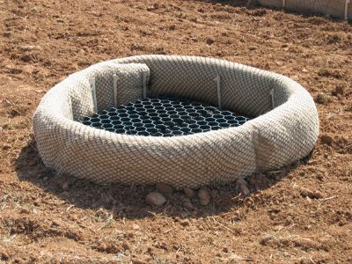
Lesson 1: Defining and Identifying Stormwater BMPs
Notes:
Welcome to Lesson 1: Defining and Identifying Stormwater BMPs

Slide 5
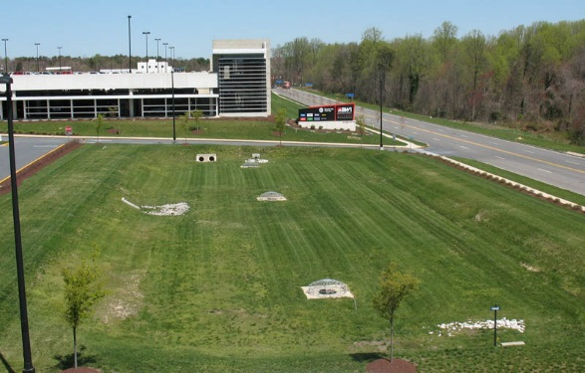
Lesson 1 Objectives
In this lesson you will learn to:
Define stormwater Best Management Practices (BMPs)
Identify BMP selection criteria unique to the airport environment
Notes:
In this lesson you will learn to:
Define stormwater Best Management Practices
Identify BMP selection criteria unique to the airport environment

Slide 6
What are BMP’s?
BMP = Best Management Practice
BMPs protect health of waterways by:
Preventing pollutants from getting into stormwater = Good Housekeeping BMP
Removing pollutants from stormwater = Structural BMP
Managing volume and flow of water = Structural BMP
Notes:
Before we get started, let’s define the term Best Management Practice or BMP.
BMPs are measures or mechanisms employed to protect the integrity and quality of receiving waters.
BMPs protect the health of streams, rivers, wetlands, and lakes by
preventing pollutants from getting into stormwater runoff through Good Housekeeping or Source Control BMPs,
removing pollutants from stormwater runoff through Structural BMPs or
managing the volume and flow of stormwater runoff to reduce other impacts, such as erosion. Managing the volume of runoff is also accomplished using structural BMPs.
BMPs can be policies and procedures, activities, or physical devices. Policies and activities, for example help to keep potential pollutants out stormwater, while physical devices or features remove pollutants already present in stormwater.

Slide 7
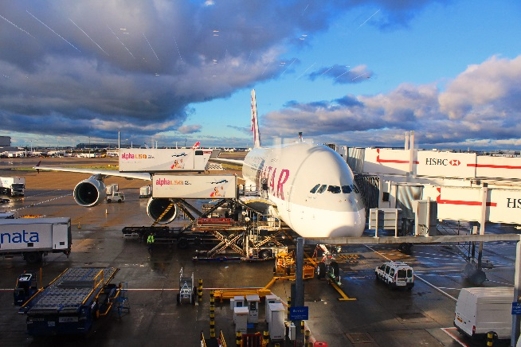
Stormwater BMP Selection
Several factors go into selecting suitable BMPs:
Stormwater Management Objectives
Pollutants of Concern at Airports
Airport Specific Safety Criteria
Drainage Basin Characteristics
Physical Conditions at BMP Location
Notes:
Several factors go into selecting suitable stormwater BMPs for a particular situation, including:
Stormwater Management Objectives
Airport Pollutants of Concern
Airport Specific Safety Criteria
Drainage Basin Characteristics and
Physical Conditions at the BMP Location.
We will highlight the “Stormwater Management Objectives”, “pollutants of concern at airports”, and the “airport safety criteria” factors in the slides that follow. The other factors are common to BMP design on any site on or off an airport.

Slide 8
Stormwater Management Objectives
Objectives include:
Keeping pollutants out of stormwater
Removing pollutants in stormwater
Slowing release rate of stormwater to
Reduce erosion and sedimentation
Minimize potential for flooding and property damage
Local requirements include detention & infiltration goals
Notes:
Stormwater management objectives are most often driven by regulatory requirements in the Airport’s NPDES permit, local codes, OR a combination of these.
Common stormwater management objectives include:
keeping pollutants out of the stormwater,
removing pollutants from stormwater runoff,
slowing the release rate of stormwater runoff to
reduce erosion and sedimentation, and
minimize the potential for flooding and property damage.
Local regulatory requirements may also include specific detention and infiltration goals.
Your airport’s NPDES Industrial permit and the local MS4 NPDES permit, if there is one, may have additional stormwater management objectives, as well. Once the objectives are established it is important to understand what pollutants may be present in the stormwater runoff.
ASK: What requirements and objectives are part of your NPDES Industrial Permit? Are you required to meet MS4 permit goals or other local requirements?
Once objectives are established, it is important to understand what pollutants may be present in stormwater runoff

Slide 9
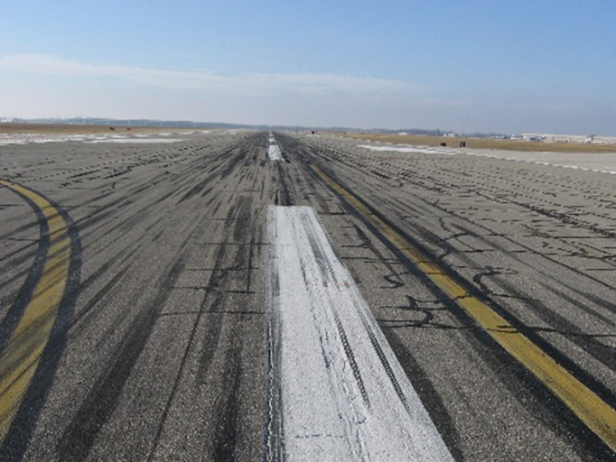
Pollutants of Concern at Airports
Deicing operations
Aircraft fueling and maintenance
Servicing ground vehicles
Fire fighting operations
Construction activities
FL DOT Study: hydrocarbon concentrations elevated in paved area where fueling occurs
Notes:
The principal pollutants of concern in airport stormwater are typically associated with activities such as deicing operations, aircraft fueling and maintenance, servicing of ground support vehicles, fire fighting operations, and construction activities. According to a Florida DOT study of pollutants in airside pavement runoff, hydrocarbon concentrations were found to be elevated in paved airside areas where fueling most often occurs. The same study also found that concentrations of nutrients in airport pavement runoff were typically lower than similar pavement on a commercial site.
A separate training module is dedicated to the BMPs associated with deicing activities because the management, control, and treatment of airport deicing runoff is highly complex and specific to airport operations. More in-depth information is included in the training titled “Managing Deicing Runoff.”
The BMPs in this training will focus on other pollutants such as: sediment, oils and fuels.
ASK: What pollutants does your NPDES permit target?

Slide 10
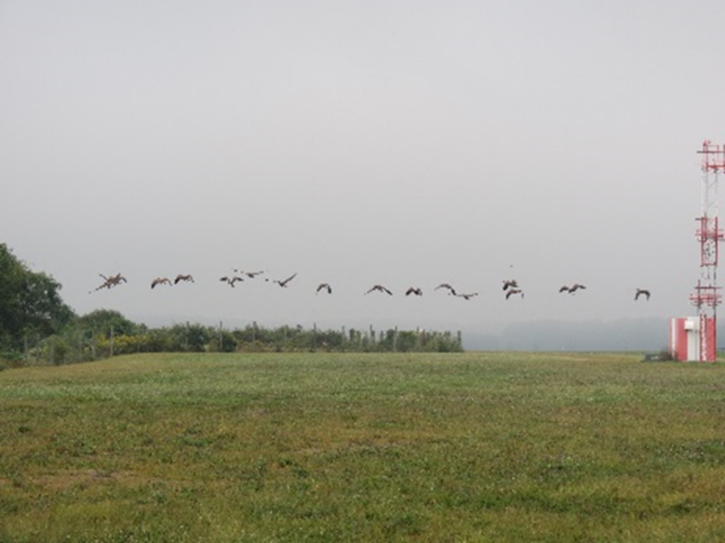
Airport Specific Safety Criteria
FAA AC 150/5200-33B, Hazardous Wildlife Attractants
FAA AC 150/5320-5D, Airport Drainage Design
Notes:
Safety is of utmost importance for airport operations; therefore there are additional considerations when selecting BMPs for airports. Some BMPs are compatible with airport safety requirements and some may require modifications to standard designs to prevent them from becoming a wildlife attractant.
There are several FAA Advisory Circulars related to airport safety and drainage design that you should be aware of. FAA Advisory Circular 150/5200-33B Hazardous Wildlife Attractants on or Near Airports, provides guidance on land uses that have the potential to attract hazardous wildlife on or near public-use airports.
FAA AC 150/5320-5D Airport Drainage Design provides guidance on the design and construction of airport surface storm drainage systems; and subsurface drainage systems for paved runways, taxiways, and aprons.

Slide 11
Airport Specific Safety Criteria
Key guidelines in Advisory Circulars:
Consider proximity to airfield operations
Avoid or minimize standing water
Avoid or minimize habitat creation
Avoid or minimize physical obstructions
Minimize maintenance requirements
Notes:
Key guidelines in the Advisory Circulars are:
Consider proximity to airfield operations
Avoid or minimize standing water
Avoid or minimize habitat creation
Avoid or minimize physical obstructions
Minimize maintenance requirements

Slide 12
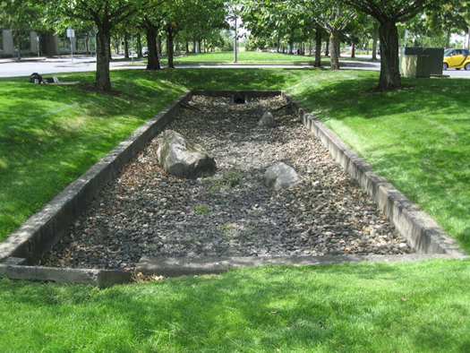
Safety Criteria: Perimeter C
Perimeter C = 5 miles between air operations area (AOA) and wildlife attractant (detention ponds, wetlands, waste disposal)
Airport ponds must drain down within 48 hours
Notes:
The FAA Advisory Circular on Hazardous Wildlife Attractants on or Near Airports designates a 5 mile radius, called Perimeter C, between the air operations area (AOA) and anything that could be considered a wildlife attractant including wet detention ponds, wetlands and waste disposal facilities.
To satisfy this requirement, airport ponds must drain down within 48 hours.
Airport managers are encouraged to notify local municipalities and surrounding communities within Perimeter C of this requirement.
ASK: Have you or your airport managers notified local municipalities within Perimeter C of your airport about FAA’s requirements?

Slide 13
Localize for Your Airport
Replace this slide with drainage area slide from your airport
Notes:
NOTES Use this slide to show general drainage at your airport
Locations for stormwater BMPs must also consider drainage areas and the conditions at a potential site for a BMP. The groundwater and soil conditions may help to narrow down locations for stormwater BMPs.

Slide 14
Knowledge Check 1
What is unique about BMP selection at airports?
Airport Pollutants of Concern
Safety Criteria
They are optional
All of the above
Notes:
It’s time for a knowledge check for the material we just covered. Multiple Choice
What is unique about BMP selection at airports?
Airport Pollutants of Concern
Safety Criteria
They are optional
A and B (Correct)

Slide 15
Knowledge Check 2
True or False
Perimeter C is equal to 10 miles between the air operations area (AOA) and anything considered a wildlife attractant like a wet detention pond, wetlands, or waste disposal.
Notes:
True or False
Perimeter C is equal to 10 miles between the air operations area (AOA) and anything considered a wildlife attractant like a wet detention pond, wetlands, or waste disposal.
Correct Answer: False – Perimeter C is equal to 5 miles

Slide 16
Lesson 2: Identifying Stormwater BMP Categories
Notes:
Welcome to Lesson 2: Identifying Stormwater BMP Categories

Slide 17
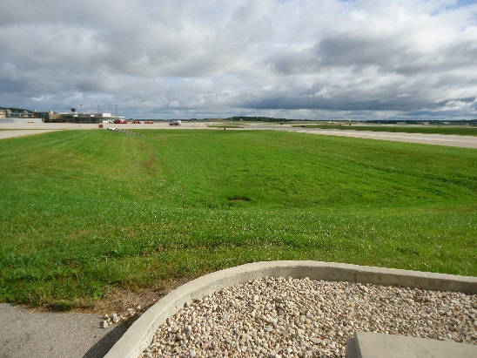
Lesson 2 Objectives
In this lesson you will identify three BMP categories:
Good Housekeeping or Source Control BMPs: prevent pollutants at source
Structural BMPs: remove or filter pollutants from runoff
Construction BMPs: specific to construction projects and include Source Control and Structural practices
Notes:
In this lesson you will learn about three categories of BMPs:
Good Housekeeping or Source Control BMPs that prevent pollutants at the source.
Structural BMPs that remove or filter pollutants from runoff
Construction BMPs which are specific to construction projects and include both Source Control and Structural practices

Slide 18
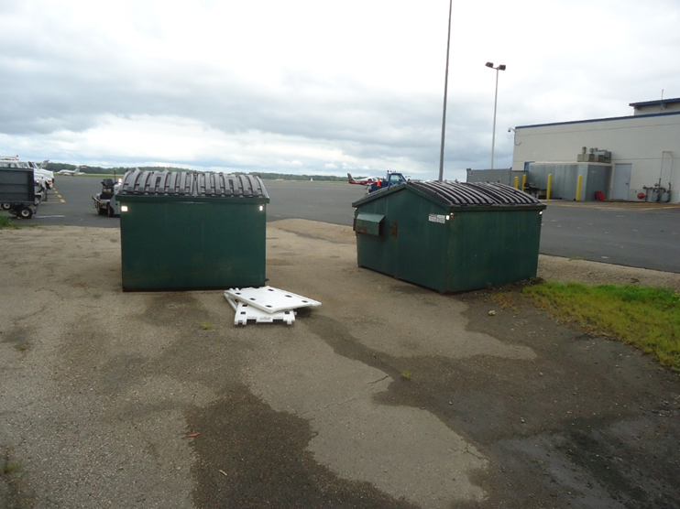
Good Housekeeping BMPs
Notes:
Good Housekeeping BMPs establish procedures and protocols aimed at keeping potential pollutants out of stormwater and ultimately out of our rivers and lakes.
Now lets look at some examples of source control BMPs common to airports.

Slide 19
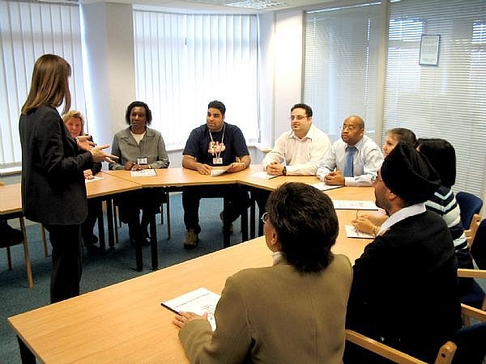
Good Housekeeping BMPs: Training
Knowledge goes beyond airport staff, tenant training should occur on a regular basis
Airport facilities maintenance need to know how their actions impact stormwater quality and requirements for maintaining stormwater facilities
Notes:
For any stormwater management program to be successful, the people whose activities can impact stormwater must know the actions or procedures required of them to prevent stormwater pollution in their day-to-day activities.
This knowledge goes beyond just the airport staff. Training tenant staff on a regular basis facilitates all members of the airport community working towards the same stormwater goals in a manner that is consistent with permit requirements.
Additionally, individuals involved in airport facilities maintenance, such as managing the landscape and pavement, need to know how their actions may impact stormwater quality, and the requirements for maintaining physical stormwater facilities.
ASK: Who gets trained at your airport?

Slide 20
Good Housekeeping BMPs: Landscape Management
Fertilizers can contribute excess nitrogen and phosphorus to receiving waters
Choose herbicide carefully and apply sparingly
Neither fertilizers nor herbicides should be used in ditches, swales, or stormwater management facilities where they can enter water bodies
Notes:
Because fertilizers have the potential to contribute excess nitrogen and phosphorus to receiving waters, they should only be used for plant establishment or as needed to prevent bare patches. Excess nitrogen and phosphorus in receiving waters causing excess algal growth harming the fish and ecosystem.
Herbicide should be chosen carefully and applied sparingly if needed. Airport policy should include decisions regarding what amount of weeds are tolerable.
Neither fertilizer nor herbicide should be used in ditches, swales, stormwater management facilities, or locations where it could be washed into streams, lakes, or other water bodies.
Pest control is necessary to reduce rodent populations that may be food sources for birds and other wildlife.
Vegetation management, physical barriers, and land use selection are management alternatives that are preferred to rodenticides.

Slide 21
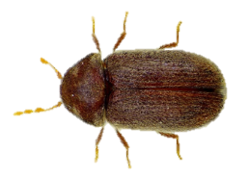
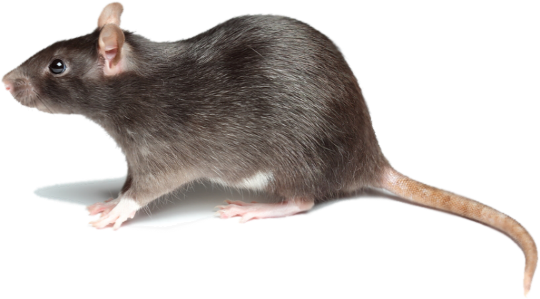
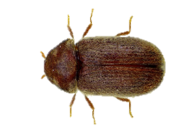
Good Housekeeping BMPs: Pest Control
Pest control is necessary to reduce rodent populations, may be food sources for birds and other wildlife
Vegetation management, physical barriers, and land use selection are management alternatives preferred to rodenticides
Notes:
Pest control is necessary to reduce rodent populations that may be food sources for birds and other wildlife.
Vegetation management, physical barriers, and land use selection are management alternatives that are preferred to rodenticides.

Slide 22
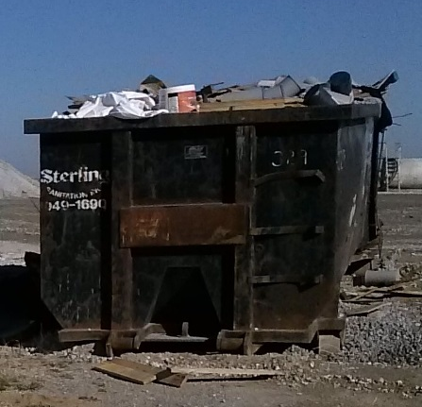
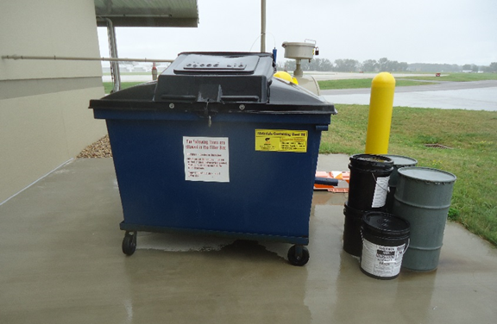
Good Housekeeping BMPs: Waste Management
Preventing litter & waste from contaminating stormwater
Trash receptacles available to public and staff
Waste containers should be covered and protected from rainfall by locating away from places where stormwater may pond or flow
Maintain waste containers, detect and repair leaks as soon as possible
Notes:
Basic Good Housekeeping includes preventing litter and waste from contaminating stormwater.
Trash receptacles should be available to the public and staff. Tenants may have their own trash receptacles or may use the airport’s. Either way, all trash receptacles should be covered and protected from rainfall by locating away from places where stormwater may pond or flow.
Waste containers should be maintained properly, with leaks detected and repaired as quickly as possible.

Slide 23
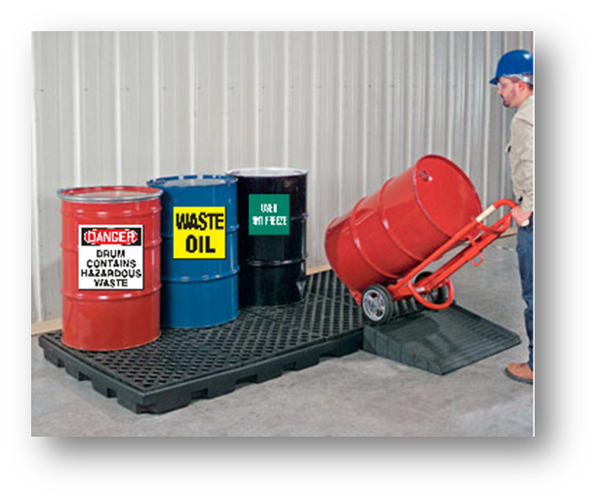
Good Housekeeping BMPs: Materials Storage
Materials stored may include aircraft and ground vehicle maintenance fluids, fuels, detergents, fire fighting foam, and deicing/anti-icing chemicals
Basic principles of waste management apply to materials storage
Materials should be covered and stored, protected from rain water
Hazardous materials stored indoors, pallets with secondary containment may be applicable
Notes:
Materials stored at an airport may include aircraft and ground vehicle maintenance fluids, fuels, detergents, and deicing/anti-icing chemicals.
The same basic principles of waste management apply to materials storage.
Whenever possible, materials should be covered and stored so they are protected from rain water and ponding.
Hazardous materials may need to be stored indoors. Elevated storage on pallets with secondary containment may be applicable.

Slide 24
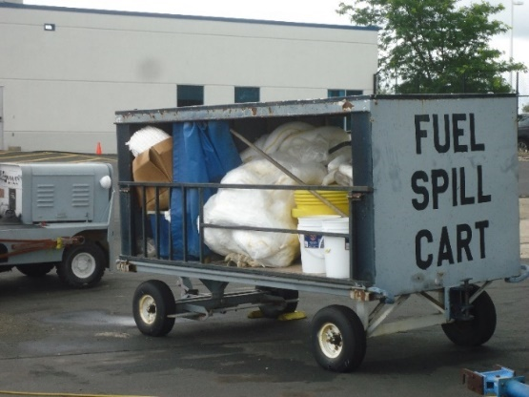
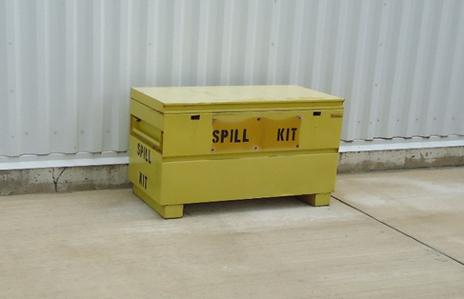
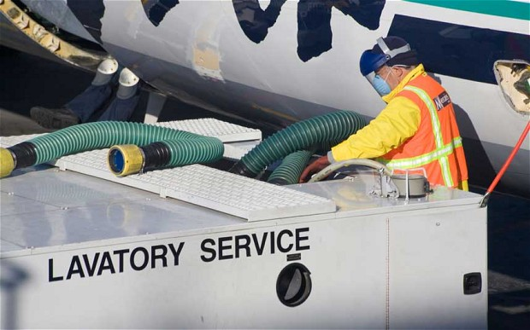
Good Housekeeping: Spill Prevention and Cleanup
Spill prevention relies heavily on good practices and procedures
Spill cleanup kits available where fluid transfers are conducted
Spill Kit = tools and materials for neutralizing and capturing spills
Notes:
Spill prevention relies heavily on good Practices and Procedures. If there is potential for something to drip, provisions should me made to catch the drips. If there is a potential for something to spill, have a plan for something to contain and remove the spilled material.
Spill cleanup kits should be available where fluid transfers are conducted. Spill cleanup kits should have an array of tools and materials for neutralizing and capturing spills such as absorbent pads, brooms, and other products to prevent the spread of spilled fluids.
ASK: Are you aware of designated areas for materials storage at your airport?

Slide 25
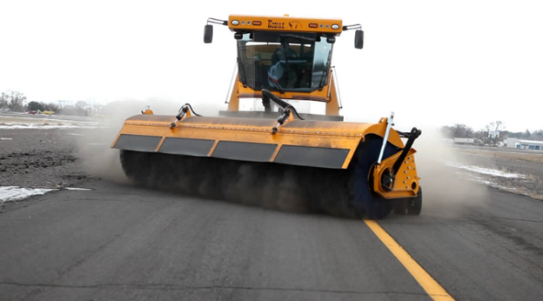
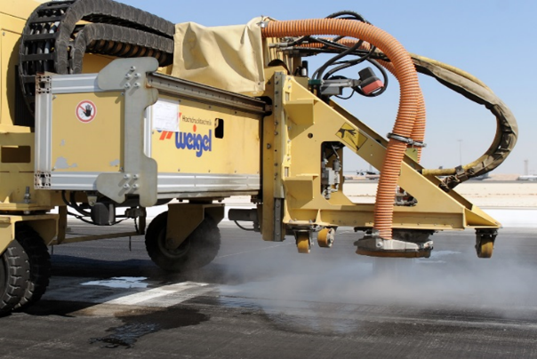
Good Housekeeping: Clean Pavements
Airside pavements kept clean for aircraft safety
Landside pavements kept clean, reduce pollution
Dust, hydrocarbons, and heavy metals can build up on pavements
Regular pavement sweeping and cleaning improves stormwater quality and reduces pollutant load on stormwater treatment facilities
Special dust control needed in arid climates
Notes:
Airside pavements are kept clean for aircraft safety reasons, which also benefits stormwater pollution prevention. Landside pavements should also be kept clean to reduce the potential for stormwater pollution.
Pollutants such as dust, hydrocarbons, and heavy metals can build up on pavements from everyday airport operations. The easiest way to keep these pollutants out of rivers and lakes is to clean them before they can be washed off with stormwater. A program of regular pavement sweeping and cleaning, include landside surfaces, will greatly improve stormwater quality and reduce the pollutant load on stormwater treatment facilities. Special dust control may be needed in arid climates.

Slide 26
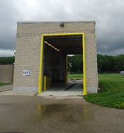
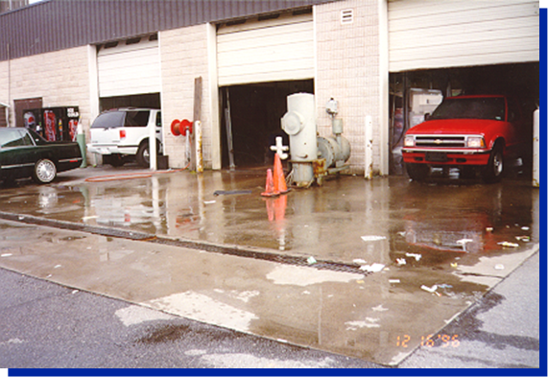
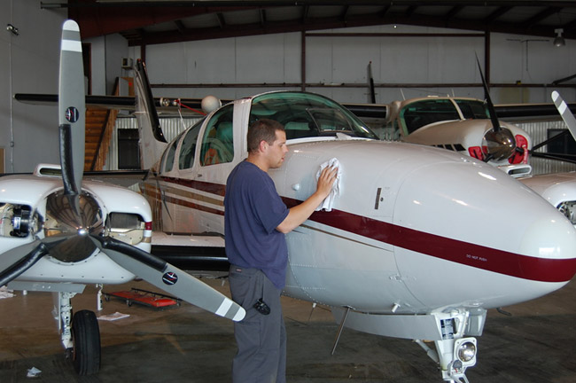
Good Housekeeping: Equipment / Vehicle Maintenance
Maintenance and cleaning should be in designated areas where runoff is contained and properly disposed of
Maintenance of ground vehicles should be performed indoors
Notes:
Ground vehicle and aircraft maintenance and cleaning should be done in designated areas where the runoff is contained and properly disposed of.
Maintenance of ground vehicles, including snowplow equipment, luggage tugs, and food supply vehicles, should be performed indoors when possible to avoid contact with stormwater.
ASK: What good housekeeping BMPs for equipment and vehicle maintenance are in place at your airport? Are there any activities or procedures that could be added to improve good housekeeping for these activities?

Slide 27
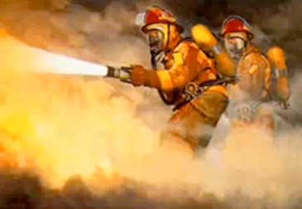
Good Housekeeping: Aqueous Film-Forming Foam (AFFF)
BMPs for AFFF:
Use of approved products
Store and handle properly
Dispose of expired product properly
Contain and dispose of AFFF dispensed during testing and training exercises
Collect and dispose of AFFF dispensed during emergency incidents
Notes:
Fire fighting training and emergency response often involves the use of aqueous film-forming foam, or AFFF (often pronounced “A-triple-F”). AFFF products may contain certain additives called “PFAS” that do not break down in the environment and have human health and ecological impacts.
BMPs for AFFF consist of:
Use of approved products that don’t contain PFAS
Store and handle AFFF to avoid contact with stormwater
Properly dispose of expired product
Contain and properly dispose of AFFF dispensed during testing and training exercises
If possible, collect and properly dispose of AFFF dispensed during emergency incidents

Slide 28
Knowledge Check 3
What actions or policies are considered good housekeeping?
Bioretention
Proper storage of waste materials
Employee Training
B & C only
All of the above
Notes:
It’s time for a knowledge check.
Multiple Choice
What actions or policies are considered good housekeeping?
Bioretention
Proper storage of waste materials
Employee Training
B & C (correct)
All of the above

Slide 29
Knowledge Check 4
True / False
Regular pavement sweeping and cleaning will improve stormwater quality and reduce pollutant load on stormwater treatment facilities.
Notes:
True / False
Regular pavement sweeping and cleaning will improve stormwater quality and reduce pollutant load on stormwater treatment facilities.
Correct Answer: True

Slide 30
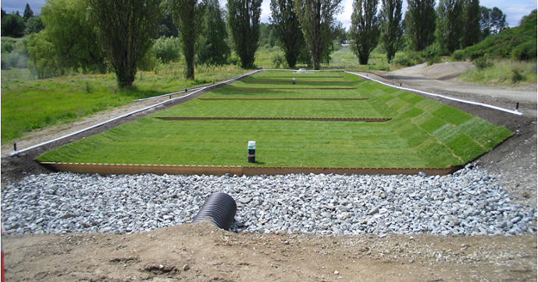
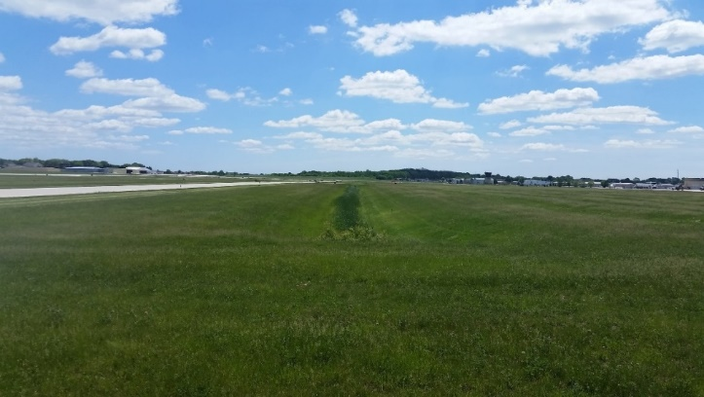
Structural BMPs
Physical components of site
Conveyance structures through which stormwater flows
Pollutant removal and flow reduction
BMPs in series = Treatment Train
Designed by licensed professional
Beneficial to analyze needs as part of facility-wide planning
Notes:
Now let’s look at structural BMPs, which are physical components of a site or stormwater infrastructure. They are located within the stormwater conveyance network. Structural BMPs can provide both pollutant removal as well as flow reduction.
Different structural BMPs can be installed in series to accomplish multiple stormwater management objectives. This is often referred to as a “treatment train”.
In general, structural BMPs must be designed by a licensed professional such a registered civil engineer to ensure protection of public health and safety, protection of the environment, and protection of other infrastructure.
It may be beneficial to analyze the need for stormwater treatment on a regional basis to meet the stormwater requirements in the Airport Layout Plan, or ALP. Such facility-wide planning often results in savings in space, design cost , construction cost and time.

Slide 31
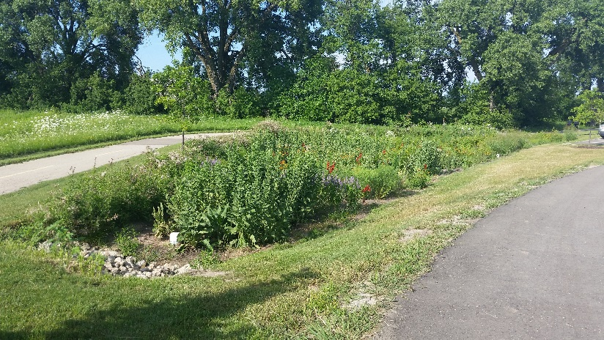
Categories of Structural BMPs
Structural BMPs Main Categories:
Pretreatment
Pollutant Removal
Detention Facilities
Infiltration
Notes:
There are four 4 main Categories of Structural BMPs:
Pretreatment, Pollutant Removal, Detention Facilities, and Infiltration.
Next, we will cover each category of structural BMP and provide examples that are most compatible with the Airport environment.

Slide 32
Pretreatment BMPs
Remove pollutants easiest to intercept: trash, oil, large sediment, extends life of downstream BMPs
Airport compatible pretreatment BMPs:
Inlet Filters
Vegetated Filter Strips and Grass Swales
Vegetated filter strips and grass swales used for infield drainage, count towards stormwater pre-treatment objectives
Notes:
Pretreatment BMPs remove pollutants that are easiest to intercept, such as trash, oil, and large sediment. Pretreatment extends the life of downstream BMPs.
EXAMPLES OF AIRPORT COMPATIBLE PRETREATMENT BMPS ARE:
Inlet Filters
Vegetated Filter Strips
Grass Swales
Vegetated filter strips and grass swales are commonly used for infield drainage and can be counted towards reaching stormwater pre-treatment objectives. Note that seed mixes must conform to the Airport’s Wildlife and Hazard Mitigation Plan and should be in conformance with what the FAA/USDA allows to prevent vegetated areas from becoming wildlife hazards.
Wet pool pretreatment designs are not compatible with the airport environment because of the potential for wildlife attraction.

Slide 33
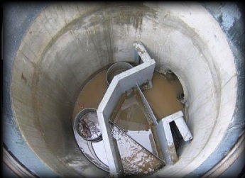
Pollutant Removal BMPs: Separators and Filtration
Pollutant removal BMPs remove pollutants already in stormwater, two main types:
Separator BMPs: effective at removal of oil and grease
Filtration BMPs: effective at removing many types of suspended pollutants
Notes:
Pollutant removal BMPs remove pollutants that are already in stormwater. There are 2 main types of pollutant removal BMPs:
Separator BMPs which are effective at removal of oil and grease and
Filtration BMPs which are effective at removing many types of suspended pollutants

Slide 34
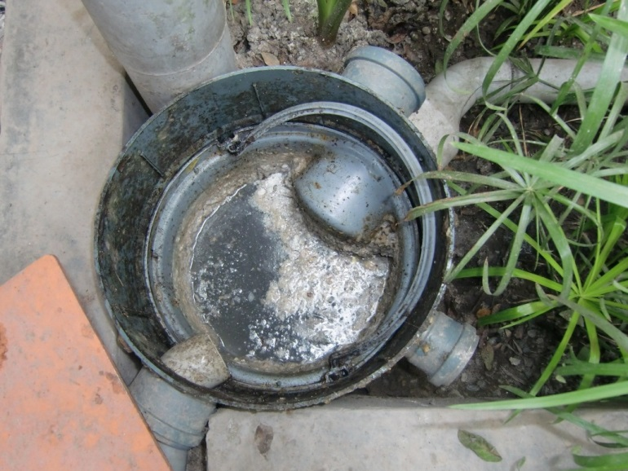
Pollutant Removal BMPs: Separators
Oil/water separators are a common type of separator:
Treat runoff where potential for contamination by oils or other petroleum products
Example = vehicle maintenance facilities
High potential with number of aircraft and vehicles in operation
Locate separators near source to minimize volume of stormwater requiring treatment, reduce facility sizing and reduce costs
Notes:
Oil/water separators are a common type of separator used to treat runoff in locations where there is potential for contamination by oils and other petroleum products. An example is near vehicle maintenance facilities. There can be a high potential for oil and grease pollutants at airports due to the number of aircraft and vehicles in operation.
Locate oil/water separators as near to the source as possible to minimize the volume of stormwater requiring treatment which will reduce facility sizing and reduce costs.

Slide 35
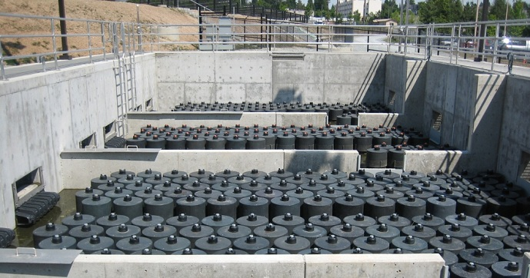
Pollutant Removal BMPs: Filtration BMPs
Can be pre-designed proprietary media filter system or a custom site specific design
Are used to reduce suspended and dissolved pollutants in stormwater
Notes:
Filtration BMPs can be pre-designed proprietary media filter systems or a custom site specific design. Filtration systems are used to capture a wide range of pollutants suspended or dissolved in stormwater.

Slide 36
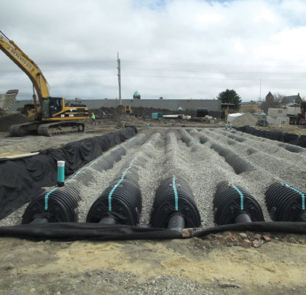
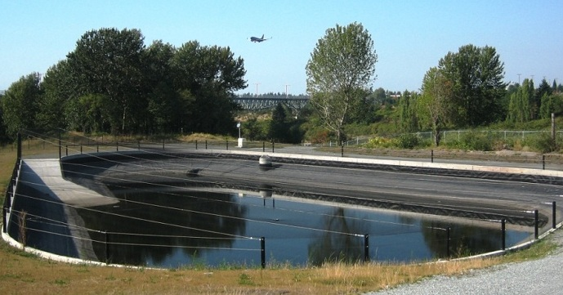
Detention Facilities
Stormwater detention facilities hold water above or below ground:
Provide removal of suspended pollutants through settling
Reduce discharge rates to mitigate for addition of impervious surfaces during development
Avoid above ground storage unless design can be modified to prevent from becoming a wildlife attractant
Special Cases Only
Notes:
Stormwater detention facilities hold water above or below ground and provide removal of suspended pollutants through settling. Stormwater detention can also reduce stormwater discharge rates to mitigate for the addition of impervious surfaces during development projects.
Because detention facilities hold water, above ground storage should generally be avoided. In special cases the design can be modified to prevent it from becoming a wildlife attractant.

Slide 37
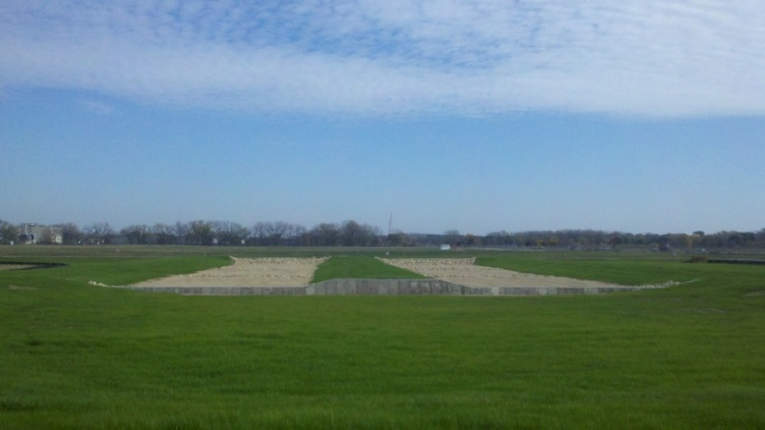
Infiltration Structural BMPs
Infiltration of runoff into the ground removes pollutants and prevents transportation to downstream waters
Infiltration BMPs can remove higher levels of pollutants
May require pre-treatment to protect groundwater
Drawdown rates may be slow, may need soil amendments, drain-tile pipe, or mechanism to draw down water within 48 hours
Avoid creating wildlife attractant
Notes:
Infiltration of runoff into the ground removes pollutants and prevents transport to downstream receiving waters.
Infiltration BMPs can remove higher levels of pollutants than other BMPs. Infiltration of stormwater runoff may require pre-treatment to protect groundwater in areas with sensitive groundwater or soils with high infiltration rates.
Where soils have a low permeability rate, drawdown rates may be slow. Infiltration facilities may still be acceptable in these locations, but the design may need to include soil amendments, drain-tile pipe and/or a mechanism to draw down the water within 48 hours.
Where plants are used, care must be taken during the selection, to avoid being a wildlife attractant. One example of plant selection criteria is to limit the height to 12 inches. Specific criteria for plants can be developed based on regional specific wildlife and plants.
ASK: What existing structural BMPs are installed at your Airport?

Slide 38
Locating Structural BMPs Near Airfield Operations
FAA AC 150/5300-13 Airport Design
From: WSDOT Aviation Stormwater Design Manual, Chapter 2.
Notes:
As mentioned previously, there are special considerations in planning and design of stormwater management BMPs at an airport. A primary consideration is designing BMPs so they are not wildlife attractants. In addition, there are zones where it may be best to simply avoid locating new structural BMPs.
FAA Advisory Circular 150/5300-13, Airport Design, defines the various zones of the airport such as the Clearway (CWY), Object Free Area (OFA), Runway Protection Zone (RPZ) and Runway Safety Area (RSA) and describes restrictions within each.
The graphic shown here depicts the restrictions within these critical areas. Examples of restrictions include: slope, height and finished surface type. It is best to locate new stormwater BMPs outside of these zones, unless they are compatible with the restrictions.
Stormwater facilities are generally allowed within the Clearway and Runway Protection Area, provided they are outside the Runway Safety Area zone. See specific restrictions in the Advisory Circular for more details.

Slide 39
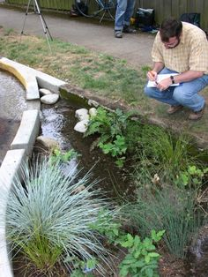
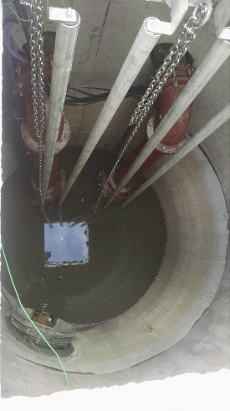
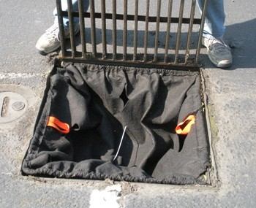
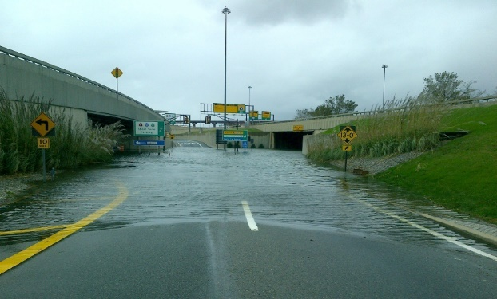
Structural Maintenance of BMPs
Regular inspections
Removal of sediment
Pump routine maintenance
Others specific to BMP
Refer to O&M manual
Maintain to preserve their function
Notes:
Structural BMPs often require maintenance such as:
Regular inspections
Removal of sediment
Pump routine maintenance
There are many others that are specific to the type of BMP. Refer to the O&M manual for each BMP for specific maintenance recommendations.
It is important to maintain BMPs to preserve their function. Without proper maintenance, BMPs may need costly repairs or total replacement earlier than expected.

Slide 40
Knowledge Check 5
_________ treat runoff where potential for contamination by oils or other petroleum products, near vehicle maintenance facilities
Oil/water separators
Baffle style separators
Coalescing plate
None of the above
Notes:
Multiple Choice
_____________ treat runoff where potential for contamination by oils or other petroleum products, near vehicle maintenance facilities
Oil/water separators (correct)
Baffle style separators
Coalescing plate
None of the above

Slide 41
What are Construction BMPs?
Temporary practices and controls that reduce stormwater pollution during construction activities:
Reducing soil erosion, keeping excess sediment from leaving site and impacting streams, rivers, waterbodies
Different BMPs may be substituted
Notes:
Construction BMPs are temporary practices and controls that reduce stormwater pollution during construction activities. They are primarily aimed at reducing soil erosion and keeping excess sediment from leaving the site and impacting streams, rivers and other waterbodies.
Some of the previously mentioned non-structural and structural BMP categories can be applied as Construction BMPs. Construction BMPs are discussed as their own subset because they are temporary in nature and specific to a construction project and its associated activities.
There is a wide range of available construction BMPs. If one type of BMP is not working sufficiently at a specific location, a different BMP may be substituted.

Slide 42
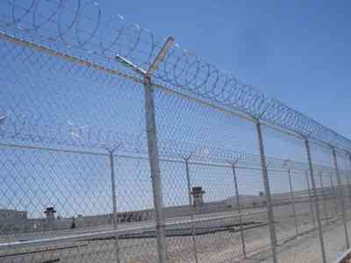
Safety and Security in Selecting Construction BMPs
BMPs compatible with criteria: height, size, and surface effects in RPZ, OFZ, or other regulated space
BMPS = No wildlife attractants or wet ponds
BMPs not interfere with airfield access and security
FAA AC 150/5370-10G, Standards for Specifying Construction of Airports, Item P-156: Basic BMPs
Notes:
Safety and security criteria must be taken into account when selecting Construction BMPs on Airports. Some specific issues include:
BMPs must be compatible with applicable criteria regarding height, size, and surface effects in RPZ, OFZ, or other regulated space.
BMPs cannot present a wildlife attractant. Outside of the various safety zones, wildlife attraction must be taken into consideration. Any form of wet treatment pond is not acceptable unless it is covered or protected from water fowl.
BMPs shall not interfere with basic airfield access and security. Stabilized construction entrance BMPs should be placed so as not to impede access and security.
Guidance on construction BMP requirements is available from FAA in:
AC 150/5370-10G, Standards for Specifying Construction of Airports, presents in Item P-156 basic guidance for Construction BMPs on airport. This document addresses basic BMP types, and leaves sufficient latitude for meeting local and regional pollution control regulations.
Local authorities may also have their own construction BMP requirements that must be met.
ASK: What unique concerns exist at your Airport related to construction sites and stormwater pollution control?

Slide 43
Construction BMP Key Categories
Design Decisions
Construction Management
Erosion Control / Soil Stabilization
Runoff and Sediment Control
Notes:
Key categories of Construction BMPs include:
Design Decisions;
Construction Management (which includes the typical Good Housekeeping-type BMPs and some physical BMPs);
Erosion Control BMPs (which include soil stabilization measures); and
Runoff and Sediment Control BMPs (which are designed to clean sediment laden runoff).
Now lets look at these categories in greater detail.

Slide 44
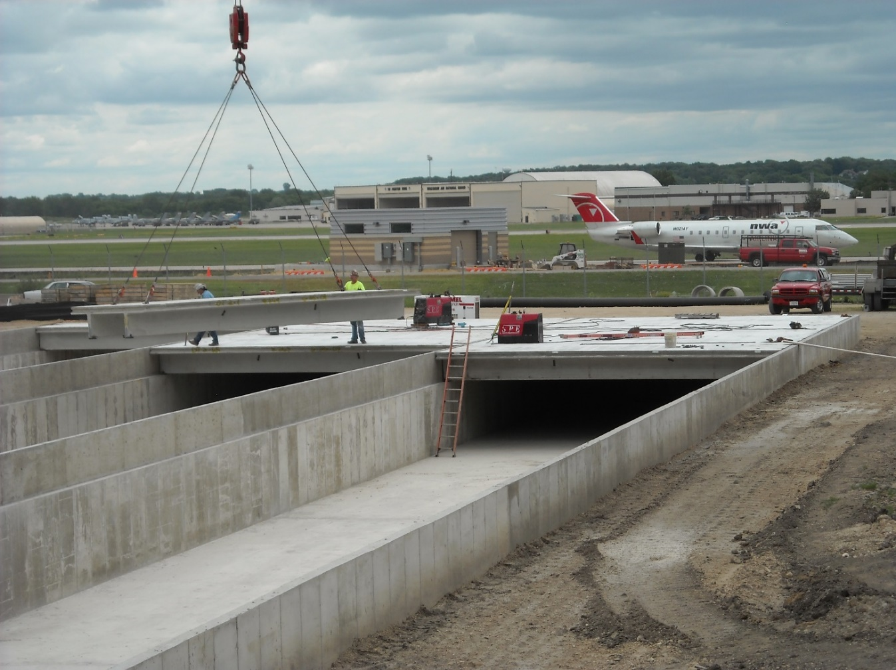
Design Decisions for Construction BMPs
Reduce disturbed area to reduce construction related erosion
Natural areas left in place
Buffer zones left undisturbed next to streams and lakes
Notes:
Design decisions help make construction phase stormwater management easier.
Wherever possible, the best way to reduce construction-related erosion is to reduce the area of disturbed land. Any natural areas that can be left in place are the best protection against erosion, and buffer zones that can be left undisturbed next to streams and lakes provide effective sediment control and runoff filtration.

Slide 45
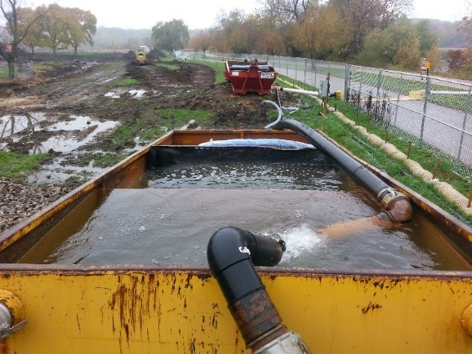
Construction Management BMPs
Reduce impacts during construction impact include:
Identifying construction zone with fencing
Maintain a Spill Prevention plan
Dust control
Proper waste management
Dewatering water treatment plan
Temporary gravel in staging areas and parking areas
Notes:
Construction management BMPs are the Good Housekeeping measures practiced during a construction project. They generally serve to reduce impacts during the construction phase caused by equipment and construction-related traffic.
Examples of construction management BMPs include:
Identifying construction zone and haul routes with fencing or other means
Maintain a Spill Prevention plan
Dust control
Proper waste management
Dewatering water treatment plan
Temporary gravel to stabilize staging areas
Parking areas should be stabilized with gravel or by other means so that construction traffic does not create excessive dust or additional erosion.

Slide 46
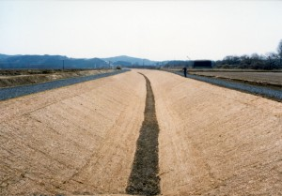
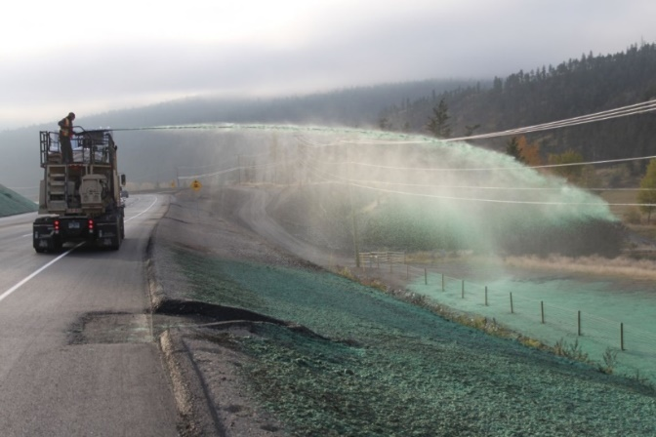
Erosion Control/Soil Stabilization BMPs
After earthwork, ground should be stabilized so soil doesn’t erode, best way is to:
Seed ground, get vegetation started with combinations of seeding, mulch and stabilizers
Nets, blankets, erosion matting for steeper slopes securely fastened to prevent from being blown onto pavement services
Notes:
After earthwork areas have been constructed to final grades and elevations, the ground should be stabilized so that the soil doesn’t erode.
The best way is to seed the ground and get vegetation started. Different combinations of seeding, mulch, and stabilizers can be applied to achieve this.
Specially designed nets, blankets, and erosion matting can also be used to stabilize soils, especially on steeper slopes. They must be securely fastened down to prevent them from being blown onto pavement surfaces.

Slide 47
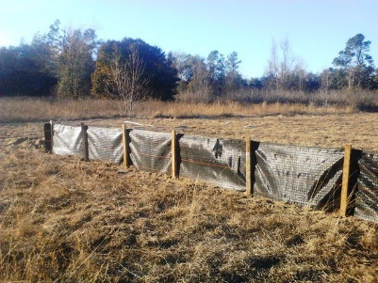
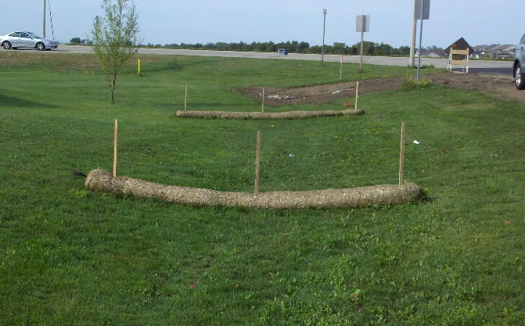
Runoff and Sediment Control
BMPs for sheet flow and shallow surface runoff have same goal: slow water down = less erosion
Compost socks
Sediment fences
Vegetated filter strips
Coir logs
Compost berms
Concrete washouts for capturing cement water
Compost Sock
Notes:
BMPs for sheet flow and shallow surface runoff all have the same goal: slow the water down. Slower water means less erosion and allows for sediment to settle out.
Compost socks and sediment fences are key elements of most erosion and sediment control plans. They are versatile and relatively simple to install and maintain.
Other BMPs can be utilized with similar effects, such as vegetated filter strips, coir logs, or compost berms.
Concrete washouts are required for capturing all cement waste.

Slide 48
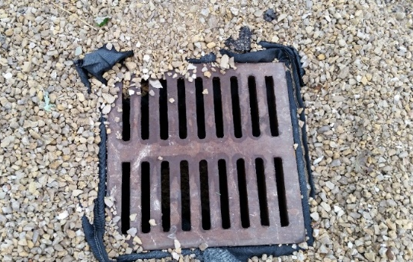
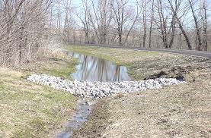
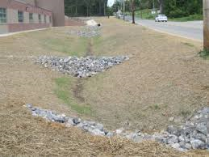
Runoff and Sediment Control: Concentrated Runoff
BMPs address concentrated flow such as:
Inlet protection
Grass lined channels
Channel lining
Check dams or dikes
Pipe drains
Check dams or dikes slow flow
Pipe drains to divert flow
Notes:
Concentrated runoff in ditches and swales downstream of construction sites may carry sediment from the construction area and have the potential to do more erosive damage.
Various BMPs address concentrated flow such as
Inlet protection
Grass lined channels
Channel lining
Check dams or dikes
Pipe drains
Different configurations of field-constructed check dams or dikes can be used to slow the flow of the water and allow for settlement.
Pipe drains and subsurface drains help collect and convey water from one location to another without causing erosion in highly susceptible areas.

Slide 49
Runoff and Sediment Control
Before discharging water offsite, sediment must be removed from stormwater with permits and regulations
“End of the line” sediment control examples:
Sediment traps and temporary sediment ponds: only if maintained as a dry pond
Outlet protection
Compost socks
Vegetated spray fields
Notes:
Before discharging water offsite, sediment must be removed from the stormwater in accordance with the construction permits and applicable regulations.
Traditional “end of line” treatment options are sediment traps and temporary sediment ponds, but these are typically not compatible with an airport unless they are kept dry.
Outlet protection using rip rap reduces the potential for additional erosion at the discharge location.
Compost socks and vegetated spray fields are two additional ways to remove sediment from runoff that may be more compatible with the airport environment.

Slide 50
Runoff and Sediment Control: Advanced Treatment
Sometimes Basic Construction BMPs are not enough, advanced treatment options may be required:
Special runoff additives, to enhance particle cohesion: chitosan in advanced filtration systems
Electro-coagulation systems = alternative to use of chemical additives
pH Neutralization: contact with concrete, mortar or Portland cement, special CO₂ systems
Notes:
Sometimes basic Construction BMPs are not enough to meet permitted discharge thresholds or levels. This may be the case when local soils have extremely fine particles that don’t settle easily and/or when downstream water bodies are extremely sensitive to pollution.
In these cases, advanced treatment options may be required. These include:
Special runoff additives to enhance particle cohesion and coagulation, if permitted. Additives such as chitosan are generally filtered back out of the water using advanced sand filtration systems.
Electro-coagulation systems are an alternative to the use of chemical additives.
pH neutralization may be required where there is a concern about high pH as a result of contact with concrete, mortar or Portland cement. Common pH neutralization techniques include the use of special carbon dioxide treatment systems or capture and treatment of runoff that comes in contact with concrete or cement.

Slide 51
Knowledge Check 6
True or False
Construction BMPs are generally temporary in nature.
Notes:
True / False
Construction BMPs are generally temporary in nature.
True

Slide 52
Knowledge Check 7
True or False
Good Housekeeping BMPs are a category of structural BMPs.
Notes:
True / False
Good Housekeeping BMPs are a category of structural BMPs.
False

Slide 53
Lesson Summary
In this lesson you learned to identify:
Different types of stormwater Best Management Practices (BMPs)
BMP selection criteria unique to the airport environment
Notes:
In this lesson you learned to identify:
Different types of stormwater Best Management Practices, or BMPs
And the BMP selection criteria unique to the airport environment

Slide 54
Lesson 3: Case Studies
Notes:
Welcome to Lesson 3 where we’ll examine some BMP case studies

Slide 55
Stormwater BMPs Case Studies
Miami International Airport
Portland Air National Guard
Dane County Regional Airport
Notes:
These three case studies showcase stormwater BMPs in the airport environment.

Slide 56
Miami International Airport BMPs
Notes:
The first case study is at the Miami International Airport and provides a good example of BMPs that reduce peak discharges and provide water quality benefits.
The airport implemented several stormwater BMPs to reduce peak flows and remove pollutants before discharge to the Blue Lagoon, C-4 Tamiami canal and C-6 Miami canal. This long term project spanned nearly 20 years. Let’s look at the project approach and a few key components of the stormwater treatment system.

Slide 57
Miami International Airport BMPs
Notes:
The project used a treatment train approach consisting of structural and non-structural practices. The non structural practices focused on controlling the pollutants at the source through a training program to educate staff on proper material management storage and disposal as well as spill prevention and a pavement sweeping program.
The structural BMPs focused on the first flush of runoff to capture approximately 70% of the average annual runoff volume. The remaining runoff volume is diverted to the Stormwater Management System. The Stormwater Management system included the retrofit of existing BMPs and construction of a new dry detention pond. The dry pond required a pumping system to meet FAA draw down requirements and prevent it from becoming a wildlife attractant. The location of the pond did not have an outlet that would allow it to be dry.

Slide 58
Miami International Airport BMPs
First flush diversion system installed on airside and land side as part of Structural BMPs
Incorporation of tenants in program and identifying responsibilities
Design specific to airfield pollutants such as oil and grease
Dry detention pond with a pumping station to meet FAA Advisory Circular to prevent it becoming a wildlife attractant
Notes:
The first flush diversion inlet system was installed on the airside and landside as part of the Structural BMPs. This system captures pollutants as close to the source as possible on the airfield apron. The first flush inlets collect runoff and convey it to the offline treatment system.
The components of the design that were modified to fit into the airport environment include:
Incorporation of tenants in the program and identifying responsibilities of the tenants and airport
A design specific to airfield pollutants such as oil and grease
A dry detention pond with a pumping station to meet FAA Advisory Circular to prevent it from becoming a wildlife attractant.

Slide 59
Portland Air National Guard (PANG) BMPs
Notes:
The second case study is located at the Portland Air National Guard Base, at Portland International Airport, and is an example of pollutant removal next to an impaired receiving water.
The Guard base has an NPDES Industrial stormwater permit. Stormwater is discharged to the Columbia Slough, a body of water that is impaired for toxics, nutrients, bacteria and temperature.
Monitoring records showed that stormwater discharges were exceeding discharge limits for zinc, phosphorous, and total suspended solids, or TSS, requiring corrective action.

Slide 60
Portland Air National Guard (PANG) BMPs
Stormwater BMPs implemented to limit phosphorus, TSS and zinc:
Lining metal outfall 008 drainage pipe, to eliminate zinc in discharge
Diverting Outfall 008 subbasin runoff to infiltration facility, reduction in pollutants
Pumping system designed to convey 100-yr design storm, no detrimental impacts to infrastructure and airfield safety
Notes:
The base implemented stormwater BMPs to limit phosphorus, TSS and zinc. The BMPs consisted of:
Lining the deteriorating metal outfall 008 drainage pipe. This was done to eliminate the identified source of zinc in the discharge.
Diverting the Outfall 008 subbasin runoff to an infiltration facility, which was designed to provide a reduction in the mass load of pollutants in runoff.
A pumping system was designed to convey the 100-year design storm such that there will be no detrimental impacts to existing infrastructure and airfield safety. A pumping station was required because there is no outlet from the infiltration facility. The enclosed depression required the use of pumping to meet FAA AC 150.

Slide 61
Portland Air National Guard (PANG) BMPs
Components of design modified for the airport environment include:
Locating pump station outside of taxiway object free area
Designing pump station to convey 100-year design storm
Adding a rip rap surface in infiltration facility
Removed an outfall and reduced pollutants
Notes:
The components of the design that were modified to fit into the airport environment. This included:
Locating the pump station outside of the taxiway free area
Designing the pump station to convey the 100-year design storm, which is more than is typically required by local regulations, but necessary in the airport environment.
And finally, adding a rip rap surface in the infiltration facility to avoid surface ponding of water and creation of a wildlife attractant.
The resulting system removed an outfall to a sensitive area and reduced the amount of pollutants in the stormwater runoff. The infiltration facility also provides some peak flow reduction through storage.

Slide 62
Dane County Regional Airport Sand Filter
Notes:
The first two case studies provide examples of stormwater treatment and detention that require pumping stations. However, pump stations are costly, require maintenance and monitoring, and not all infiltration and detention areas at airports require a pump station. This final case study demonstrates how underdrain piping can be used to tie into an existing storm drainage system instead of a pump station.
The project is located at Dane County Regional Airport in Madison, Wisconsin. The primary objective was reducing total suspended solids to meet MS4 NPDES permit requirements for the local municipality.
The Airport had prepared a stormwater master plan to encompass current and future development within the airport’s property. The plan evaluated water quality and quantity. The infield areas and grass swales were utilized for TSS reduction, along with some modifications to the existing drainage system. The existing areas did not provide enough TSS reduction to achieve the MS4 permit requirement of reducing TSS by 40% compared to pre-control conditions.

Slide 63
Dane County Regional Airport: TSS Reduction
Sand filter infiltration area was constructed
To overcome poor infiltration properties of soils at project site: amended with engineered soil mix and complex underdrain system installed connected to an overflow pipe discharging to nearby swale
Coordinated with Wisconsin Dept of Natural Resouces and City of Madison to achieve TSS reduction requirements of MS4 permit and stormwater ordinance
Notes:
To achieve the remaining TSS reduction, a sand filter infiltration area was constructed. In order to overcome relatively poor infiltration properties of the soils at the project site, they were amended with an engineered soil mix, and a complex underdrain system was installed with a connection to an overflow pipe discharging to a nearby swale.
This stormwater treatment project was closely coordinated with the Wisconsin Department of Natural Resources and the City of Madison to develop an approach that achieves TSS reduction requirements of the City’s MS4 permit and the City’s stormwater Ordinance.

Slide 64
Dane County Regional Airport: Design Components
Components of the design were modified to fit into the airport environment included:
Sand filter located outside of airport
Rip rap surface in sand filter infiltration facility
Amending clay soil to promote better infiltration and treatment
Notes:
The components of the design that were modified to fit into the airport environment included:
Sand Filter located outside of the airfield on property the airport owns
Rip rap surface in the sand filter infiltration facility
Amending the clay soil to promote better infiltration and treatment

Slide 65
Knowledge Check 8
What are modifications to typical BMP designs presented in the Case Studies?
Drawdown time of 48 hours to prevent becoming a wildlife attractant.
Locating practices as close to runway as possible
Incorporating tenants in BMP program
A & C
A, B and C
Notes:
What are modifications to typical BMP designs presented in the Case Studies?
Drawdown time of 48 hours to prevent becoming a wildlife attractant.
Locating practices as close to the runway as possible
Incorporating tenants in the BMP program
A & C (correct)
A, B and C.

Slide 66
BMP Resources and References
EPA https://www.epa.gov/npdes/national-menu-best-management-practices-bmps-stormwater-documents FAA, AC 150/5320-5D, Surface Drainage Design, 8/15/2013
http://www.faa.gov/documentLibrary/media/Advisory_Circular/150_5320_5d.pdf
FAA, AC 150/5200-33B, Hazardous Wildlife Attractants On Or Near Airports, 8/28/2007
http://www.faa.gov/documentLibrary/media/advisory_circular/150-5200-33B/150_5200_33b.pdf
FL DOT Aviation Office, Statewide Airport Stormwater Best Management Practices Manual, 4/27/2013
http://www.dot.state.fl.us/aviation/flpub.shtm
NC Department of Environmental Quality, Stormwater BMP Manual, Chapter 13 “BMP Toolbox for Public Airports,” 10/1/2012
http://deq.nc.gov/about/divisions/energy-mineral-land-resources/energy-mineral-land-permit-guidance/stormwater-bmp-manual
WA State DOT, Aviation Stormwater Design Manual – Managing Wildlife Hazards Near Airports, December, 2008 http://www.wsdot.wa.gov/aviation/airportstormwaterguidancemanual.htm
Notes:
These references are listed on your course guide. Additional BMP resources include a wide array of information and resources on the EPA website.

Slide 67
Course Summary
In this course you learned to:
Discuss how stormwater BMP selection is unique at airports
Describe three categories of stormwater BMPs and define where each is applicable
Review three design case study examples of BMPs that fit within the airport environment
Notes:
In this course you will learn to:
Discuss how stormwater BMP selection is unique at airports
Describe three categories of stormwater BMPs and define where each is applicable
Review three design case study examples of BMPs that fit within the airport environment

Slide 68
Class Wrap-up
Notes:
Instead of a taking final quiz, let’s wrap-up with a quick review discussion of today’s topics.
Note: The correct answer is given in bold.
1. True / False Oil/water separators are a good example of “end of the line” treatment.
2. True / False Construction BMPs are typically temporary aside from stabilization measures
3. True / False BMP stands for Better Measure Please
4. Multiple Choice Examples of how stormwater BMP selection is unique at Airports include:
Preventing the BMP from becoming a wildlife attractant
Pollutants of Concern at an Airport
Local Regulations
Permit Requirements
All of the above
None of the above
5. True / False Three categories of BMPs are Construction, Structural and Good Housekeeping
6. True / False Airport staff should have a regular dialogue with local governments within Perimeter C to follow AC 150/5200
7. Multiple Choice ______________ are a good source of stormwater treatment at airports that do not require a significant capital investment.
Swales
Vegetated Open Areas
Pavement
A and B.
8. Multiple Choice Examples of Good Housekeeping measures are:
Sweeping of Airfield and Landside pavements
Employee Training
Spill Kits
First Aid Kits
A, B, and C
None of the above
9. Multiple Choice Erosion Control BMPs can be classified into the following 4 categories
Good Housekeeping, Employee Dress Code, Design Decisions Erosion Control
Design Decisions, Construction Management, Erosion Control, Runoff and Sediment Control
No Smoking Policy, BDPs, Erosion Control, Spill Plans
10. Multiple Choice
Providing proper trash disposal is an example of what type of BMP:
Structural
Good Housekeeping
Construction
None of the above

Slide 69
Note:
This certificate is designed to be printed. You should test print on regular paper to ensure proper positioning before printing on card stock.
You may need to uncheck Scale to Fit Paper in the Print dialog (in the Full Page Slides dropdown).
Certificate
This Acknowledges That
___________
Has completed Planning and Design of Stormwater BMPs 1.5 Hour ACRP Training
facilitator
Date

