Slide 1
ACRP WebResource 21: Environmental Stewardship and Compliance Training for Airport Employees
Water Quality Training Course

Slide 2
Course Objectives and Overview
This course will provide a high-level overview of water quality, water quality regulations, and how regulations apply to airports.
In this course, you will learn:
The importance of water quality at airports
Water quality regulations relevant to airports and airport projects
Water quality related permits and plans
Typical airport water pollutants and their sources
Links to federal references may be modified over time. Please search FAA and other federal websites to find the most current reference material.

Slide 3
Key Definitions and Terms
Aqueous Film Forming Foam (AFFF) – firefighting foam used worldwide, known for its effectiveness in fighting aircraft fires; contains per- and polyfluoroalkyl substances (PFAS)
Best Management Practices (BMPs) – schedules of activities, maintenance procedures, and management practices implemented to minimize point source discharge impacts
Clean Water Act (CWA) – establishes the basic structure for regulating discharges of pollutants into the waters of the United States and regulating quality standards for surface waters
Impervious Surface – “a hard surface area that either prevents or slows the entry of water into the soil mantle or causes water to run off the surface in greater quantities or at an increased rate of flow, which can potentially contribute to flooding and transport pollutants into lakes and streams”
National Pollutant Discharge Elimination System (NPDES) – a permit issued by the EPA authorizing point source discharges into navigable waters of the United States
Non-point Source – “a diffuse source of pollution, having no single point of origin”
Source: EPA. n.d. Home page. https://www.epa.gov/

Slide 4
Key Definitions and Terms (cont’d)
Per- and Polyfluoroalkyl Substances (PFAS) – a group of manufactured chemicals that have been used in industry and consumer products since the 1940s, also called “forever chemicals" because they do not break down easily
Perfluorooctane Sulfonic Acid (PFOS) – a member of the PFAS chemical group, designated by the EPA as a drinking water contaminant that causes some negative health effects
Perfluorooctanoic Acid (PFOA) – a member of the PFAS chemical group, designated by the EPA as a drinking water contaminant that causes some negative health effects
Point Source – “a fixed location or facility that discharges pollution—for example, a factory smokestack, a ship, an ore pit, a ditch, or a pipe discharging treated industrial wastewater or treated sewage into a waterway”
Runoff Pollutants – pollutants from point source and non-point source runoff, which may include metals, oils, greases, hazardous materials, solids, hydrocarbons, pesticides, and herbicides
Source: EPA. n.d. Home page. https://www.epa.gov/

Slide 5
Key Definitions and Terms (cont’d)
Spill Prevention Control and Countermeasure (SPCC) – a CWA regulation that requires facilities to develop an SPCC plan to prevent oil from reaching navigable waters and adjoining shorelines, as well as to contain discharges of oil
Stormwater Pollution Prevention Plan (SWPPP) – a plan that outlines how stormwater runoff, erosion, and sediment will be controlled to minimize polluted stormwater runoff into waters
U.S. Army Corps of Engineers (USACE) – an agency that conducts or verifies jurisdiction of waters of the U.S., develops CWA Section 404 policy and guidance, and administers Section 404 permits
U.S. Environmental Protection Agency (EPA) – a federal organization established in 1970 to protect human health and the environment
Water Quality Certificate – a certificate required for a project to ensure it does not violate state or Tribal water quality standards under Section 401 of the CWA; a certificate required by airport sponsors when applying for a CWA Section 404 permit from USACE
Source: EPA. n.d. Home page. https://www.epa.gov/

Slide 6
Water Resources
Water resources, including both surface waters and groundwater, are important to life on Earth and have the following traits:
Vital to society
Vital to wildlife
Provides drinking water
Water resources also support recreation, transportation and commerce, industry, agriculture, and aquatic ecosystems.
Photo credit: iStock/Getty Images/Bkamprath

Slide 7
Holistic System
It is important to think of water resources as a holistic system:
The natural water system is connected and acts as an integrated system
Disruption or contamination of one water resource impacts the entire system
Analysis should consider the system as a whole
Consider the entire water system when analyzing impacts to water.

Slide 8
Primary Water Resources
The following primary water resources may be found in and around airports. Consider that there may be others present:
Wetlands – areas where water covers the soil, or is present either at or near the surface of the soil, all year or for varying periods of time during the year, including during the growing season
Floodplains - lowland areas adjoining inland and coastal waters that are periodically inundated by floodwaters
Surface water – a body of water above ground, including streams, rivers, lakes, ponds, estuaries, and oceans
Groundwater – a subsurface water body that occupies the space between sand, clay, and rock formations
Wild and scenic rivers - rivers that have remarkable scenic, recreational, geological, fish, wildlife, historic, or cultural values as defined by the Wild and Scenic Rivers Act

Slide 9
Importance of Water Quality at Airports
According to the FAA, without proper water quality management, the following may occur:
Construction activities may cause sediment-laden runoff to enter waterways
Seasonal pollutants from deicing activities may be present in stormwater runoff
Water quality impacts can be from point sources and non-point sources
Pollutants can accumulate on impervious surfaces and wash into creeks, streams, lakes, or other waters due to storm events
Water quality impacts may adversely affect animal, plant, and human populations
Airport development and operations can result in water quality impacts.

Slide 10
Water Pollutants and Sources at Airports
The following water pollutants and their sources are typically found at airports:
Deicing/anti-icing of aircraft is a source of ethylene or propylene glycol pollutants
Deicing/anti-icing of runways, aprons, and taxiways is a source of urea, acetate, and formate pollutants
Spills during refueling and leaks from pipes or tanks are sources of fuel pollutants
Firefighting exercises are a source of fire suppressant chemical and foam pollutants
Paved surfaces and engine leaks are sources of dust, dirt, and hydrocarbon pollutants
Vegetation and pest control are sources of herbicide and pesticide pollutants
Source: ICAO. n.d. Eco-Airport Toolkit E-collection. https://www.icao.int/environmental-protection/pages/ecoairports.aspx

Slide 11
Clean Water Act
The Clean Water Act (CWA) is the overarching statutory framework used in federal decisions regarding water quality impacts. The FAA must evaluate proposed airport landside and airside projects that have the potential to impact water quality.
Example landside projects include:
Construction, relocation, and repair of airport access roads
Repair and maintenance of remote parking facilities
Repair and maintenance of rental car lots
Example airside projects include:
Building or expanding terminals and hangars
Building new or extending runways and taxiways
Installing navigational aids
The Clean Water Act always applies to airports, even if a federal action is not in play.
Source: FAA. 2023, October. 1050.1 Desk Reference (v3). https://www.faa.gov/about/office_org/headquarters_offices/apl/environ_policy_guidance/policy/faa_nepa_order/desk_ref

Slide 12
Waters of the United States
Waters of the United States (WOTUS) are water bodies protected under the CWA. The definition of WOTUS has changed over time, but it is intended to protect water bodies such as:
Traditional navigable waters (e.g., certain large rivers and lakes)
Territorial seas
Interstate waters
Upstream waters that may affect the integrity of downstream waters
Current information regarding the classification of WOTUS can be found here: U.S. EPA’s Waters of the United States

Slide 13
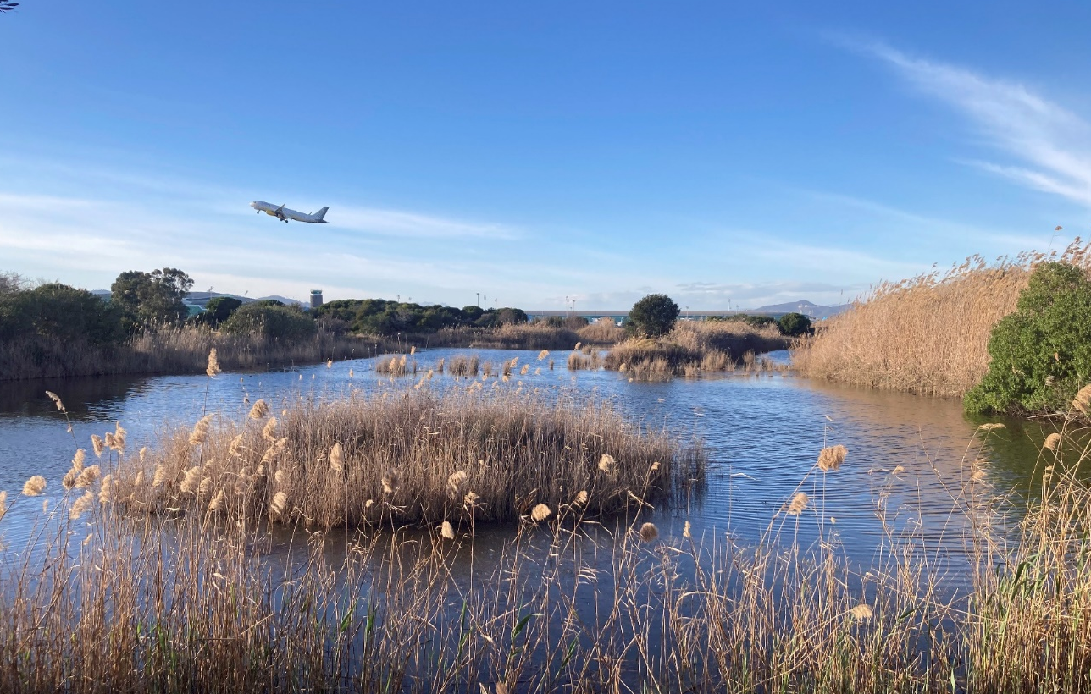
Water Quality Regulations – Wetlands
The following statutes, regulations, and executive orders are in place to protect wetlands and aquatic systems:
Executive Order 11990, Protection of Wetlands
Clean Water Act
Fish and Wildlife Coordination Act
U.S. DOT Order 5660.1A, Preservation of the Nation’s Wetlands
State and local statutes protecting surface waters
Photo credit: iStock/Getty Images/Xavi Arroyo
Text Source: FAA. 2023, October. 1050.1 Desk Reference (v3). https://www.faa.gov/about/office_org/headquarters_offices/apl/environ_policy_guidance/policy/faa_nepa_order/desk_ref

Slide 14
Water Quality Regulations – Floodplains
The following statutes, regulations, and executive orders are in place to protect floodplains:
Executive Order 11988, Floodplains Management
National Flood Insurance Act
U.S. DOT Order 5650.2, Floodplain Management and Protection
State and local statutes protecting surface waters
Use the online FEMA Flood Map Service Center to see if your airport or airport project is outside the 100-year and 500-year floodplains, at msc.fema.gov/portal.
Source: FAA. 2023, October. 1050.1 Desk Reference (v3). https://www.faa.gov/about/office_org/headquarters_offices/apl/environ_policy_guidance/policy/faa_nepa_order/desk_ref

Slide 15
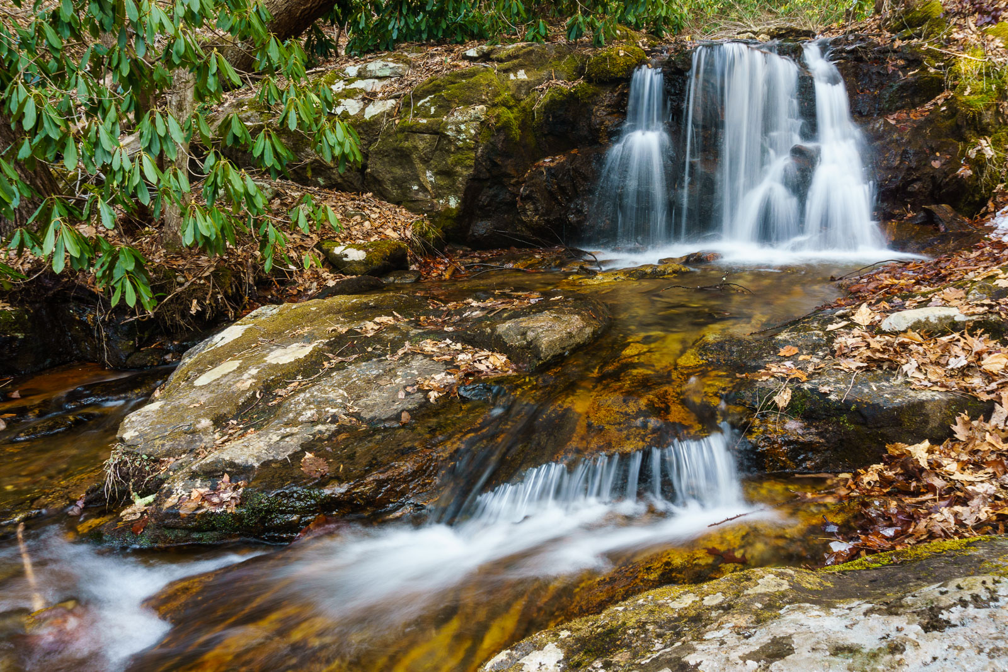
Water Quality Regulations – Surface Waters
The following statutes and regulations are in place to protect surface waters:
Clean Water Act
Fish and Wildlife Coordination Act
Rivers and Harbors Act
Safe Drinking Water Act
State statutes protecting surface waters
Text Source: FAA. 2023, October. 1050.1 Desk Reference (v3). https://www.faa.gov/about/office_org/headquarters_offices/apl/environ_policy_guidance/policy/faa_nepa_order/desk_ref

Slide 16
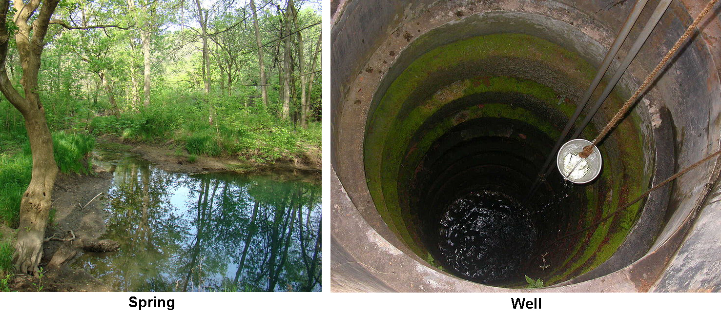
Water Quality Regulations – Groundwater
The following statutes and regulations are in place to protect groundwater:
Safe Drinking Water Act
State statutes protecting surface waters
Text Source: FAA. 2023, October. 1050.1 Desk Reference (v3). https://www.faa.gov/about/office_org/headquarters_offices/apl/environ_policy_guidance/policy/faa_nepa_order/desk_ref

Slide 17
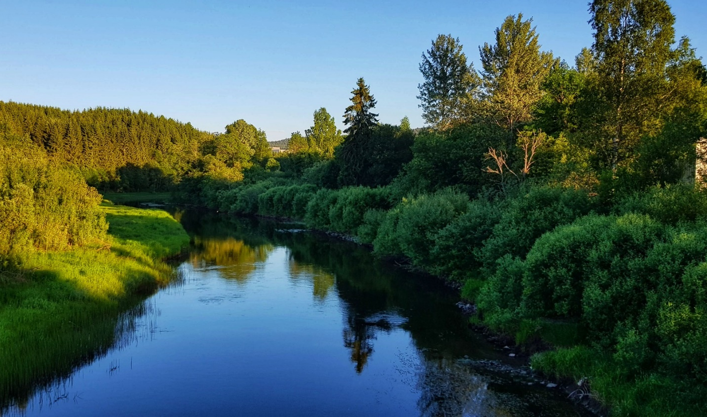
Water Quality Regulations – Wild and Scenic Rivers
The following statutes and regulations are in place to protect wild and scenic rivers:
Wild and Scenic Rivers Act
Text Source: FAA. 2023, October. 1050.1 Desk Reference (v3). https://www.faa.gov/about/office_org/headquarters_offices/apl/environ_policy_guidance/policy/faa_nepa_order/desk_ref

Slide 18
Water Quality Permits
The following are typical water quality permits that may apply to airports:
National Pollutant Discharge Elimination System (NPDES) permit under Section 402 of CWA – for projects having a point source discharge to a navigable waterway or that would disturb at least one acre
U.S. Army Corps of Engineers (USACE) Section 404 permit under Section 404 of CWA – for projects filling or dredging navigable waters of the U.S., including jurisdictional wetlands
Water Quality Certificate – a CWA Section 401 certificate, required if a Section 404 permit is needed
State and local permits also apply – vary by state and region
For applicability of various permits, see Table 3-1 in ACRP Research Report 169: Clean Water Act Requirements for Airports
Source: Mericas, D., J. Longsworth, and K. Shannon. 2016. ACRP Research Report 169: Clean Water Act Requirements for Airports. Transportation Research Board, Washington, DC. https://doi.org/10.17226/24657

Slide 19
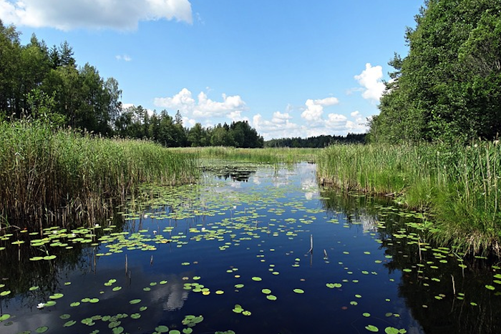
U.S. Army Corps of Engineers Section 404 Permit
The USACE Section 404 permit, in the context of airports, typically involves wetlands.
A 404 permit may apply if airport property contains wetlands that are within WOTUS
The need for a 404 permit is based on wetland acreage impacts
Prior to beginning construction or development activities, the airport must confirm whether the wetlands are federally regulated as WOTUS
If the wetlands are confirmed as federally regulated and the acreage impact is above regulatory thresholds, then a nationwide permit or individual permit is required
Text Source: Mericas, D., J. Longsworth, and K. Shannon. 2016. ACRP Research Report 169: Clean Water Act Requirements for Airports. Transportation Research Board, Washington, DC. https://doi.org/10.17226/24657

Slide 20
National Pollutant Discharge Elimination System Industrial Stormwater Permit
The National Pollutant Discharge Elimination System (NPDES) permit enables pollutant discharges from point sources into waters of the United States (WOTUS). The permit contains limits on what can be discharged, monitoring and reporting requirements, and other provisions to ensure that the discharge does not hurt water quality or people’s health.
An NPDES permit is required if discharging into WOTUS and may apply to the following airport activities:
Equipment cleaning and maintenance, which includes vehicle and equipment repairs, painting, fueling, and lubrication
Deicing/anti-icing operations
Construction with a disturbance of one acre or more
Text Source: EPA. 2023. NPDES Permit Basics. https://www.epa.gov/npdes/npdes-permit-basics

Slide 21
Spill Prevention, Control, and Countermeasure
The Spill Prevention, Control, and Countermeasure (SPCC) plan describes equipment, workforce, procedures, and training to prevent, control, and provide adequate countermeasures to a discharge of oil.
An SPCC plan is required for:
Facilities that store greater than 1,320 gallons of oil
Facilities with completely buried oil storage capacity greater than 42,000 gallons
Tanks and containers with individual oil storage capacity of 55 gallons or greater (typically drums and totes)
Facilities that have a “reasonable expectation of an oil discharge” to water
Non-transportation-related storage of oil, including gasoline, at airports
The SPCC plan is required by federal law and is a standalone plan separate from NPDES.
Source: ACRP, Research Report 169: Clean Water Act Requirements for Airports (2016), http://nap.nationalacademies.org/24657

Slide 22
Storm Water Pollution Prevention Plan
The Storm Water Pollution Prevention Plan (SWPPP) outlines how stormwater runoff, erosion, and sediment will be controlled to minimize polluted stormwater runoff into waters.
Required as part of an NPDES permit (for operations and construction)
Identifies stormwater Best Management Practices (BMPs) to reduce the potential for industrial pollutants to mix with stormwater
May require periodic updates to account for stormwater changes and new projects
Project-specific SWPPPs and SPCCs can be required in addition to overall airport plans.
Text Source: Mericas, D., J. Longsworth, and K. Shannon. 2016. ACRP Research Report 169: Clean Water Act Requirements for Airports. Transportation Research Board, Washington, DC. https://doi.org/10.17226/24657

Slide 23
Best Management Practices
Best Management Practices (BMPs) may be implemented to minimize point source discharge impacts. These can include:
Modifications to schedules or activities
Maintenance procedures
Management practices
Construction practices (such as erosion control)
BMPs can be employed in day-to-day operations to reduce water quality impacts. Protecting water quality can be accomplished without creating or enhancing hazardous wildlife habitat.
Source: FAA, 1050.1 Desk Reference (Oct. 2023), https://www.faa.gov/about/office_org/headquarters_offices/apl/environ_policy_guidance/policy/faa_nepa_order/desk_ref

Slide 24
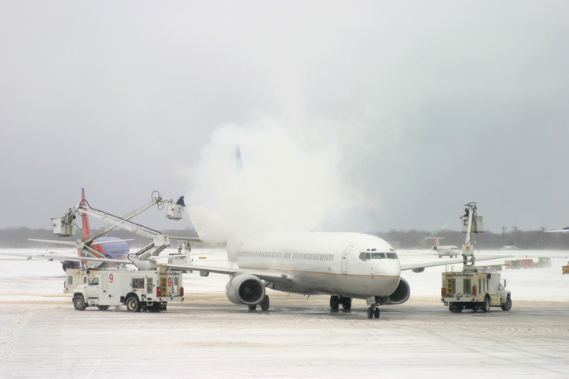
Deicing and Anti-icing Guidelines
Deicing aircraft and airfield pavement is critical to ensuring safe flight operations during winter weather; however, runoff from deicing and anti-icing applications can have adverse environmental impacts.
The EPA has established rules for discharges associated with aircraft and pavement deicing
Without discharge controls in place, deicing operations can degrade nearby water bodies
Airports are required to obtain stormwater discharge permits under the NPDES program and ensure that wastes from deicing operations are properly collected and treated
For more information from the EPA on effluent deicing guidelines, visit www.epa.gov/eg/airport-deicing-effluent-guidelines

Slide 25
Per- and Polyfluoroalkyl Substances
Per- and polyfluoroalkyl substances (PFAS) are synthetic chemicals with unique properties, including both water and oil repellency and surfactant properties.
Nicknamed “forever chemicals” because they do not break down easily
PFAS are used in aqueous film forming foam (AFFF), which is used to extinguish Class B flammable liquid fires at a variety of facilities, including commercial airports
If an airport has never stored, transported, or used AFFF, the airport is unlikely to have a concern associated with AFFF or PFAS
The regulation of PFAS is evolving—additional information can be found at www.epa.gov/pfas
Source: Thalheimer, A.H. et al. 2017. ACRP Research Report 173: Use and Potential Impacts of AFFF Containing PFASs at Airports. Transportation Research Board, Washington, DC. https://doi.org/10.17226/24800

Slide 26
Sources of PFAS at Airports
Regulations pertaining to PFAS are evolving; monitor changes in regulations if the potential for PFAS exists at your airport.
Potential sources of PFAS at airports include:
Firefighting training areas where AFFF is used
Firefighting equipment maintenance areas (e.g., from foam tests)
Disposal areas
Treatment lagoons
Impacted soils
Fire suppression systems in hangars
Drainage and wastewater systems used to contain discharged fire-extinguishing materials
Storage areas for AFFF
Tanks, vehicles, equipment, and distribution systems used to store or apply AFFF that were not adequately rinsed and may have become a continuous source
Source: Thalheimer, A.H. et al. 2017. ACRP Research Report 173: Use and Potential Impacts of AFFF Containing PFASs at Airports. Transportation Research Board, Washington, DC. https://doi.org/10.17226/24800

Slide 27
What Does this Mean to Your Airport?
How does your airport ensure water quality is maintained?
Does your airport have an NPDES permit?
Does your airport have a current SPCC and SWPPP?
When were they last updated?
Whose responsibility is it to update the permit?
What water resources are present on your airport?
Are there obvious wetlands or surface waters?
What about dry creek or groundwater sources?
When was the last wetland and stream delineation completed at your airport?
Is your airport at risk for PFAS contamination?
Review historic use of AFFF at the airport, and map the locations of use

Slide 28
Course Wrap-Up
Some key takeaways include:
Water runoff from airports can impact nearby water quality, potentially impacting animals, plants, and human populations
Obtaining the proper permits, creating prevention plans, and using BMPs for construction projects can help prevent water quality impacts
Understanding the water resources in proximity to the airport and the regulations that protect them is key to preventing water quality impacts

Slide 29
References
EPA. n.d. Home page. https://www.epa.gov/
EPA. 2023. NPDES Permit Basics. https://www.epa.gov/npdes/npdes-permit-basics
FAA. 2023, October. 1050.1 Desk Reference (v3). https://www.faa.gov/about/office_org/headquarters_offices/apl/environ_policy_guidance/policy/faa_nepa_order/desk_ref
ICAO. n.d. Eco-Airport Toolkit E-collection. https://www.icao.int/environmental-protection/pages/ecoairports.aspx
Mericas, D., J. Longsworth, and K. Shannon. 2016. ACRP Research Report 169: Clean Water Act Requirements for Airports. Transportation Research Board, Washington, DC. https://doi.org/10.17226/24657
Thalheimer, A.H. et al. 2017. ACRP Research Report 173: Use and Potential Impacts of AFFF Containing PFASs at Airports. Transportation Research Board, Washington, DC. https://doi.org/10.17226/24800

Slide 30
ACRP Disclaimer and Publication Details
This presentation was produced as part of ACRP Project 02-101, “Environmental Stewardship and Compliance Training for Airport Employees.” The full publication for this project can be accessed at crp.trb.org/acrpwebresource21. Program information for ACRP can be found at www.TRB.org/ACRP.
The ACRP is sponsored by the Federal Aviation Administration. ACRP is administered by the Transportation Research Board, part of the National Academies of Sciences, Engineering, and Medicine.
Any opinions expressed or implied in resulting research products are those of the individuals and organizations who performed the research and are not necessarily those of TRB; the National Academies of Sciences, Engineering, and Medicine; or ACRP sponsors.

