Slide 1
ACRP WebResource 21: Environmental Stewardship and Compliance Training for Airport Employees
Environmental 101 Training Course

Slide 2
Course Objectives and Overview
This course will provide a high-level overview of environmental topics and how they apply to airports.
Specifically, participants will be knowledgeable of the following upon completion of the course:
Which environmental topics are most important to airports
A basic understanding of the environmental topics affecting airports and airport development
Training available to airport management and operations staff through ACRP WebResource 21.
Links to federal references may be modified over time. Please search FAA and other federal websites to find the most current reference material.

Slide 3
Key Definitions and Terms
Clean Air Act (CAA) – the United States' primary federal air quality law, intended to reduce and control air pollution nationwide
Clean Water Act (CWA) – establishes the basic structure for regulating discharges of pollutants into the waters of the United States and regulating quality standards for surface waters
Day Night Average Sound Level (DNL) – the standard metric calculated using the A-weighted decibel unit (dBA) for determining cumulative exposure of individuals to noise
Direct Emissions – emissions that occur from sources that are controlled or owned by an organization (e.g., emissions associated with fuel combustion in boilers, furnaces, vehicles)
Environmental Protection Agency (EPA) – federal agency with a mission to protect human health and environment
Source: EPA. n.d. Home page. https://www.epa.gov/

Slide 4
Key Definitions and Terms (cont’d)
Hazardous Materials – any substances or materials commercially transported that pose unreasonable risk to public health, safety, and property. They include hazardous wastes and hazardous substances as well as petroleum and natural gas substances and materials
Indirect Emissions – emissions associated with the purchase of electricity, steam, heat, or cooling resulting from the organization’s energy use
National Environmental Policy Act (NEPA) – an act signed into law in 1970 requiring federal agencies to assess the environmental effects of their actions prior to making decisions
Resiliency – the ability to anticipate, prepare for, and respond to hazardous events, such as earthquakes, wildfires and flooding, and trends or disturbances related to the changing climate
Source: EPA. n.d. Home page. https://www.epa.gov/

Slide 5
Key Definitions and Terms (cont’d)
Sustainability – according to the U.N. (1987), sustainability is “meeting the needs of the present without compromising the ability of future generations to meet their own needs”
Wildlife Habitat - a place where a population of plants or animals lives, grows, and reproduces; habitats can be small (e.g., a log) or large (e.g., desert) (EPA n.d.)

Slide 6
Airports and the Environment
Understanding how airports coexist with the environment is key to understanding how to reduce potential environmental impacts.
Airports of all sizes can have an impact on the environment
Consequences of the environmental impacts can harm human health
Airports can directly impact the environment within airport boundaries but also indirectly impact the surrounding areas
Airports can train management and operations staff on environmental topics to understand how to reduce the airport’s environmental impact (footprint)

Slide 7
Top Environmental Topics for Airports
Through airport interviews, the following were identified as the most pressing topics that airports want more information on:
Air Quality
Airport Resiliency
Airport Sustainability
Aviation Noise
NEPA
Water Quality
Wildlife Habitat Management and Control
Hazardous Materials and Waste Management

Slide 8
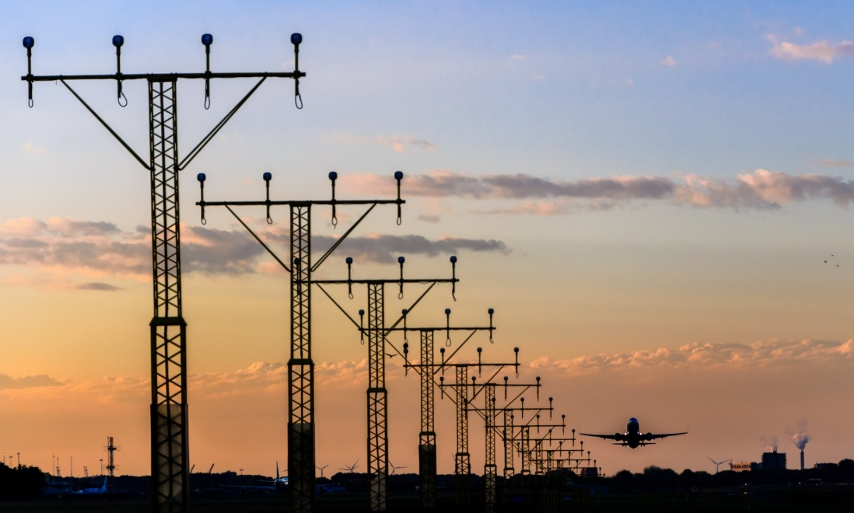
Air Quality – Training Introduction
The Air Quality course will provide a high-level overview of air quality, air quality regulations, and how regulations apply to airports.
In the Air Quality course, participants will learn:
The importance of air quality at airports and potential impacts
Air quality statutes and regulations, including the Clean Air Act (CAA), that are relevant to airports and airport projects
Greenhouse gas (GHG) emissions at airports
Typical airport emissions and their sources

Slide 9
Air Quality – Why is it Important?
Air quality can impact residential areas, recreational areas and the quality of the local environment.
Air pollution reduces the quality of the air we breathe daily
Poor air quality from air pollution has been linked to a variety of health problems
Older adults, children, and people with heart and respiratory diseases have greater risk for air pollution-related health effects
Emissions from aircraft, surface transportation and construction all contribute to an airport’s emissions footprint, including direct and indirect emissions that may affect surrounding communities
FAA often requires that an air quality analysis be completed for airport improvements to measure emission-related impacts and ensure compatibility with the local air quality standards
Be sure to consider the entire project, landside and airside, when analyzing air quality emissions.

Slide 10
Airport Resiliency – Training Introduction
The Airport Resiliency course will provide basic information regarding resiliency and how airports can use resiliency practices to predict, manage, and prevent disruptive events.
Resiliency will be discussed in terms of climate change, with the understanding that resiliency at airports can encompass a wide variety of topics.
In the Airport Resiliency course, participants will:
Gain a basic understanding of airport resiliency
Become knowledgeable about climate adaptation within the aviation context
Develop an awareness of steps that could be undertaken to minimize extended disruptions

Slide 11
Airport Resiliency – Why is it Important?
Resiliency is the ability to adapt to changing conditions as well as withstand and rapidly recover from disruptions due to emergencies.
Organizations use business continuity plans and procedures to keep operating during disruptive events
A resilient organization continuously anticipates changing conditions and disruptions and adjusts to them
This approach is summarized as prevention, protection, mitigation, response and recovery
Airports need to consider addressing airport resiliency for uninterrupted operations
Consider establishing an airport resiliency team and/or an airport resiliency plan to adequately assess and create action plans following events.

Slide 12
Airport Sustainability – Training Introduction
The Airport Sustainability course will provide basic information regarding sustainability and how it can be applied at airports. It will present general concepts, examples and benefits, and resources available to aid airports in developing and maintaining sustainability programs.
In the Airport Sustainability course, participants will:
Gain a basic understanding of sustainability in the context of airports
Become familiar with available airport sustainability resources
Gain awareness of steps that can be undertaken to develop and maintain sustainability programs
Photo credit: iStock/Getty Images/pidjoe

Slide 13
Airport Sustainability – Why is it Important?
The U.N. has defined sustainability as “meeting the needs of the present without compromising the ability of future generations to meet their own needs.”
Sustainability promotes a holistic and balanced approach to managing organizations. The aviation industry recognizes numerous benefits of sustainability, including:
Promotes innovative practices
Reduces operational and reputational risk
Enhances organizational and infrastructure resiliency
Improves asset utilization
Supports cost efficiencies
Strengthens stakeholder relationships
Increases transparency
Sustainability is scalable and applicable to airports of all sizes in all regions.
Source: United Nations (U.N.) Brundtland Commission. 1987. Report of the World Commission on Environment and Development: Our Common Future

Slide 14
Aviation Noise – Training Introduction
The Aviation Noise course will provide a high-level overview of noise impacts and regulations and how they apply to aviation.
In the Aviation Noise course, the participant will learn:
Noise levels at airports and potential impacts
Noise statutes and regulations relevant to airports and airport projects
Day Night Average Sound Level (DNL) and how it applies at airports
Noise analysis and how it applies to airports
Photo credit: iStock/Getty Images/ David-Prado

Slide 15
Aviation Noise – Why is it Important?
Aviation-related noise has the potential to impact residential and recreational areas in proximity to an airport.
In terms of airports, noise is most often associated with aircraft operations, impacting nearby residential and recreation areas
Noise has been linked to human health impacts
Noise from aircraft, surface transportation and construction all contribute to an airport’s noise profile
FAA often requires a noise analysis for airport improvements to measure noise-related impacts and ensure compatibility with surrounding land uses
When considering noise-sensitive areas, be sure to consider areas that will be directly and indirectly impacted. Indirect areas may be outside the project area or flight path but still exposed to increased noise.

Slide 16
NEPA 101 – Training Introduction
The NEPA 101 course will provide a high-level overview of NEPA regulations and how they apply to airport management and operations.
In the NEPA 101 course, participants will learn:
The definition of NEPA and why it is important in aviation
NEPA and the types of airport projects considered federal actions
Required levels of NEPA documentation
NEPA environmental impact categories
A high-level understanding of FAA Order 1050.1 and how it applies to airport management and operations roles

Slide 17
NEPA 101 – Why is it Important?
The National Environmental Policy Act (NEPA) requires federal agencies to assess the environmental effects of their actions prior to making decisions.
Regarding airports, NEPA applies to:
Federally funded actions
Federal approval of changes to Airport Layout Plans (ALPs)
Issuance of federal grants
Federal approval of land purchases and land disposals
Locally/privately funded projects, if they result in a change to the ALP
Future conditions that are conditionally approved and shown on an ALP
Imposing and spending Passenger Facility Charge (PFC) funds for airport projects
Changes in land use at the airport
Future conditions shown on an ALP are conditionally approved upon further environmental review. Just because it is shown does not mean it is approved.

Slide 18
Water Quality – Training Introduction
The Water Quality course will provide a high-level overview of water quality, water quality regulations, and how regulations apply to airports.
In the Water Quality course, participants will learn:
The importance of water quality at airports
Water quality regulations relevant to airports and airport projects
Water quality-related permits and plans
Typical airport water pollutants and their sources
Photo credit: iStock/Getty Images/Xavi Arroyo

Slide 19
Water Quality – Why is it Important?
Clean water resources are vital to all forms of life. They include a variety of sources, such as surface water, groundwater, wetlands, and floodplains.
Water quality can impact both on-airport and off-airport water resources.
Water runoff from airports can impact nearby water quality, potentially impacting animals, plants, and human populations
The use of permits, prevention plans, and Best Management Practices (BMPs) can help prevent water quality impacts
Understanding water resources and the regulations that protect them is key to preventing water quality impacts
Consider the entire water system when analyzing impacts to water.

Slide 20
Wildlife Habitat Management and Control – Training Introduction
The Wildlife Habitat Management and Control course will provide a high-level overview of wildlife hazards at both Part 139 and non-Part 139 airports and describe how FAA wildlife requirements apply to airport management and operations.
In the Wildlife Habitat Management and Control course, participants will learn:
Requirements at airports in relation to wildlife habitat management
Wildlife hazard identification
Recommended techniques for wildlife control
Photo credit: iStock/Getty Images/In Stock

Slide 21
Wildlife Habitat Management and Control – Why is it Important?
Wildlife strikes impact aviation safety and safe airport operations.
Wildlife strikes pose a risk to aircraft crews, passengers and aircraft
Economic losses are in the billions of dollars
Wildlife hazards can be present at all airports, regardless of size or number of operations
Airports are required to take appropriate action to mitigate wildlife hazards
The management of wildlife hazards is an ongoing process
Control strategies need to account for threatened and endangered species
It is important to understand how the land on your airport is being used; for example, standing water may serve as a wildlife attractant.

Slide 22
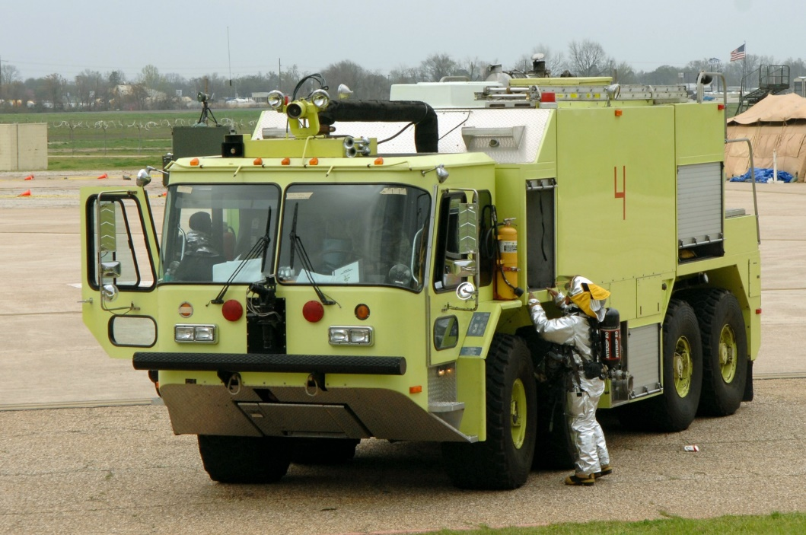
Hazardous Materials and Waste Management – Training Introduction
The Hazardous Materials and Waste Management course will provide a high-level overview of waste management and hazardous materials and how regulations apply to airports.
In the Hazardous Materials and Waste Management course, participants will learn:
Typical hazardous materials at airports, their sources, and potential impacts
Hazardous material and waste management regulations relevant to airports and airport projects
Typical sources of waste at airports

Slide 23
Hazardous Materials and Waste Management – Why is it Important?
Appropriate storage and handling of hazardous materials at airports is vital to protect the local environment.
Proper waste management at airports can help divert hazardous materials and solid waste from landfills.
Federal, state, and local laws regulate hazardous materials use, storage, transport and disposal
Airport sponsors purchasing or developing lands for airport purposes may encounter hazardous materials contamination
Disturbing sites that contain hazardous materials or contaminants may cause significant impacts to soil, surface water, groundwater, air quality and the organisms using these resources
Accidental spills of hazardous materials may violate federal, state and local laws

Slide 24
What Does this Mean to Your Airport?
Which environmental topics are important to your airport?
Provide links to the online training resources, and prioritize the training for airport staff
What are the environmental resources that have potential to exist in and around your airport?
Provide a list and a map of potential environmental resources in and around your airport
What environmental programs does your airport have in place to help protect the environment?
Provide a few statements regarding the sustainability goals/commitments at your airport and explain how employees can help contribute
Describe any recycling, reuse and waste reduction efforts at your airport and share any wins in waste reduction

Slide 25
Course Wrap-Up
Some key takeaways include:
The environment can be impacted by airports big and small
Consequences of the environmental impacts can harm human health
Airports can directly impact the environment within airport boundaries but also indirectly impact the surrounding areas in proximity to the airport
Airports can train management and operations staff on environmental topics using the trainings in ACRP WebResource 21 to help reduce the airport’s environmental impact (footprint)

Slide 26
References
EPA. n.d. Home page. https://www.epa.gov/
United Nations (U.N.) Brundtland Commission. 1987. Report of the World Commission on Environment and Development: Our Common Future

Slide 27
ACRP Disclaimer and Publication Details
This presentation was produced as part of ACRP Project 02-101, “Environmental Stewardship and Compliance Training for Airport Employees.” The full publication for this project can be accessed at crp.trb.org/acrpwebresource21. Program information for ACRP can be found at www.trb.org/ACRP.
The ACRP is sponsored by the Federal Aviation Administration. ACRP is administered by the Transportation Research Board, part of the National Academies of Sciences, Engineering, and Medicine.
Any opinions expressed or implied in resulting research products are those of the individuals and organizations who performed the research and are not necessarily those of TRB; the National Academies of Sciences, Engineering, and Medicine; or ACRP sponsors.

