Slide 1
ACRP WebResource 21: Environmental Stewardship and Compliance Training for Airport Employees
Aviation Noise Training Course

Slide 2
Course Objectives and Overview
This course will provide a high-level overview of noise impacts, noise regulations, and how they apply to aviation.
In this course, you will learn:
Noise levels at airports and potential impacts
Noise statutes and regulations relevant to airports and airport projects
Day Night Average Sound Level (DNL) and how it applies at airports
Noise analysis and how it applies to airports
Links to federal references may be modified over time. Please search FAA and other federal websites to find the most current reference material.

Slide 3
Key Definitions and Terms
Day Night Average Sound Level (DNL) – the FAA’s standard metric (using decibels) for determining cumulative exposure of individuals to noise (FAA 2022b)
Decibels (dB) – “the unit used to measure the intensity of a sound” (FAA 2022b)
Federal Interagency Committee on Noise (FICON) – a 1990 research committee formed to review federal policies that govern the assessment of noise impacts (FICON 1992)
Noise contours – contour lines on a map that depict levels of aircraft noise exposure surrounding an airport (FAA 2022b)

Slide 4
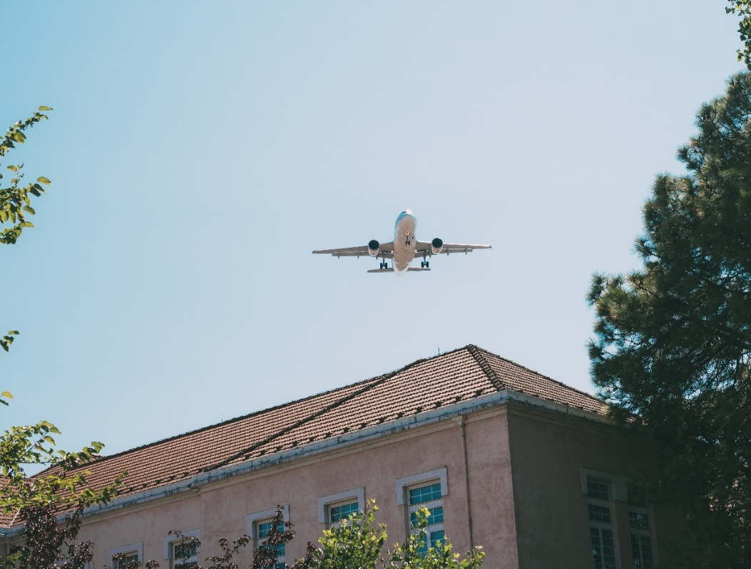
What is Noise and Why is it Important?
Having a common understanding of noise and its potential impacts is key to understanding aviation noise:
Noise is considered unwanted sound that can disturb routine activities (e.g., sleep, conversation, student learning) and can cause annoyance (FAA 2022b)
In terms of aviation, noise is most often associated with aircraft operations (FAA 2022b)
Noise has been linked to the following human health impacts (Civil Aviation Authority. n.d.):
Cognitive impairment in children
Increased risk in cardiovascular disease
Sleep disturbance and fatigue
Photo credit: iStock/Getty Images/David-Prado

Slide 5
Factors Determining Aviation Noise
Numerous factors determine how much aircraft noise is experienced on the ground, including:
What model aircraft and what type of engines are being used for each flight?
Are the aircraft taking off, landing, or completing a runup?
What is the flight path of the flights going overhead?
How quickly does each plane ascend and descend?
Are the aircraft operating at full power or partial power?
Flight schedules
Weather
Text Source: FAA. 2022a. Community Response to Noise. https://www.faa.gov/regulations_policies/policy_guidance/noise/community

Slide 6
Airport Noise Levels
Airport noise is measured in terms of Day Night Average Sound Level (DNL):
DNL is the 24-hour average sound level in decibels (dB); derived from all aircraft operations during a 24-hour period, DNL represents an airport’s average annual operational day
FAA adopted DNL to evaluate cumulative noise effects on people due to aviation activities in 1981
Federal Interagency Committee on Noise (FICON) research in 1992 “concluded that the DNL is the recommended metric and should continue to be used as the primary metric for aircraft noise exposure”
The level of annoyance from noise varies for each individual.
Source: FAA. 2023, October. 1050.1 Desk Reference (v3). https://www.faa.gov/about/office_org/headquarters_offices/apl/environ_policy_guidance/policy/faa_nepa_order/desk_ref

Slide 7
Airport Noise Profile
An airport’s noise profile has several components:
An airport’s loudest noise levels control the 24-hour average
DNL adds a 10 dB noise penalty to the airport’s DNL baseline for each aircraft operating during nighttime hours (10 p.m. to 7 a.m.), meaning noise from one aircraft operating during that time period counts as 10 operations
Typical noise contours used for analysis are DNL 60, 65, 70 and 75 dB resulting from aircraft operations
The FAA currently considers DNL 65 and below to be compatible/acceptable for residential areas
Noise is often perceived to be louder at night with fewer other noise emissions.
Source: FAA. 2023, October. 1050.1 Desk Reference (v3). https://www.faa.gov/about/office_org/headquarters_offices/apl/environ_policy_guidance/policy/faa_nepa_order/desk_ref

Slide 8
Aviation Noise Analysis in Residential Areas
Airport and aircraft noise perception can vary depending on DNL values experienced in residential areas, making it difficult to identify aviation noise issues.
Typical ambient DNL noise levels in residential areas can range from “quiet” to “very noisy”:
A quiet suburban residential area has a sound level of DNL 50 (dB)
A suburban residential area has a sound level of DNL 55 (dB)
An urban residential area has a sound level of DNL 60 (dB)
A noisy urban residential area has a sound level of DNL 65 (dB)
A very noisy urban residential area has a sound level of DNL 70 (dB)
For additional DNL comparisons, see FAA’s aviation noise policies.
Source: FAA. 2022a. Community Response to Noise. https://www.faa.gov/regulations_policies/policy_guidance/noise/community

Slide 9
Airport Noise Regulations
The following statutes, regulations, and executive orders are in place for airport noise and noise-compatible land use:
The Control and Abatement of Aircraft Noise and Sonic Boom Act of 1968 – authorizes the FAA to prescribe standards for the measurement of aircraft noise and establish regulations to abate noise
The Noise Control Act of 1972 – amends the Control and Abatement of Aircraft Noise Sonic Boom Act of 1968 to add consideration of the protection of public health and welfare and to add the EPA to the rulemaking process for aircraft noise and sonic boom standards
Aviation Safety and Noise Abatement Act of 1979 – directs the FAA to establish, by regulation, a single system for measuring noise and determining the exposure of people to noise—which includes noise intensity, duration, frequency, and time of occurrence—and to identify land uses normally compatible with various noise exposures
Source: FAA. 2023, October. 1050.1 Desk Reference (v3). https://www.faa.gov/about/office_org/headquarters_offices/apl/environ_policy_guidance/policy/faa_nepa_order/desk_ref

Slide 10
Airport Noise Regulations (cont’d)
Airport and Airway Improvement Act of 1982 – authorizes funding for noise mitigation and noise compatibility planning and projects, as well as establishes certain requirements related to noise-compatible land use for federally funded airport development projects
Airport Noise and Capacity Act of 1990 – sets forth congressional findings with respect to (1) airport noise policy; (2) passenger facility charges; and (3) airport slots.
14 Code of Federal Regulations (CFR) Part 150 – prescribes regulations for airport noise compatibility planning
14 CFR Part 161 – prescribes regulations for notice and approval of airport noise and access restrictions
Other state and local noise laws and ordinances may apply to airport noise
More FAA airport noise regulations can be found online at www.faa.gov/noise.
Text Source: FAA. 2023, October. 1050.1 Desk Reference (v3). https://www.faa.gov/about/office_org/headquarters_offices/apl/environ_policy_guidance/policy/faa_nepa_order/desk_ref

Slide 11
Airport Noise and Land-Use Compatibility
Airport noise may be analyzed to ensure land-use compatibility for the surrounding airport environs:
FAA designated the DNL 65 dB contour as the cumulative noise exposure level for land-use compatibility
14 Code of Federal Regulations (CFR) Part 150 establishes compatibility guidelines related to DNL noise levels (i.e., residential land use)
Part 150 should not be used to determine aviation noise impacts on wildlife
Part 150 guidelines do not adequately address surrounding areas that are considered low noise or quiet areas — such as historic sites, national parks, or wildlife refuges—and may require supplemental noise analysis
State and local land-use compatibility guidelines and standards still apply
Source: FAA. 2023, October. 1050.1 Desk Reference (v3). https://www.faa.gov/about/office_org/headquarters_offices/apl/environ_policy_guidance/policy/faa_nepa_order/desk_ref

Slide 12
Airport Noise Significance Threshold
Noise thresholds at airports are important to consider when taking on new construction and development projects and determining action impacts:
Impacts are considered significant if:
An action would increase noise by DNL 1.5 dB or more for a noise-sensitive area that is exposed to noise at or above the DNL 65 dB noise exposure level, or
An area will be exposed to noise at or above the DNL 65 dB level due to a DNL 1.5 dB or greater increase when compared to the no-action alternative for the same timeframe
Impacts are determined by comparing base case (no action/existing condition) to alternatives
The FAA released the results of their Neighborhood Environmental Survey in 2021. The survey was part of the FAA’s ongoing effort to reduce the effects of aircraft noise exposure on communities. Results from the survey, combined with additional research, may change the DNL level that is found to be acceptable or compatible.
Source: FAA. 2023, October. 1050.1 Desk Reference (v3). https://www.faa.gov/about/office_org/headquarters_offices/apl/environ_policy_guidance/policy/faa_nepa_order/desk_ref

Slide 13
Noise-Sensitive Areas
Noise-sensitive areas in airport environs include:
Residential, educational, health, and religious structures and sites
Parks, recreational areas, areas with wilderness characteristics, wildlife refuges, and cultural and historical sites
When considering noise-sensitive areas, be sure to consider areas that will be directly and indirectly impacted. Indirect areas may not be within the project area or flight path, but they may still be exposed to increased noise.

Slide 14
Actions Normally Requiring a Noise Analysis
The following actions typically require an airport to conduct a noise analysis:
New airport location
New runway
Major runway extension
Runway strengthening
Aviation actions where:
Forecasted aircraft propeller annual operations exceed 90,000 operations
Forecasted jet aircraft annual operations exceeds 700 operations
Forecasted 10 daily helicopter operations (annual basis)
Actions that change the number, type, or pattern of aircraft may require a noise analysis.
Source: FAA. 2023, October. 1050.1 Desk Reference (v3). https://www.faa.gov/about/office_org/headquarters_offices/apl/environ_policy_guidance/policy/faa_nepa_order/desk_ref

Slide 15
Noise Analysis Tools
These tools are used by the FAA to screen and estimate impacts:
Area Equivalent Method (AEM) – a screening tool used by the FAA to determine if a more detailed noise analysis is needed
Aviation Environmental Design Tool (AEDT) – a tool used by the FAA for estimating the environmental consequences of aviation actions, such as noise, fuel consumption, and air pollutant emissions
Be sure to consider the entire project, landside and airside, when analyzing noise.
Source: FAA. 2023, October. 1050.1 Desk Reference (v3). https://www.faa.gov/about/office_org/headquarters_offices/apl/environ_policy_guidance/policy/faa_nepa_order/desk_ref

Slide 16
Other Sources of Aviation Noise
Aircraft are not the only noise generators at airports. Other sources include:
Surface transportation noise resulting from:
New, expanded, or realigned airport access roads
Increased airport automobile or truck activity
Increased vehicle speeds
Other surface transportation-related actions
Construction noise resulting from:
Blasting demolition
Construction equipment operation
Use of temporary haul routes
Temporary rerouting of vehicles

Slide 17
Helicopters, Unmanned Aircraft, and Advanced Air Mobility
Helicopters, unmanned aircraft (UA) and advanced air mobility (AAM) pose additional noise concerns to communities:
Helicopter noise abatement strategies include public outreach, helicopter noise management programs, and noise abatement procedures (Mestre, Schomer, and Liu 2016)
Fly Neighborly is a voluntary noise reduction program that publishes noise abatement guidelines for airports and helicopter operators (Mestre, Schomer, and Liu 2016)
UA and AAM noise standards are being developed by the FAA on a per aircraft basis due to the novelty and variety of these aircraft (FAA 2023)
For additional FAA information on helicopter noise, visit Fly Neighborly.

Slide 18
Airport Noise Management Program
Airports can invest in an airport noise management program to address noise issues such as noise complaints, local opposition to airport development programs, community pressure to change operations, and threats of legal action.
An airport noise management program can include the following:
Establish noise management goals with public input
Develop noise mitigation and abatement programs with public input
Implement public outreach programs and stakeholder engagement
Measure program progress and performance using Noise and Operations Monitoring System (NOMS)
Measure program progress by engaging and involving the public
Text Source: Valdes, C. et al. 2022. ACRP Research Report 237: Primer and Framework for Considering an Airport Noise and Operations Monitoring System. Transportation Research Board, Washington, DC. https://doi.org/10.17226/26527

Slide 19
Noise and Operations Monitoring System
Noise and Operations Monitoring System (NOMS) is a modern tool for analyzing airport noise problems and measuring airport noise management program success. A NOMS can be funded using Airport Improvement Program (AIP) grants and is a key component of an airport noise management program, giving airports the ability to:
Assess noise control for alternative flight procedures
Assist with the investigation of public inquiries and complaints
Validate noise modeling efforts
Educate pilots, airlines, and the public about airport noise
Manage public expectations and replace perceptions with facts
Source: Valdes, C. et al. 2022. ACRP Research Report 237: Primer and Framework for Considering an Airport Noise and Operations Monitoring System. Transportation Research Board, Washington, D.C. https://doi.org/10.17226/26527

Slide 20
Noise Abatement Through Community Engagement
Community engagement is a key component of noise abatement programs. Strategies for successful community engagement include:
Have a community/service-oriented commitment
Develop progressive communication strategies
Establish continuous proactive engagement
Acquire good listening skills
Develop information, valuing quality over quantity
Build lasting relationships, and establish trust
Manage community expectations through transparency and two-way communication
Address feelings, and do hard things
Decide when help is needed
Text Source: Woodward, J. M., L. L. Briscoe, and P. Dunholter. 2009. ACRP Report 15: Aircraft Noise: A Toolkit for Managing Community Expectations. Transportation Research Board of the National Academies, Washington, DC. https://doi.org/10.17226/14338

Slide 21
Noise Abatement Action Best Practices
Noise compatibility issues can be addressed through abatement best practices, including:
Modify flight track locations to overfly corridors of compatible use land
Establish voluntary runway utilization programs that maximize the use of compatible lands for arrivals and departures
Restrict run-up operations during nighttime hours
Restrict run-up activities to locations away from noise-sensitive areas, or construct a ground run-up enclosure to mitigate noise from run-ups
Implement a “good neighbor” policy through pilot awareness programs and community engagement
The FAA is phasing out older, noisier civil aircraft, resulting in a reduction in noise from the overall aircraft fleet within the United States.
Source: Woodward, J. M., L. L. Briscoe, and P. Dunholter. 2009. ACRP Report 15: Aircraft Noise: A Toolkit for Managing Community Expectations. Transportation Research Board of the National Academies, Washington, DC. https://doi.org/10.17226/14338

Slide 22
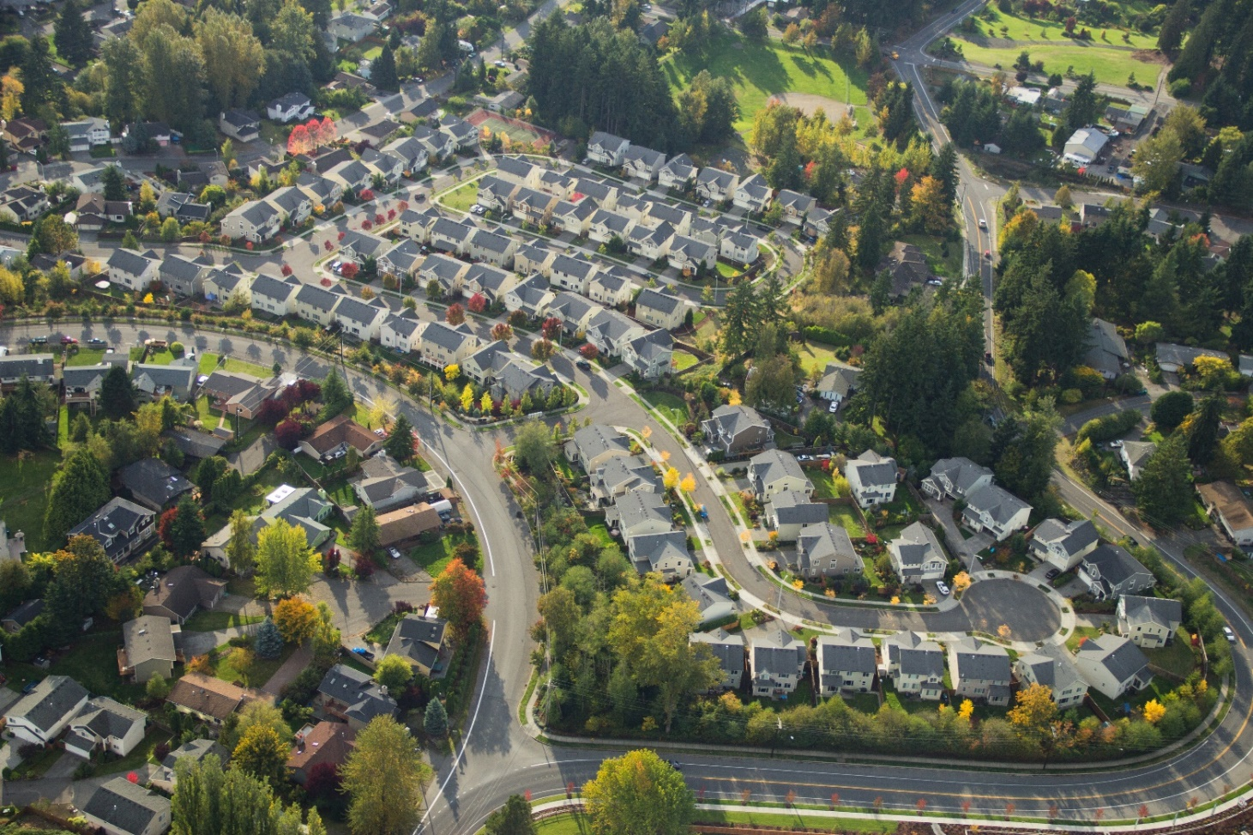
Mitigation Action Best Practices
Noise compatibility issues can be addressed through mitigation best practices, including:
Acquiring property within significant noise-level areas
Sound insulation of noise-sensitive properties (churches, schools, and residences)
Comprehensive community planning
Noise overlay zoning for development compatible with airport environs
Establishment of avigation (noise and/or overflight) easements
Collaboration between airport management and local land-use planners
Text Source: Woodward, J. M., L. L. Briscoe, and P. Dunholter. 2009. ACRP Report 15: Aircraft Noise: A Toolkit for Managing Community Expectations. Transportation Research Board of the National Academies, Washington, DC. https://doi.org/10.17226/14338

Slide 23
What Does this Mean to Your Airport?
What is your airport’s noise profile?
Provide the most recent noise contours and date of completion, if available
What are the noise-sensitive areas surrounding your airport?
Provide maps showing areas that are sensitive to noise—might be residential areas, parks, schools, etc.
What are the construction-related noise sources at your airport?
Determine construction-related noise, including common haul routes, and any noise-sensitive areas in your airport’s environs
How does your airport address noise complaints?
Provide advice on the sensitive nature of noise issues and how to address noise complaints

Slide 24
Course Wrap-Up
Some key takeaways include:
Noise from airport aircraft, surface transportation, and construction all contribute to the airport’s noise profile
The FAA requests noise analysis for airport improvements to reduce noise-related impacts and ensure compatibility with surrounding land uses
Airports need to understand their baseline airport noise profile when making key decisions that may change future operations and the level of noise affecting communities in areas surrounding the airport

Slide 25
References
Civil Aviation Authority. n.d. Aviation Noise and Health: The Effects of Aviation Noise. https://www.caa.co.uk/consumers/environment/noise/aviation-noise-and-health/
FAA. 2022a. Community Response to Noise. https://www.faa.gov/regulations_policies/policy_guidance/noise/community
FAA. 2022b. Fundamentals of Noise and Sound. https://www.faa.gov/regulations_policies/policy_guidance/noise/basics
FAA. 2022c. History of Noise. https://www.faa.gov/regulations_policies/policy_guidance/noise/history
FAA. 2023, July. Noise Certification of UAS/AAM Using Rules of Particular Applicability. https://www.faa.gov/about/office_org/headquarters_offices/apl/aee/noise/uas_noise_certification
FAA. 2023, October. 1050.1 Desk Reference (v3). https://www.faa.gov/about/office_org/headquarters_offices/apl/environ_policy_guidance/policy/faa_nepa_order/desk_ref
FICON. 1992, August. Federal Agency Review of Selected Airport Noise Analysis Issues. https://www.faa.gov/fican/about_ficon_findings_1992.pdf
Mestre, V., P. Schomer, and K. Liu. 2016. ACRP Synthesis 76: Helicopter Noise Information for Airports and Communities. Transportation Research Board, Washington, DC. https://doi.org/10.17226/23609
Valdes, C. et al. 2022. ACRP Research Report 237: Primer and Framework for Considering an Airport Noise and Operations Monitoring System. Transportation Research Board, Washington, DC. https://doi.org/10.17226/26527
Woodward, J.M., L.L. Briscoe, and P. Dunholter. 2009. ACRP Report 15: Aircraft Noise: A Toolkit for Managing Community Expectations. Transportation Research Board of the National Academies, Washington, DC. https://doi.org/10.17226/14338

Slide 26
ACRP Disclaimer and Publication Details
This presentation was produced as part of ACRP Project 02-101, “Environmental Stewardship and Compliance Training for Airport Employees.” The full publication for this project can be accessed at crp.trb.org/acrpwebresource21. Program information for ACRP can be found at www.TRB.org/ACRP.
The ACRP is sponsored by the Federal Aviation Administration. ACRP is administered by the Transportation Research Board, part of the National Academies of Sciences, Engineering, and Medicine.
Any opinions expressed or implied in resulting research products are those of the individuals and organizations who performed the research and are not necessarily those of TRB; the National Academies of Sciences, Engineering, and Medicine; or ACRP sponsors.

