Slide 1
ACRP WebResource 21: Environmental Stewardship and Compliance Training for Airport Employees
Air Quality Training Course

Slide 2
Course Objectives and Overview
This course will provide a high-level overview of air quality, air quality regulations, and how these regulations apply to airports.
In this course you will learn:
The importance of air quality at airports and potential impacts
Air quality statutes and regulations relevant to airports and airport projects
Greenhouse gas (GHG) emissions at airports
Typical airport air pollutants and their sources
Links to federal references may be modified over time. Please search FAA and other federal websites to find the most current reference material.

Slide 3
Key Definitions and Terms
Attainment Area – a geographical area where the levels of all criteria pollutants meet the National Ambient Air Quality Standards (NAAQS)
Clean Air Act (CAA) – the United States’ primary federal air quality law, intended to reduce and control air pollution nationwide
Criteria Air Pollutants – air pollutants for which the Environmental Protection Agency (EPA) has established a set of air quality standards. The six “criteria” air pollutants are: carbon monoxide (CO); lead (Pb); nitrogen dioxide (NO₂), ozone (O₃), particulate matter (PM) for both PM10 and PM2.5, and sulfur dioxide (SO₂)
Emissions – gases and particles which are put into the air or emitted by various sources
Greenhouse Gases (GHGs) – certain types of gaseous emissions that may contribute to increases in the earth’s average temperature through a phenomenon called the “greenhouse effect”
Source: EPA. n.d. Home page. https://www.epa.gov/

Slide 4
Key Definitions and Terms (cont’d)
Hazardous Air Pollutants (HAPs) – toxic gases known to have impacts on human health
Maintenance Area – a geographical area previously designated “nonattainment” but re-designated as a “maintenance area” because air pollution levels have improved above levels that would place the area in nonattainment status
National Ambient Air Quality Standards (NAAQS) – Standards set by the EPA as required by the CAA for the six criteria air pollutants
Non-attainment Area – a geographical area where the concentration of one or more criteria air pollutants is higher than NAAQS
State Implementation Plan (SIP) – an EPA-approved plan developed by a state to achieve or maintain the NAAQS within timeframes set under CAA
Ultrafine Particulate Matter – Particulate matter (PM) with an aerodynamic diameter of less than 0.1 µm (a particle small enough to penetrate the lower respiratory tract)
Source: EPA. n.d. Home page. https://www.epa.gov/

Slide 5
Impacts of Air Quality
Humans can be impacted by air quality every day:
Air pollution reduces the quality of the air we breathe daily
Poor air quality from air pollution has been linked to a variety of health problems
Older adults, children, and people with heart and respiratory diseases have greater risk for air pollution-related health effects
Air pollutants such as greenhouse gases (GHGs) contribute to climate change
For additional information on air quality, see the EPA’s website Our Nation’s Air.

Slide 6
Aviation Contributions to Air Quality
Primary air pollutants of interest from airport operations include:
Greenhouse gases (GHGs)
Criteria pollutants
Hazardous air pollutants (HAPs)
Ultrafine particulate matter
Lead from aviation gasoline (AvGas)

Slide 7
Airport Greenhouse Gas Emissions
Greenhouse gas (GHG) emissions are often associated with climate change:
GHGs refer to certain types of gaseous emissions that may contribute to increases in the earth’s average temperature through a phenomenon called the “greenhouse effect”
Primary GHGs include carbon dioxide (CO₂), methane (CH₄), nitrous oxide (N₂O), hydrofluorocarbons (HFCs), perfluorocarbons (PFCs), and sulphur hexafluoride (SF₆)
The GHG most relevant to aviation is CO₂
According to the Intergovernmental Panel on Climate Change, aviation is responsible for between 2-3% of total current global human-induced carbon emissions, with airports accounting for approximately “2% of total global share”
Source: Airport Carbon Accreditation. n.d. Home page. https://www.airportcarbonaccreditation.org/

Slide 8
Airport Greenhouse Gas Emissions – Progress as Promised!
The aviation industry is taking action to reduce its impacts on climate, including a net zero carbon goal by 2050 (by reducing and offsetting carbon emissions). The aviation industry is making progress:
Aviation carbon reduction July 2009 to June 2010
56,633 tons of CO₂ – the equivalent of carbon sequestered by 399 acres of forest
Aviation carbon reduction July 2018 to June 2019
322,297 tons of CO₂ – the equivalent of emissions from 767 million hours of video streaming in high definition
Additional information on airport CO₂ reduction and airport carbon accreditation can be found on the About pages for the Airport Carbon Accreditation program.
The FAA published the United States Aviation Climate Action Plan on November 9, 2021. The plan describes the government’s path toward achieving net-zero emissions by 2050. For additional information, visit Aviation Climate Action Plan.
Source: Airport Carbon Accreditation. n.d. Home page. https://www.airportcarbonaccreditation.org/

Slide 9
Greenhouse Gas Emissions Sources
Greenhouse gas sources at airports are typically divided into three categories, or “scopes,” based on the amount of control an airport has in reducing the emissions:
Scope 1 – emissions from airport-owned or controlled sources. Examples include airport-owned power plants that burn fossil fuels, conventional vehicles that use gasoline, or conventional ground support equipment (GSE) that uses diesel fuel.
Scope 2 – indirect emissions from the consumption of purchased energy (electricity, heat, steam, cooling, etc.).
Scope 3 – indirect emissions that the airport does not control but can influence. Examples include tenant emissions, on-airport aircraft emissions (typically after an aircraft is parked on the apron), emissions from passenger vehicles arriving or departing the airport, and emissions from waste disposal and processing.
When considering pollutant emission impacts, be sure to consider areas that will be directly and indirectly impacted. Indirect areas may be outside the project area but still impacted by emissions.
Source: FAA. 2023, November. Airport Carbon Emissions Reduction. https://www.faa.gov/airports/environmental/air_quality/carbon_emissions_reduction

Slide 10
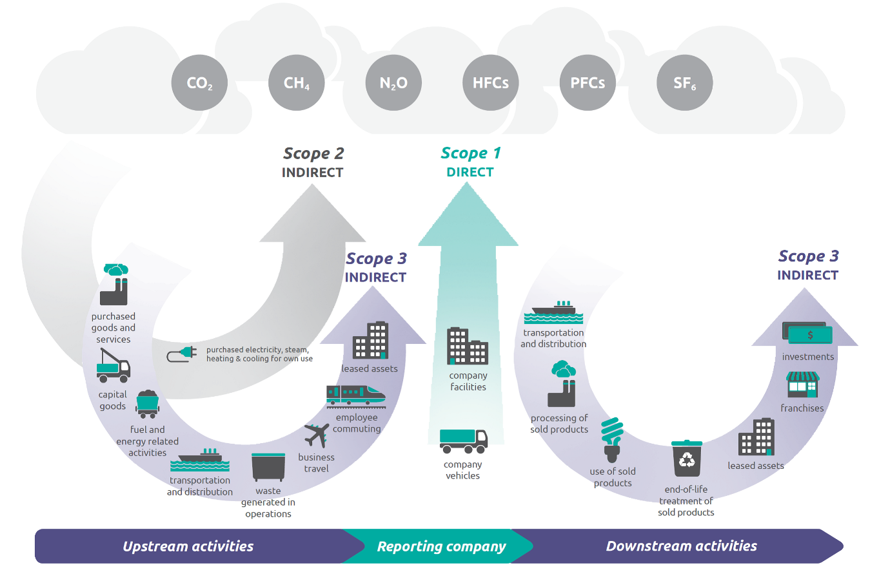
Greenhouse Gas Resources
Additional information on greenhouse gases (GHGs) can be found on the EPA website pages provided below or by searching for “GHG Inventory Development Process and Guidance” at www.epa.gov.
Scopes 1, 2 and 3 Emissions Inventorying and Guidance
Scope 1 and Scope 2 Inventory Guidance
Scope 3 Inventory Guidance
Source: WRI/WBCSD. n.d. Corporate Value Chain (Scope 3) Accounting and Reporting Standard, page 5.

Slide 11
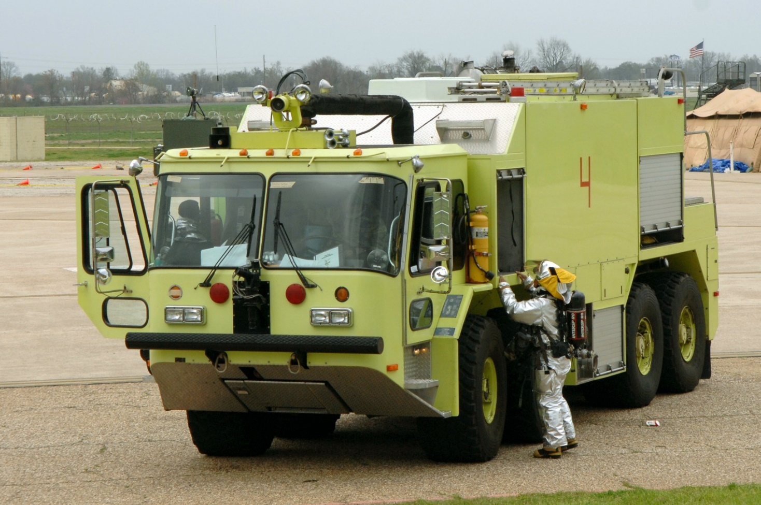
Scope 1 Emissions
Scope 1 – emissions from airport-controlled sources include:
Vehicles/GSE belonging to the airport
On-site waste management
On-site wastewater management
On-site power generation
Firefighting exercises
Boilers and furnaces
De-icing substances
Refrigerant losses
Text Source: Airport Carbon Accreditation. n.d. Home page. https://www.airportcarbonaccreditation.org/

Slide 12
Scope 2 Emissions
Scope 2 – emissions from electricity purchased by airports include off-site electricity generation for:
Heating
Cooling
Lighting
Text Source: Airport Carbon Accreditation. n.d. Home page. https://www.airportcarbonaccreditation.org/

Slide 13
Scope 3 Emissions
Scope 3 – emissions from other sources for airport-related activities include:
Flights
Aircraft ground movements
Auxiliary power unit
Third-party vehicles/GSE
Passenger travel to the airport
Staff commutes
Off-site waste management
Off-site water management
Staff business travel
Non-road construction vehicles and equipment
De-icing substances
Refrigeration losses
Source: Airport Carbon Accreditation. n.d. Home page. https://www.airportcarbonaccreditation.org/

Slide 14
Airport GHG Emissions Reduction Techniques
Multiple techniques can be used to reduce GHG emissions at airports:
Map out and identify emissions sources and scopes
Inventory existing airport carbon emissions using Airports Council International’s free Airport Carbon and Emissions Reporting Tool (ACERT)
Pursue cost-effective energy efficiency measures, like improving building insulation to reduce GHG emissions and lower operating costs
Purchase renewable energy
Install renewable energy systems at the airport (provided they are compatible with airport operations)
Reduce energy consumption
Monitor the efficiency of heating, ventilation, and cooling systems
Purchase low- or zero-emissions vehicles and ground support equipment (GSE)
More information on GHG emissions reduction and ACERT can be found on FAA’s website under Airport Carbon Emissions Reduction.
Source: FAA. 2023, November. Airport Carbon Emissions Reduction. https://www.faa.gov/airports/environmental/air_quality/carbon_emissions_reduction

Slide 15
AvGas and Lead Emissions Reduction
Aviation gas (AvGas) is a source of lead emissions at airports:
AvGas contains tetraethyl lead (TEL), which is toxic and can affect human health if inhaled or ingested
The U.S. has a goal to eliminate the use of leaded aviation fuels for piston-engine aircraft by 2030
Ways to reduce lead emissions at airports include:
Working to offer additional unleaded fuel types to facilitate the transition
Minimizing engine idling time and run-up times of piston-engine aircraft
Promote airport and pilot awareness
Increase distance between pre-flight/maintenance run-up locations and people on/off airport by relocating run-up locations or distributing run-ups to multiple locations
For more information from the FAA on lead emissions reduction, visit their EAGLE initiative page.
Source: FAA. 2022. Environment & Airports. https://www.faa.gov/about/initiatives/avgas/env_airports

Slide 16
Air Quality Regulations
The Clean Air Act (CAA) is the federal regulation for protecting air quality:
CAA regulates air pollutant emissions from stationary and mobile sources
CAA authorizes the EPA to establish National Ambient Air Quality Standards (NAAQS) for criteria pollutants
CAA authorizes EPA to regulate hazardous air pollutants (HAPs)
Text Source: FAA. 2023, October. 1050.1 Desk Reference (v3). https://www.faa.gov/about/office_org/headquarters_offices/apl/environ_policy_guidance/policy/faa_nepa_order/desk_ref

Slide 17
Clean Air Act and Airport Construction and Development
CAA governs air quality impacts from airport actions, including construction and development projects. The FAA must evaluate proposed airport landside and airside projects and their potential for impacting air quality.
Example landside projects include:
Construction, relocation and repair of airport access roads
Repair and maintenance of remote parking facilities
Repair and maintenance of rental car lots
Example airside projects include:
Building or expanding terminals and hangars
Building new or extending runways and taxiways
Installing navigational aids
The environmental review for proposed development projects that may impact air quality often requires an emissions and GHG analysis. These are most often required if the airport is in a non-attainment area for NAAQS.
Source: FAA. 2023, October. 1050.1 Desk Reference (v3). https://www.faa.gov/about/office_org/headquarters_offices/apl/environ_policy_guidance/policy/faa_nepa_order/desk_ref

Slide 18
National Ambient Air Quality Standards
Under the CAA, the EPA has established National Ambient Air Quality Standards (NAAQS) for the six criteria pollutants. Counties and air pollution districts may be in attainment, in nonattainment, or in maintenance for the criteria pollutants as designated by a state’s EPA-approved State Implementation Plan (SIP):
Attainment area – a geographical area where the levels of all criteria pollutants meet NAAQS
Nonattainment area – a geographical area where the concentration of one or more of the criteria air pollutants is higher than NAAQS
Maintenance area – a geographical area previously designated “nonattainment” but re-designated as a “maintenance area” because air pollution levels have improved above levels that would place the area in nonattainment status
EPA’s Green Book has county-level data showing whether a county is in attainment. To access the Green Book, visit www.epa.gov/green-book.
Source: FAA. 2023, October. 1050.1 Desk Reference (v3). https://www.faa.gov/about/office_org/headquarters_offices/apl/environ_policy_guidance/policy/faa_nepa_order/desk_ref

Slide 19
Actions Normally Requiring an Air Quality Analysis
An air quality analysis (emissions inventory) may be required in the following scenarios since they can change aircraft operations:
New airport location
A new runway
A major runway extension
Runway strengthening
Aviation actions where:
The proposed airport action would occur at a general aviation (GA) airport with a total of 180,000 GA and air taxi annual operations
The proposed airport action would occur at a commercial service airport with more than 1.3 million enplanements (2.6 million passengers) or more than 180,000 GA and air taxi annual operations
The proposed airport action serves a combination of operations and passengers
The proposed airport action would increase traffic coming to the airport and increase congestion at off-airport highway intersections
Be sure to consider the entire project, landside and airside, when analyzing air quality emissions.
Source: FAA. 2023, October. 1050.1 Desk Reference (v3). https://www.faa.gov/about/office_org/headquarters_offices/apl/environ_policy_guidance/policy/faa_nepa_order/desk_ref

Slide 20
Air Quality Analysis Significance Threshold
The FAA must consider if an action is significant and has potential impacts:
Considered significant if an action would exceed one or more NAAQS
Impacts are determined by comparing base case (no action/existing condition) to proposed alternatives
More information on NAAQS can be found in the NAAQS Table on the EPA’s website, under Criteria Air Pollutants.
Source: FAA. 2023, October. 1050.1 Desk Reference (v3). https://www.faa.gov/about/office_org/headquarters_offices/apl/environ_policy_guidance/policy/faa_nepa_order/desk_ref

Slide 21
Air Quality Permits
Permits may be required for air quality impact actions:
Permitting under CAA differs by EPA region, state and Tribe
Specific permitting information for each area can be found on the EPA’s website under CAA Permitting at www.epa.gov/caa-permitting
Text Source: FAA. 2023, October. 1050.1 Desk Reference (v3). https://www.faa.gov/about/office_org/headquarters_offices/apl/environ_policy_guidance/policy/faa_nepa_order/desk_ref

Slide 22
Best Management Practices
BMPs can be employed in day-to-day construction and development activities to reduce air quality impacts.
Dust and other airborne particles can be controlled during construction using Best Management Practices (BMPs):
Expose the minimum area of erodible earth
Apply temporary mulch with or without seeding
Use water sprinkler trucks
Use covered haul trucks
Use dust palliatives or penetration asphalt on haul roads
Use plastic sheet coverings
Source: FAA. 2023, October. 1050.1 Desk Reference (v3). https://www.faa.gov/about/office_org/headquarters_offices/apl/environ_policy_guidance/policy/faa_nepa_order/desk_ref

Slide 23
Airport Air Quality Management Plan
An Air Quality Management Plan is a distinct document that provides data on airport emissions and outlines the actions to be taken to reduce airport emissions. The goal of the plan is to improve efficiency and effectiveness in airport operations.
The plan:
Can be part of the Airport Master Plan
Includes an inventory of existing emissions
Provides a systematic plan for managing air quality issues
Includes mitigation plans
Can be utilized by airport tenants to further reduce emissions
Maintaining vehicles and GSE—including replacing old equipment with new, fuel-efficient equipment—is a good first step in reducing overall airport emissions under mitigation plans.
Source: ICAO. n.d. Air Quality Management at Airports: Eco Airport Toolkit. https://www.icao.int/environmental-protection/Documents/ecoairports/AIR%20QUALITY%20MANAGEMENT%20AT%20AIRPORTS.pdf

Slide 24
Funding for Airports to Improve Air Quality
The FAA offers two programs to aid airports in funding air quality improvements:
Zero Emissions Vehicle (ZEV) Program: The FAA’s Airport Zero Emissions Vehicle and Infrastructure Pilot Program boosts air quality and the use of new zero-emissions technologies at airports across the country. The program lets airports use Airport Improvement Program (AIP) funding to purchase zero-emissions vehicles.
Voluntary Airport Low Emissions (VALE) Program: Similar to ZEV, the VALE program allows the use of AIP funding and Passenger Facility Charges (PFCs) to purchase low-emissions vehicles and related infrastructure and air quality improvements. This program helps airports meet their state-related requirements under the Clean Air Act.
More information on the two FAA programs can be found at www.faa.gov by searching for the Zero Emissions Vehicle Program and VALE Program
These programs are only available to select airports in non-attainment areas.
Source: FAA. 2023, November. Airport Carbon Emissions Reduction. https://www.faa.gov/airports/environmental/air_quality/carbon_emissions_reduction

Slide 25
What Does this Mean to Your Airport?
What are the sources of emissions at your airport?
Provide a list of Scope 1, 2, and 3 emission sources at your airport
Based on the previous training slides, how can your airport reduce greenhouse gas (GHG) emissions?
Consider developing an action plan to reduce GHG emissions
What are the construction-related emissions at your airport?
Determine whether your airport is in a nonattainment area

Slide 26
Course Wrap-Up
Some key takeaways:
Emissions from aircraft, surface transportation and construction vehicles all contribute to an airport’s emissions footprint, including direct and indirect emissions
FAA conducts air quality analysis for airport improvements to reduce emissions-related impacts and ensure compatibility with the local State Implementation Plan (SIP).
Airports need to understand their emission scopes and footprint when making key decisions that may change future operations and emission sources potentially affecting surrounding communities

Slide 27
References
Airport Carbon Accreditation. n.d. Home page. https://www.airportcarbonaccreditation.org/
EPA. n.d. Home page. https://www.epa.gov/
FAA. 2022. Environment & Airports. https://www.faa.gov/about/initiatives/avgas/env_airports
FAA. 2023, October. 1050.1 Desk Reference (v3). https://www.faa.gov/about/office_org/headquarters_offices/apl/environ_policy_guidance/policy/faa_nepa_order/desk_ref
FAA. 2023, November. Airport Carbon Emissions Reduction. https://www.faa.gov/airports/environmental/air_quality/carbon_emissions_reduction
ICAO. n.d. Air Quality Management at Airports: Eco Airport Toolkit. https://www.icao.int/environmental-protection/Documents/ecoairports/AIR%20QUALITY%20MANAGEMENT%20AT%20AIRPORTS.pdf
WRI/WBCSD. n.d. Corporate Value Chain (Scope 3) Accounting and Reporting Standard, page 5.

Slide 28
ACRP Disclaimer and Publication Details
This presentation was produced as part of ACRP Project 02-101, “Environmental Stewardship and Compliance Training for Airport Employees.” The full publication for this project can be accessed at crp.trb.org/acrpwebresource21. Program information for ACRP can be found at www.TRB.org/ACRP.
The ACRP is sponsored by the Federal Aviation Administration. ACRP is administered by the Transportation Research Board, part of the National Academies of Sciences, Engineering, and Medicine.
Any opinions expressed or implied in resulting research products are those of the individuals and organizations who performed the research and are not necessarily those of TRB; the National Academies of Sciences, Engineering, and Medicine; or ACRP sponsors.

