Slide 1
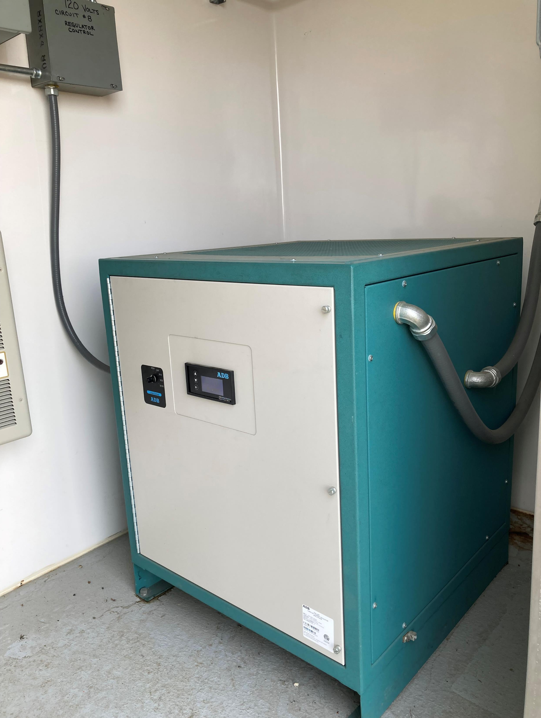
Basic
De-energized Regulator Troubleshooting

Slide 2
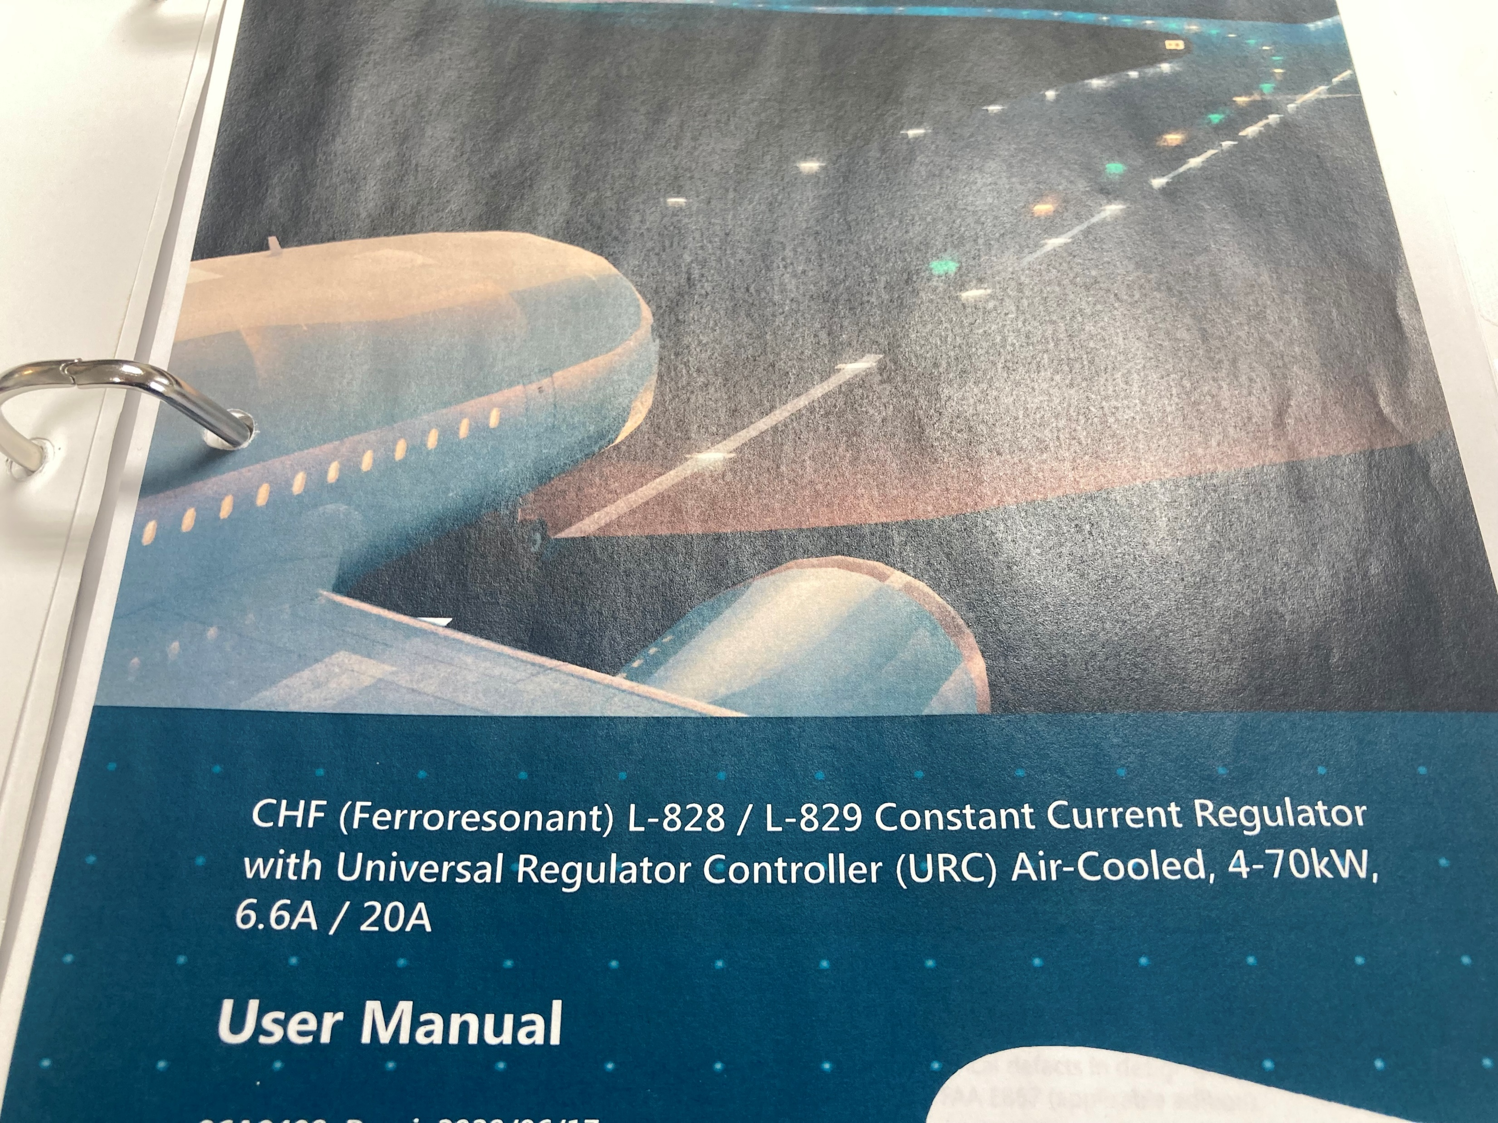
Before your regulator has a problem you should:
Know Your Equipment
Is your regulator Ferro-resonant or Thyristor?
Have your manual
Have basic spare parts
  Fuses
  Master Control Circuit Board
  SCR

Slide 3
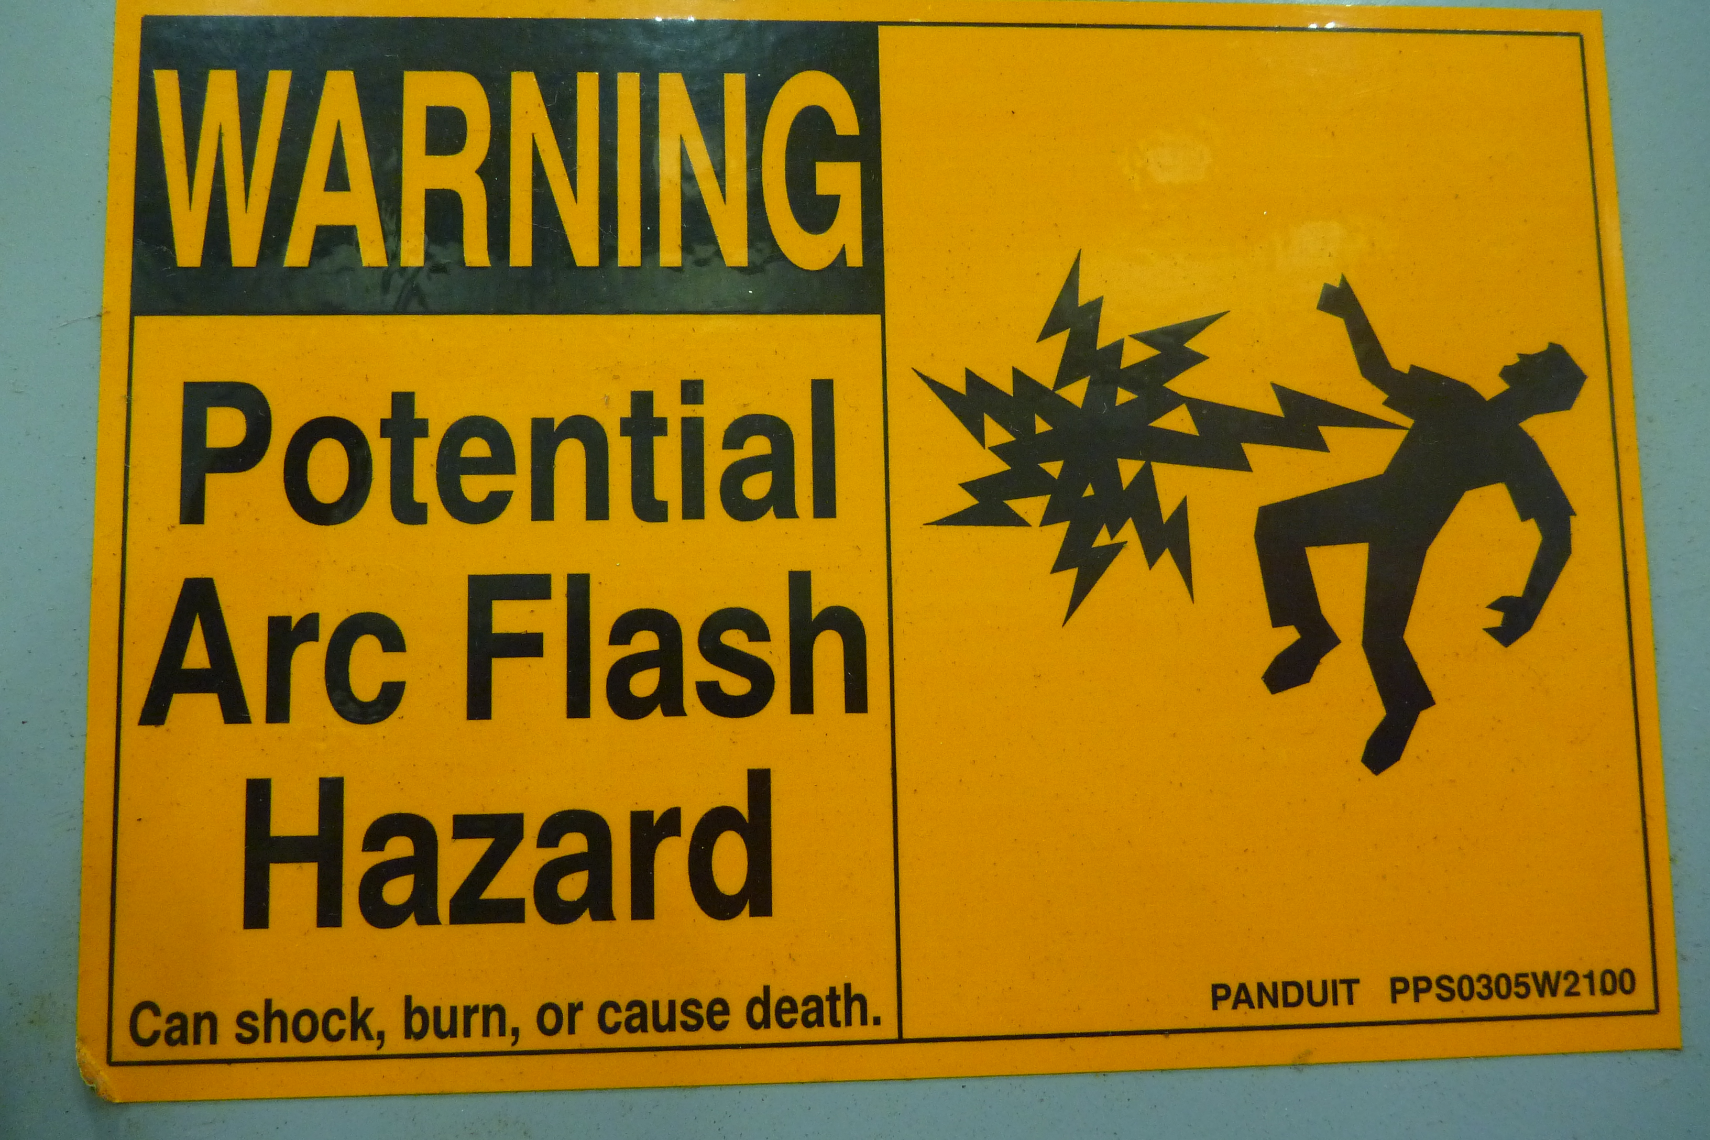
Danger
Only a Qualified Worker should work on Airfield Lighting Regulators.
A Qualified Worker must be trained to understand and identify hazards involved with the task.
A Qualified Worker must know how to identify and lock out all energy sources, verify de-energization, and make sure unit can not be turned on by any means.
There is potential for injury or death.
If you are not trained and qualified
Stay Out!

Slide 5
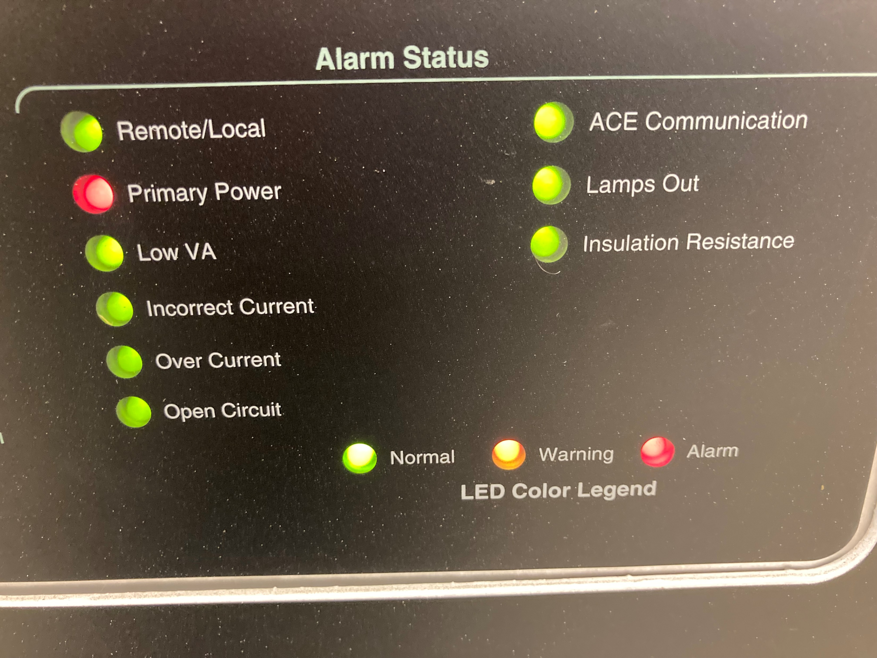
First Checks
Visual Exam
      Is there a smell of burned wires, smoke, or loud noise?
Check Alarms
        What Problem is indicated?
Quick check:
        Manual Control – Auto or OFF?
        Cut out – Turned or Removed?
        Circuit Lock Out Records
        (has it been worked on recently?)
4. Verify if the problem is in the field or in the regulator:
        Turn the S1-Cut Out

Slide 6
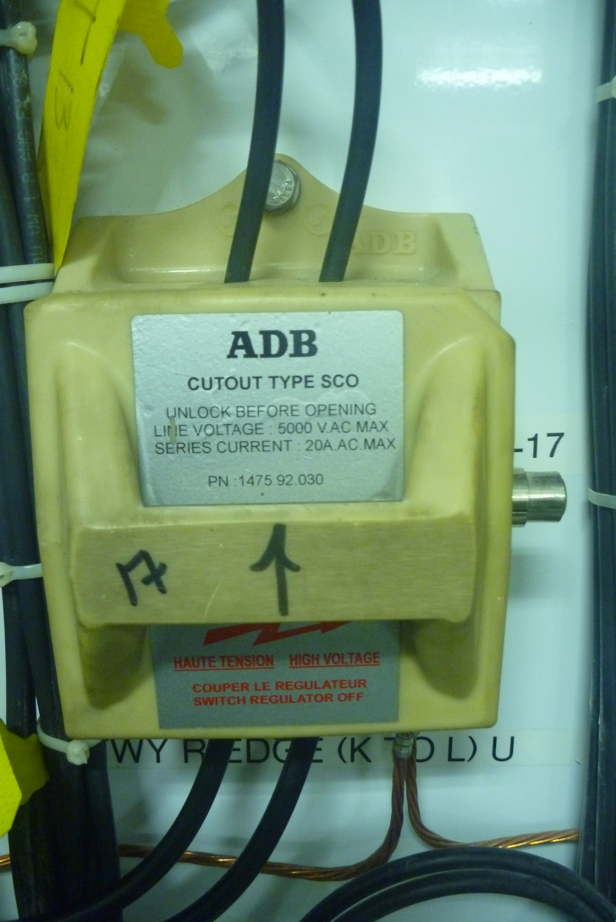
S1 Cut-Out – Normal Position
Note Angled Corner is Top-Right

Slide 7
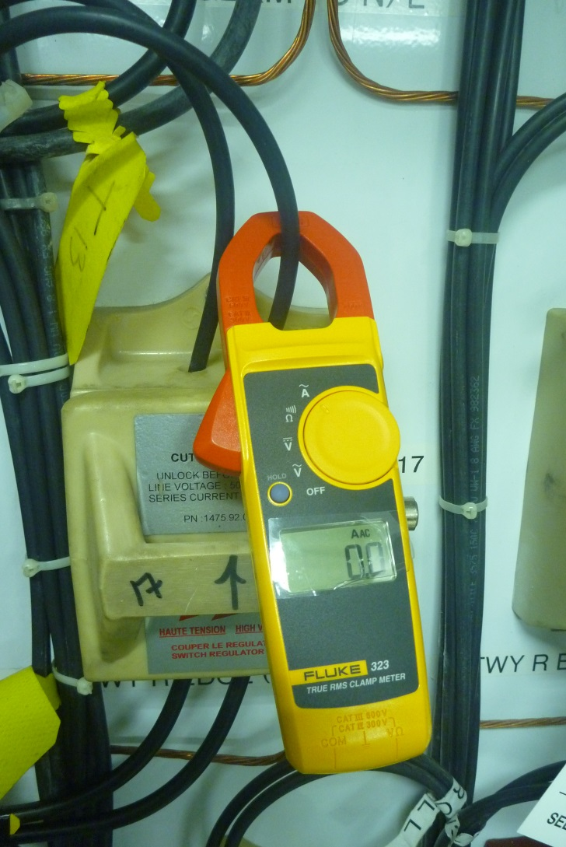
Always Test For Amperage Before
Pulling S1 Cut-Out

Slide 8
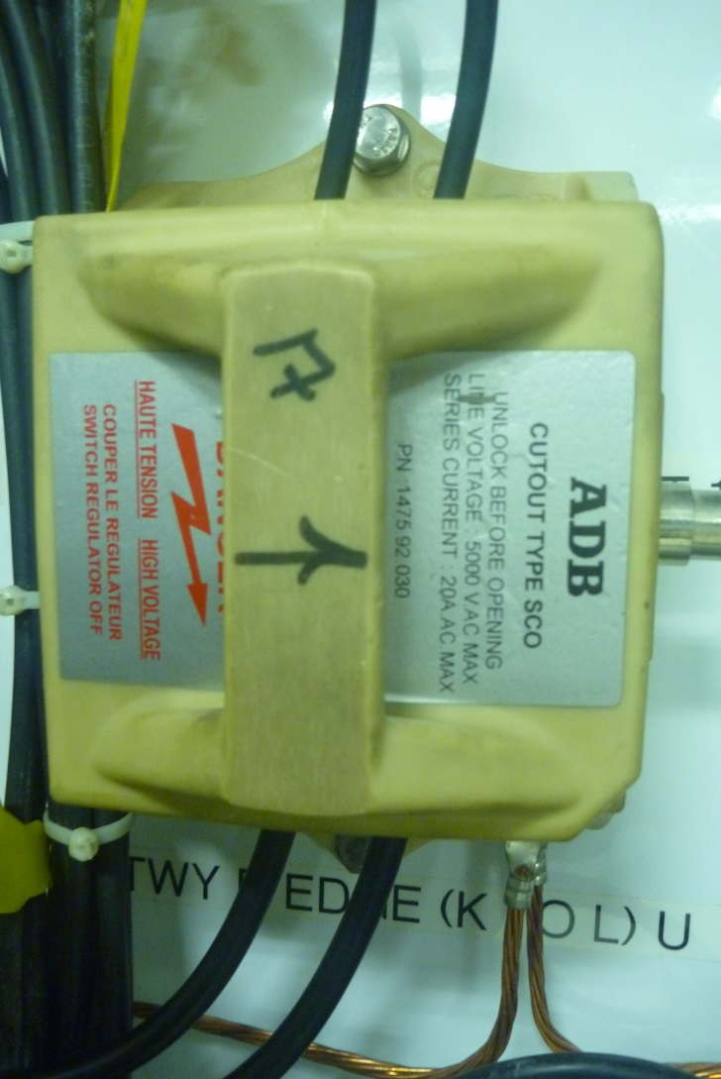

S1 Cut-Out :“Test and Measure”
Position Turned 90° Right
By separating the field and regulator, this position can be used to distinguish between a field problem and a regulator problem, or for calibrating the regulator.
This position disconnects the field from the regulator and closes the regulator output circuit.

Slide 9
Determining Problem Source:
Once the regulator is separated from the field circuit with the S1 Cut-Out, turn the regulator on and work it through all lighting steps with the manual control.
If the regulator now works properly, you should suspect a problem out on the airfield.
If the regulator still doesn’t work properly, the problem is in the regulator.

Slide 10
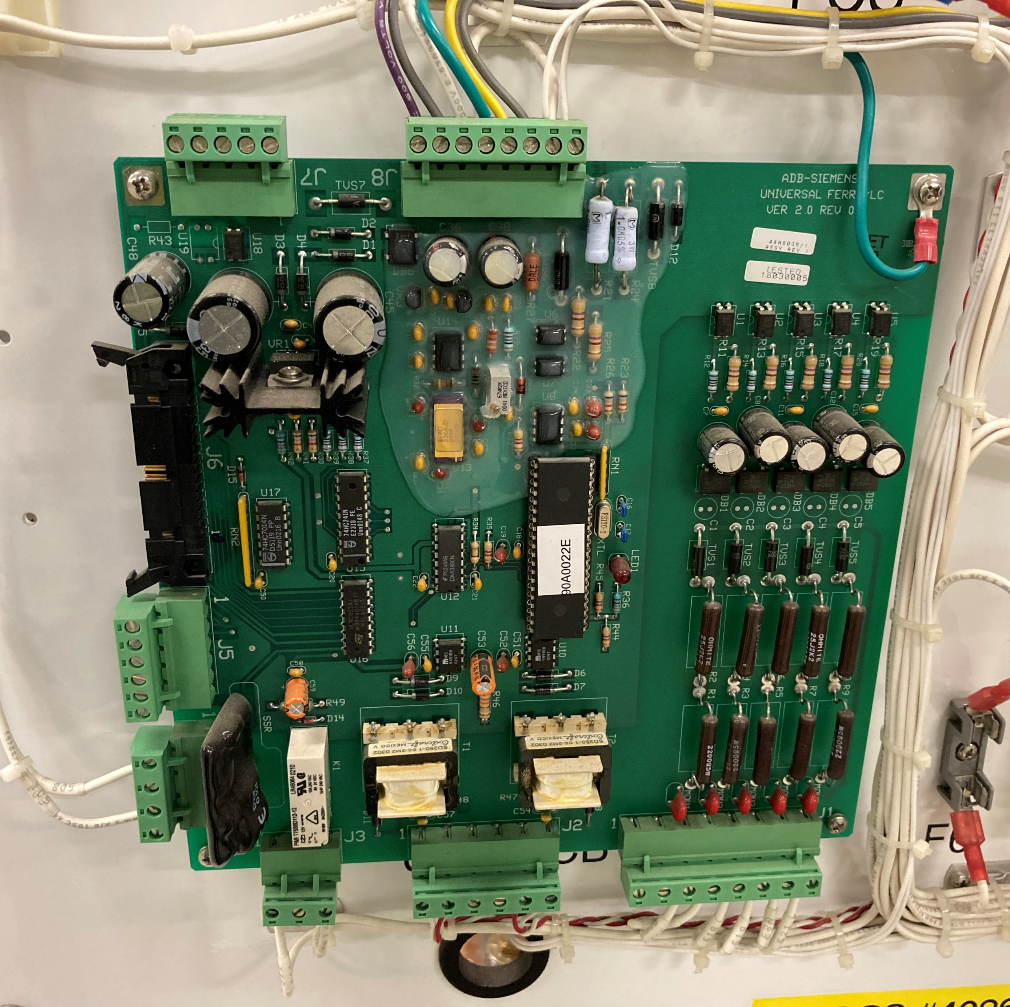
The Regulator Control Board is the most common failure point in Regulators.
Changing it can be a simple solution to most regulator problems.
Always de-energize all sources of energy before replacing the board.

Slide 11
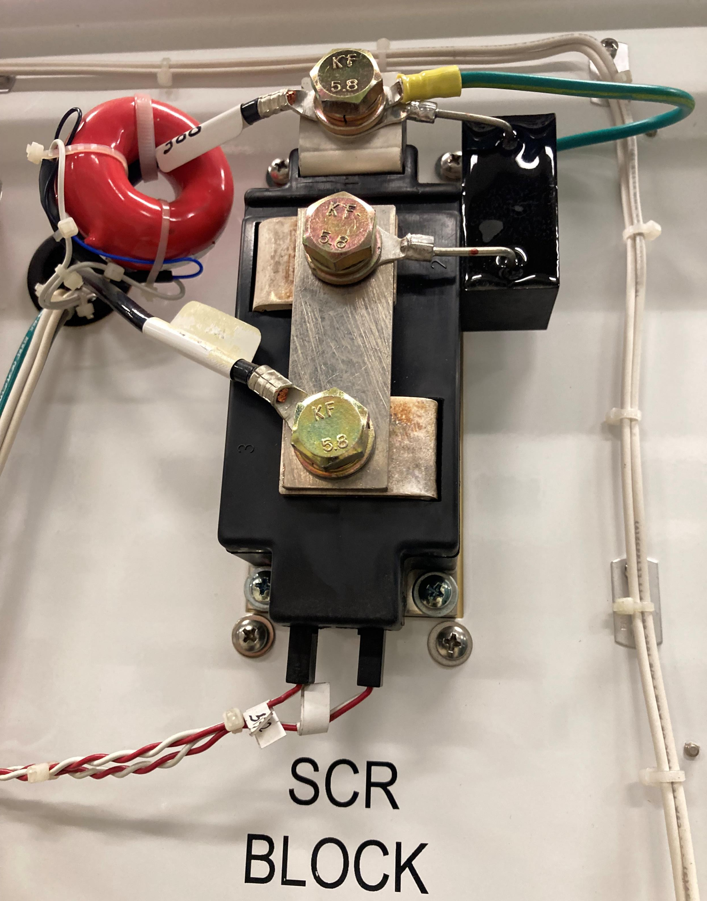
The SCR is another common failure point in a regulator.

Slide 12
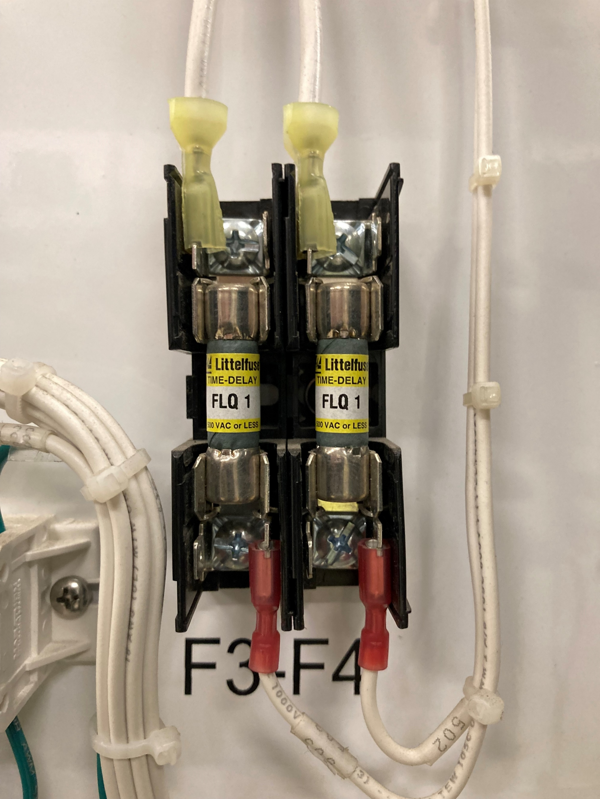
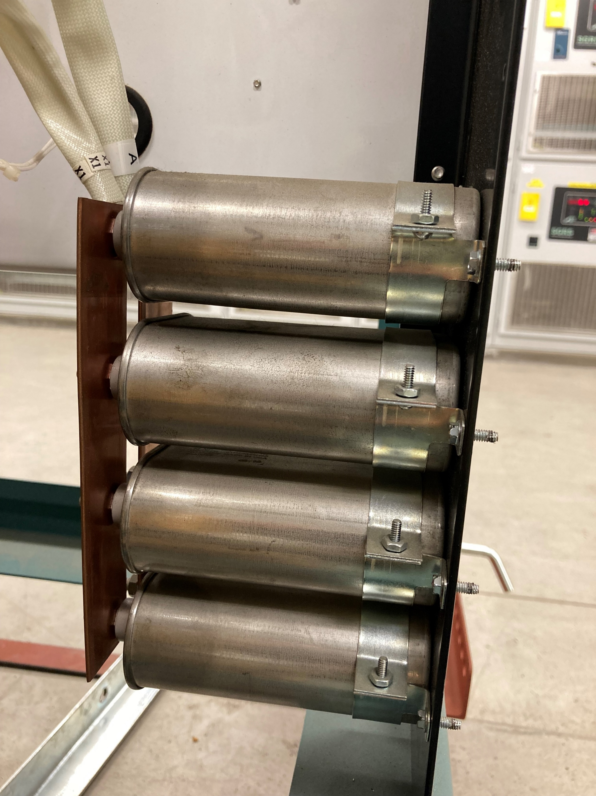
Check all fuses and inspect the capacitor bank for leaks and bulging.
If the regulator will not reach required ampacity at high step, it could be related to bad capacitors.

Slide 13
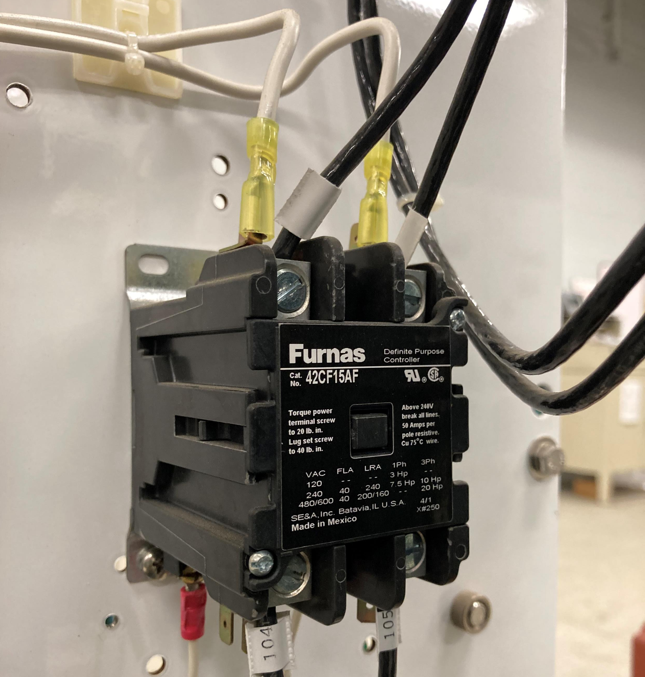
Inspect the main contactor for scorches or discoloration. Check input and output voltage if you are qualified to do so.
Contactors have been known to “stick open.” Manually exercising can free it. Replace if necessary.

Slide 14
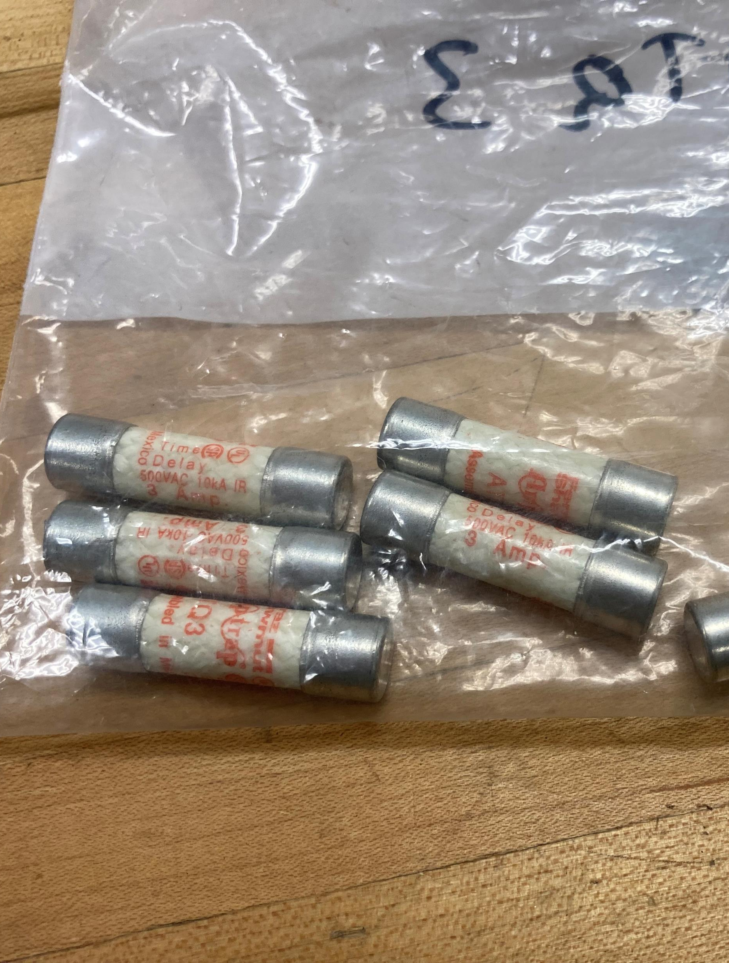
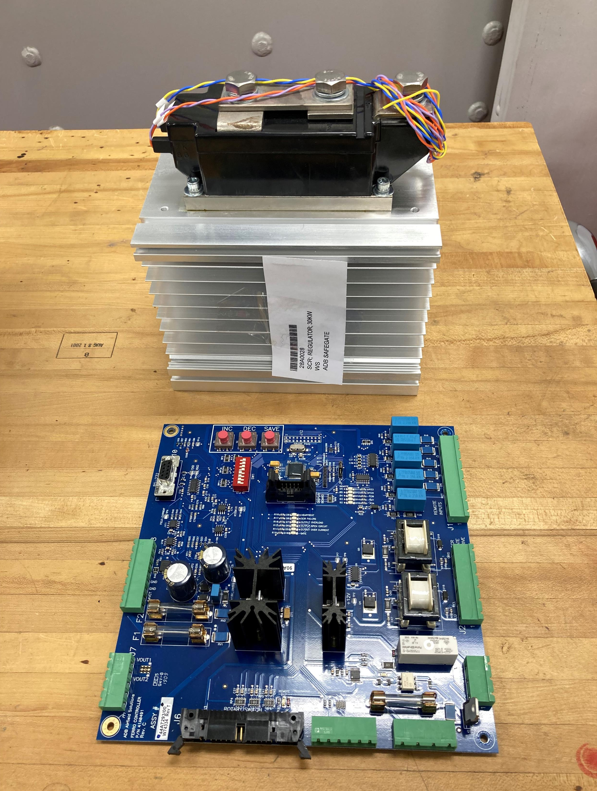
Always have the correct spare parts for your regulator.
Control Board
SCR
Fuses

Slide 15

Most regulator problems can be solved with these simple steps.
If more in-depth troubleshooting is required, calling the manufacturer or a qualified service technician is recommended.

Slide 16

ACRP Project 09-22
ACRP WebResource 20: Safe Maintenance of Airfield Electrical Systems for Small Airports https://crp.trb.org/acrpwebresource20/
The Airport Cooperative Research Program (ACRP) is sponsored by the Federal Aviation Administration. ACRP is administered by the Transportation Research Board (TRB), part of the National Academies of Sciences, Engineering, and Medicine. Any opinions and conclusions expressed or implied in resulting research products are those of the individuals and organizations who performed the research and are not necessarily those of TRB; the National Academies of Sciences, Engineering, and Medicine; or ACRP sponsors.

