Slide 1
The following document is supplemental to ACRP WebResource 17: Developing a Holistic Airport Common Use Program (ACRP Project 03-52 “Guidelines for Adapting and Managing Airport Common Use Programs”). The full WebResource can be found at https://crp.trb.org/acrpwebresource17/.
The Airport Cooperative Research Program (ACRP) is sponsored by the Federal Aviation Administration. ACRP is administered by the Transportation Research Board (TRB), part of the National Academies of Sciences, Engineering, and Medicine. Any opinions and conclusions expressed or implied in resulting research products are those of the individuals and organizations who performed the research and are not necessarily those of TRB; the National Academies of Sciences, Engineering, and Medicine; or ACRP sponsors.

Slide 2
A Holistic Common Use Perspective and Program
Project 03-52: Guidelines for Developing a Holistic Airport Common Use Program
What it is and why it is needed

Slide 3
Purpose of this Presentation Template
Use this presentation template to present your colleagues with a summary of the reasons to consider the shift to a holistic common use perspective and formalize a program

Slide 4
Background of Common Use at Airports
Starting in mid-1980s–early 2000s
Current state at many airports
Flexibility, but limited
Flexibility is maximized over time
See Chapter 1 of the WebResource for more information on this topic

Slide 5
Understand What Can Be Common Use
…everything on the airport campus
See Chapter 1 of the WebResource for more information on this topic

Slide 6
Understand What Can Be Common Use
Facilities and Related Services – This includes, for example:
All buildings/physical space
Electricity
Amenities
Safety systems
Baggage handling (bag drop and handling)
Concessions services (hours of operation, concession types, concession wayfinding)
Airport Operations – This includes, for example:
Roadway operations (such as signage and curbside systems and services)
Airside operations (such as runways and taxiways)
Terminal operations (such as janitorial cleaning (including of systems such as kiosks and FIDS screens), signage, and queue management)
Information Technology – This includes, for example:
IT infrastructure (wired and wireless network and servers)
IT systems (passenger processing, gate management, communications, security/camera systems)
IT services (management support and maintenance)
IT security
Airport Business Management – This includes, for example:
Contracts such as the airline lease and use agreement, governing municipal ordinance(s)
Rates and charges that address per-turn charges and other flexible fees
Policies and procedures related to the business aspects (e.g., reservation, reporting, and payment)
Budgeting processes
See Chapter 1 of the WebResource for more information on this topic

Slide 7
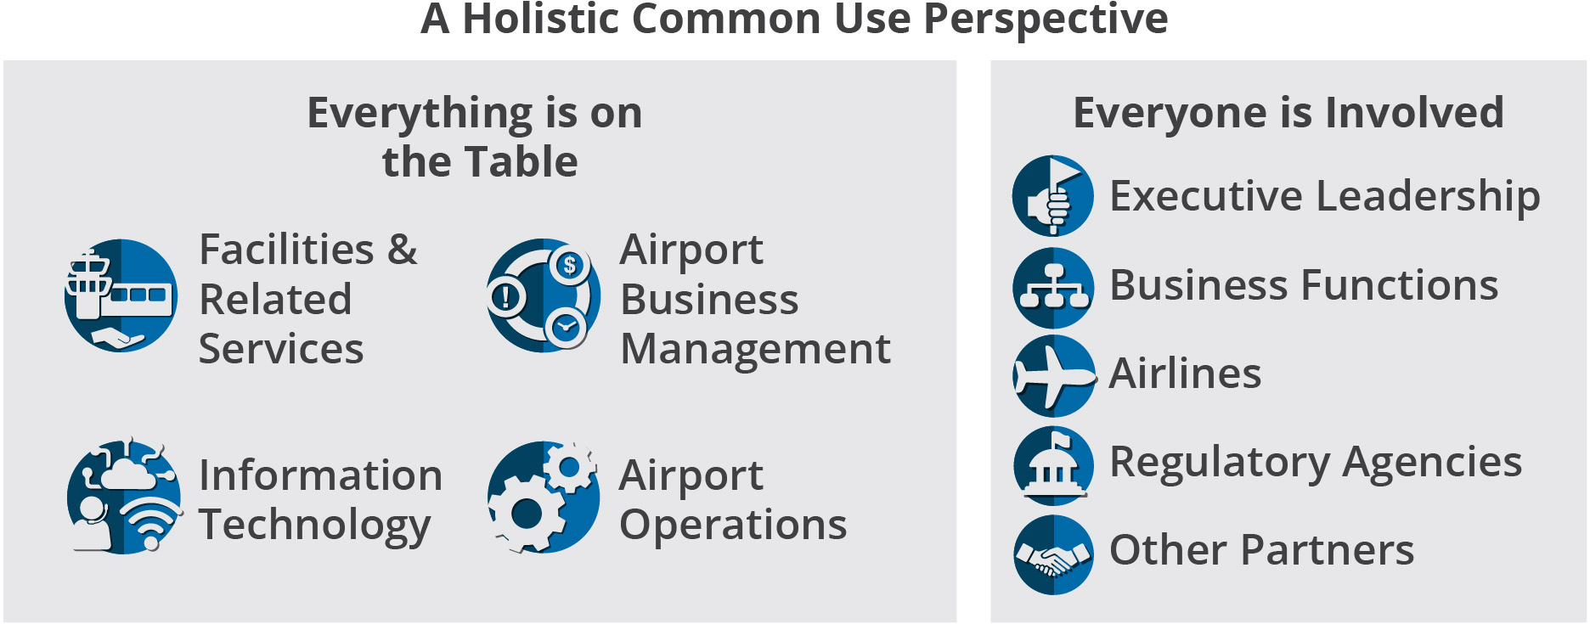
Does Your Airport Have this Perspective?
…when everything is on the table, everyone must be involved to ensure success
See Chapter 2 of the WebResource for more information on this topic

Slide 8
Why this is Needed
See Chapter 2 of the WebResource for more information on this topic

Slide 9
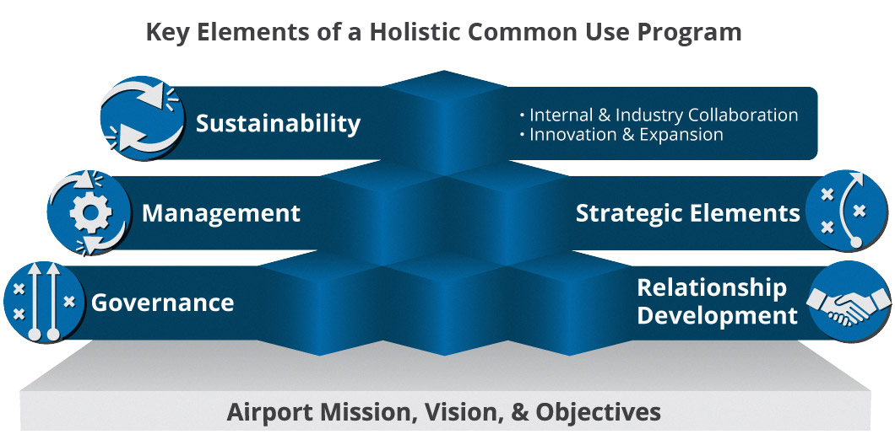
Elements of a Program
See Chapter 2 of the WebResource for more information on this topic

Slide 10
Start Where You Are, Plan from There
Full descriptions of each level provided in Chapter 3 of the WebResource
See Chapter 3 of the WebResource for more information on this topic

Slide 11
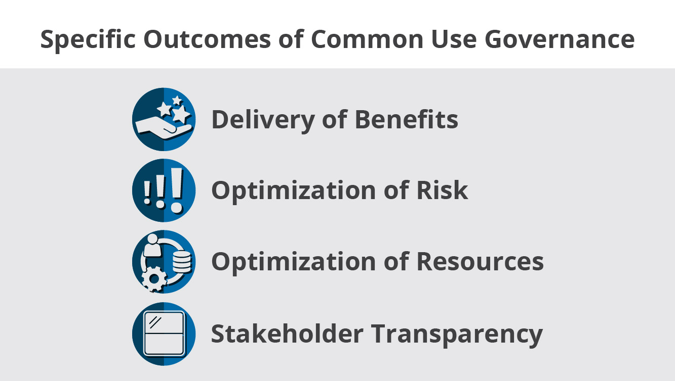
Program Elements: Governance
See Chapter 5 of the WebResource for more information on this topic

Slide 12
Program Elements: Strategic Elements
Ensure alignment with the airport business direction
Establish a clear plan of action
Ensure efforts fit into existing airport business architecture, or clearly plan for changes to it
See Chapter 6 of the WebResource for more information on this topic

Slide 13
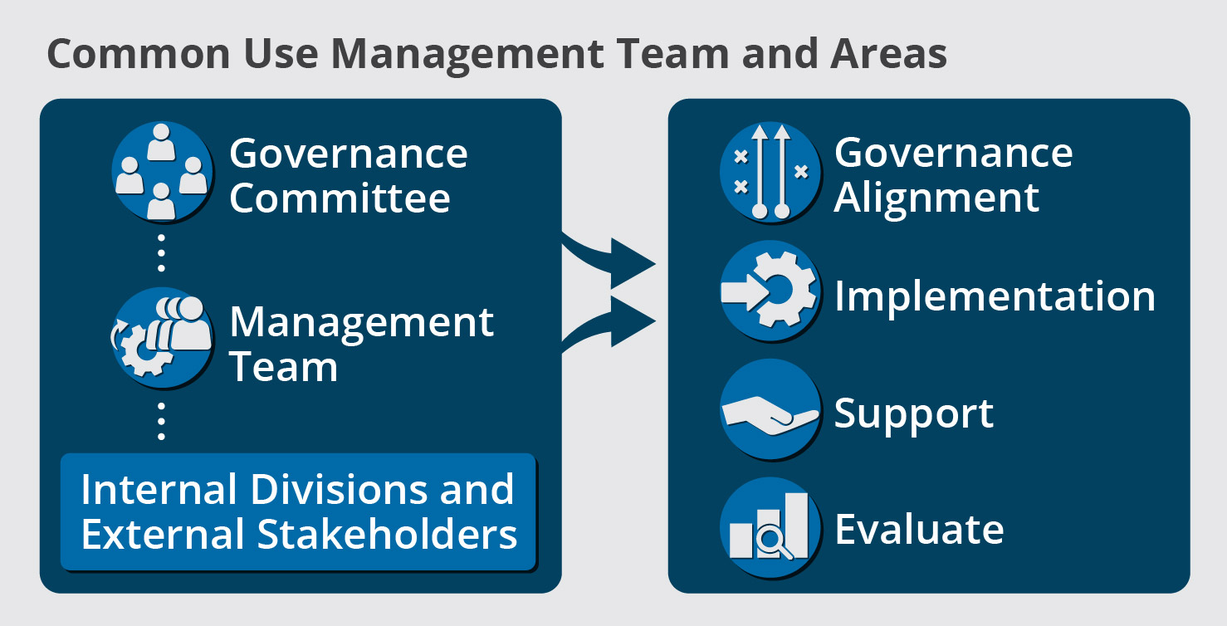
Program Elements: Management
Keep the program in alignment with its objectives
Ensure future implementations are managed well and transitioned into operation
Provide the support, security, and controls needed for operational use
Measure performance and compliance
See Chapter 9 of the WebResource for more information on this topic

Slide 14
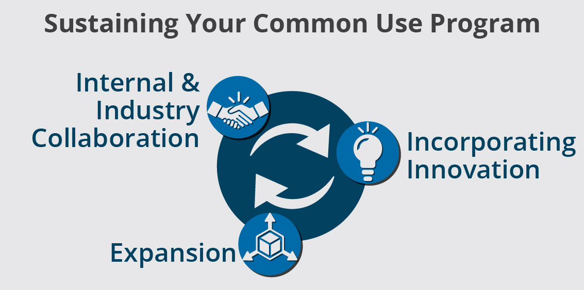
Program Elements: Sustainability
Solve challenges through collaboration
Keep pace with progress and customer expectaitons
Ensure logical expansion and growth
See Chapter 10 of the WebResource for more information on this topic

Slide 15
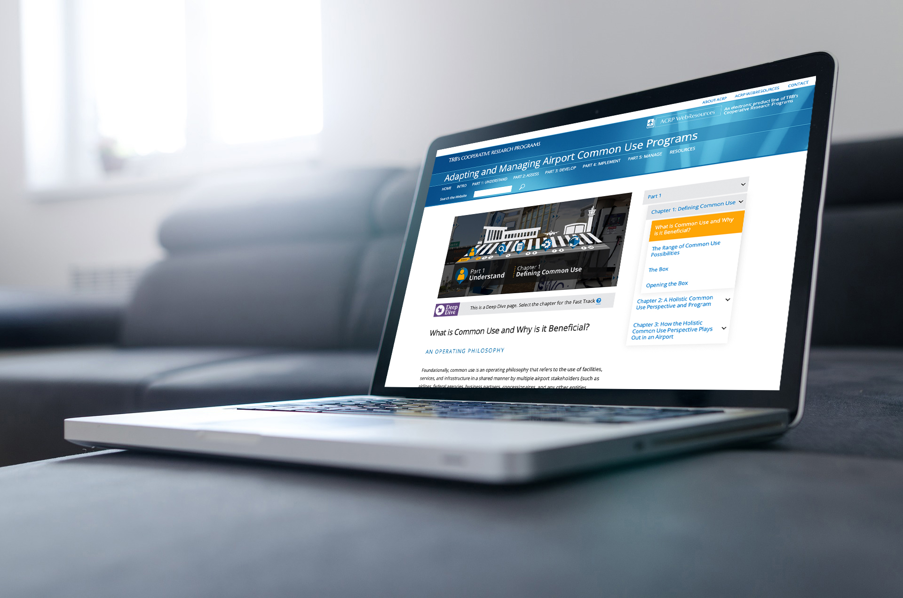
Project 03-52: Guidelines for Developing a Holistic Airport Common Use Program
Access the full WebResource at:
https://crp.trb.org/acrpwebresource17/

