Slide 2
Agenda
ACRP Project 09-12
Problem Statement
What is NextGen?
Spatial Data and Why it’s Important to NextGen
Spatial Data Types
NextGen Programs That Use or Require Spatial Data
Benefits & Costs to Airports
Discussion on Cost
Increasing Your Chances of Realizing These Benefits
Summary & Recommendations for Further Research

Slide 3
ACRP NextGen Projects
09-12 is one of five concurrent ACRP projects focused on NextGen, which are concluding in Spring 2016
01-27, A Primer
01-28, Guidance for Engaging Airport Stakeholders
03-33, Airport Planning and Development
03-34, Understanding the Airport’s Role in PBN
09-12, Leveraging NextGen Spatial Data to Benefit Airports

Slide 4
09-12 Problem Statement
What are the benefits that can be derived from spatial data that is to be collected in support of the FAA’s NextGen effort? How do NextGen programs use this data and how can airports maximize use of this data?
Notes:
Speaker should state that the Guidebook contains the following information:
Overview of NextGen
Benefits and costs including initial investment and maintenance
Other data that may be available and beneficial to airports
If/how data may be monetized to generate revenue for the airport
Case studies/summaries
Recommended additional research
Relevant technology trends

Slide 5
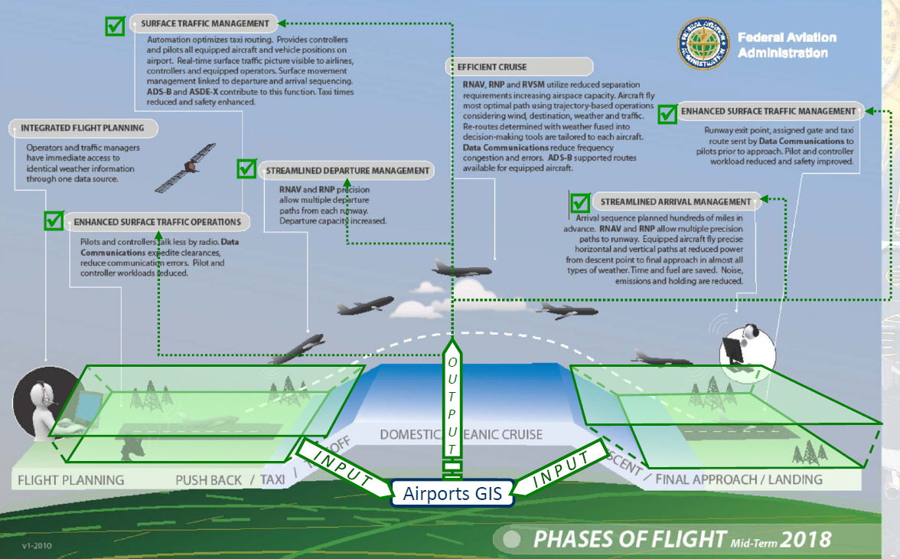
Study Focus Area
Notes:
The geographic focus of this project is on airport property and those areas directly surrounding an airport, to the extent of the airspace protection surfaces (Exhibit A). These areas are, most notably, where airports develop or have a need for spatial data to support their everyday operational requirements.

Slide 6
Notes:
Airports are responsible for ensuring that objects affecting navigable airspace are identified, removed, and/or mitigated according to certain standard requirements. The identification of these objects is a spatial data exercise. The data produced is submitted to the FAA and ultimately is used, in part, in the development of new flight procedures, or even in the review of existing procedures for that airport. The graphic on this page depicts the protected airspace around an airport and represents the geographic extents of this study.

Slide 7
NextGen
NextGen is the modernization of the air transportation system
Improvements to air traffic management (ATM) technologies and procedures
Airport infrastructure
Includes environmental, safety and security-related enhancements
(Source: FAA - The Business Case for the Next Generation Air Transportation System; FY 2014)
NextGen consists of many different programs with multiple priorities and requirements

Slide 8
NextGen Priorities
In 2015 four NextGen Priorities were identified
Focus on those programs that will have the greatest impact on the air transportation system in the near term

Slide 9
NextGen and Spatial Data
Some programs in NextGen have a need for spatial data
The sources for this spatial data can come from multiple organizations
Airports create spatial data through AGIS and other means
NextGen also creates spatial data
Airports receive direct benefits from the use of their spatial data in NextGen programs
Airports also receive direct benefits from NextGen programs that use third party or FAA legacy data sets

Slide 10
Why Spatial Data is Important to NextGen
High accuracy data supports key programs such as PBN and Multiple Runway Operations
Safety
Improvements to the environment
Improved flight procedures
Programs such as Surface Operations utilize third party sources that airlines and airports benefit from
Airfield operational efficiencies
Improved safety in aircraft and vehicle movements

Slide 11
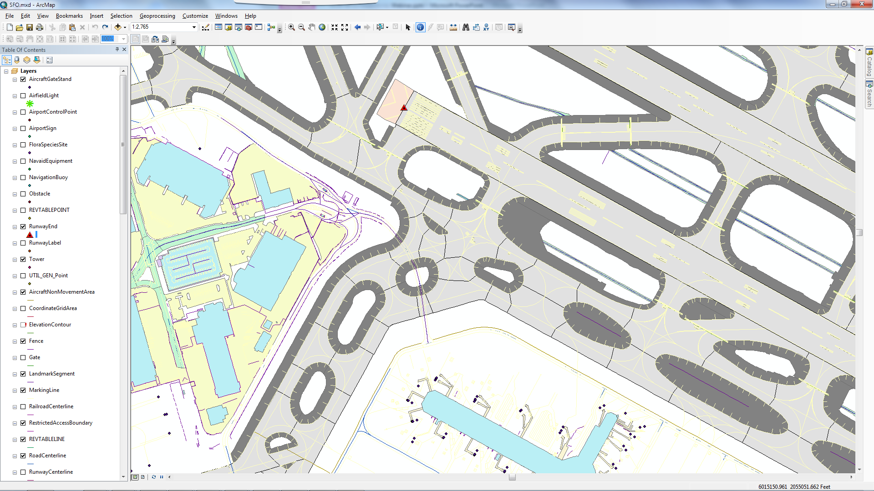
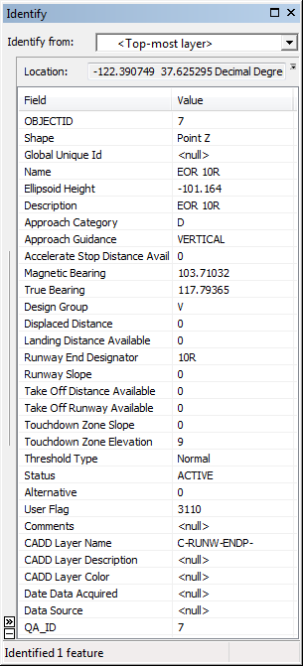
An Example of AGIS Spatial Data
Notes:
SFO AGIS Data
Runway end point is shown along with the associated attributes for that point.

Slide 12
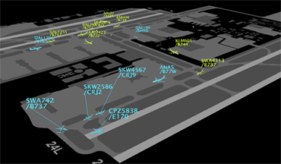
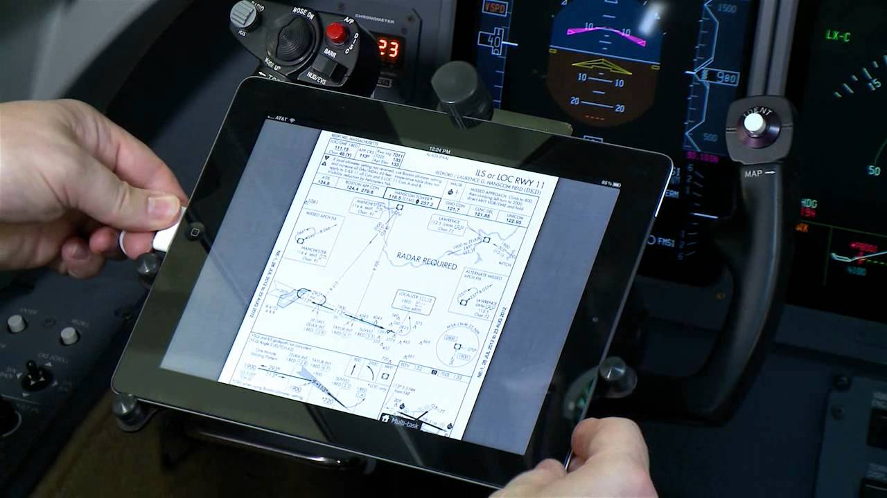
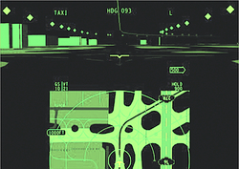
Other Spatial Data Applications
Source: Cockpit Guidance Gets Down To The Ground
Mar 25, 2013 John Croft | Aviation Week & Space Technology
Notes:
Surface Operations related applications use spatial data – often created by and provided by third party vendors
Spatial applications shown
Aircraft locations on the airfield
Digital Flight Bag
Heads up display for surface guidance
Surface surveillance applications

Slide 13
Some Definitions
Spatial Data
Geometry (e.g., points lines and polygons) that show the location and shape of tangible (e.g., runway), intangible (e.g., obstruction id surface), manmade (e.g., building), natural (e.g., tree), current (e.g., today’s runway), and future (e.g., planned extension) objects in relation to their position on (i.e., 2D) and above (i.e., 3D) the face of the earth
Attributes add details about the object (e.g., size, color)
Metadata add details about the data itself (e.g., when it was collected)
Layers are collections of similar objects (e.g., runways)
Maps are collections of multiple layers (e.g., runways, taxiways, aprons, etc. = Airport Layout Plan) with symbology

Slide 14
FAA Requires Airport Data
Safety-Critical
Runway ends, Profiles, and Thresholds
Obstacles and OIS
NAVAIDS
NextGen
PBN Procedures
Multiple Runway Operations
Airfield Configuration
Runway, Taxiway, Apron
Signs, Lights, Marking
Gates
Surface Operations & ADS-B
Charting & NOTAMs
Utilities
Facilities & Equipment
Environmental
Airfield Planning & Design
Land Acquisition
Properties
Surface Trans.

Slide 15
Airports Feel that NextGen Can Offer Them Spatial Data
Procedures
Planning
Aircraft Locations
Design
NAVAIDs & Utilities
Operations
Obstacles
Maintenance

Slide 16
Benefits and Costs
There is a perception that airports bear new costs but do not reap new rewards for the collection of spatial data.
Airports are in fact gaining new capacity, reducing minimums, and increasing safety because they have collected this data.
These benefits, unfortunately, have not been as apparent or as well documented as the costs.
The system-wide benefit to cost ratio of spatial data for procedure design is immeasurably high.
The problem is that from an airport’s perspective the costs are immediate, tangible, and not-optional, but the benefits are prolonged and indirect.

Slide 17
Summary - NextGen
“NextGen” has many meanings
Airports find it difficult in clearly understanding what their roles and responsibilities are for NextGen
Under NextGen, there is an increasing need for high quality, current, and accurate spatial data depicting airports, as well as airspace around airports
Not all NextGen initiatives or programs within NextGen require or produce spatial data

Slide 18
Summary - AGIS
FAA’s Airport Geographic Information System (AGIS) program has long been called an “enabler” of NextGen
While there is a clear and direct link between AGIS and PBN, many of the programs do not currently utilize the FAA’s AGIS data
For many of these programs, spatial data is now needed for more airports than AGIS can currently provide
Many NextGen capabilities rely on spatial data produced by third party vendors
1/3 of top 30 airports have still not done a full AGIS project however there is a push by FAA to get these done

Slide 19
Summary - Spatial Data Outside of AGIS
Airports can benefit from the spatial data that NextGen initiatives produce (e.g., aircraft positions, FAA-installed NAVAIDS & utilities)
Through the use of third party or FAA legacy spatial data in NextGen, airports are receiving benefits.
Situational awareness technologies using ASDE-X data
Spatial data technologies that share data between the TRACON and the airport tower
Heads up displays in the cockpit for low-visibility
These are indirect benefits; safety, efficiencies, revenue

Slide 20
Recommendations for Additional Research
Consideration for UAS in NextGen
The integration of UAS into the national airspace is a high priority for the FAA and related agencies. An in depth study of the spatial data needs for UAS planning and operations and ways in which GIS can support UAS is recommended.
Common set of spatial data standards
DO 272 and AC 150/5300-18 are two standards that are either required or recommended for spatial data development. An assessment of the potential for merging them into one industry standard is warranted.

