Slide 1
ACRP WebResource 21: Environmental Stewardship and Compliance Training for Airport Employees
Wildlife Habitat Management and Control for GA Airports Training Course

Slide 2
Course Objectives and Overview
This course will provide a high-level overview of wildlife hazards at airports and how FAA wildlife requirements apply to airport management and operations.
In this course, you will learn:
Requirements for airports in relation to wildlife hazard management
Wildlife hazard identification
The recommended techniques for wildlife control
Links to federal references may be modified over time. Please search FAA and other federal websites to find the most current reference material.

Slide 3
Key Definitions and Terms
Depredation Permit – nearly all wildlife are protected by state or federal laws. This is a legal document authorizing the take (capture or kill) of specified wildlife to help reduce damage to agricultural crops/livestock, private property, human health and safety (including airports), and protected wildlife (U.S. Fish and Wildlife Service n.d.).
Qualified Airport Wildlife Biologist (QAWB) – a biologist with specific experience and training in understanding wildlife hazards to aviation that meet the FAA’s specific requirements to be considered a “qualified biologist” (DeFusco et al. 2015)
Wildlife Hazard Assessment (WHA) – a precursor to and basis for a Wildlife Hazard Management Plan, this one-year assessment is conducted by a QAWB and results in a document providing a baseline of data and understanding of hazardous wildlife and the features that attract them to or near an airport (DeFusco et al. 2015)

Slide 4
Key Definitions and Terms (cont’d)
Wildlife Hazard Management Plan (WHMP) – identifies the specific actions the airport will take, and who is responsible for those actions, to mitigate the risk of hazardous wildlife on or near the airport (DeFusco et al. 2015)
Wildlife Hazard Site Visit (WHSV) – an abbreviated analysis of an airport’s wildlife hazards that is conducted by a QAWB to determine if a full WHA is warranted and, if necessary, to provide actionable information that allows the airport to expedite the mitigation of wildlife hazards (DeFusco et al. 2015)
Source: DeFusco, R.P. et al. 2015. ACRP Report 145: Applying an SMS Approach to Wildlife Hazard Management. Transportation Research Board, Washington, DC. https://doi.org/10.17226/22091

Slide 5
Non-Part 139 Airport Requirements
For non-Part 139 airports, the FAA does not require a Wildlife Hazard Assessment (WHA) or a Wildlife Hazard Management Plan (WHMP); however, best practices for managing wildlife hazards at airports can be gleaned from both
The FAA has “strongly encouraged” many larger, non-Part 139 airports to obtain a WHA and develop a WHMP
Wildlife Hazard Site Visits (WHSVs) are often required at GA airports to qualify for certain funding, such as wildlife fences higher than five feet (see FAA’s AIP Handbook for additional guidance)
The FAA does not fund direct wildlife control projects. Airports are responsible for managing hazardous wildlife.

Slide 6
Why is Wildlife Control Important at Airports?
Wildlife strikes impact aviation safety and safe airport operations.
More than 301 people have been killed because of wildlife strikes from 1988-2021
298 civil and military aircraft have been destroyed from 1988-2021
Economic losses are in the billions of dollars
Birds are not the only animals to cause problems at GA airports. Between 1990 and 2007, mammal strikes accounted for 14% of all reported strikes occurring at GA airports.
Source: FAA. Wildlife Strikes to Civil Aircraft in the United States, 1990–2021

Slide 7
Wildlife Strikes
The number of wildlife strike reports have been increasing due to the following:
The populations of most large-bird species in North America have increased over the last three decades and have adapted to urban environments
Improvements in engine designs have resulted in quieter engines that birds cannot detect and avoid
Pilots and airport personnel recognize the importance of strike data, which has resulted in a significant increase in reporting
Text Source: FAA. Wildlife Strikes to Civil Aircraft in the United States, 1990–2021

Slide 8
What is Bringing Wildlife to Your Airport?
Wildlife’s primary goals in life are to survive and reproduce.
Wildlife habitats
Wildlife attractants – food, water, and shelter
Increases in local and migratory wildlife populations
Changes in seasonal migratory patterns
Lack of perimeter fence
Bird migration may seasonally increase bird populations in your area.

Slide 9
Wildlife Habitats
Knowing what habitats are present around the airport will help you determine how to manage wildlife hazards.
Natural habitats (e.g., vegetation for nesting habitat)
Artificial habitats (e.g., building rooftops for roosting habitat)
It’s important to understand how the land on your airport is being used; for example, standing water may serve as a wildlife attractant.
Source: FAA. 2020. Hazardous Wildlife Attractants on or near Airports. https://www.faa.gov/airports/resources/advisory_circulars/index.cfm/go/document.current/documentNumber/150_5200-33

Slide 10
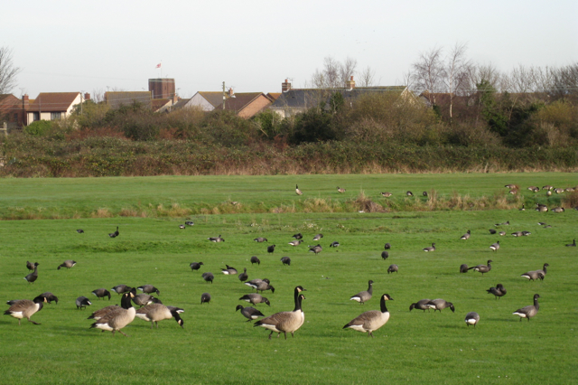
Land Use Wildlife Attractants
Knowing what attractants are present around the airport will help you determine how to manage wildlife hazards.
Common land use attractants are:
Solid waste landfills
Water management facilities
Water resources (e.g., wetlands)
Agriculture fields
Golf courses
Landscaping
Wildlife preserves or refuges
Text Source: Cleary, E.C. and A. Dickey. 2010. ACRP Report 32: Guidebook for Addressing Aircraft/Wildlife Hazards at General Aviation Airports. Transportation Research Board of the National Academies, Washington, D.C. https://doi.org/10.17226/22949

Slide 11
Wildlife Attractants During Construction
Construction projects can introduce wildlife attractants at your airport.
Common construction project attractants are:
Staging and stockpile areas that attract rodents
Pits and depressions that fill with water after a rain
Clogged drainage ditches causing standing water
Food trash and other wastes attracting insects, rodents, and birds
Monitor construction sites, staging areas, and haul routes daily for potential wildlife hazards
Provide guidance to construction crews regarding the importance of minimizing wildlife attractants (e.g., reducing trash related to lunch breaks)
Source: ICAO. 2020. Airport Services Manual, Wildlife Control and Reduction. https://store.icao.int/en/airport-services-manual-part-iii-wildlife-hazard-management-doc-9137p3

Slide 12
Wildlife Control Training
A comprehensive airport wildlife control training program should include the following elements:
Bird identification
Mammal identification
Basic life history of common species
Habitat preferences
Feeding behaviors and food preferences
Daily movement patterns
Breeding and migration schedules
Wildlife environmental laws and regulations
Control techniques
Recordkeeping and strike reporting

Slide 13
Wildlife Control Strategies
Four basic control strategies are available to mitigate wildlife problems on airports (strategies may need to account for threatened and endangered species):
Aircraft flight schedule modification
Habitat modification and exclusion
Repellent and harassment techniques
Wildlife removal – federal and state depredation permits may be required
Off-airport control strategies can be influenced by airport overlays, airport perimeter limits of separation, and zoning restrictions in vicinity of the airport.
Staff members conducting repellent and harassment techniques should obtain training by a QAWB.
Source: FAA. 2005. Wildlife Hazard Management at Airports, second edition. https://www.faa.gov/sites/faa.gov/files/airports/environmental/policy_guidance/2005_FAA_Manual_complete.pdf

Slide 14
Wildlife Control Methods and Techniques
The following wildlife control methods and techniques can be implemented to deter wildlife:
Install wildlife fencing, sometimes with underground skirting to keep mammals off aircraft movement areas. Fencing must be maintained so agile mammals, such as coyotes and deer, that take full advantage of poorly maintained fences are kept out.
Daily wildlife patrols conducted by airport staff
Clear fields of bird nests (depending on species and time of year), small-animal carcasses, and debris
Use runway sweeps in vehicles
Propane cannons, pyrotechnics, and falconers to scare away wildlife
Trapping and translocating and limited lethal reinforcement to eliminate stubborn wildlife that habituate to nonlethal methods
Source: Cleary, E.C. and A. Dickey. 2010. ACRP Report 32: Guidebook for Addressing Aircraft/Wildlife Hazards at General Aviation Airports. Transportation Research Board of the National Academies, Washington, D.C. https://doi.org/10.17226/22949

Slide 15
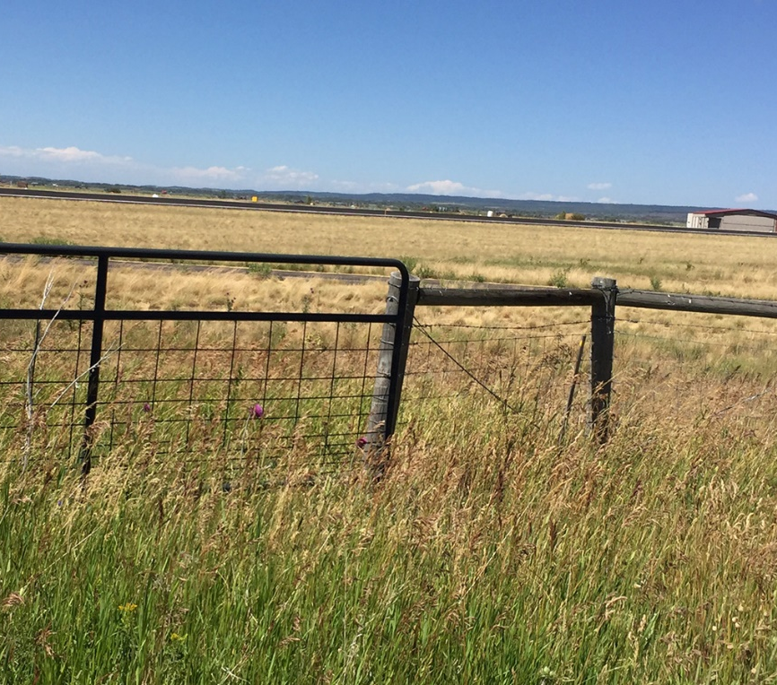
Wildlife Hazard Site Visit
A Wildlife Hazard Site Visit (WHSV) is used to evaluate potential hazards on and near airports.
The WHSV:
Provides mitigation recommendations
Determines whether a full Wildlife Hazard Assessment (WHA) is necessary
Lasts one to three days for data collection and field observations
Includes a final report with recommendations to the airport
The WHSV should be completed by a QAWB
FAA makes Airport Improvement Program (AIP) grants available for WHSV surveys and select wildlife-related capital improvement projects (e.g., wildlife fencing and wetlands mitigation)
Text Source: FAA. 2018. Advisory Circular 150/5200-38: Protocol for the Conduct and Review of Wildlife Hazard Site Visits, Wildlife Hazard Assessments, and Wildlife Hazard Management Plans. https://www.faa.gov/regulations_policies/advisory_circulars/index.cfm/go/document.information/documentid/1020779

Slide 16
Reasons for Conducting a WHSV
Reasons for conducting a WHSV include:
Any airport trying to quickly evaluate and mitigate potential hazards on and near airports
Non-certified airports wanting to establish a basic Wildlife Hazard Management Plan (WHMP)
Airports trying to decide if a proposed land use in the vicinity of the airport would increase the potential for wildlife hazards at the airport
Any airport applying for Part 139 certification or any existing Part 139 airport
U.S. Department of Agriculture (USDA) Wildlife Services sponsors the Airport Wildlife Hazards Program, which consists of a nationwide network of more than 400 biologists trained and certified in wildlife hazard management, to assist airports with site visits and wildlife consultations.
Source: FAA. 2018. Advisory Circular 150/5200-38: Protocol for the Conduct and Review of Wildlife Hazard Site Visits, Wildlife Hazard Assessments, and Wildlife Hazard Management Plans. https://www.faa.gov/regulations_policies/advisory_circulars/index.cfm/go/document.information/documentid/1020779

Slide 17
Wildlife Hazard Assessment
A Wildlife Hazard Assessment (WHA) is an intensive airport study that identifies hazardous wildlife and attractants and serves as the basis for the WHMP, if one is needed. The WHA includes the following:
A minimum 12-month hazardous wildlife study
A minimum of two data-collection trips per month, with surveys during morning, afternoon, and evening daylight hours
A minimum of one offsite avian survey each quarter
A minimum of one mammal survey each quarter
Identification of attractants
Identification of trends in wildlife numbers, locations, species, and strikes
Recommendation of mitigation methods
Source: FAA. 2018. Advisory Circular 150/5200-38: Protocol for the Conduct and Review of Wildlife Hazard Site Visits, Wildlife Hazard Assessments, and Wildlife Hazard Management Plans. https://www.faa.gov/regulations_policies/advisory_circulars/index.cfm/go/document.information/documentid/1020779

Slide 18
Wildlife Hazard Management Plan
The Wildlife Hazard Management Plan (WHMP) is established to minimize the risk to aviation safety, airport structures or equipment, or human health posed by populations of hazardous wildlife on and around the airport. At a minimum, a WHMP:
Includes measures to decrease wildlife hazards
Prioritizes and determines a target schedule for implementing measures
Identifies resources that the certificate holder will use to implement the plan
Documents wildlife control permits needed
Provides effective communication to implement the plan and training
Outlines procedures to review and evaluate the plan
Must be approved by the FAA
Is required for Part 139 airport certification
Source: FAA. 2018. Advisory Circular 150/5200-38: Protocol for the Conduct and Review of Wildlife Hazard Site Visits, Wildlife Hazard Assessments, and Wildlife Hazard Management Plans. https://www.faa.gov/regulations_policies/advisory_circulars/index.cfm/go/document.information/documentid/1020779

Slide 19
Wildlife Strike Report
Reporting wildlife strikes is a critical component in determining wildlife hazards and mitigation methods. The FAA’s wildlife strike report is used to capture the important elements related to wildlife strikes.
Report a strike through the FAA Wildlife Strike Database website
The critical information to include on a strike report includes date and time, location (airport), phase of flight—or AGL at a minimum—and species
Other useful information includes operator, aircraft make/model, engine make/model, aircraft registration, what part of the aircraft was struck, and damage and estimated costs

Slide 20
Tips on Identifying a Species
Knowing the exact species provides guidance to the size, behavior, and ecology of the bird in question and is key to tracking species trends as well as focusing preventative measures.
The Smithsonian Institution’s Feather Identification Lab can be used to identify species.
The lab is funded by the FAA, U.S. Air Force, U.S. Navy and the Smithsonian Institution.
The Feather Identification Lab provides microscopic structure, feather matching, and DNA analysis
Contact the Smithsonian Institution’s Feather Identification Lab at (202) 633-0801
Source: FAA. 2005. Wildlife Hazard Management at Airports, second edition. https://www.faa.gov/sites/faa.gov/files/airports/environmental/policy_guidance/2005_FAA_Manual_complete.pdf

Slide 21
FAA Wildlife Regulations and Guidance
For further guidance from the FAA, refer to the following Advisory Circulars:
AC 150/5200-33C: Hazardous Wildlife Attractants on or near Airports
AC 150/5200-32C: Reporting Wildlife Aircraft Strikes (replaces AC 150/5200-32B)
AC 150/5200-38: Protocol for the Conduct and Review of Wildlife Hazard Site Visits, Wildlife Hazard Assessments, and Wildlife Hazard Management Plans
Source: FAA. 2005. Wildlife Hazard Management at Airports, second edition. https://www.faa.gov/sites/faa.gov/files/airports/environmental/policy_guidance/2005_FAA_Manual_complete.pdf

Slide 22
What Does this Mean to Your Airport?
What wildlife has been spotted around your airport?
Provide any site visit or assessment results
What are potential wildlife attractants and habitats identified around your airport?
Provide maps showing location “hotspots,” structures, landscaping, and other land-uses
How is your airport protected from wildlife?
Provide information on wildlife fences, design of drainage basins, depredation permits, etc.
What are the wildlife hazards on your airport?
Evaluate mitigation measures to reduce habitat, and discuss how employees can assist in the effort
Does your airport have a relationship with a QAWB?
Provide contact information
Consider providing specific training opportunities for operations staff with your QAWB

Slide 23
Course Wrap-Up
Some key takeaways include:
Wildlife hazards can be present at all airports, regardless of size or number of operations
Airports are required to take appropriate action to mitigate wildlife hazards
The management of wildlife hazards is an ongoing process
A wildlife hazard management program does not have to be overly complex or time-consuming
The simple steps outlined in this training can and do help reduce the number and severity of wildlife strikes at airports

Slide 24
References
Cleary, E.C. and A. Dickey. 2010. ACRP Report 32: Guidebook for Addressing Aircraft/Wildlife Hazards at General Aviation Airports. Transportation Research Board of the National Academies, Washington, D.C. https://doi.org/10.17226/22949
DeFusco, R.P. et al. 2015. ACRP Report 145: Applying an SMS Approach to Wildlife Hazard Management. Transportation Research Board, Washington, DC. https://doi.org/10.17226/22091
FAA. 2005. Wildlife Hazard Management at Airports, second edition. https://www.faa.gov/sites/faa.gov/files/airports/environmental/policy_guidance/2005_FAA_Manual_complete.pdf
FAA. 2018. AC 150/5200-38: Protocol for the Conduct and Review of Wildlife Hazard Site Visits, Wildlife Hazard Assessments, and Wildlife Hazard Management Plans. https://www.faa.gov/regulations_policies/advisory_circulars/index.cfm/go/document.information/documentid/1020779
FAA. 2020. Hazardous Wildlife Attractants on or near Airports. https://www.faa.gov/airports/resources/advisory_circulars/index.cfm/go/document.current/documentNumber/150_5200-33
FAA. 2023. Wildlife Strikes to Civil Aircraft in the United States, 1990–2022. https://www.faa.gov/sites/faa.gov/files/Wildlife-Strike-Report-1990-2022.pdf
ICAO. 2020. Airport Services Manual, Wildlife Control and Reduction. https://store.icao.int/en/airport-services-manual-part-iii-wildlife-hazard-management-doc-9137p3
U.S. Fish and Wildlife Service. n.d. Migratory Bird Depredation. https://www.fws.gov/service/3-200-13-migratory-bird-depredation

Slide 25
ACRP Disclaimer and Publication Details
This presentation was produced as part of ACRP Project 02-101, “Environmental Stewardship and Compliance Training for Airport Employees.” The full publication for this project can be accessed at crp.trb.org/acrpwebresource21. Program information for ACRP can be found at www.TRB.org/ACRP.
The ACRP is sponsored by the Federal Aviation Administration. ACRP is administered by the Transportation Research Board, part of the National Academies of Sciences, Engineering, and Medicine.
Any opinions expressed or implied in resulting research products are those of the individuals and organizations who performed the research and are not necessarily those of TRB; the National Academies of Sciences, Engineering, and Medicine; or ACRP sponsors.

