Slide 1
Airport Land Use Planning
Meeting Date/Time Here

Slide 2
Agenda
Welcome and Introductions
Basics of Compatible Land Use
What is it?
5 Areas of Concern
Typical Land Use Classifications
Basis for Airport Zoning

Slide 3
Introductions

Slide 4
Compatible Land Use
What is it?
Developments that comply with generally accepted restrictions on location, height, and activity that provide for safe aircraft movement and airport operations, as well as the preservation of public health, safety, and welfare for those persons located in the surrounding airport environs.

Slide 5
5 Areas of Concern
1) Noise Sensitivity
2) Population Density
3) Tall Structures
4) Visual Obstructions
5) Wildlife Attractants

Slide 6
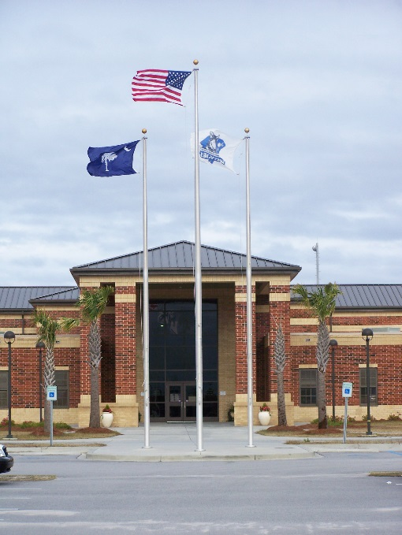
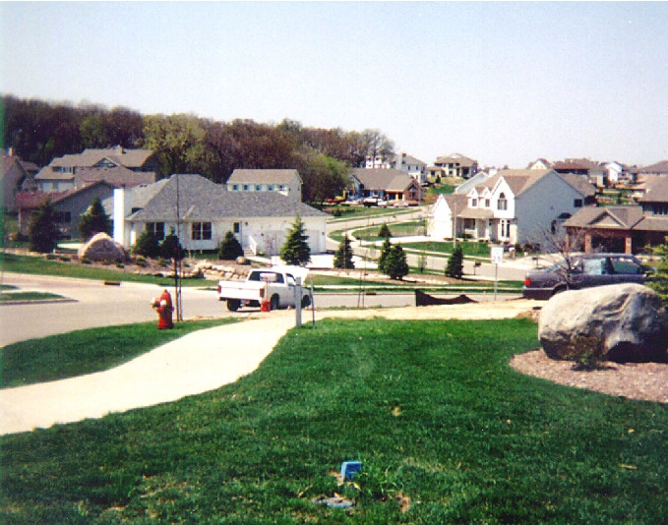
Noise Sensitivity
Concern regarding the disruption of activities
Critical uses include:
Schools
Religious Institutions
Residential development
Other
School
Residential subdivision

Slide 7
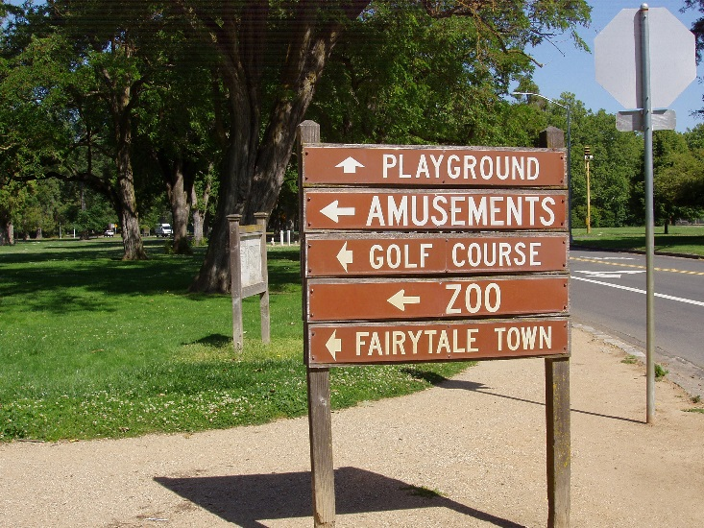
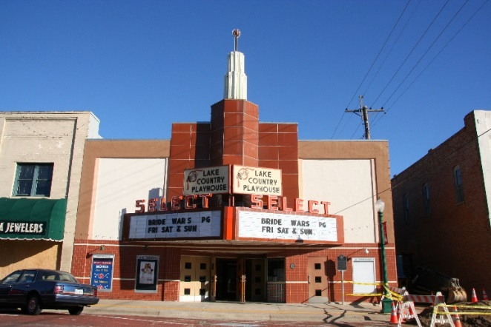
Population Density
Concern regarding concentrations of people in proximity to the Airports
Critical uses include:
Residential development
Hospitals
Recreational/special uses
Other
Recreation/Special Use
Special Use - Theater

Slide 8
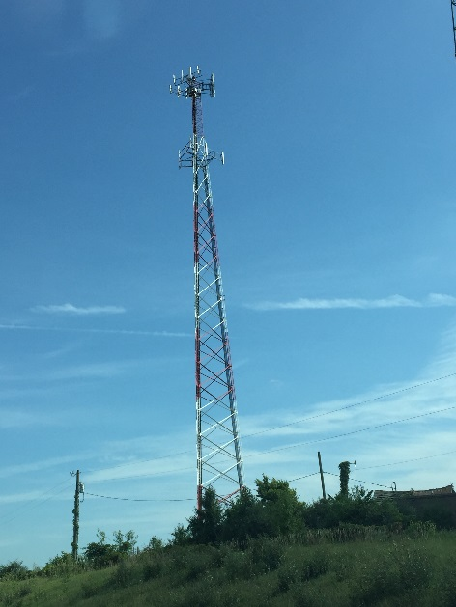
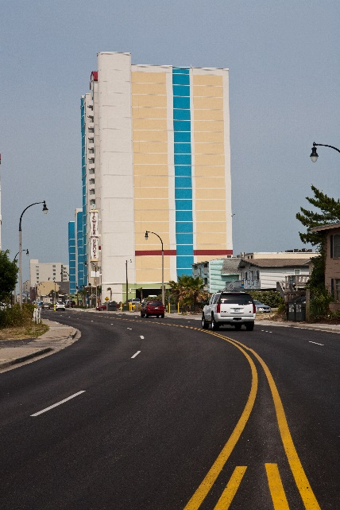
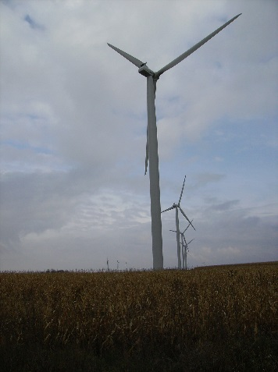
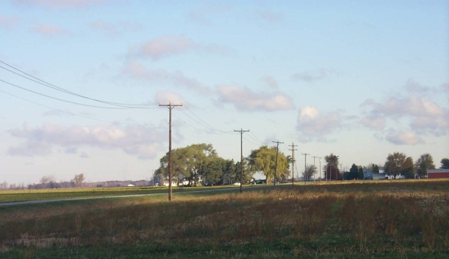
Tall Structures
Concern regarding obstructions to flight
Critical uses include:
Cell towers
Power lines
Vegetation (trees)
Tall buildings
Wind turbines
Other
Cell tower
Buildings
Power lines
Wind turbine

Slide 9
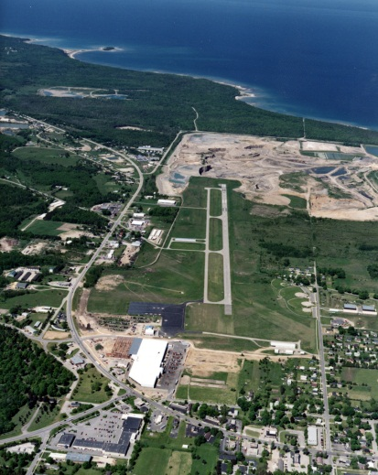
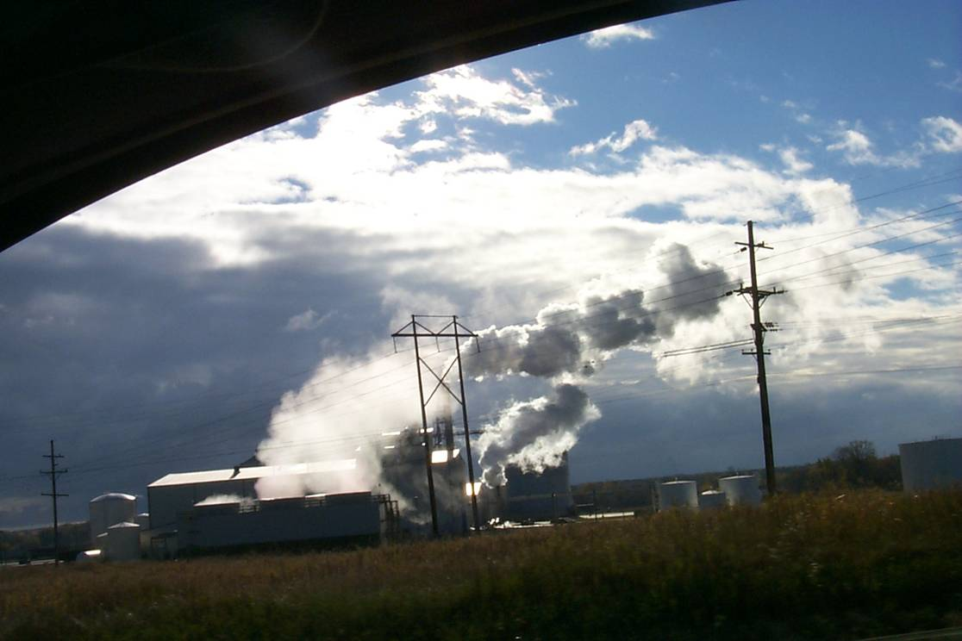
Visual Obstructions
Concern regarding:
Smoke/steam
Dust
Glare
Light emissions
Critical uses include:
Industrial
Farmland
Water bodies
Other
Dust – gravel extraction
Glare – body of water
Light emissions
Steam emissions – industrial

Slide 10
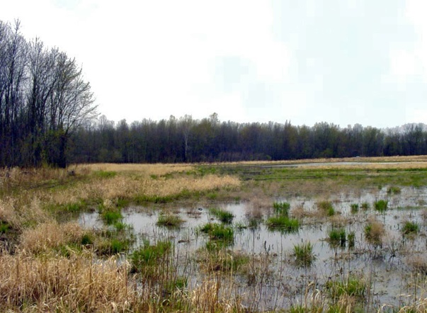
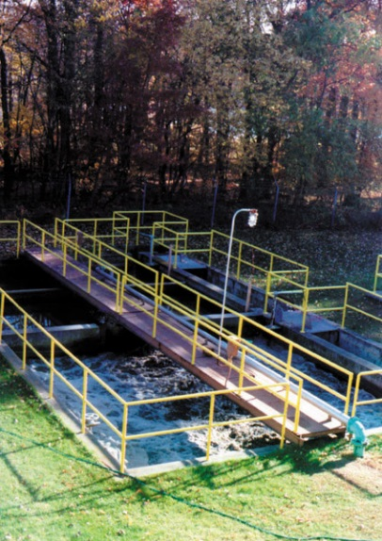
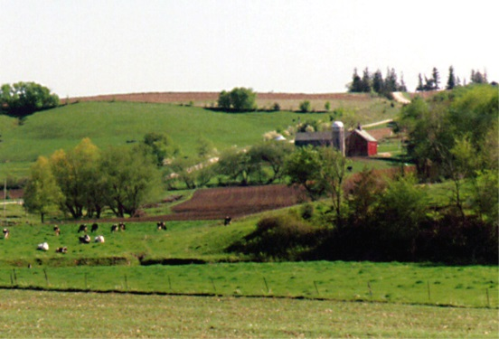
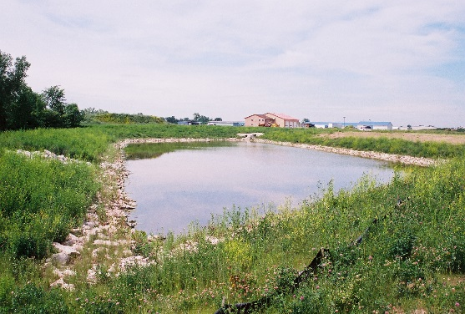
Wildlife Attractants
Concern regarding hazards to aircraft
Critical uses include:
Landfills/sewage treatment
Farmland
Water bodies
Recreational
Other
Wetlands
Sewage treatment
Farmland
Pond

Slide 11
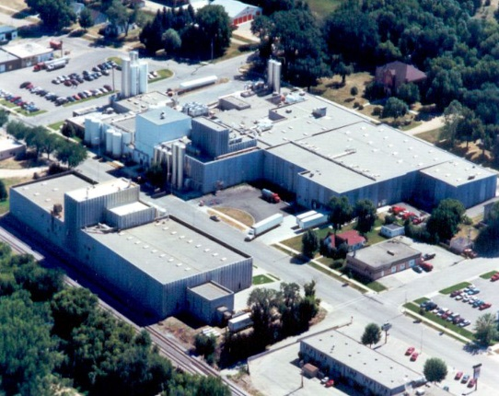
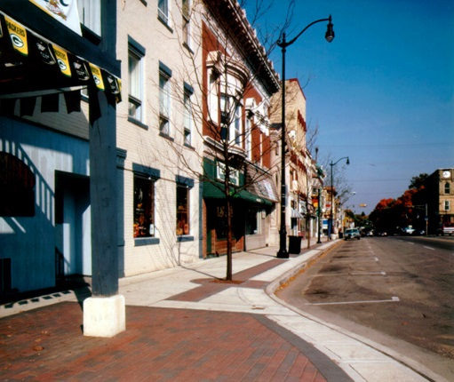
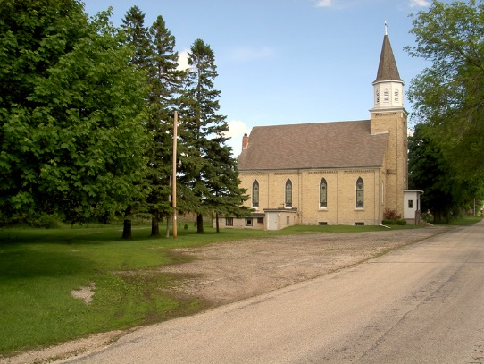
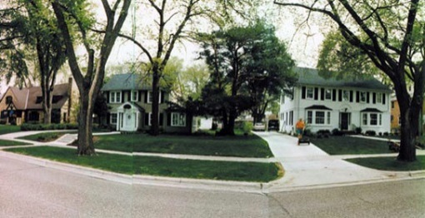
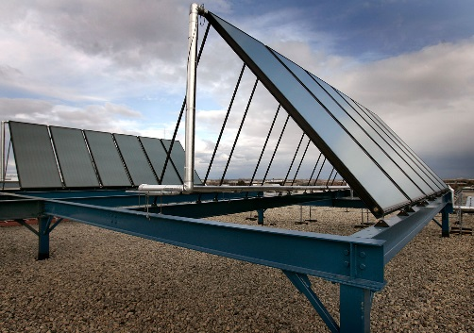
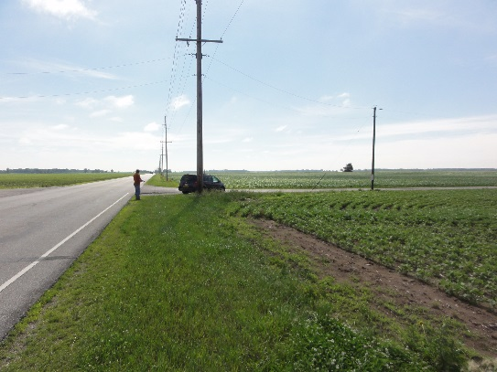
Typical Land Use Classifications
Residential Activities
Commercial Activities
(shopping, business, or trade)
Industrial/Manufacturing
(industrial, manufacturing, and waste)
Institutional
Infrastructure
Agriculture
Parks and Recreation

Slide 12
Basis for Airport Land Use Compatibility
Grant Assurances
20 – Hazard Removal and Mitigation
21 – Compatible Land Use
Orders and Advisory Circulars (ACs)
Federal Aviation Regulation (FAR) Part 77
A set of imaginary surfaces, called “Part 77 Surfaces,” that are used to protect the areas surrounding an airport from incompatible use. These surfaces include:
Primary Surface
Horizontal Surface
Approach Surface
Conical Surface
Transitional Surface

